Slide 1

Successful PS&E Submittals
Rielly O’Donnell
BPD - Proposal Management Section Chief
SE Region Design Conference
March 17, 2026
Notes:
Read me notes for WisDOT PowerPoint template – this document is also provided as a separate pdf.
This WisDOT PowerPoint template has a widescreen (16:9) aspect ratio (1920 x 1080). The 1920 by 1080 size is the current format for the following:
showing your presentation on a large widescreen television.
showing your presentation using a display in widescreen format.
converting your presentation to video in the future.
WisDOT logo and usage guidelines here: https://wisconsindot.gov/Pages/about-wisdot/newsroom/logo-photo-gal/graphic-standards.aspx
When to choose the light gray background (navy and red type styles) – Slides 1 through 9
Use if you have positive versions of graphics and logos.
Some experts say if you're presenting in a small room with most of the lights on, use a lighter gray background, then the background will tend to fade away while the other components will grab attention.
Other experts say that if your copy is kept short and sweet, the lightness or darkness of the background is irrelevant, as viewers then have little to read.
When to choose the blue background (white and gold type) – Slides 10 through 18
Use if you have reverse or negative versions of graphics and logos.
Some experts say if you are presenting with most of the lights off in the room or in a darker presentation area, consider using the blue background color, then the background won't intrude on the message and the lighter components will stand out.
Other experts say that if your copy is kept short and sweet, the lightness or darkness of the background is irrelevant, as viewers then have little to read.
SLIDE DECK
Title slide options - Slides 1, 2 and 10, 11 are layout options for the title slide of your WisDOT presentation. The title of your presentation goes at the top in the white text (for the light gray background) or blue text (for the gray background). The title may be one or two lines.
Managing placeholders - If your presentation does not need all the text placeholders, delete the placeholders you do not need and then you may need to lower or adjust the height between lines.
Various slide layouts - Slides 3-7 and 12-16 are examples of slide layouts you may use in your presentation. The headline of each example describes which content placeholders are available in its layout. Review the slide layouts and decide which one best matches your content.
Blank slides - Slides 8-9 and 17-18 are blank slides for custom layouts in your presentation.
Ways to transfer a PowerPoint presentation from another design to this template.
The recommended way is to copy text line by line, slide by slide, from the other PowerPoint design. Then paste it into Notepad, copy from Notepad, then return to this template, select the text in the desired placeholder and copy.
If you would like to get all your text out of the other design at once, choose file, save as .rtf, then copy all text from the .rtf, paste it into Notepad. Then use the Notepad file to copy the text line by line into this template by selecting the desired placeholder and copying. (Notepad will clear styles from the other PowerPoint design.)
How to paste text and keep template’s font styles and color
Select the text in placeholder, then copy. If copying and pasting text into a slide layout does not preserve the template’s font styles, select text in placeholder and right click on the placeholder and select the first paste option: use destination theme. Doing so will keep your pasted text in the font style and color designed for WisDOT template.
How to add more slides with the layout you want
To add a new slide layout to your presentation: in normal view, on the home tab, select new slide. Slide layout options for the WisDOT template will appear. Select the slide layout you want.
Changing a current slide layout on to a different current slide layout is not recommended, as sometimes this results in additions of unmatched text and placeholders. It’s best to add a new slide layout to your presentation: in normal view, on the home tab, select new slide. Slide layout options for the WisDOT template will appear. Select the slide layout you want and add new text to this slide layout.
Use of additional logos:
Limited to logos approved for use by the WisDOT Office of Public Affairs approved logos. No external agency or consultant logos.
WisDOT division, section or bureau logos may be placed on the right side of the banner or on the first slide using layout slide number 2.
Logos in the bottom banner should be .68 inch in height. Logos on the first slide should be 2 inches in height and the WisDOT and additional logo centered side by side below the date.
If available, use a positive logo on the gray slides and negative logo on blue slides.
PLEASE NOTE:
When it comes to PowerPoint - less is better.
Don't put your entire presentation on the slides. Include only:
main ideas
keywords
talking points
If a chart or photo will cover any portion of the bottom banner - use the blank slide format.
Font sizes may be adjusted either 2 points smaller or 2 points larger from sizes listed.
GRAY BACKGROUND FONT SIZES and COLORS
Blue = R39 G56 B75
Red = R128 G47 B45
Slides 1 and 2: gray background
Headline line 1 and line 2 – Arial Narrow Bold, 58 pt, blue
Name of presenter – Arial Narrow Bold, 47 pt, red
Title of presenter – Arial Narrow, 35 pt, red
Name of conference – Arial Narrow, 29 pt, blue
Date – Arial Narrow Bold, 25 pt, red
Slide 3, 4, 6: gray background
Example – Arial Narrow Bold, 48 pt, blue
Subhead – Arial Narrow Bold, 39 pt, red
Bullet 1 – Arial Narrow, 35 pt, blue
Bullet 2 – Arial Narrow, 32 pt, red
Slide 5: gray background
Example – Arial Narrow Bold, 48 pt, blue
Subhead – Arial Narrow Bold, 39 pt, red
Slide 7: gray background
Example – Arial Narrow Bold, 48 pt, blue
Subhead – Arial Narrow Bold, 39 pt, red
Text – Arial Narrow, 28 pt, blue
BLUE BACKGROUND FONT SIZES and COLORS
White type = R255 G255 B255
Yellow type= R255 G217 B102
Slides 10 and 11: blue background
Headline line 1 and line 2 – Arial Narrow Bold, 58 pt, white
Name of presenter – Arial Narrow Bold, 47 pt, yellow
Title of presenter – Arial Narrow, 35 pt, yellow
Name of conference – Arial Narrow, 29 pt, white
Date – Arial Narrow Bold, 25 pt, yellow
Slide 12, 13, 14: blue background
Example – Arial Narrow Bold, 48 pt, white
Subhead – Arial Narrow Bold, 39 pt, yellow
Bullet 1 – Arial Narrow, 35 pt, white
Bullet 2 – Arial Narrow, 32 pt, yellow
Slide 15: blue background
Example – Arial Narrow Bold, 48 pt, white
Subhead – Arial Narrow Bold, 39 pt, yellow
Slide 16: blue background
Example – Arial Narrow Bold, 48 pt, white
Subhead – Arial Narrow Bold, 39 pt, yellow
Text – Arial Narrow, 28 pt, white

Slide 2
Proposal Management Contacts
General
ESubmittals
Plans and Estimates
AASHTOWare Project (AWP)
Special Provisions
Addenda

Slide 3
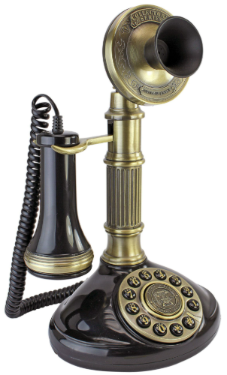
General Contact Information
Rielly O’Donnell
  Letting schedule – Late PS&E Requests – Deferrals
Cyle Haag
  Plans – Estimates – AWP
Jodi Jarosinski
  Special Provisions – Time Chart – AWP Interim Completions
Mike Coleman
  Addenda – Contractor Questions

Slide 4

Esubmittals
FDM 19-10
Tied Projects
  Plan Letter, Estimate, Special Provisions, and Time Chart are always a single document.
  R/W Cert, Utility Status Report, and Railroad Certificate are always a separate document. Do another eSubmittal for each project.
  If combined plan sets, submit a combined SDD list.
  If separate plan sets, submit separate SDD list.

Slide 5
Esubmittals
  Do not resubmit Plans, Estimate or Special Provisions after the PS&E submittal without coordinating with Proposal Management.
  May have already started the review.
  Discuss resubmittal options.
  Special Provisions updates should usually be inserts.
  Plan Letter and Time Chart resubmittals are required if affected by review comments.
  Advanceable projects always go to the ExLET folder.
  Proposal Management does not monitor 30%, 60%, 90%, or ExLet submittals.

Slide 6
Plans and Estimates
FDM 15
Electronic Plans Submittal FDM 15-5-10
  Follow all guidance, including document properties. Recheck for any subsequent plan sheet revisions.
  Standard Detail Drawings spreadsheet
  Use the spreadsheet version associated with the letting month.

Slide 7
Plans and Estimates
Estimates
  Round unit prices as appropriate.
  Run validations for errors.
  Verify information for ASP-1 for federally funded projects are in the estimate and match Plan Letter quantities.
Quantities
  Round quantities as appropriate.
  Check and verify quantities and unit prices before PS&E submittal and during Central Office review. Quantity errors should not perpetuate to be caught by contractors or as part of post-letting bid analysis.

Slide 8
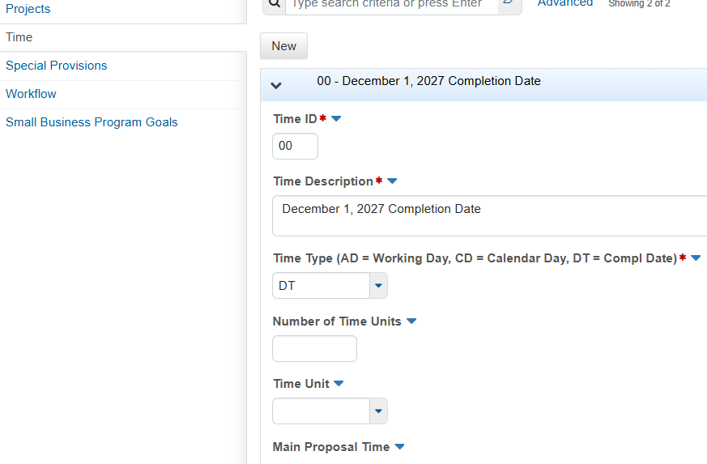
AASHTOWare Project (AWP)
AWPKB
Time – Must be filled out by designers.
  Completion Dates
    Last date that work is allowed.
  Interim Completions
    All Special Provision information should be entered.
    Do in midnight-midnight, 24-hour units.
    Liquidated damage rates should not follow
    standard spec 108.11.
    Do not intermix interim Calendar Days/Completion
    Date with Working Day contracts, and vice versa.

Slide 9
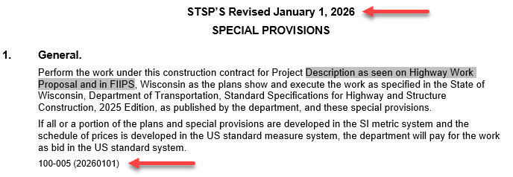
Special Provisions
FDM 19-15, Special Provisions Web Page
Correct Template
  Order of articles.
  Latest articles (see STSP Log).
  Article Design Notes.
Content
  Do not repeat standard specs, plan notes, state statutes/codes, MUTCD, federal regulations, etc.
  Avoid redundancy of standard spec section 100 items.
  Do not pull from other projects if not relevant.

Slide 10
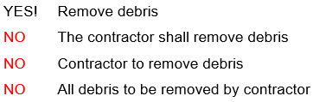
Special Provisions
Formatting
  DOs
    Follow standard specs on presentation
    First person / imperative.
    Same font size and style as STPS
    Avoid ambiguity
  DO NOTs
    Avoid “should” “minimize” “as possible”. Provide clear direction.
    Do not bold, underline, or all-caps for emphasis.
    Do not copy in information (DNR etc.) not applicable to work by the contractor.

Slide 11
Special Provisions
Content
  Modify standard spec instead of new bid item if practical:
    Add the following to standard spec XXX.X:
    Delete standard spec XXX.X(X).
    Modify standard spec XXX.X.X to the following:
    Do Not Use “Append” or “Supplement”
  Measurement and Payment by the department, not the municipality.
    Revise municipal specifications to match standard specs.
  Payment:
    Do not include “and for furnishing all labor, tools, equipment and incidentals necessary to complete the work”.

Slide 12
Special Provisions
Prosecution and Progress
  Information that affects construction timing.
    Start / stop dates and interim completions.
    Environmental restrictions (birds, bats, turtles, fish, etc).
    Staging of construction work.
Traffic
  Information that affects traffic.
    Do not duplicate standard specs or (W)MUTCD.
    Provide staging of traffic.
Notice to Contractor information goes elsewhere.

Slide 13
Special Provisions
Resources - Reference for every PS&E Submittal
  https://wisconsindot.gov/pages/doing-bus/eng-consultants/cnslt-rsrces/tools/stsp.aspx
  Newsletter
  Special Provision Manual
  Appropriate STSP Template
  STSP log of Updates
  Addressing Frequent Special Provision Comments
  “If we receive Special Provisions that have an outdated/obsolete template or STSP articles, incorrect formatting, or poor overall quality, we will notify the designer to recreate and resubmit the Special Provisions for the project.”

Slide 14
Addenda
FDM 19-22
Required if there will be difficulty submitting an accurate bid.
  Quantity errors or missing bid items.
  Ambiguous or conflicting information.
  Not constructable.
Submit addenda early.
  Avoid bottleneck and emergency addenda.
  Give contractors more time to prepare an accurate bid.
  Prefer multiple addenda instead of single addendum just prior to the deadline.

Slide 15
Addenda
Submit addenda to the Proposal Management mailbox, and not through the DOT Bidx QA mailbox discussion.
DOTDTSDBPD@dot.wi.gov
DOTBIDXQA@dot.wi.gov
Include both forms.
Contact Proposal Management if there are questions on need or content.

Slide 16
Questions ?
Rielly O’Donnell, P.E.
Proposal Management Section Chief
Office: 608-266-3721
Mobile: 608-512-2063
rielly.odonnell@dot.wi.gov
Notes:
Read me notes for WisDOT PowerPoint template – this document is also provided as a separate pdf.
This WisDOT PowerPoint template has a widescreen (16:9) aspect ratio (1920 x 1080). The 1920 by 1080 size is the current format for the following:
showing your presentation on a large widescreen television.
showing your presentation using a display in widescreen format.
converting your presentation to video in the future.
WisDOT logo and usage guidelines here: https://wisconsindot.gov/Pages/about-wisdot/newsroom/logo-photo-gal/graphic-standards.aspx
When to choose the light gray background (navy and red type styles) – Slides 1 through 9
Use if you have positive versions of graphics and logos.
Some experts say if you're presenting in a small room with most of the lights on, use a lighter gray background, then the background will tend to fade away while the other components will grab attention.
Other experts say that if your copy is kept short and sweet, the lightness or darkness of the background is irrelevant, as viewers then have little to read.
When to choose the blue background (white and gold type) – Slides 10 through 18
Use if you have reverse or negative versions of graphics and logos.
Some experts say if you are presenting with most of the lights off in the room or in a darker presentation area, consider using the blue background color, then the background won't intrude on the message and the lighter components will stand out.
Other experts say that if your copy is kept short and sweet, the lightness or darkness of the background is irrelevant, as viewers then have little to read.
SLIDE DECK
Title slide options - Slides 1, 2 and 10, 11 are layout options for the title slide of your WisDOT presentation. The title of your presentation goes at the top in the white text (for the light gray background) or blue text (for the gray background). The title may be one or two lines.
Managing placeholders - If your presentation does not need all the text placeholders, delete the placeholders you do not need and then you may need to lower or adjust the height between lines.
Various slide layouts - Slides 3-7 and 12-16 are examples of slide layouts you may use in your presentation. The headline of each example describes which content placeholders are available in its layout. Review the slide layouts and decide which one best matches your content.
Blank slides - Slides 8-9 and 17-18 are blank slides for custom layouts in your presentation.
Ways to transfer a PowerPoint presentation from another design to this template.
The recommended way is to copy text line by line, slide by slide, from the other PowerPoint design. Then paste it into Notepad, copy from Notepad, then return to this template, select the text in the desired placeholder and copy.
If you would like to get all your text out of the other design at once, choose file, save as .rtf, then copy all text from the .rtf, paste it into Notepad. Then use the Notepad file to copy the text line by line into this template by selecting the desired placeholder and copying. (Notepad will clear styles from the other PowerPoint design.)
How to paste text and keep template’s font styles and color
Select the text in placeholder, then copy. If copying and pasting text into a slide layout does not preserve the template’s font styles, select text in placeholder and right click on the placeholder and select the first paste option: use destination theme. Doing so will keep your pasted text in the font style and color designed for WisDOT template.
How to add more slides with the layout you want
To add a new slide layout to your presentation: in normal view, on the home tab, select new slide. Slide layout options for the WisDOT template will appear. Select the slide layout you want.
Changing a current slide layout on to a different current slide layout is not recommended, as sometimes this results in additions of unmatched text and placeholders. It’s best to add a new slide layout to your presentation: in normal view, on the home tab, select new slide. Slide layout options for the WisDOT template will appear. Select the slide layout you want and add new text to this slide layout.
Use of additional logos:
Limited to logos approved for use by the WisDOT Office of Public Affairs approved logos. No external agency or consultant logos.
WisDOT division, section or bureau logos may be placed on the right side of the banner or on the first slide using layout slide number 2.
Logos in the bottom banner should be .68 inch in height. Logos on the first slide should be 2 inches in height and the WisDOT and additional logo centered side by side below the date.
If available, use a positive logo on the gray slides and negative logo on blue slides.
PLEASE NOTE:
When it comes to PowerPoint - less is better.
Don't put your entire presentation on the slides. Include only:
main ideas
keywords
talking points
If a chart or photo will cover any portion of the bottom banner - use the blank slide format.
Font sizes may be adjusted either 2 points smaller or 2 points larger from sizes listed.
GRAY BACKGROUND FONT SIZES and COLORS
Blue = R39 G56 B75
Red = R128 G47 B45
Slides 1 and 2: gray background
Headline line 1 and line 2 – Arial Narrow Bold, 58 pt, blue
Name of presenter – Arial Narrow Bold, 47 pt, red
Title of presenter – Arial Narrow, 35 pt, red
Name of conference – Arial Narrow, 29 pt, blue
Date – Arial Narrow Bold, 25 pt, red
Slide 3, 4, 6: gray background
Example – Arial Narrow Bold, 48 pt, blue
Subhead – Arial Narrow Bold, 39 pt, red
Bullet 1 – Arial Narrow, 35 pt, blue
Bullet 2 – Arial Narrow, 32 pt, red
Slide 5: gray background
Example – Arial Narrow Bold, 48 pt, blue
Subhead – Arial Narrow Bold, 39 pt, red
Slide 7: gray background
Example – Arial Narrow Bold, 48 pt, blue
Subhead – Arial Narrow Bold, 39 pt, red
Text – Arial Narrow, 28 pt, blue
BLUE BACKGROUND FONT SIZES and COLORS
White type = R255 G255 B255
Yellow type= R255 G217 B102
Slides 10 and 11: blue background
Headline line 1 and line 2 – Arial Narrow Bold, 58 pt, white
Name of presenter – Arial Narrow Bold, 47 pt, yellow
Title of presenter – Arial Narrow, 35 pt, yellow
Name of conference – Arial Narrow, 29 pt, white
Date – Arial Narrow Bold, 25 pt, yellow
Slide 12, 13, 14: blue background
Example – Arial Narrow Bold, 48 pt, white
Subhead – Arial Narrow Bold, 39 pt, yellow
Bullet 1 – Arial Narrow, 35 pt, white
Bullet 2 – Arial Narrow, 32 pt, yellow
Slide 15: blue background
Example – Arial Narrow Bold, 48 pt, white
Subhead – Arial Narrow Bold, 39 pt, yellow
Slide 16: blue background
Example – Arial Narrow Bold, 48 pt, white
Subhead – Arial Narrow Bold, 39 pt, yellow
Text – Arial Narrow, 28 pt, white

