Slide 1
Group Activity
Each group will identify as many issues as possible
The group with the lowest total of issues found will report out first, then second lowest, then highest, no one is to repeat an issue

Slide 2
Freeway/ Expressway
Notes:
PCMS in taper
Taper in curve
Drum spacing (between initial arrow board and beginning of taper)
Lane closed sign missing on barricade
Sign Covers
643 ASP 6 drums on side of road

Slide 3
Freeway/ Expressway w/ Issues
Notes:
PCMS in taper
Taper in curve
Drum spacing (between initial arrow board and beginning of taper)
Lane closed sign missing on barricade
Sign Covers
643 ASP 6 drums on side of road

Slide 4
Flagging w/ Issues
Notes:
Drum condition
Hand signal could be better
Flagger paddles
Sign spacing
Rumble strip spacing
Only one array of rumble strips

Slide 5
Flagging w/ Issues
Notes:
Drum condition
Hand signal could be better
Flagger paddles
Sign spacing
Rumble strip spacing
Only one array of rumble strips

Slide 6
Urban
Notes:
Sign Covering
Arrow board with lane shift
Sign Sheeting
Devices could be tighter
Signs mounted on drums
Pedestrians

Slide 7
Urban w/ Issues
Notes:
Sign Covering
Arrow board with lane shift
Sign Sheeting
Devices could be tighter
Signs mounted on drums
Pedestrians

Slide 8
Maintenance

Slide 9
Maintenance w/ Issues

Slide 10
Utility

Slide 11
Utility w/ Issues

Slide 12
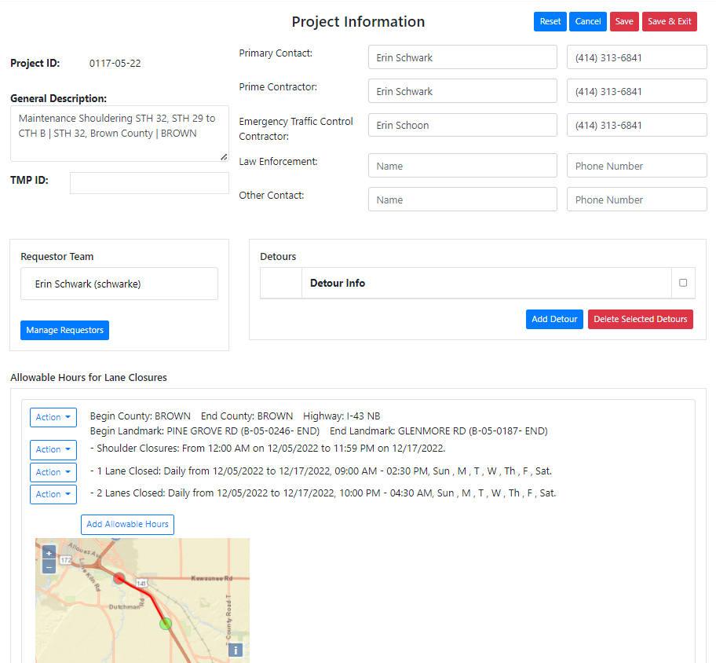
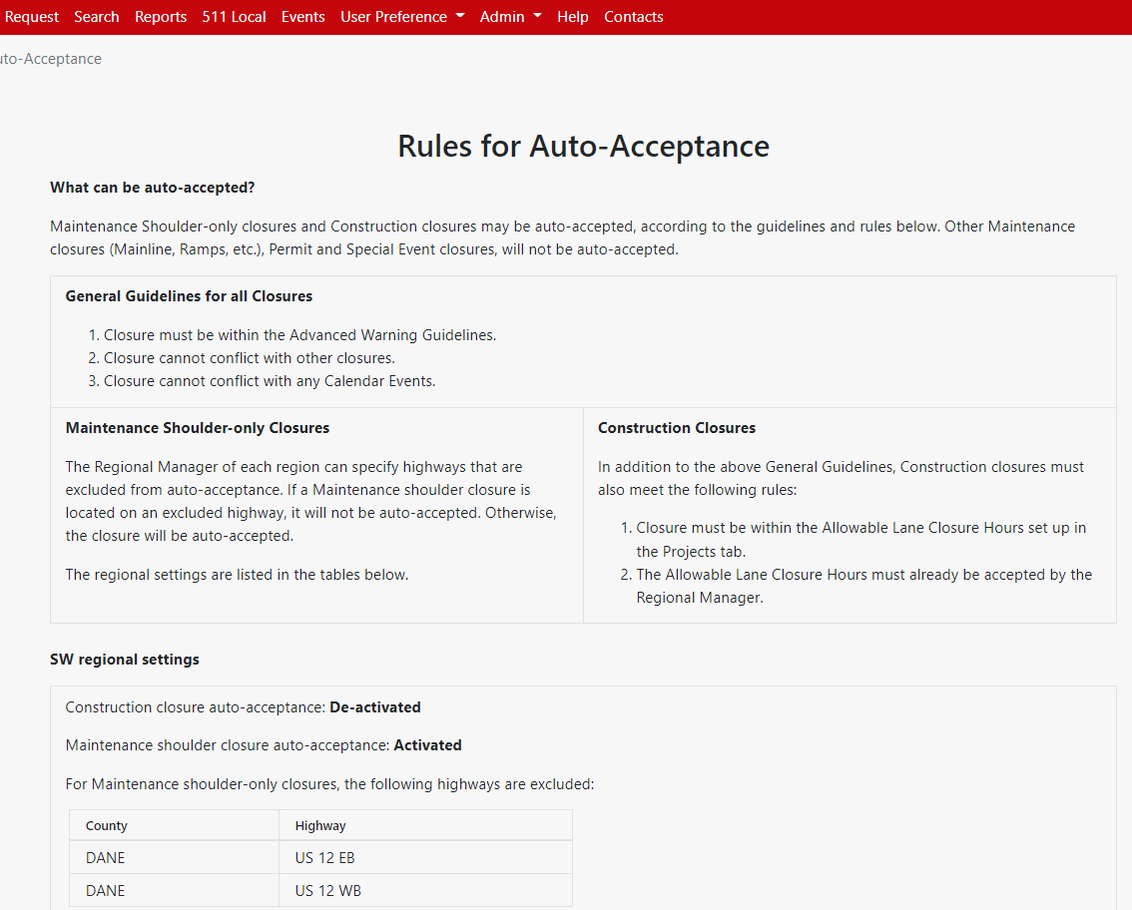
Lane Closure System
New for the 2023 Construction Season:
  Allowable Hours (SE, SW, NC, NW)
  Auto-Acceptance (SE, SW, NC, NW)
  Available Width will be required
  Build lane diagram
Emails
  Subscriptions
  Automatic ones
Reports
511 Local
  Continue to use LCS 1.0 if entering local closures

Slide 13
Lane Closure System - Issues
Start Dates
  Do not modify the start date of a closure that has already happened or is on-going
Lane Closure Length
Rolling Closure
  These are defined as full freeway closures, with LE, lasting less than 15 min
Flagging
  Should not be a continuous closure, almost always entered as daily
Various Lanes Closed
  Should not be used for long term lane closures, short-term like maintenance operations

Slide 14
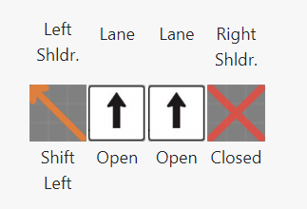
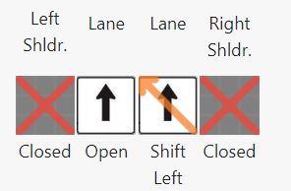
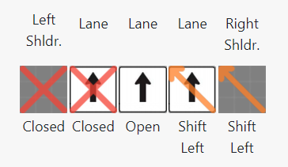
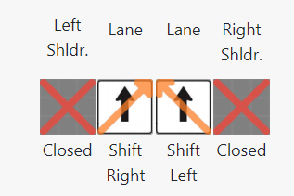
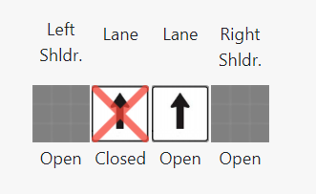
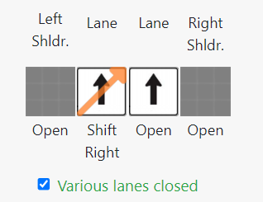
Lane Closure System – Lane Diagram Issues
Should this be closed or the left lane shifted?
Should this be closed?
Should this be closed?
Conflicting shifts, one or the other?
Should this be closed?
Various lanes closed with shift?

Slide 15
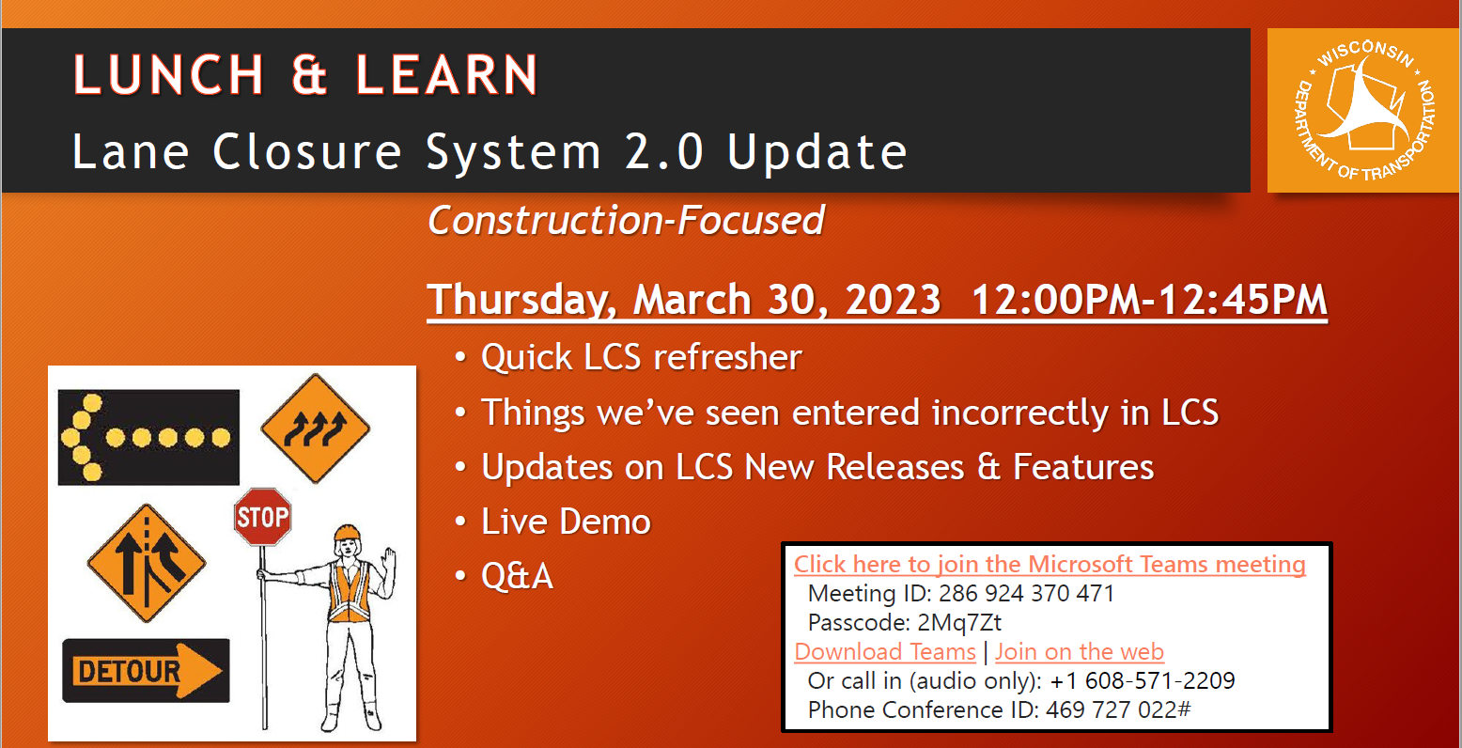
Lane Closure System - Training
Email: Erin.Schwark@dot.wi.gov for invite if you didn’t receive one.

Slide 16
Plan Modifications
Unexpected/overlooked features not in the plan
Contractor initiated
Hazardous traffic situation

Slide 17
Plan Modification
Check the TMP to for traffic analysis
Check the TMP/Specials for lane closure times
If making a substantial change to the planned strategies a TMP amendment will need to be created

Slide 18
Plan Modifications
SDDs might have the exact layout that is needed for a situation
Modifications might need to be made to the SDD
If an SDD does not have the layout check the WMUTCDs Typical Applications
WMUTCD will also have the charts for taper length

Slide 19
Plan Modifications
Start with the TMP to determine the impact to traffic
  Will there be queues? If so, how long?
If TMP does not help, contact your Regional Traffic Engineer

Slide 20
Plan Modifications
TMP Amendments
  When the traffic mitigation strategies are changed
  Schedule changes that will impact traffic
Typically approved at the region level
FHWA and BTO included if there is oversight

Slide 21
TMP Closeout
Once the construction season is complete the TMP needs to be marked as Completed
This is done by the Project Manager
Add any information in the comments that may help with future TMP development

