Slide 1
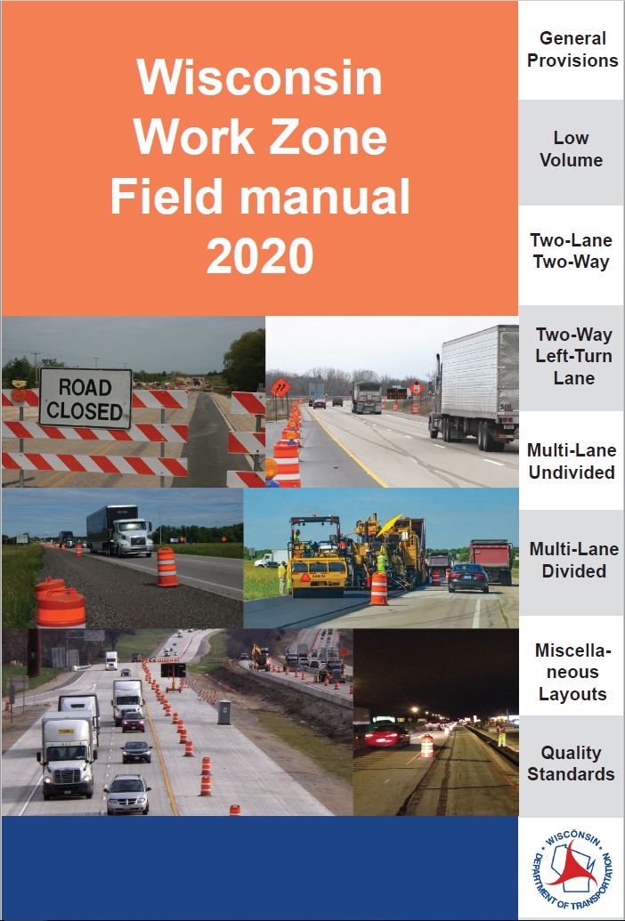

Slide 2
Work Zone Field Manual
Why?
Old booklet was inadequate, did not include:
  70 mph
  Roundabouts
  Maintenance WZ were substantially different than improvement project WZ

Slide 3
Work Zone Field Manual
For work 3 days or less
Who is it for:
  Counties
  Utilities
  Electricians
  Other individuals who work on the state highway system

Slide 4
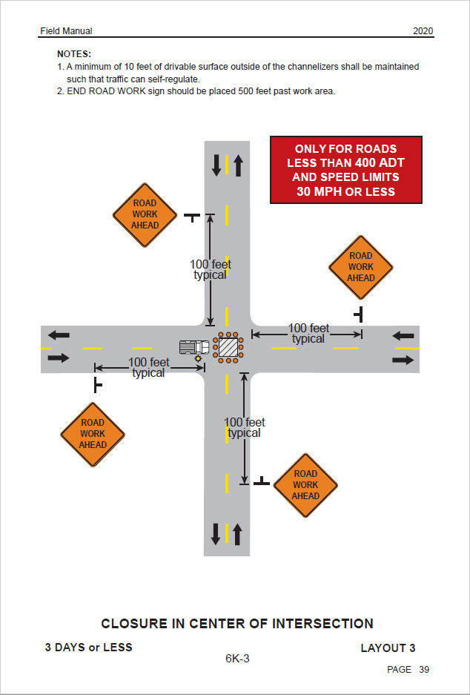
Work Zone Field Manual
Layouts
Title
Layout Number
Work Duration
  15 minutes up to 3 days
Notes
Red Restriction Box
Dimensions

Slide 5
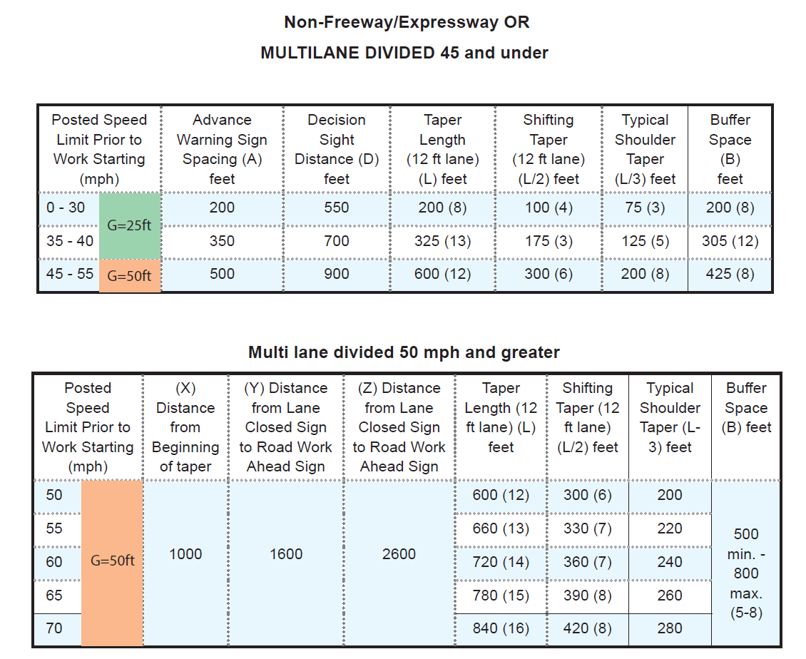
Work Zone Field Manual
Distance Charts
Distance for device spacing
G is for channelizing devices
Undivided highways/divided highways 45 mph and below
  Advance warning changes with speed
Divided highways 50 mph and above
  Advance warning extends at least 1 mile

Slide 7
Work Zone Field Manual
General Provisions
Low Volumes
Two-Lane Two-Way
Two-Way Left-Turn Lane
Multi-Lane Undivided
Multi-Lane Divided
Miscellaneous Layouts
Quality Standards

Slide 8
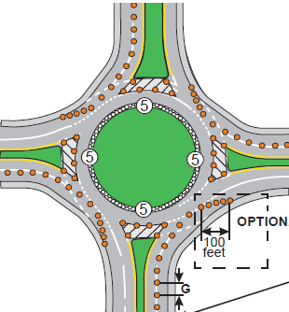
Work Zone Field Manual
Roundabouts
Quadrant Closure
  Single Lane Roundabout
  Flagging of roundabout
  Issues with long splitter islands
Lane Closure

Slide 9
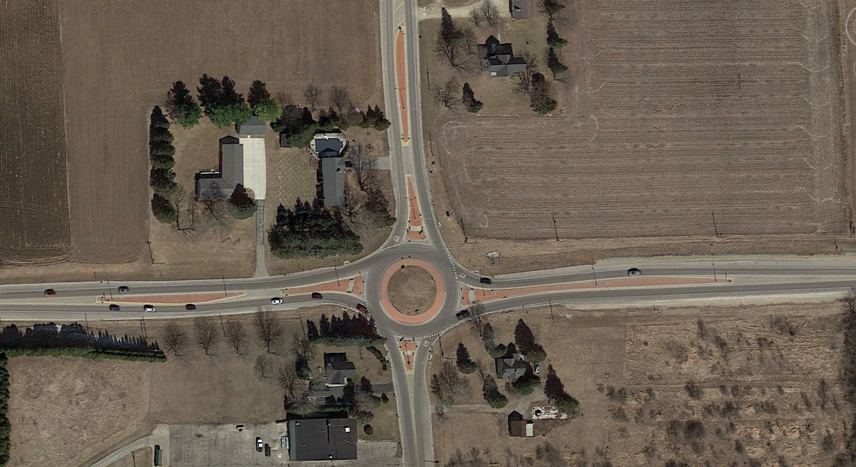
Roundabouts
Google Maps
Notes:
Generate discussion
-Long splitter islands
-Do we use flagging?
-How many flaggers do we need
-

Slide 10
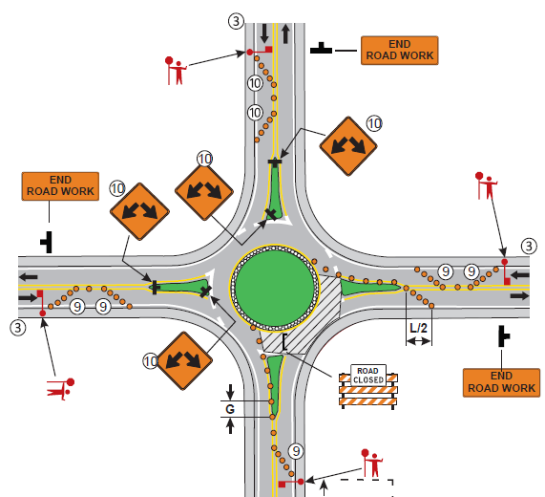
Roundabouts
Notes:
Generate discussion
-Long splitter islands
-Do we use flagging

Slide 11
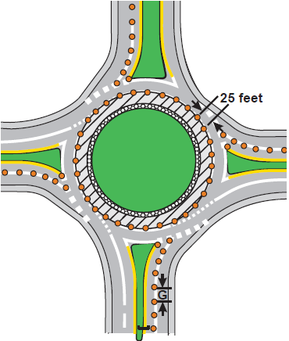

Roundabouts

Slide 12
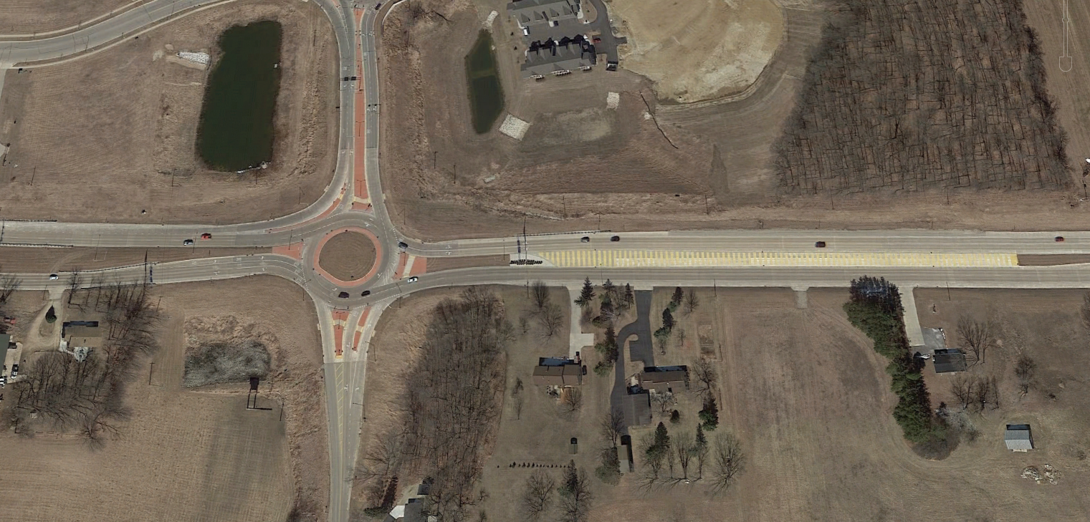
Roundabouts
Google Maps
Notes:
Generate discussion
-Long splitter islands
-Do we use flagging
-WIS 60 55 mph divided you xyz chart
-Concrete blow out on the splitter island
How do we do traffic control
-Use multiple layouts

Slide 13

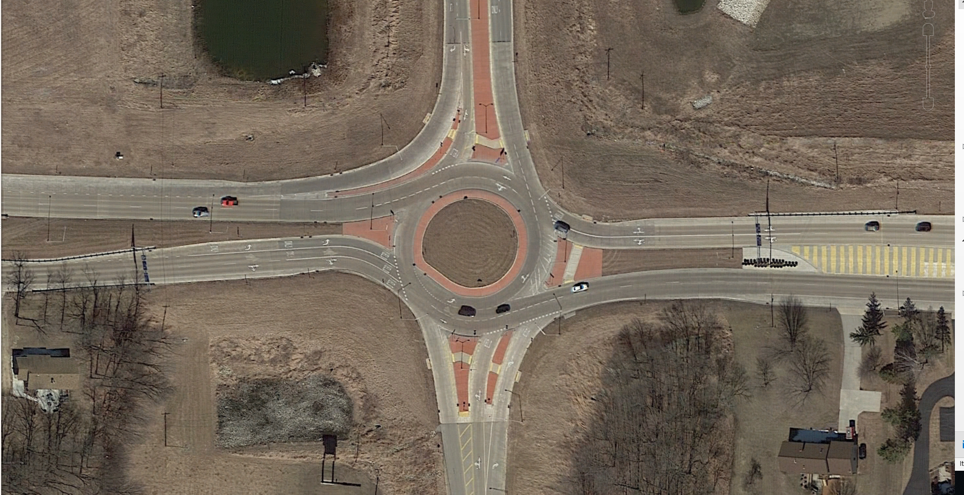
Google Maps
Notes:
EB 50 MPH
WB 50 MPH Hill
SB 45 MPH coming out of another roundabout
NB 45 MPH

Slide 14
Roundabouts
Road Work Ahead
50 mph and above Lane Closure
Multi-Lane Divided
Closing One Turn Lane on Dual Turn Lanes
Left Lane Closure in Roundabout
Road Work Ahead
Google Maps
Notes:
Generate discussion
-Long splitter islands
-Do we use flagging
-WIS 60 55 mph divided you xyz chart
-Concrete blow out on the splitter island
How do we do traffic control
-Use multiple layouts

Slide 15
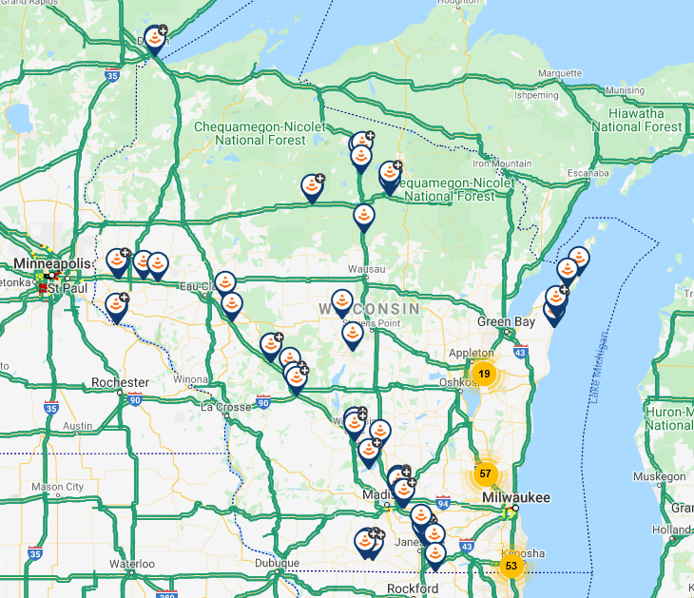

Operations

Slide 16
Before Work Begins
Determine the needs of your work zone:
  How long will the fix be?
  How large of an impact will there be?
  What type of traffic is on the road?
  What Layout(s) will be used?
  What traffic control devices are needed?
Use WisDOT as a reference, ask for help
Lane Closure System Entry

Slide 17
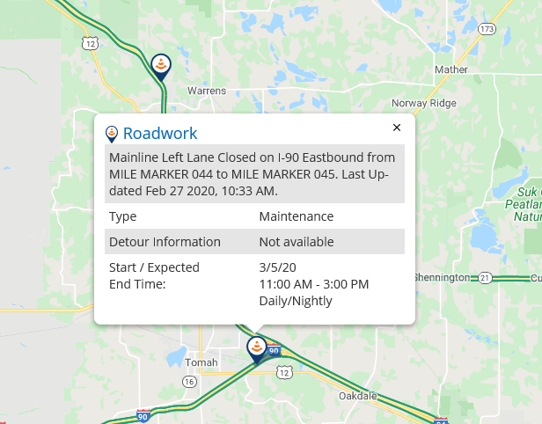
Lane Closure System
Why?
Traveler Information
  Entries go into 511
  3rd Party Traveler Information (WAZE, Google, etc.)
OSOW Permits
  Better planning and coordination
Notes:
essentially let them know it is not acceptable to block off an entire month or couple weeks to be out there 1 or 2 days.

Slide 18
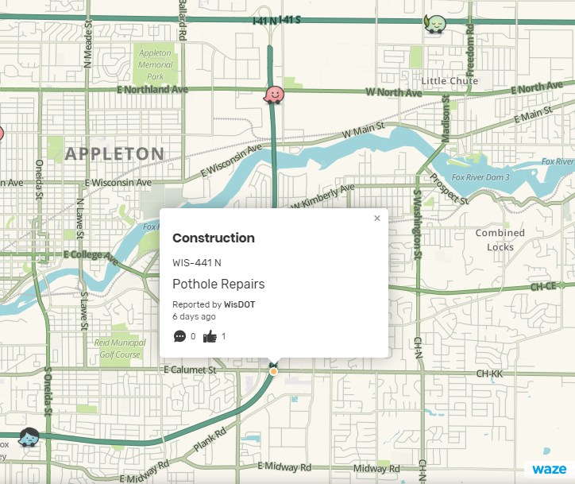
Lane Closure System

Slide 19
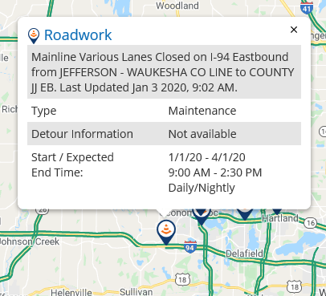
Lane Closure System
Requirements:
  7 days in advanced if width restrictions
  3 days in advance if no width restrictions
  Cancel/Postpone Closures that do not happen

Slide 20
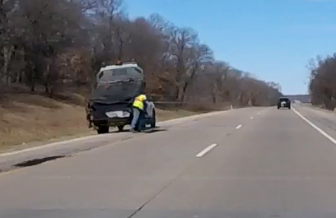
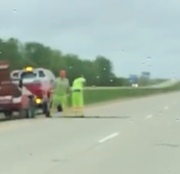
Inspections
What are we looking for?
Correct Advance Warning Area
Workers with Hi-Vis apparel
LCS Entries
Correct devices
Flagger Certification

