Slide 1
Traffic Control Devices
Drums
42” Cones
Barricades
Arrow Boards
Portable Changeable Message Boards
Signs and Sign Stands
Truck/Trailer Mounted Attenuators
Pedestrian Accommodations
Smart Work Zones
Notes:
May want to include a plug for our work zone devices purchasing contract

Slide 2
MASH Requirements
Manual for Assessing Safety Hardware (MASH) 2016
  All devices manufactured after December 31, 2019 must successfully pass MASH 16
NCHRP Report 350 & MASH 09
  Devices may still be used throughout their normal service lives, WisDOT has set sunset dates in agreement with other states in the Midwest
Notes:
https://safety.fhwa.dot.gov/roadway_dept/countermeasures/reduce_crash_severity/docs/memo_joint_implementation_agmt.pdf

Slide 3
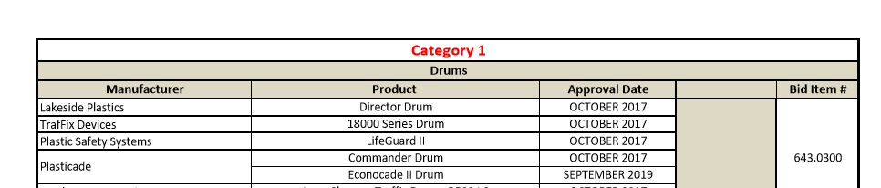
WisDOT Approved Products List (APL)
Set up to help inspectors
If you want a device added contact: DOTSignMarkWZMaterials@dot.wi.gov
Sunset dates for certain devices shown

Slide 4
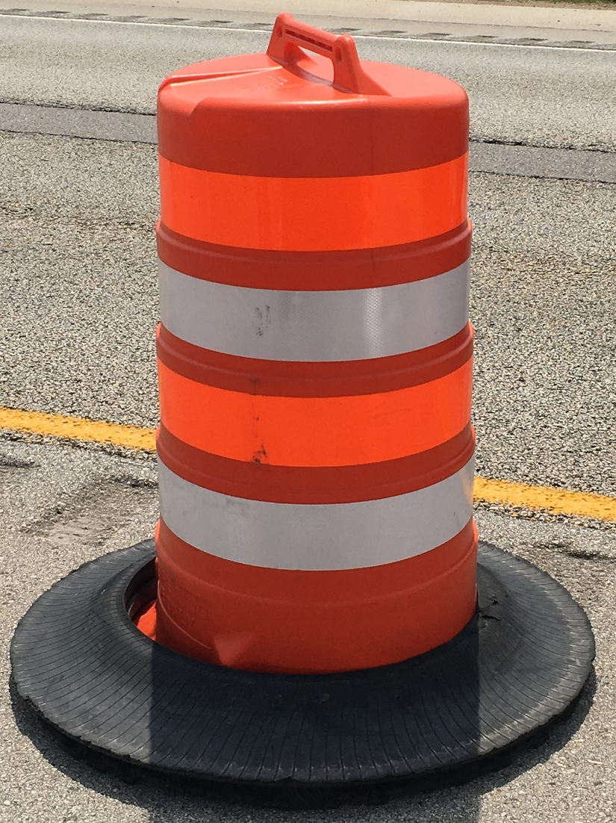
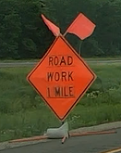
Quality Standards
Acceptable

Slide 5
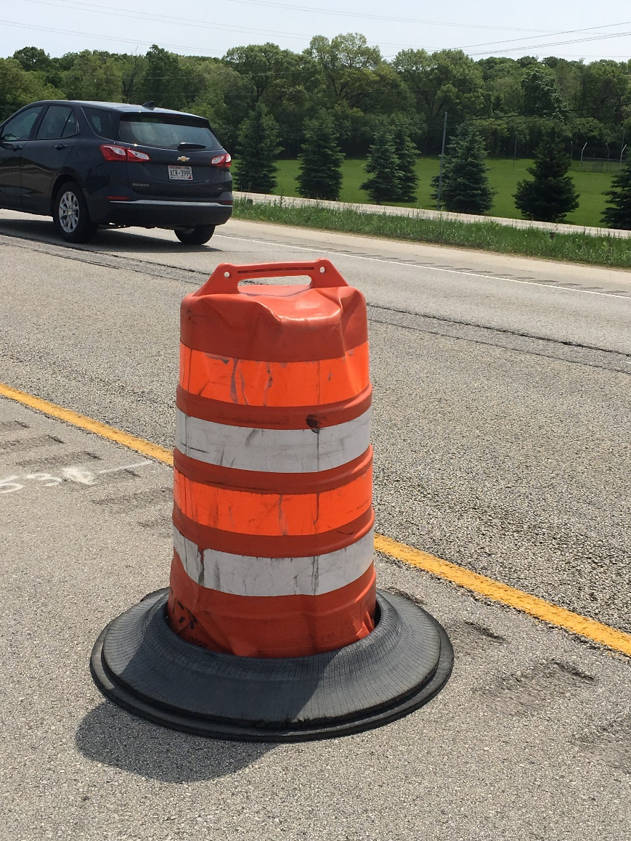
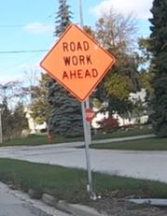
Quality Standards
Marginal

Slide 6
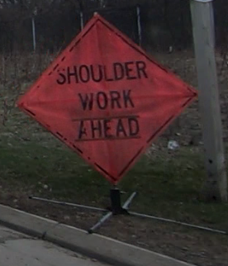
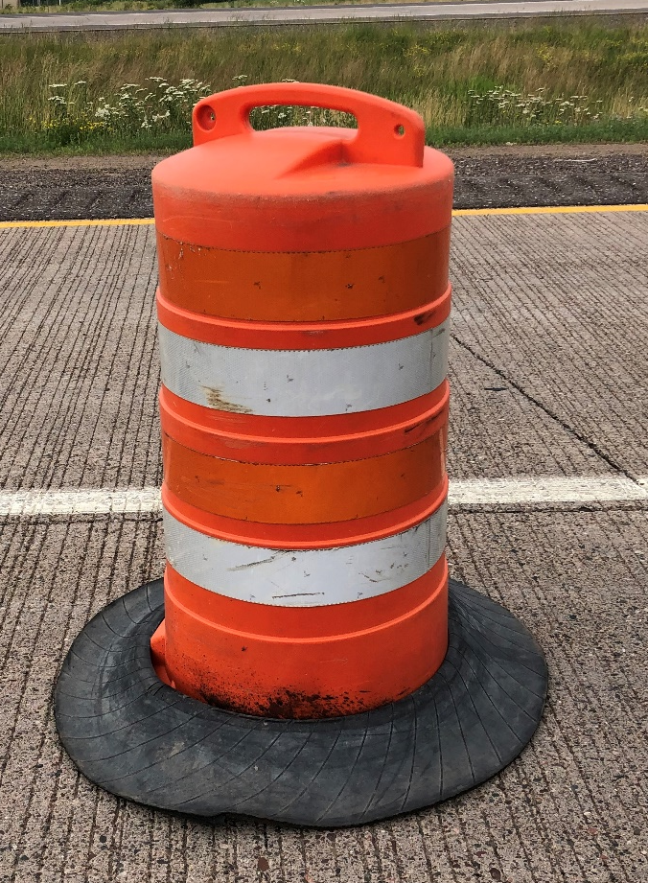
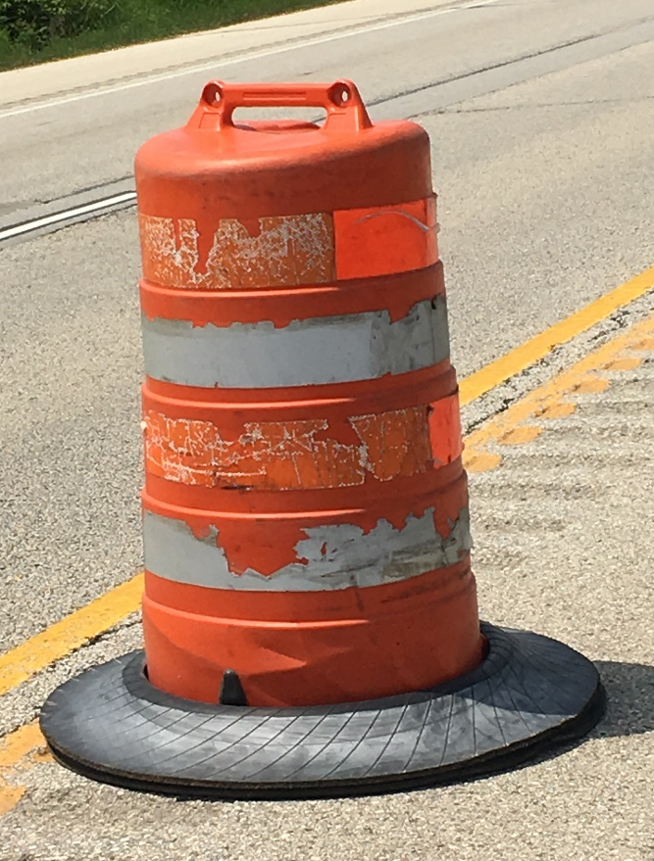
Quality Standards
Unacceptable

Slide 7
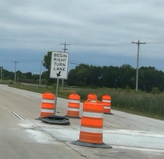
Traffic Control Drums
Spec. 643, SDD 15c11b
Large target value
4”-6” white and fluorescent orange sheeting
Weighted base
Clean/not crushed
Brown Co. 7/18/2019

Slide 8
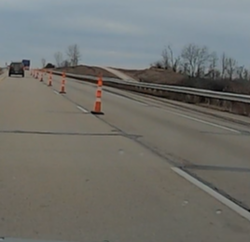
42-Inch Cones
Spec. 643, SDD 15c11b
Smaller target value
4”-6” white and fluorescent orange sheeting
Weighted base
½ the spacing of drums
Do not use in tapers
Washington Co. 11/25/2019

Slide 9
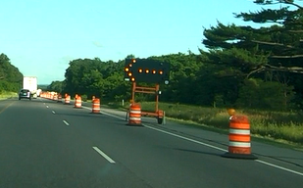
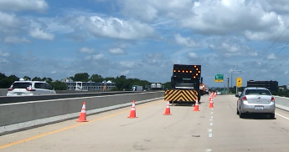
Drums vs. Cones
Dane Co. 8/7/2019

Slide 10
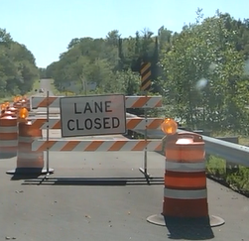
Barricades
Spec. 643, SDD 15c11b
Three panels with orange and white stripes
Stripes point down toward traffic
Barricades at night need lights
Iron Co. 8/20/2019

Slide 11
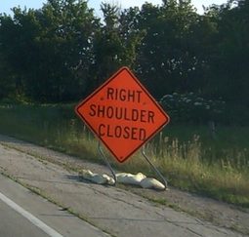
Signs
Spec. 643
Fluorescent Orange
  Use APL
Diamond are typically 48”x48”
Roll-up or metal
Stands must be crashworthy
200 ft. minimum spacing
Utility 7/18/2019
Notes:
Use Road Work 1 mile on Freeways and Expressways

Slide 12
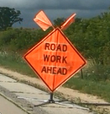
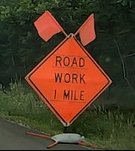
Correct Advance Warning Sign
Road Work Ahead vs. Road Work 1 Mile
Iowa Co. 8/6/2019
Barron Co. 7/9/2019

Slide 13
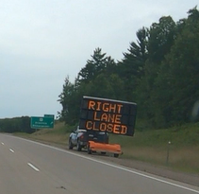
Portable Changeable Message Signs
(PCMS)
Spec. 643, TEOpS 6-02
Letter height, trailers 18”, vehicles 10”
Three lines of text
Two phases
  Problem/Action
Do not use words Danger, Hazardous, and Caution
Mounting height, 5 ft. rural, 7 ft. urban
Lincoln Co. 8/20/2019

Slide 14
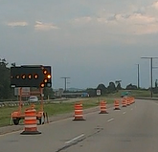
Arrow Boards
Spec. 643
Only use Flashing Arrow
Do not use chevrons
Only use arrow for lane closure
Solid bar or 4 corners for shoulder closures or boards within a lane closure
Any lights out in the head of the arrow is unacceptable
Improvement Project 7/15/2019

Slide 15
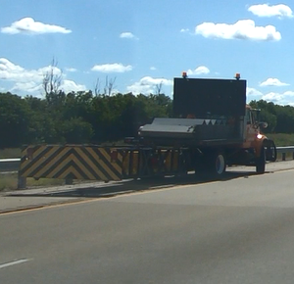
Truck/Trailer Mounted Attenuators
HMM 5-1-43
Anytime vehicles are used as a protection vehicle for workers
Use the proper TMA for the facility
Have the proper weight for the host vehicle
Use manufacturers roll ahead distance

Slide 16
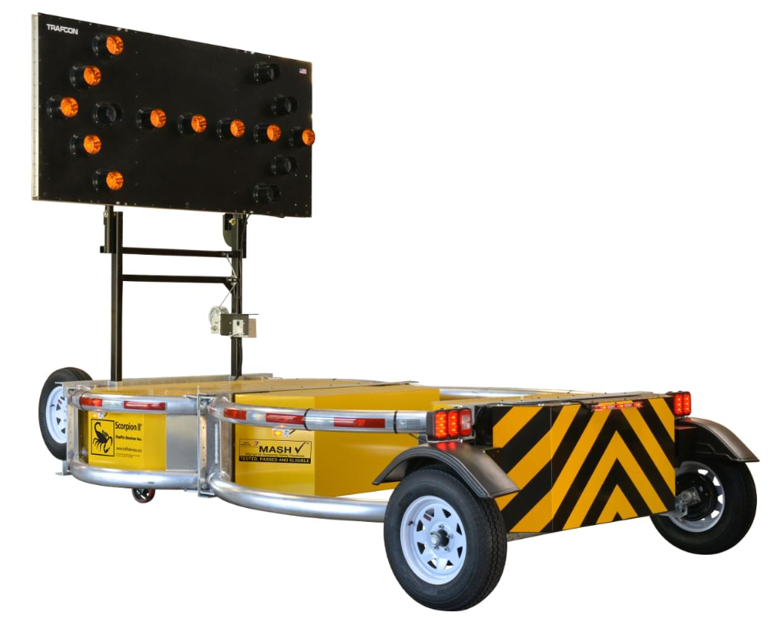
Truck/Trailer Mounted Attenuators
Crashworthiness
If you have NCHRP 350 TL-3 TMA’s
  Use until end of useful life or sunset date
When purchasing new TMA’
  MASH TL-3
Photo: TrafFix Devices Scorpion II
Notes:
https://www.youtube.com/watch?v=OdIYXnYWEfM
https://www.youtube.com/watch?v=ce0B8jyvE9o

Slide 17
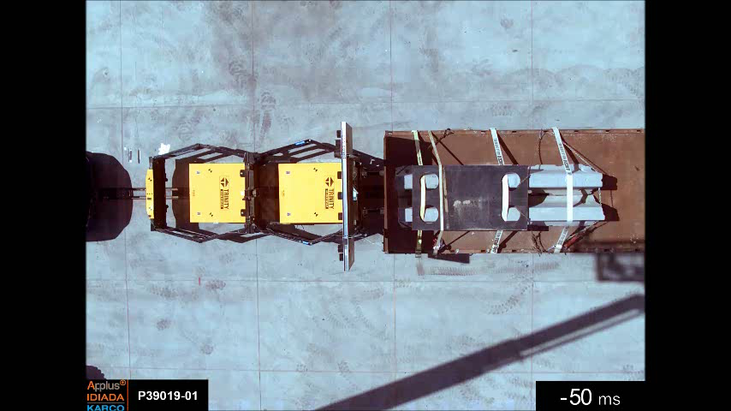
Truck/Trailer Mounted Attenuators

Slide 18
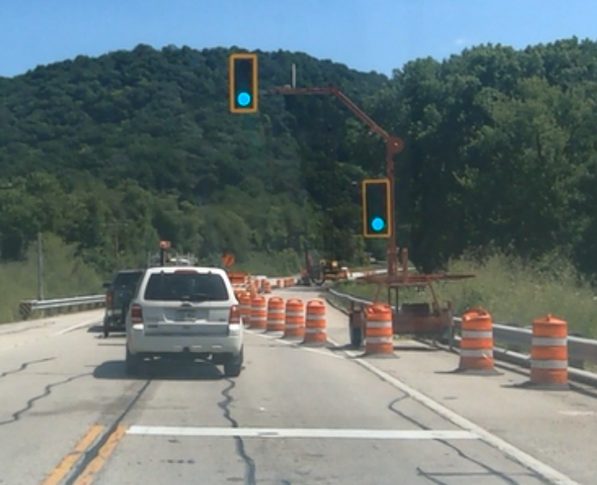
Temporary Signals
Spec. 661
Two signal heads required
Stop bar required
Traffic dependent
Electrical APL

Slide 19
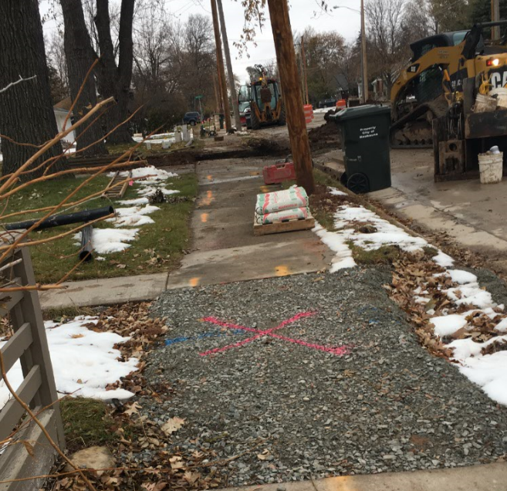
Pedestrian Accommodations
Detour pedestrians around work
  Do not close off both side of sidewalk if available
Stop work allow them to pass through
Improvement Project 11/18/2019

Slide 20
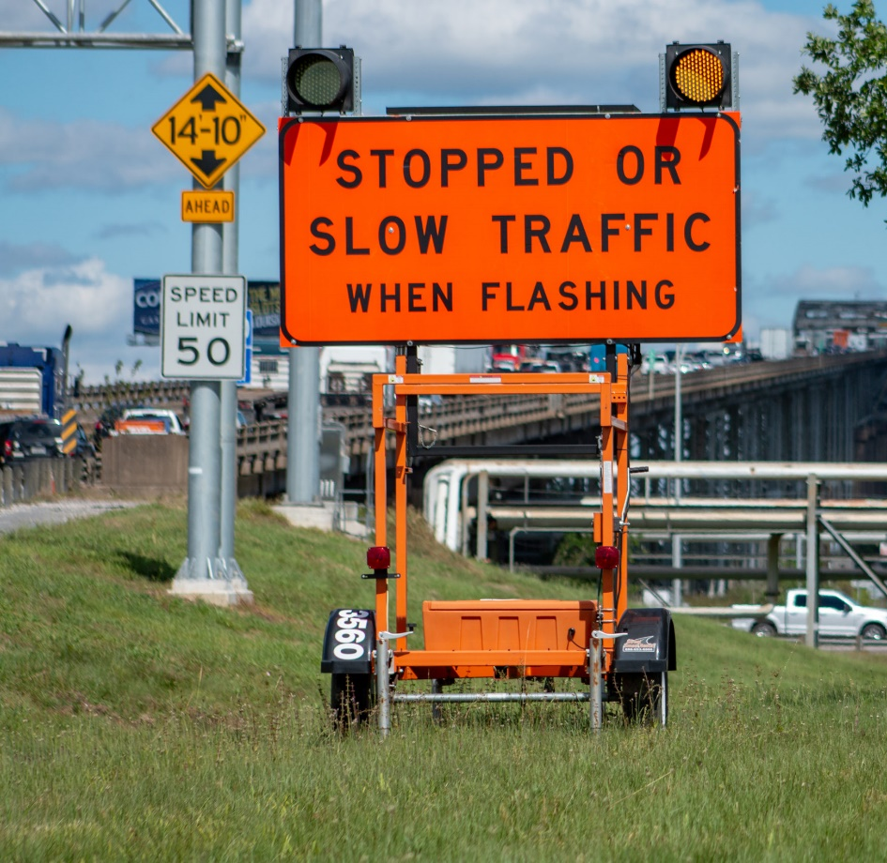
Smart Work Zones
New devices
Smart Arrow Boards
Queue Warning Systems
Start and End of Work Zone tracking: iPin, sensors
Photo: Street Smart Rentals

Slide 21
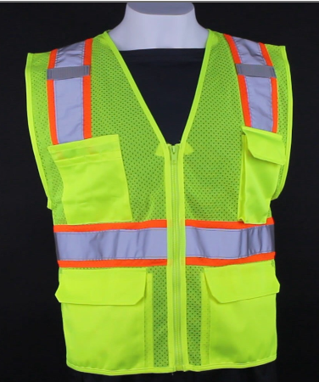
High Visibility Apparel
HMM 05-02-10
Daytime
  Class 2 or Class 3
Nighttime
  Vest and Pants Required
ANSI 107-2015 Type R
Clean
Photo: HiVis Supply

Slide 22
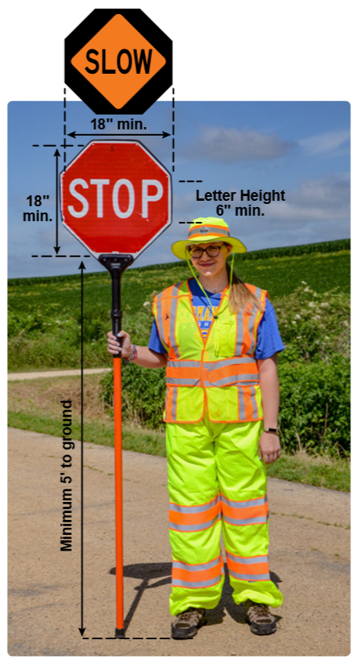
Flagging
2020 Flagging Handbook
Flaggers must be certified for work on the state highway system
Vest and pants
  Minimum Class 2 Vest
  Class E pants
Proper sign size and staff height

Slide 23
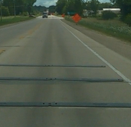
Temporary Portable Rumble Strips
Flagging Handbook, SDD 15c12, Spec 104.6
1 hour or more
Only use TPRS from APL
40 mph and above
Spacing of strips depends on speed
Monitor hourly for placement
Notes:
make note of change for this year, all flagging operations require them and only one set in each direction

