Slide 1
Safety Certification Process
General Overview
Notes:
This presentation will discuss the Safety Certification Process.

Slide 2
Overview
Purpose of the Safety Certification Process (SCP)
When to perform the SCP
Steps involved
Process Interaction
Notes:
This training will cover the background and purpose of the Safety Certification process, the interaction with other safety programs and functions within the Department, and a brief description of the steps and procedures.

Slide 3
Safety Certification Process
Why does WisDOT have this process?
Notes:
Why does the Department have this process?

Slide 4
Safety Certification Process
The Safety Certification Process (SCP)
  Defined in FDM 11-38
  Implements a performance-based practical design (PBPD) approach to asset management (FDM 11-1-10)
    An approach to decision making that encourages engineered solutions rather than reliance on maximum values or limits found in design specifications
    Is grounded in performance management
    Exercises engineering judgment to address the purpose and need
    Considers both short and long-term project and system goals
Notes:
The Safety Certification Process, or SCP, is defined in the Facilities Development Manual chapter 11-38. The Department is continuously balancing fiscal constraints with competing highway needs. This process was created to implement a performance-based practical design approach as part of the Department’s asset management philosophy. This approach helps with decision making by encouraging engineering solutions in areas of need, rather than reliance on maximum or desirable values found in design specifications, also referred to as nominal safety. Using this approach ties into the performance measures by targeting locations of need with improvements that demonstrate a positive return on investment from a safety perspective. This process exercises engineering judgement to address the purpose and need of a project and considers both the short and long-term goals of a project.

Slide 5
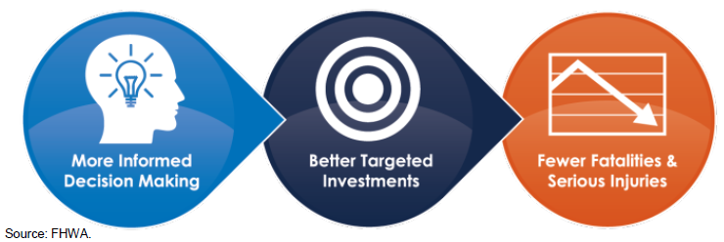
Safety Certification Process
Evaluates safety-driven roadway improvements
  Uses evidence-based tools to evaluate the current and future safety performance of roadway improvements
  Predicts the number and severity of crashes for each project alternative, allowing safety performance to be considered independent of other factors
  Allows WisDOT to target investments with more confidence and reduce severe crashes
Notes:
The Safety Certification Process uses a data-driven approach to quantify the safety component of a project. This involves using tools which evaluate the current and future safety performance of a roadway which compares the cost of crashes to the construction cost of an improvement. These tools use predictive crash modeling to determine the number and severity of crashes for each project alternative. Predictive crash modeling evaluates the safety of a project and does not evaluate other factors such as operations, vehicle travel time, delay, maintenance cost, or environmental factors. By quantifying safety, independent of these other factors, it allows the Department to target and prioritize investments with more confidence which can reduce severe injury crashes.

Slide 6
Safety Certification Process
Purpose of the SCP
  Assists in defining the purpose and need of a project
  Identifies locations with the highest potential for crash reduction
  Investigates safety countermeasures focused on crash history
  Quantifies safety to determine safety improvement impacts
  Consistent application of safety analysis
Notes:
The Safety Certification Process was created to ensure that identifying safety needs is completed early in the project development process to assist the Department in identifying the purpose and need of a project. This process identifies locations on the state highway network that have the highest potential for crash reduction. These locations are investigated for safety countermeasures based on existing crash trends and the safety benefits are quantified to determine the impacts of the reviewed countermeasures. By completing these steps, it provides a consistent approach to performing an analysis which increases the reliability of safety analyses and avoids unnecessary expenditures for improvements that aren’t needed.

Slide 7
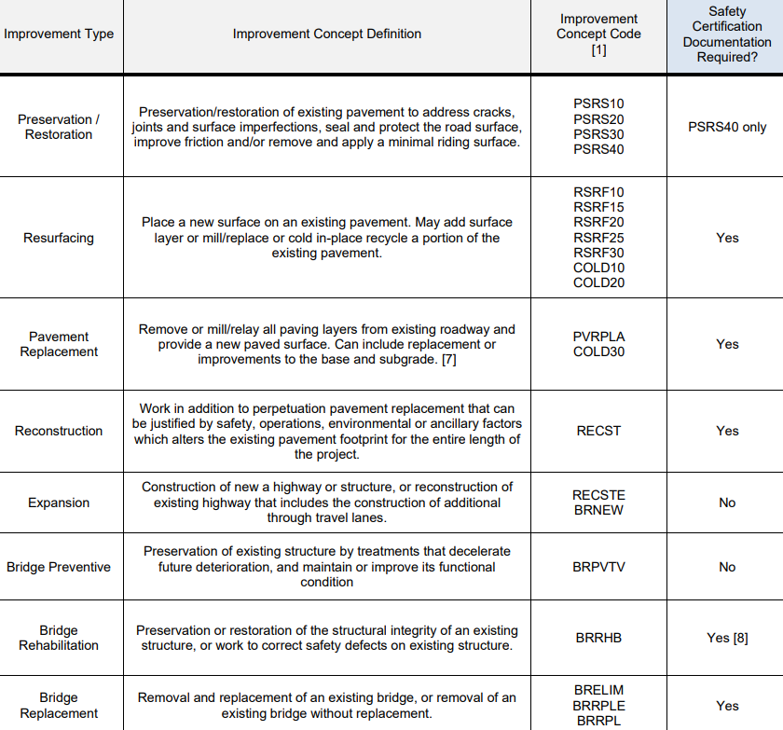
When is this completed?
  Required on all improvement projects except preservation/restoration, maintenance and expansion improvement types
    FDM 11-1 Attachment 10.1
Notes:
When does this process need to be completed? The Safety Certification Process is required for most projects, as identified by the improvement concept code in FDM 11-1 Attachment 10.1. Some work types are exempt from the process, such as preservation, bridge, and emergency projects. Also exempt from the SCP are projects that have a Modernization Improvement Strategy as these projects construct facilities to the upper end of design criteria.

Slide 8
Safety Certification Process
Overview of the Safety Certification Process Steps
Notes:
Overview of the SCP steps.

Slide 9
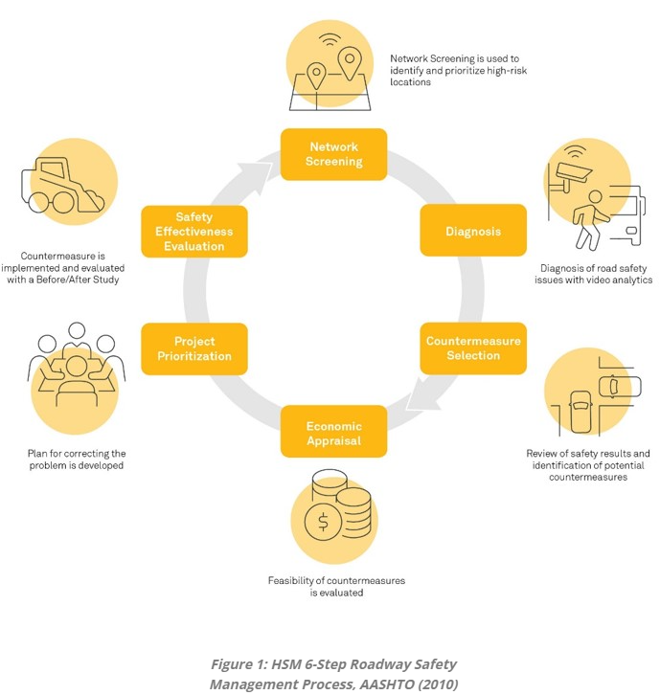
Safety Certification Process
Aligns with the Highway Safety Manual’s (HSM) Roadway Safety Management Process
  Network Screening for Safety Sites of Promise
  Diagnosis of Safety Sites of Promise
  Countermeasure Identification
  Safety Evaluation & Economic Appraisal
  of Alternatives
  Documentation
Notes:
The American Association of State Highway and Transportation Officials’ Highway Safety Manual (HSM) was released in 2010. This manual contains the Roadway Safety Management Process which agencies can use to implement a continuous approach to safety. The SCP implements components of the Roadway Safety Management Process by performing the five steps outlined on the slide.

Slide 10
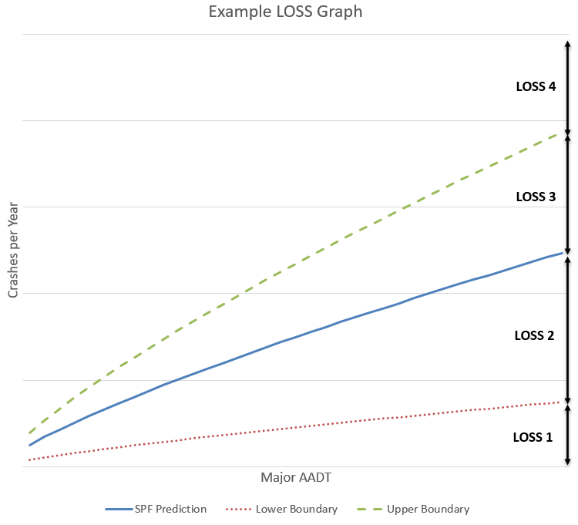
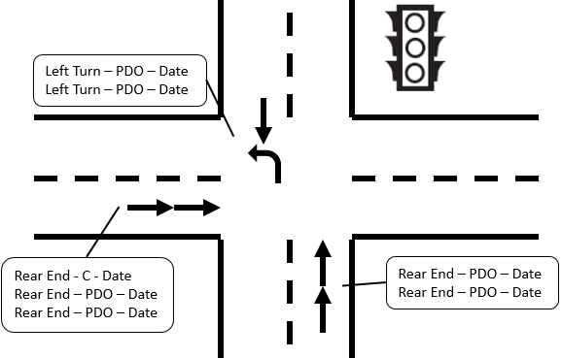
Safety Certification Process
  Network Screening for Safety Sites of Promise
    Finds potential improvement locations
    Uses Level of Service of Safety (LOSS) and Crash Flags in Meta-Manager
  Diagnosis of Safety Sites of Promise
    Understand the location conditions review crash data to identify contributing factors and trends
Notes:
The first step in the SCP is the Network Screening for Safety Sites of Promise. Intersections use the Level of Service of Safety and segments use Crash Flags from Meta-Manager to identify safety sites of promise. Locations that are “flagged” by this network screening are investigated further since they are performing worse than their peers.
In the Diagnosis of Safety Sites of Promise step, for each flagged location, the analyst should confirm the correct information is used in the screening process, and then review the crash data and site conditions. Identifying crash trends and contributing factors is important when considering potential countermeasures to implement.

Slide 11
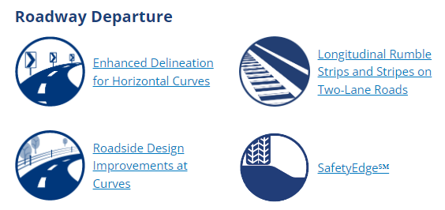
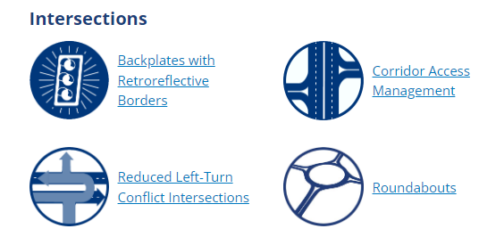
Safety Certification Process
  Countermeasure Identification
    Select countermeasures to target identified crash trends
    Note: BTO recommends completing an Intersection Control Evaluation (ICE) report after this step (if needed)
Source: FHWA Proven Countermeasures
Notes:
The third step in the SCP is to identify potential countermeasures. For each location, the analyst should use the crash trend information and contributing factors when considering which countermeasures to pursue.
If a change in traffic control is considered, an Intersection Control Evaluation (ICE) report will need to be completed.

Slide 12
Safety Certification Process
  Safety Evaluation & Economic Appraisal of alternatives
    Determine the safety benefit of each alternative using the appropriate analysis method
      Estimated Crash Frequency – least reliable
      Predicted Crash Frequency
      Expected Crash Frequency – most reliable
    Intersections typically use Method 2 and Segments typically use Method 3
    Compare the safety benefits and cost of constructing the alternative
      A safety benefit-cost ratio greater than 1.0 are economically justified
      A safety benefit-cost ratio between 0 and 1 may be considered reasonable when combined with other factors (e.g., operations, environmental, etc.)
      Alternatives investigated at a non-Safety Site of Promise with a benefit-cost ratio of greater than 2.0 is economically justified
Notes:
Once countermeasures are proposed, they are evaluated based on safety performance and cost in the fourth step of the SCP. To determine the safety benefits for each alternative, the correct analysis method needs to be utilized. Per the HSM, the same analysis method must be used for all alternatives. This should be the most reliable method available. Additionally, all alternatives are compared to the lowest cost alternative, which is typically the alternative which perpetuates the existing, or base, conditions.
All alternatives that have a positive safety benefit-cost ratio, which is any value greater than zero, are considered reasonable. Those alternatives with a safety benefit-cost ratio greater than one are economically justified. For alternatives investigated that are not identified as a Safety Site of Promise, a benefit-cost ratio of greater than 2.0 is required to economically justify the improvement from a safety perspective.

Slide 13
Safety Certification Process
  Documentation
    Put all analysis, reports, diagrams, assumptions, engineering judgement, etc., into the Safety and Operations Certification Document (SOCD)
      Template: FDM 11-38 Attachment 10.5
      Note: There is a separate Operations Certification Process (OCP) that utilizes the same document for recording findings. OCP is found in FDM 11-52.
    Does not select a final alternative. Indicates which alternatives should move forward in the project development process.
    This document is included in the Final Scope Certification (FSC) to provide information pertaining to the existing safety and the safety of proposed alternatives.
Notes:
The final step in the SCP is to document all the data, diagrams, and findings in the Safety and Operations Certification Document, or SOCD. It is recommended that as information is gathered it is placed in the document instead of waiting until the end.
The Safety and Operations Certification Document does not select a final alternative, as safety is one component of the decision-making process. Instead, it is a summary of the safety considerations for the project and is utilized in the Final Scope Certification (FSC). This document may also contain operational information if the OCP is completed.

Slide 14
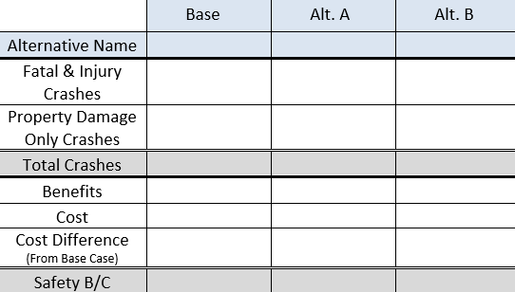
Safety Certification Process
  Documentation
    Important to understand one number does not tell the whole story. There is nuance to the Safety B/C and Total Crash values.
Example 1: Safety B/C |  |  | Crash Distribution by Severity
Alternative | Benefit | Cost | B/C
Roundabout | $1,160,000 | $2,000,000 | 0.58
Double Up Stop Signs | $126,000 | $10,000 | 12.6
Example 2: Number of Crashes | Crash Distribution by Severity
 | Total | PDO | Fatal & Injury | K | A | B | C
Alt. 1 | 27 | 20 | 7 | 1 | 1.5 | 1.5 | 3
Alt. 2 | 35 | 25 | 10 | 0.25 | 0.5 | 1.25 | 8
Notes:
When documenting the results of the analysis, it is important to understand there is nuance to the crash values reported.
Let’s look at some examples.
Example one looks at the safety benefit-cost ratio. Doubling up the stop signs yields the best safety benefit-cost ratio. This is due to a very low cost for the benefit it provides. The roundabout provides a larger safety benefit, although at a higher cost, which is why it has a lower safety benefit-cost ratio. Depending on the purpose and need of the project, either alternative could be correct to implement. This information should be carried forward into the FSC where additional data can be considered.
In the next example, alternative one has fewer total crashes, property damage only crashes, and combined fatal and injury crashes when compared to the alternative two. However, the second alternative has fewer fatal crashes, injury A crashes, and injury B crashes. This reduction in the more serious injury and fatal crash types is likely a safer alternative even though the total number of crashes is higher.
These two examples illustrate the need to understand the complete safety picture, not just one or two numbers.

Slide 15
Safety Certification Process
Bureau of Traffic Operations (BTO) Role
Notes:
What is the Bureau of Traffic Operations’ role in the SCP?

Slide 16
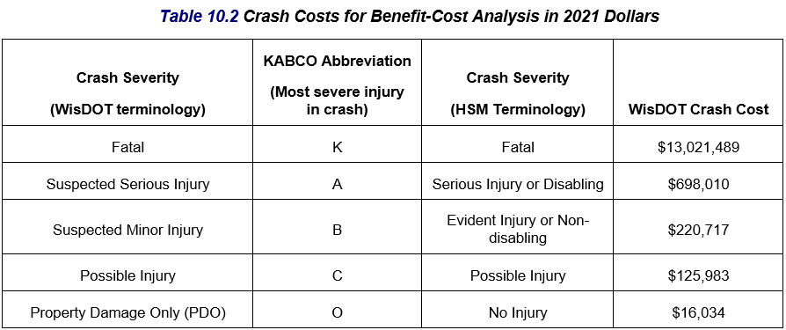
Bureau of Traffic Operations Role
Maintain and update safety analysis tools
  Evaluate and distribute tools when new versions are available
  Manage Calibration Factors and Crash Severity/Type Proportions within IHSDM
  Update crash costs
Approve Certification Document when safety evaluations are completed
  Verify methodology and analyses
Notes:
The role of the Bureau of Traffic Operations is to maintain the SCP policy and update safety analysis tools as needed. These tools are periodically updated to incorporate newer volume information, crash information. When new Safety Performance Functions are developed nationally, BTO calibrates them using Wisconsin specific data, so they are more representative of Wisconsin roadways. Crash costs are also updated periodically to account for inflation and other trends.
Updates to software packages are be coordinated with BITS and pushed to WisDOT computers. External partners can access the updated files on the WisDOT webpage, shown on the next slide.
When a Safety and Operations Certification Document (SOCD) is produced where at least one Safety Site of Promises performs step 4, Safety Evaluation and Economic Appraisal of Alternatives, the SOCD is sent to BTO for review and BTO approval is required. BTO’s responsibility is to verify that the SCP policy was followed and documented correctly. It is the responsibility of the analyst and Region to review the inputs and data.

Slide 17
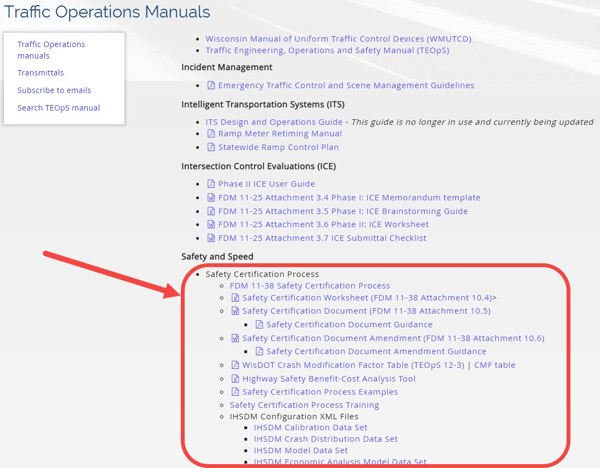
Resources
https://wisconsindot.gov/Pages/doing-bus/local-gov/traffic-ops/manuals-and-standards/manuals.aspx
Notes:
The Safety Certification Process is defined in FDM 11-38. In addition to this, the WisDOT webpage for Traffic Operation Manuals contains templates, configuration files, training materials, and examples.

Slide 18
Safety Certification Process Interaction
How does this process work with Intersection Control Evaluations (ICE) and the Highway Safety Improvement Program (HSIP)?
Notes:
Now we will discuss how the Safety Certification Process may interact with the Intersection Control Evaluation process and the Highway Safety Improvement Program. These processes are independent of the Safety Certification Process but may overlap with the SCP at various steps.

Slide 19
Process Interaction
An Intersection Control Evaluation (ICE) (FDM 11-25-3) is required when
  New or changes to traffic control or configuration is considered
  Intersection access/median restrictions considered
  Offsetting intersections considered
When required, it is recommended to complete an ICE prior to the Safety Evaluation and Economic Appraisal procedure
  Confirms alternatives that should be analyzed which fit within the purpose and need
Notes:
The Intersection Control Evaluation Process, or ICE, is required on state highway projects when a new or change to existing traffic control or configuration is considered. Examples of this include converting a stop-controlled intersection to a roundabout or converting an at-grade intersection to an interchange.
Other triggers for this process include access or median restrictions or offsetting an intersection.
The ICE Process interacts with the Safety Certification Process when these types of changes are investigated as potential countermeasures. Once sites of promise with proposed alternatives meeting these criteria are identified within the SCP, it is recommended to complete the ICE process prior to performing the safety analysis . The ICE process will confirm which proposed alternatives fulfil the purpose and need and move on in the improvement project process. In some cases, removing alternatives from consideration which reduces the number of alternatives analyzed in the Safety Certification Process.

Slide 20
Process Interaction
Highway Safety Improvement Program (HSIP) Process
  Process overview:
    https://wisconsindot.gov/Pages/doing-bus/local-gov/astnce-pgms/highway/hsip.aspx
  Separate process from the SCP
    Federally-driven
    Goal is to develop and implement safety projects to reduce the number and severity of crashes on all streets and highways (state and local)
Notes:
The Highway Safety Improvement Program, H-S-I-P, commonly referred to as hiss-sip, is a separate and independent process from the SCP. This is a core federal aid program which has a goal of reducing fatal and serious injury crashes on all roadways: local and state.

Slide 21
Process Interaction
HSIP role within the SCP
  Improvement program project
    Projects undergo network screening and safety countermeasures considered can use HSIP as a funding mechanism
    Both the HSIP process and SCP are required
  Standalone HSIP projects
    Projects evaluated for HSIP, originating outside of the improvement program due to a safety need, do not need to complete the SCP
Notes:
The Highway Safety Improvement Program has two potential scenarios that interact with the SCP. The first is when an improvement project is loaded into the program. This project undergoes the Safety Certification Process which screens the project for locations experiencing crash issues. Locations identified through this process, or brought forward by other areas or concerns, may be eligible to receive HSIP funding to make safety improvements. A Region may choose to submit a countermeasure for HSIP funding to make proposed improvements investigated within the SCP. In this situation, both the Safety Certification Process and HSIP process need to be followed and HSIP acts as a funding mechanism which is tied to the improvement project.
The second scenario is when a project is identified through an existing safety issue or brought forward by other stakeholders. In this situation, an immediate need is identified which originates outside of an upcoming improvement project. A Region or local municipality may submit a proposed project for HSIP funding. If approved, these standalone projects would not be required to follow the Safety Certification Process, as they originated outside of the improvement project and the purpose and need is defined. For these situations, the HSIP application would be the safety documentation for the project.

Slide 22
BTO Contacts
BTO General Mailbox for SCP
DOTBTOSafetyEngineering@dot.wi.gov
Kevin M. Scopoline
State Traffic Safety Engineer – Research
KevinM.Scopoline@dot.wi.gov
Dan Brugman
State Traffic Safety Engineer – Improvement
Daniel.Brugman@dot.wi.gov
Notes:
If you have questions regarding the Safety Certification Process, please contact BTO by emailing them

