Slide 1

2020 Spring Marking Training
Wisconsin Department of Transportation

Slide 2
Agenda
Contacts/Contracts
Product
Who to Contact When Issues Arise
WisDOT Work Zone Expectations
Marking Field Manual
SDD Updates
NPZ Changes
Questions

Slide 3

WisDOT Staff
Policies/Standards
608-246-5408
jeannie.silver@dot.wi.gov
Products/Materials
Materials Engineer
414-333-6234
linette.rizos@dot.wi.gov
Matt Rauch
Traffic Design Unit Supervisor
Jeannie Silver
Pavement Marking Engineer
Linette Rizos
Political
Matt.rauch@dot.wi.gov

Slide 4
Procurement Contracts
Paint
Ennis Flint
21 Calendar Day Delivery
Beads
Potters
21Calendar Day
Tabs
Apex Universal
28 Calendar Day Delivery
Traffic Control Devices
Decker Supply, Inc
28 Calendar Day Delivery
Guardrail Delineators
Lightle Enterprises, LLC
21 Day Delivery

Slide 5
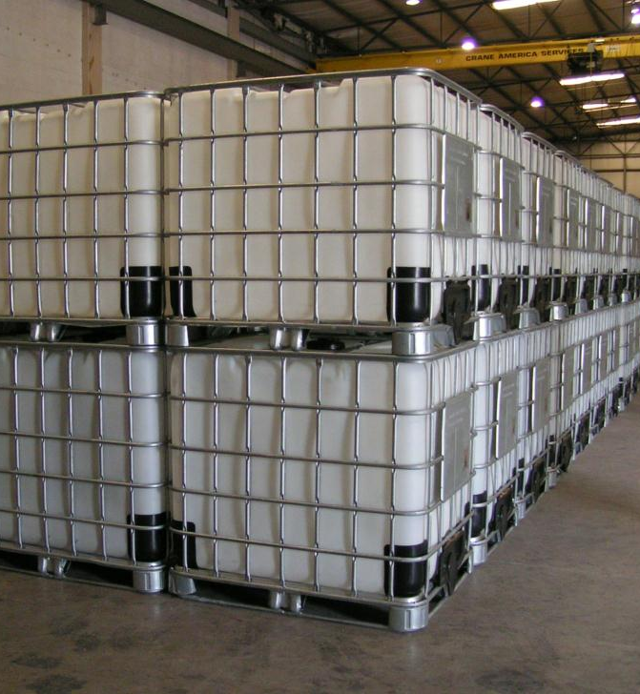
2020 Waterborne Contract
1 Contract with Ennis Flint
  Price of Yellow went down
  Price of White stayed the same
Application Rate = 16 mil
  ~ 18 gal/mile
Notes:
White went up
Yellow went down

Slide 6
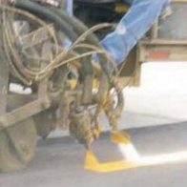
2020 Glass Bead Contract
Prices Increased Slightly
Application Rate
= 10 lb/gal
= 180 lb/mile
Notes:
Price went up 36/tote

Slide 7
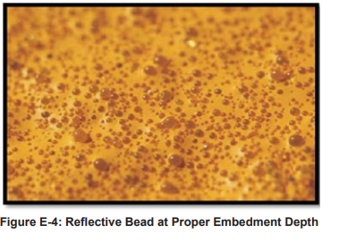
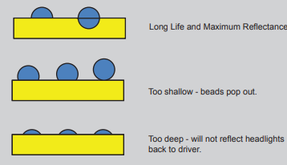
Bead Embedment

Slide 8
Bead Calibration
Speed (MPH) | Milliliters of Beads in 10 Seconds
3 | 450
4 | 595
5 | 740
6 | 890
7 | 1040
8 | 1190
9 | 1340
10 | 1490

Slide 9
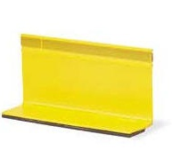
2020 Temp Raised Pavement Markers
Follow SDD 15C34
  Tabs every 50’ for centerline
  Double tab at zone changes
Channelizing lines
  Double tab at start of line
  25’ spacing
Notes:
Price went up 36/tote

Slide 10
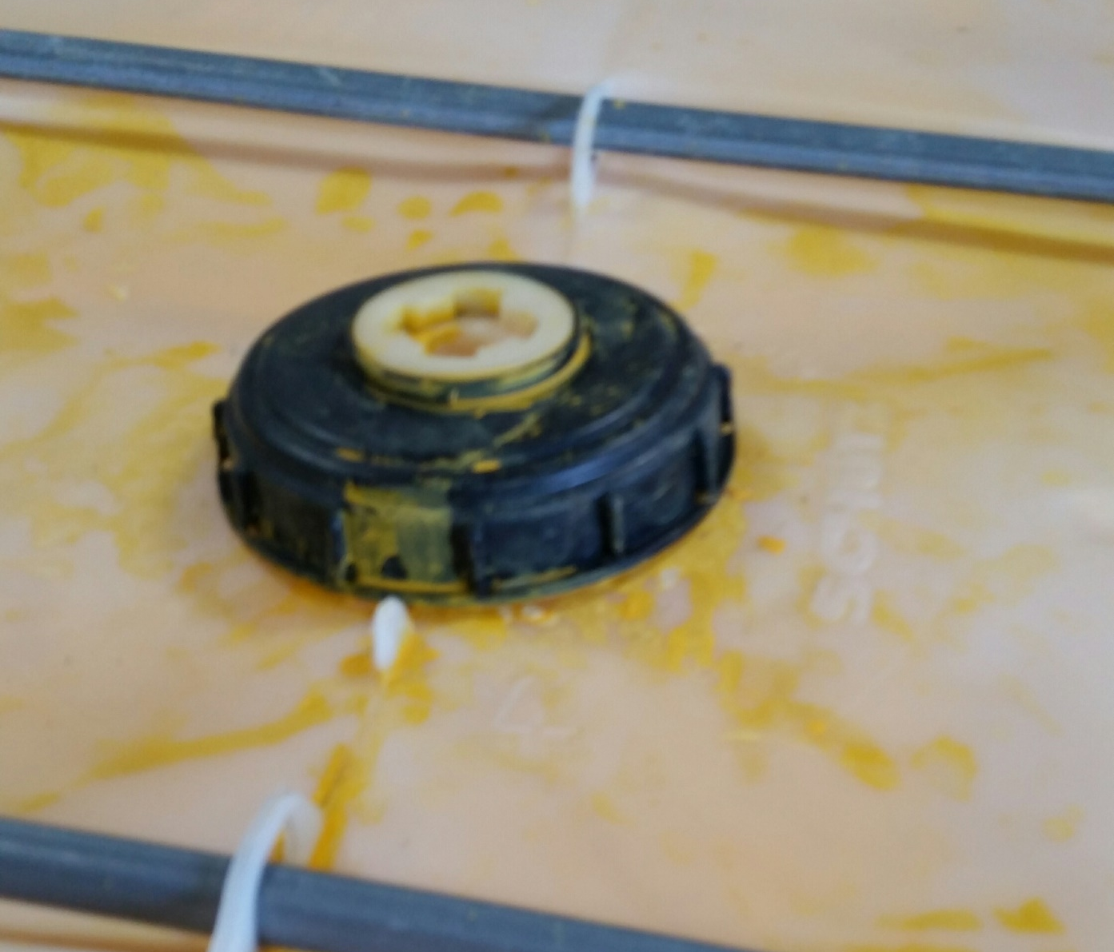
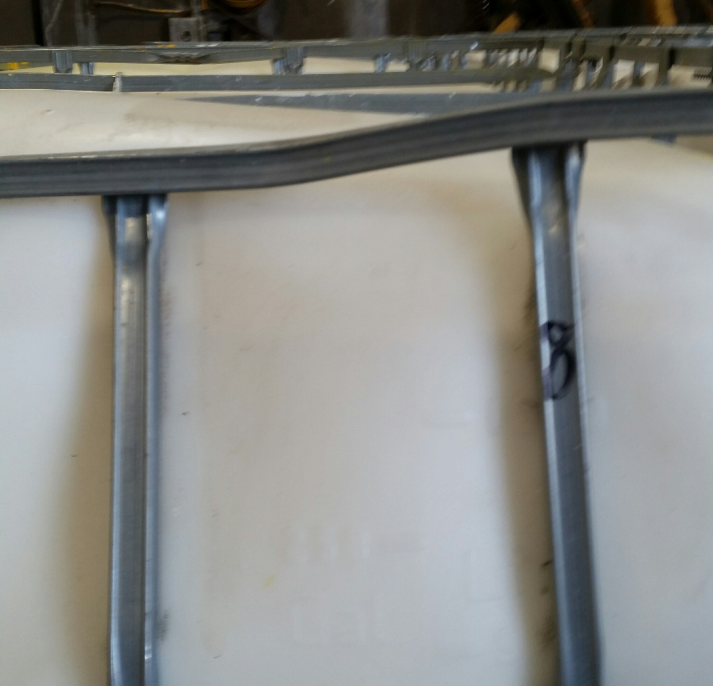
Waterborne Paint Product
  Receiving Product
    Inspect ALL SHIPMENTS upon arrival.
    Reject Shipment if Totes are:
      Deformed
      Dirty
      Damaged
      Etc..
    We do not want to pay for products that are not up to the standards

Slide 11
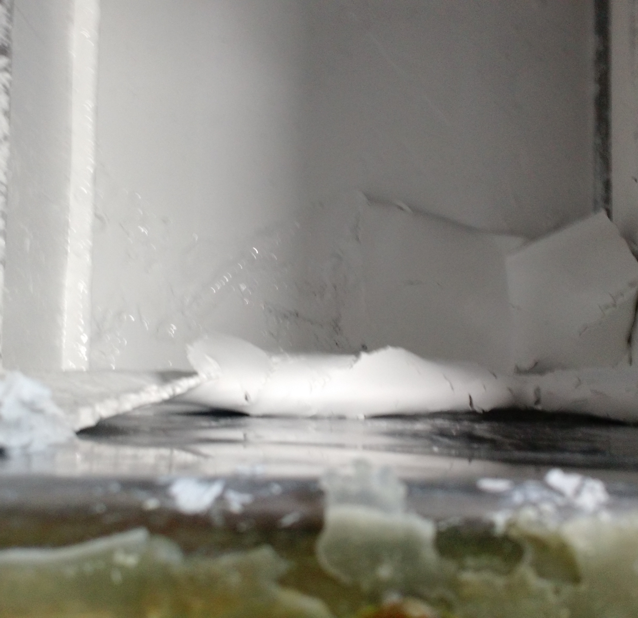
Waterborne Paint Product
Ammonia Float
  When to use the float:
    Sitting more than 24 hours Without Agitation
    Non-stainless Steel Equipment

Slide 12
Ammonia Float
If you don’t want it request it to not be delivered on your order.
Extra pails of Ammonia Float can be returned to a neighboring county or one time only shipment back to the sign shop.

Slide 13
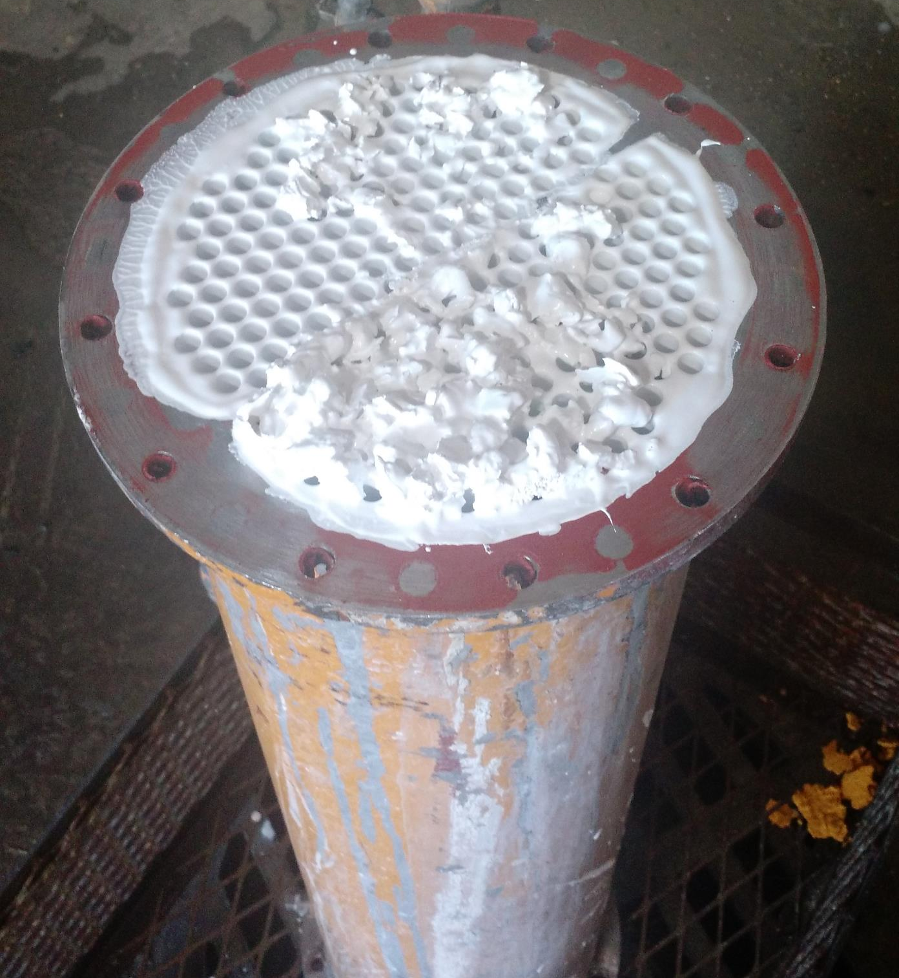
Waterborne Paint Product
  Problems with Clogging Screens
    Higher Quality = Thicker Paint
      Frequently Clean Screens
        Daily or multiple times a week
        Frequently Calibrate Nozzle
      Notify Linette Rizos

Slide 14
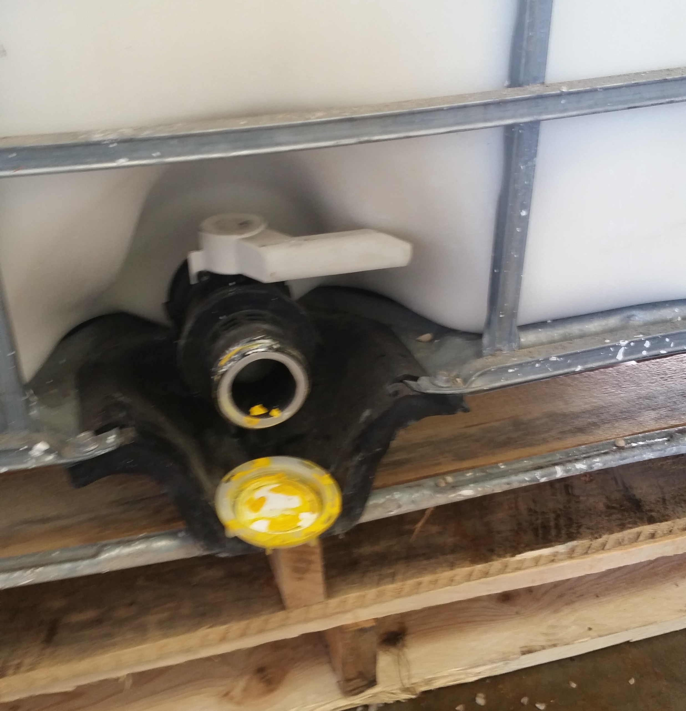
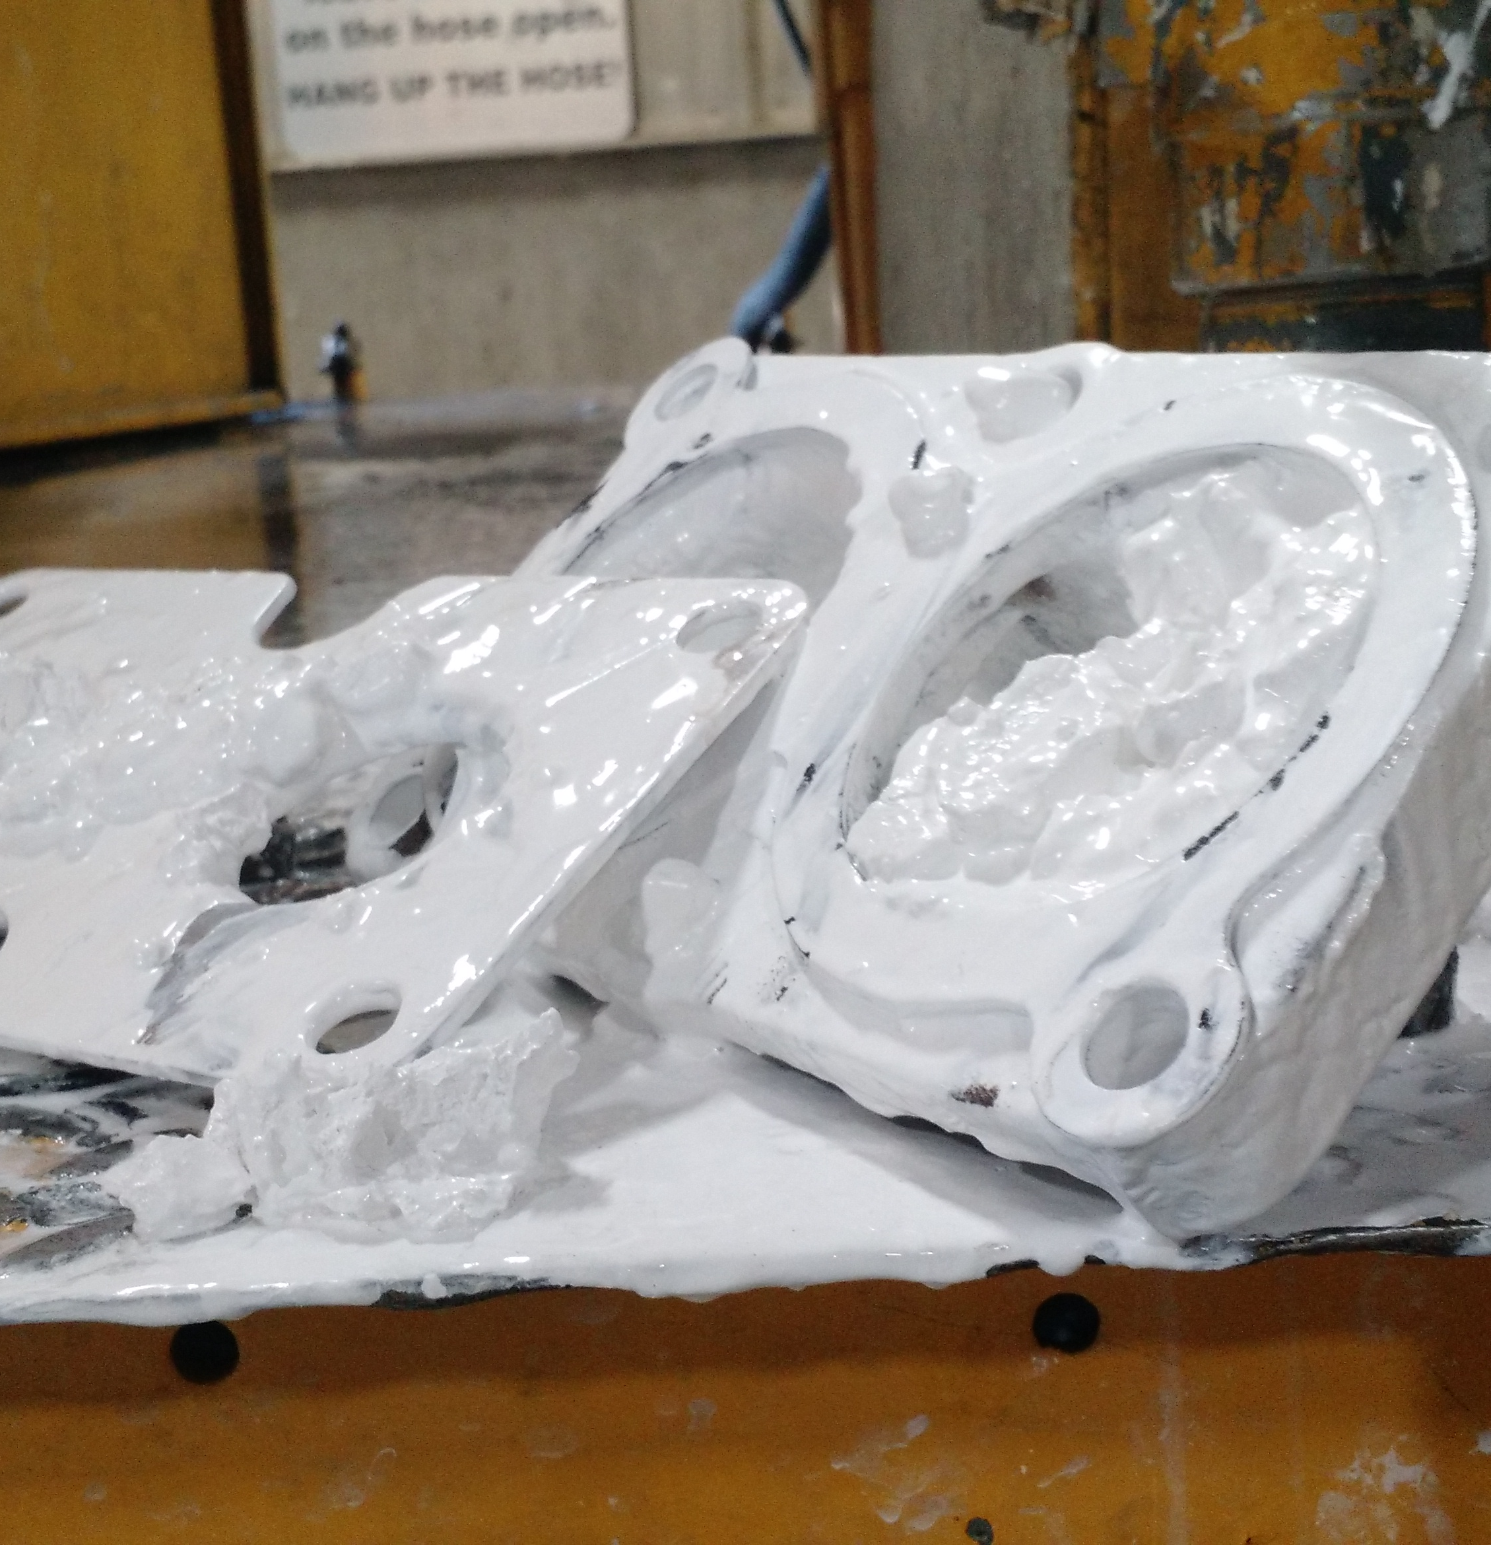
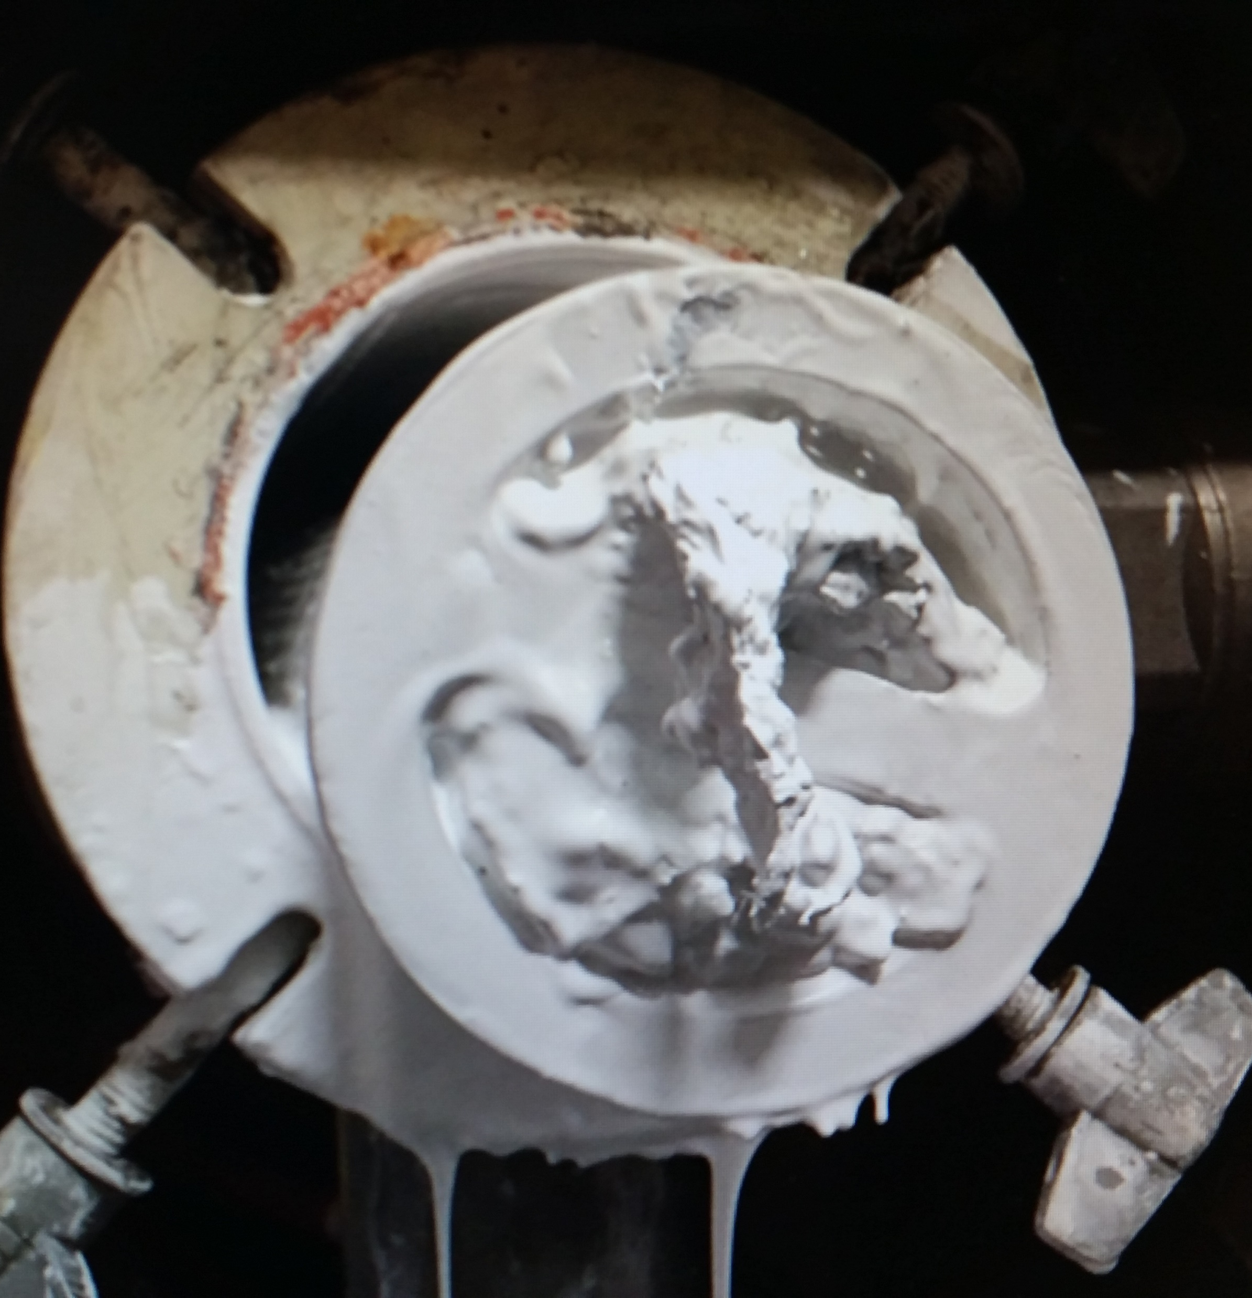
Waterborne Paint Product Issues

Slide 15
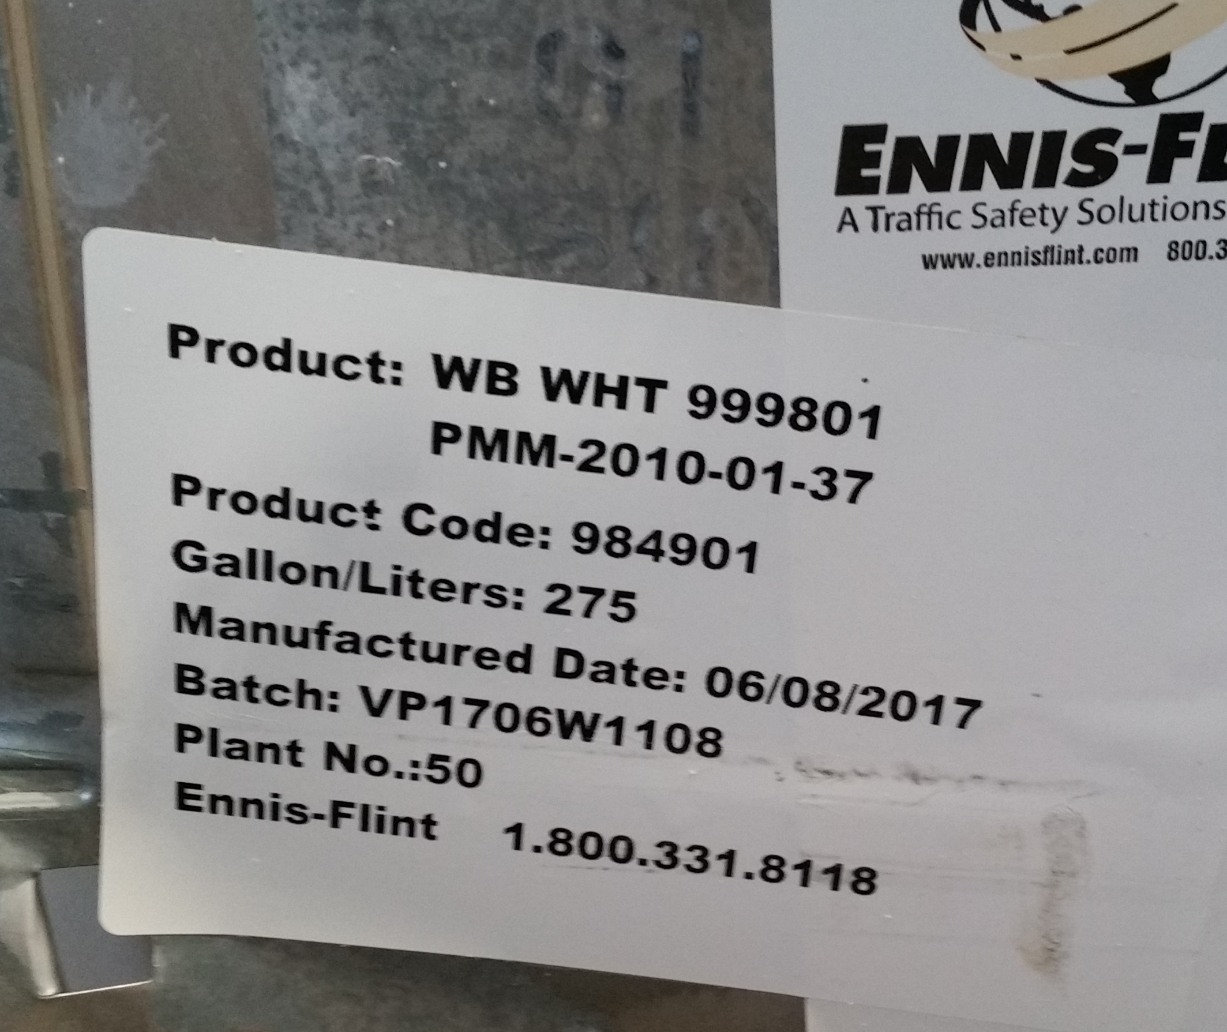
Who to Contact When Issues Arise
Product Issues
  Contact
    Linette Rizos via email
    Marking Coordinator
    Pete McCafferty
  Be very descriptive
    Ship Dates
    Batch Numbers
    Pictures (if possible)

Slide 16

Who to Contact When Issues Arise
Shipping Issues/Receiving Issues
  Notified it MIGHT not arrive on time
    Contact to get Delivery Dates (via phone or email)
  Past 21 day delivery
    Linette Rizos
    Marking Coordinator
Include Details
  Order Date
  Date of follow up calls on the delivery
  Who did you talk to
  Delivery Date or Status
  Any Other Important Information

Slide 17
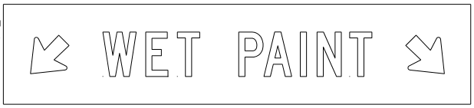
Work Zone Expectations
3 Vehicle Convoy
  2 Flashing/Revolving Yellow Lights
  Flashing Arrow Panel in Caution Mode
  Wet Paint Signs

Slide 18




Work Zone Expectations- 48” Fl. Orange Sheeting
Painting Begins 500’ Downstream
Trail Vehicle (1-way only)

Slide 19
Simultaneously Painting
Cone both wet lines
Have they seen an increase with paint claims or tracking?

Slide 20
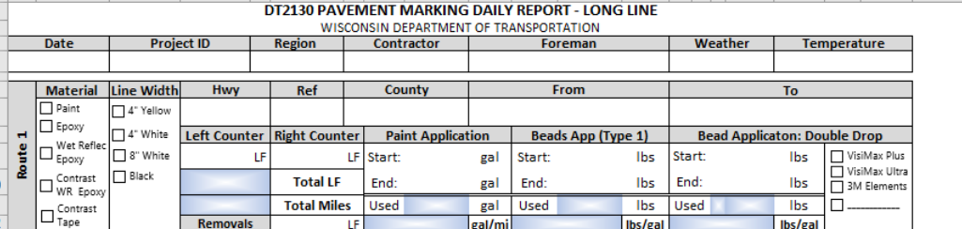
Paint Report
Send to Region Coordinators
Be Accurate
We do use these numbers

Slide 21
Marking Field Manual & SDDs
Updated Manuals for everyone
  2 per county
Contact Jeannie Silver if
  Anything is unclear or confusing
  Any details that are not included
https://wisconsindot.gov/dtsdManuals/traffic-ops/manuals-and-standards/teops/03-25.pdf

Slide 22
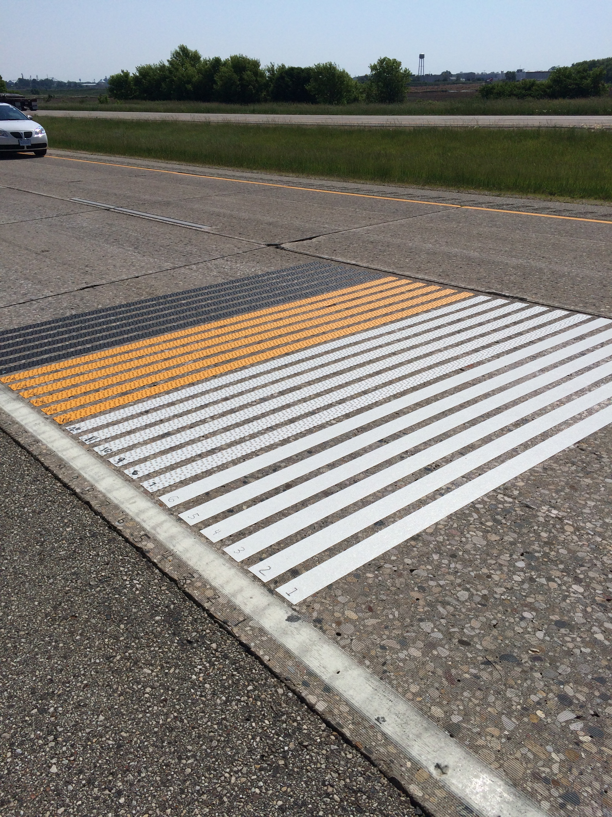
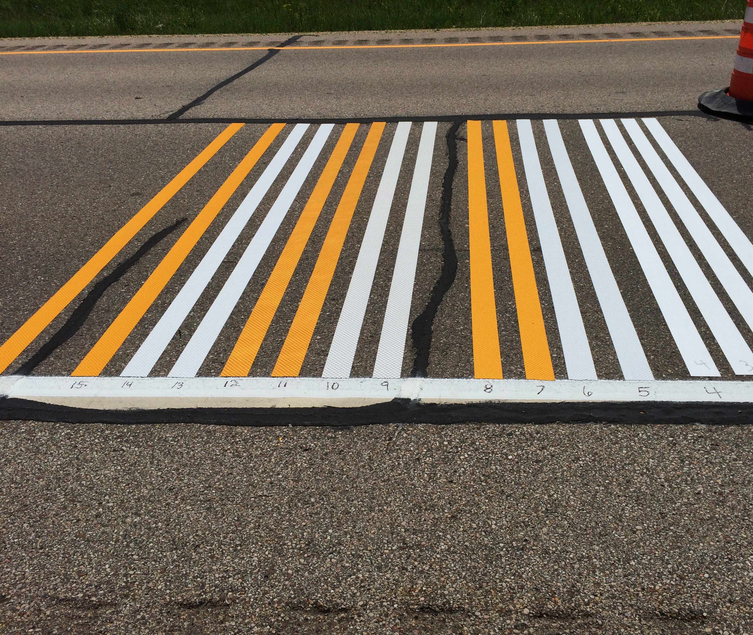
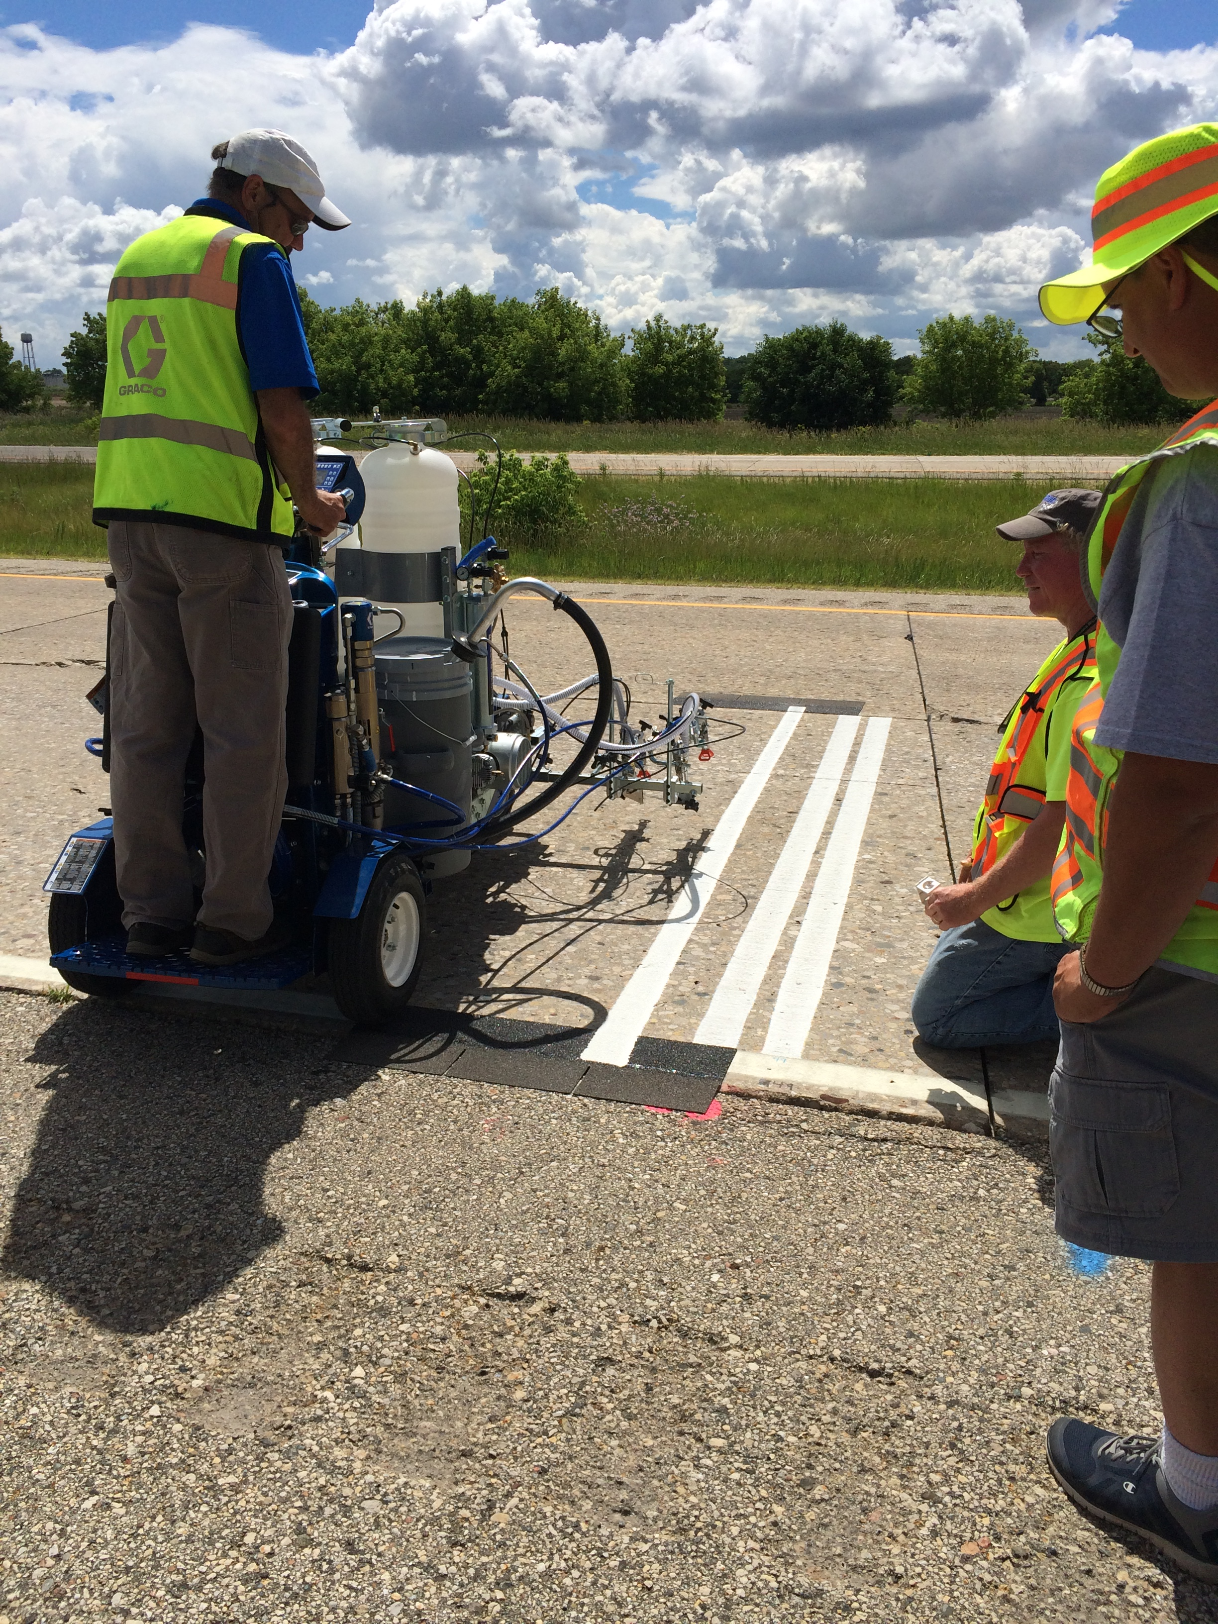
NTPEP
National Transportation Product Evaluation Program

Slide 23
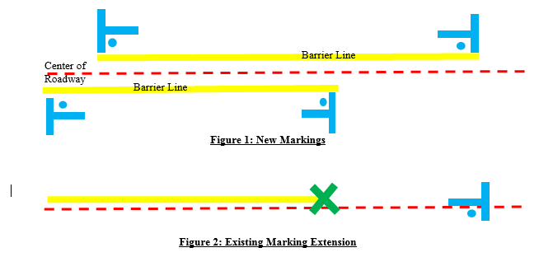

NPZ Changes
Charge work to 0072-01-81
If T’s are missing
  Please contact Marking Coordinator
Suspect/Incorrect Zone
  Please contact Marking Coordinator
Marking Logs
  Contact Marking coordinator

Slide 24
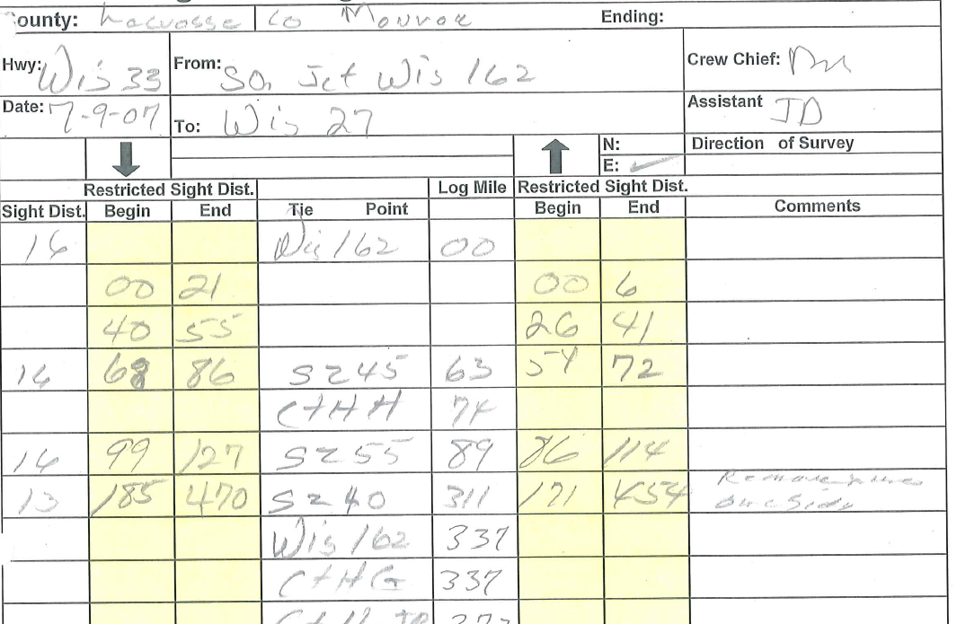
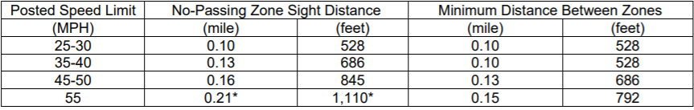

Slide 25
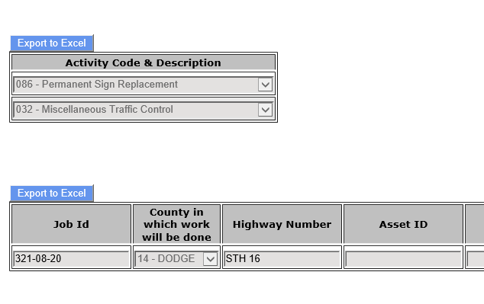
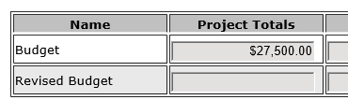
MPM
Cannot go over your allocation
Activity Code/Job ID must match exactly what is in MPM
Please be detailed on your invoices

Slide 26
Is anyone here interested in Epoxy

Slide 27

QUESTIONS

