Slide 1
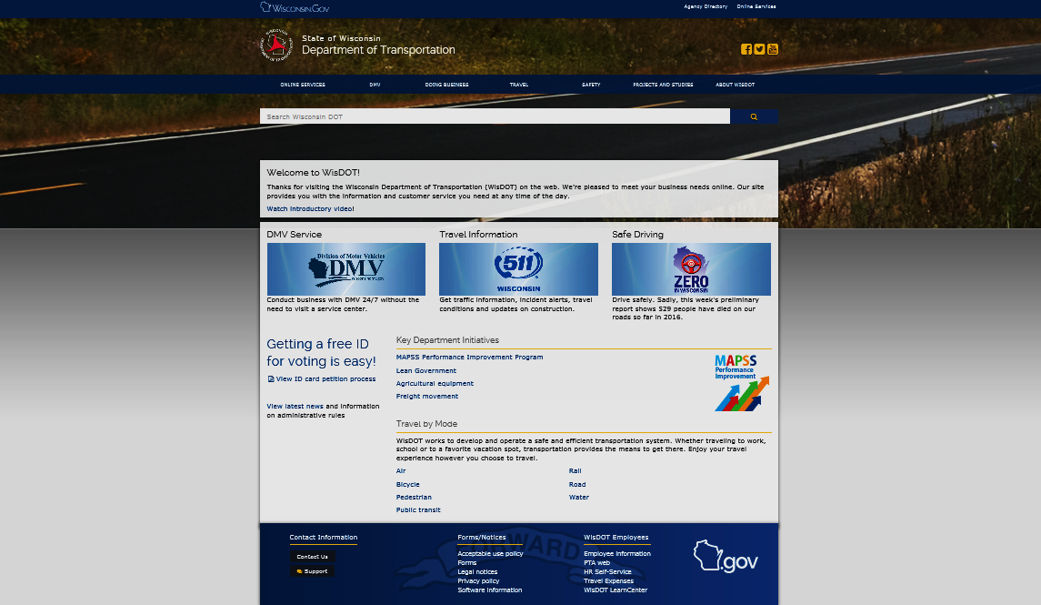
Allow at least 30 minutes to view this presentation (more if you try links).
WisDOT Real Estate
Tools & Resources
This presentation is recommended for every new employee (and consultant) as part of their initial orientation to WisDOT Real Estate. It introduces our most common tools and basic resources, giving tips and tricks for making the best use of our electronic systems and the tools of technology.
Tip: Go to “slide show view” if presentation does not automatically start as a slide show

Slide 2


WisDOT Real Estate Tools & Resources
As WisDOT Real Estate (RE) staff and consultants, most tools and resources we use are no longer even offered in a traditional paper format. For the most part, we now direct staff and consultants that our only option is to access tools needed from resources that are only available electronically. Electronic systems help to create a statewide uniformity to processes, processing, and procedures. If everyone can learn to use the same tools, from the same centralized resources, we’ve already raised the confidence level for our work. It simply makes good business sense and is easier if everyone is working from and with the most current, official, and approved tools and resources, and this presentation was created to help get us all on the “same page” (no pun intended). By learning to effectively use the tools and resources highlighted in this presentation, you will be doing your part in support our mission. Hope you enjoy the tips and tricks!
Note: Unfortunately, any intranet (dotnet) linked materials referenced as part of this presentation will not be accessible to consultants who may be viewing this presentation.
www.wisconsindot.gov

Slide 3
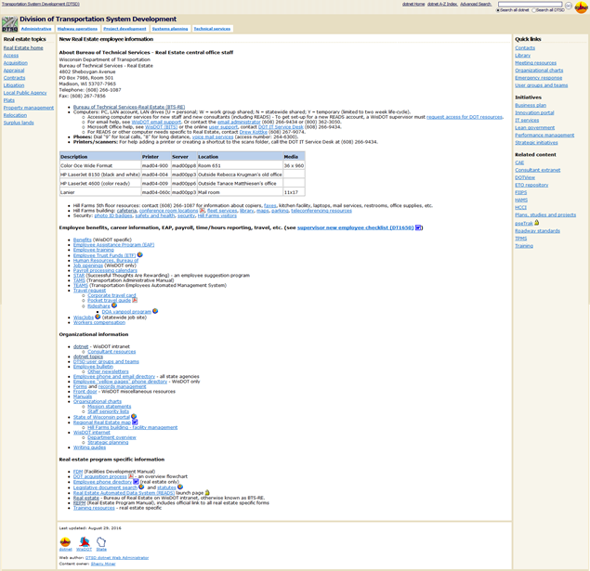

If you are a brand new internal WisDOT Real Estate staff member, may we suggest you start here; this is our very own ‘New Real Estate employee’ information page. It may not give you everything you need, but does offer a good start for identifying and tapping into our basic resources. Your local HR and payrolls reps, IT, and immediate supervisor should still be your first “go to” for help.
Sorry consultants, this site is for internal staff only; accessible only from our dotnet.
NOT MEANT FOR ACTUAL VIEWING/SAMPLE ONLY
Click now to go to ‘New Real Estate employee’ dotnet page: http://dotnet/dtsd/technical/realestate/training/new-employee.htm

Slide 4
For this presentation, we are only going to attempt to described the most basic universal tools and resources that every Real Estate staff and consultant needs to know about and needs to become proficient in using, regardless of your actual job or job duties.
What are the most basic tools and resources that every WisDOT Real Estate staff and consultant MUST learn (at least to some degree) and utilize?
Tip #1: Learn the best ways to find information on the web.

Slide 5


To start, it’s good to understand that we essentially operate in a world of two web systems here at WisDOT. First, we have the world wide web (the internet), which we continue to expand. We have information available to the general public, to our consultants, and to our staff via the internet. Second, we have an internal system
(for staff only); our closed/internal web system is commonly called, the intranet and to us WisDOT folks, we’ve nicknamed it, the ‘dotnet.’ As employees, you often move throughout your workday back and forth between the inter- and intranets for various reasons; as consultants, your only access is to information on the internet. Bottom-line for everyone, almost everything you need, you will need to get it by starting from a page on the web these days.
Internet: www.wisconsindot.gov
Intranet: http://dotnet/...
Tip: This symbol indicates WisDOT internet -
- Tip: This symbol indicates WisDOT intranet

Slide 6

TIP: Everybody needs to know how to save key web pages to your favorites as bookmark links and how to create shortcuts. Do this for all your key online tools and resources to make for quick, easy, effortless repeated access. Its just good business practice, like putting a label on a file folder in your desk drawer; helps you find stuff later.
To keep us confused, for most electronic processes, there seems to be more than one way to get there. Individuals being the unique characters we are tend to adopt some of our own personal tricks and tips, but then we get into a rut and fail to recognize or try new and other, possibly even more efficient, ways of getting our work done. There are several quick methods to create a favorite (or bookmark) in Microsoft Internet Explorer and to create a shortcut. Whichever method(s) here you choose to use on a regular basis is probably no better or worse than another, but try them all so you learn. Then, get comfortable in using some that you can remember without always having to go back and look at instructions.
FAVORITE
Bookmark

Slide 7

To save a web page as a favorite or bookmark (the terms are
interchangeable in this case), the first step is to navigate (find your way)
to the page you’d like saved as a favorite (bookmark) or as a shortcut,
then choose to either...
Right-click on a any blank portion of that web page;
Create any unique name (keep it short) and select any existing
or new folder where you want link saved;
Click Add.
- - - - - - - - - - - - - Or - - - - - - - - - - - - - -
Press Ctrl + D;
Create any unique name (keep it short) and select any existing
or new folder where you want link saved;
Click Add.
- - - - - - - - - - - - - Or - - - - - - - - - - - - - -
Look to very top, right-hand corner of the browser window,
then click the Star Icon; Click Add to favorites;
Create any unique name (keep it short) and select any existing
or new folder where you want link saved.
- - - - - - - - - - - - - Or - - - - - - - - - - - - - -
Right-click on a any blank portion of that web page;
From pop-up, pick Create shortcut on your desktop; or, you can also open a
folder and paste the shortcut (link) directly into that folder.

Slide 8
This is WisDOT as we see it from the world wide web (the internet)...
www.wisconsindot.gov

Slide 9
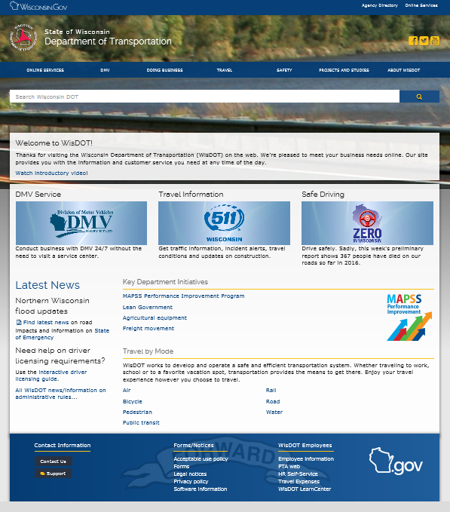

From WisDOT internet home page, click “DOING BUSINESS”
The wisdot internet is your ‘go to’ site for anything open and available to the public and to our consultant partners; most key services and information can be found by starting from the TOP Tab, entitled
www.wisconsindot.gov

Slide 10
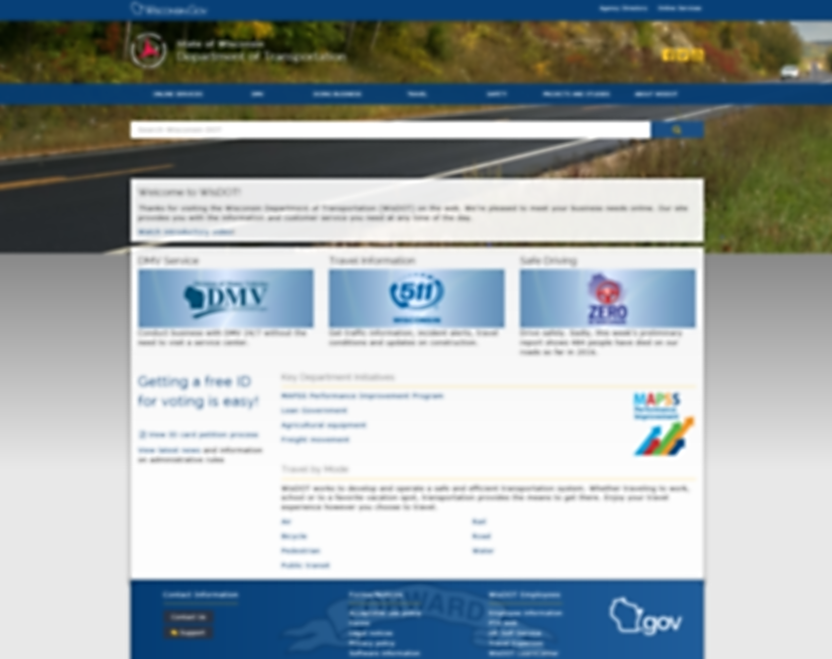
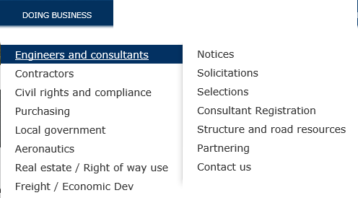
For our consultants, click Engineers and consultants, then Structure and road resources; or go directly to any of the other key points
From www.wisconsindot.gov, click...

Slide 11
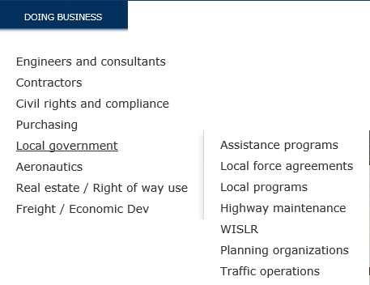
For LPA projects, click Local government, then Assistance programs
From www.wisconsindot.gov, click...

Slide 12
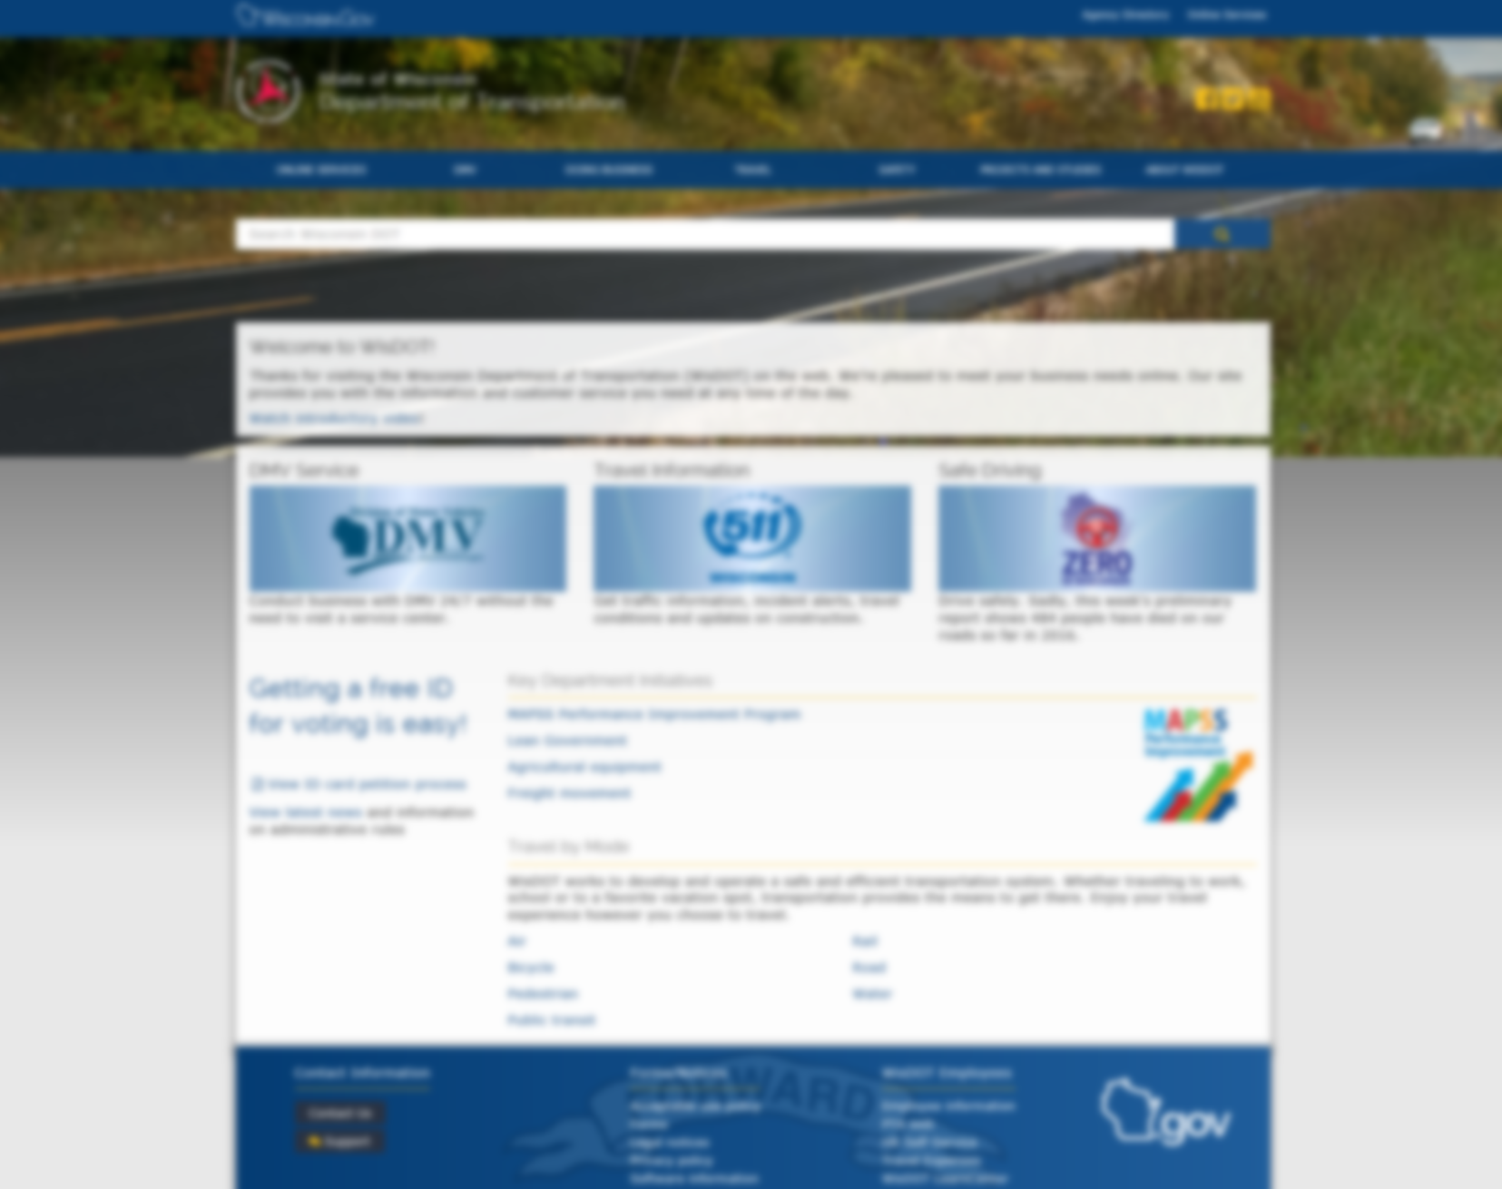
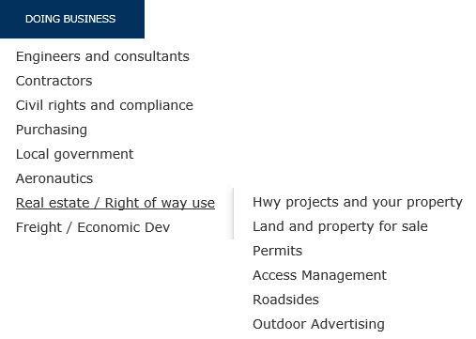
For our public, from Real estate / Right of way use, click Hwy projects and your property for general info; or, Land and property for sale
From www.wisconsindot.gov, click...

Slide 13
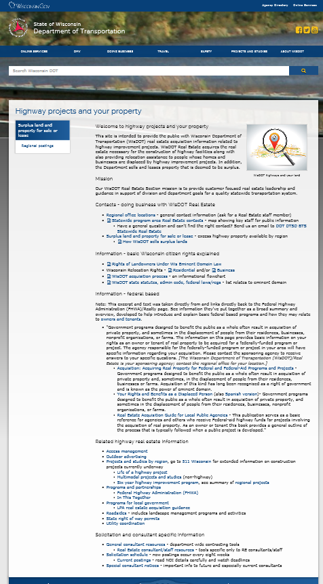
In 2015, we finally developed a world wide web presence specifically about WisDOT Real Estate and now offer limited, but at least some basic and general information to the public about us.
Here, we provide oversight about what we do and some basic resources, including the brochures about citizen rights, regional contact info, and some related links. We even give some basic direction to current and future consultants. Probably our most popular link from this page goes to our surplus sales area, see...
NOT MEANT FOR ACTUAL VIEWING/SAMPLE ONLY
“Highway projects and your property”
http://wisconsindot.gov/Pages/doing-bus/real-estate/hghwys-yourland/default.aspx

Slide 14

We want your feedback! Corrections, suggestions, updates to our WisDOT web pages should be reported to BTS-RE;
Attn: Sherry Miner;
608-266-2370
NOT MEANT FOR ACTUAL VIEWING/SAMPLE ONLY
Note: The public can contact us at:
DOT DTSD BTS Statewide Real Estate
http://wisconsindot.gov/Pages/doing-bus/real-estate/hghwys-yourland/default.aspx

Slide 15

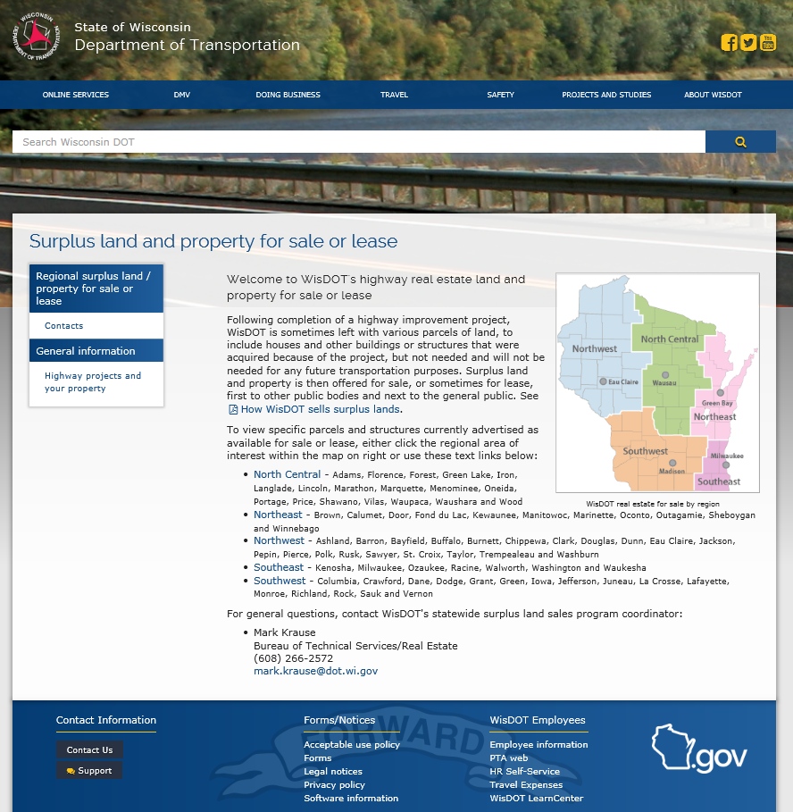

WisDOT surplus land and property for sale or lease
Excess highway property is available by region with current postings available for the public to see on these pages
WisDOT RE property managers in each region should be contacted to discuss current listings; and, since this is a revenue income area, every agent should travel with extra copies of “How WisDOT sells surplus land” and make that info available to anyone who asks!
http://wisconsindot.gov/Pages/doing-bus/real-estate/landsales/default.aspx

Slide 16
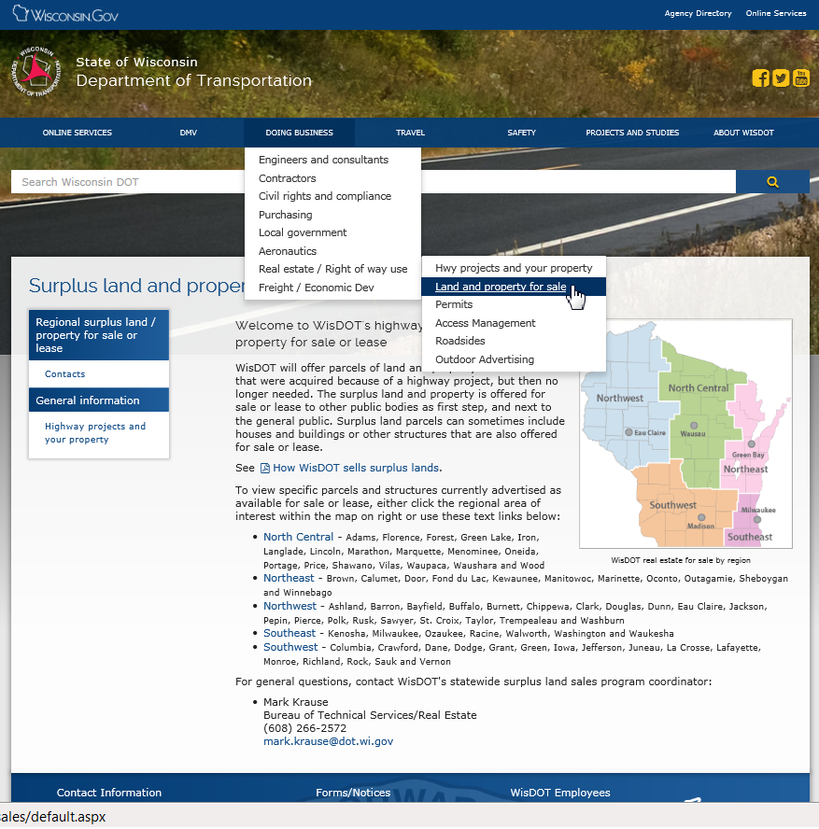
1) From ‘DOING BUSINESS’ tab,
2) Or, simply type the words “surplus land” or anything similar into the “Search Wisconsin DOT” box
Our ‘Surplus land and property for sale or lease’ pages can also be reached directly from WisDOT’s home page in either of two easy ways...
http://wisconsindot.gov/Pages/doing-bus/real-estate/landsales/default.aspx

Slide 17

Before we go too far, let’s go back for a closer look at our public info page...
Welcome to highway projects and your property
The Wisconsin Department of Transportation, Bureau of Technical Services-Real Estate
(WisDOT/BTS-RE) works to acquire the real property needed for highway construction and highway related facilities. This page is intended to provide the general public with basic information about the WisDOT acquisition process as it relates to highway improvement projects. As part of any acquisition, we also provide relocation assistance and services to all individuals and businesses that may be displaced because of a highway project and so we have included some basic information about relocation assistance and services as well. WisDOT/Real Estate is also charged with the mission to sell or lease property that we've acquired in the past as part of a highway construction project, but that has since been deemed to be surplus. See 'How WisDOT sells surplus lands' and check the regional postings for current offerings. Any consultants interested in doing work for us with experience in eminent domain processes are directed to the solicitation and consultant specific information as linked at the bottom of this page.
Mission
Our WisDOT Real Estate Section mission is to provide customer focused real estate leadership and guidance in support of division and department goals for a quality statewide transportation system.
Contacts - doing business with WisDOT Real Estate
Regional office locations - general contact information (ask for a Real Estate staff member)
Statewide program area Real Estate contacts - map showing key staff for public information
  Have a general question and can't find contact? Send email DOT DTSD BTS Statewide Real Estate
Surplus land and property for sale or lease - excess highway property available by region
  How WisDOT sells surplus lands
http://wisconsindot.gov/Pages/doing-bus/real-estate/hghwys-yourland/default.aspx

Slide 18
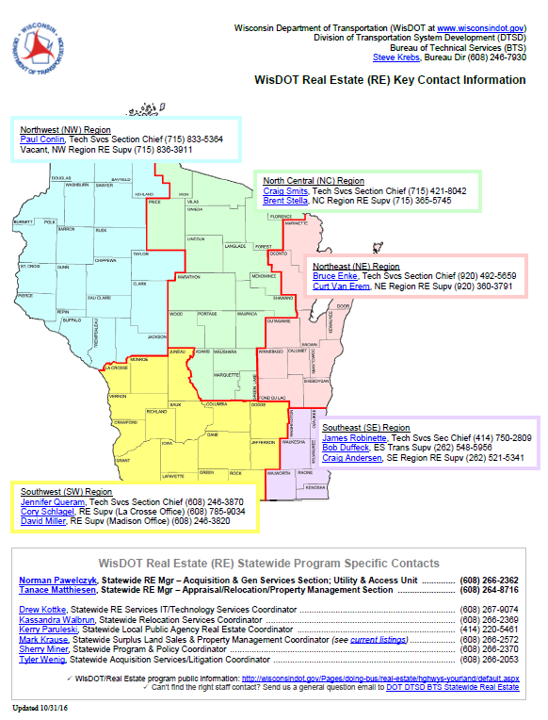
Since we operate using more of a decentralized business model here at WisDOT, we typically tell the general public that it is best to contact their regional office locations and ask to speak with a Real Estate staff member. We also post a statewide program area Real Estate contacts map on our public info page. For any member of the public who prefers to send an email, we offer this as an additional point of contact:
DOT DTSD BTS Statewide Real Estate. This general email address is received and maintained by the central Madison bureau (BTS-RE) who may forward inquiries to the regions as needed.
WisDOT Real Estate
Offices, staff & consultants statewide
http://wisconsindot.gov/Pages/doing-bus/real-estate/hghwys-yourland/default.aspx

Slide 19
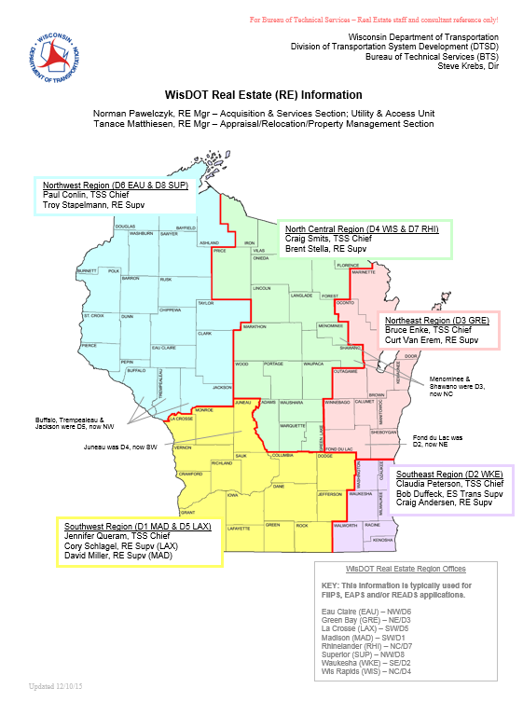
We have Wisdot real estate staff in offices for every region. There are approximately 100 Staff Statewide, not Counting our consultant partners, Limited Term Employees (LTE), or student interns. Add our immediate partners, and All total, we hover around 200 people statewide working for and on behalf of wisdot real estate.
200+ strong!
WisDOT/DTSD/BTS-RE
North Central
Northeast
Southeast
Southwest
Northwest
http://wisconsindot.gov/dtsdManuals/re/re-staffresources/regions-dtsd-re.docx

Slide 20
Processes may vary by region
Since we do operate with a rather decentralized structure here at WisDOT, as a way to more efficiently administer programs and services for each outlying region, our processes and processing procedures tend to vary somewhat from region to region and even from project to project; but, we do have many tools and resources that are universal to everyone and that are required for use by everyone. When in doubt, staff and consultants need to look to the web for help. By accessing the information made available through our web pages, you can be reasonably assured that you are using the correct, current, approved methods, and latest tools available for all your transactions. Everything posted to the web goes through the Madison central bureau office for review and approval and is intended to provide guidance to everyone statewide. If you can’t find the guidance or tools needed on one of our web pages, then you may need to re-think your strategy. Everything that gets approved, is current, and that should be used and trusted as a universal process and a statewide tool, should be posted and available to all staff. Contact for updates and additions to our web content is through the Madison central bureau (BTS-RE).

Slide 21

We have several required pieces of information for Wisconsin citizen rights explained; for convenience, these are all linked for the public to reference before and after our visits and all are print-ready; acquisition and relocation staff must also always provide copies of these required docs as part of each individual transaction.
WisDOT Real Estate public information
Required by Dept. of Administration (DOA), their brochures:
Rights of Landowners Under Wis Eminent Domain Law
Residential and/or Business Wisconsin Relocation Rights
Helpful materials and resources (but not required):
WisDOT acquisition process - an informational flowchart
WisDOT state statutes, admin code, federal laws/regs - a list of key eminent domain rules, regs, etc.
http://wisconsindot.gov/Pages/doing-bus/real-estate/hghwys-yourland/default.aspx

Slide 22


From the middle part of our RE public info page, we have citizen rights as explained from the federal side...
This excerpt and text was taken directly from and links directly back to the Federal Highway Administration (FHWA)/Realty page. See information they've put together as a broad summary and overview, developed to help introduce and explain basic federal based programs and how they may relate to owners and tenants.
"Government programs designed to benefit the public as a whole often result in acquisition of private property, and sometimes in the displacement of people from their residences, businesses, nonprofit organizations, or farms. The information on this page provides basic information on your rights as an owner or tenant of real property to be acquired for a federally-funded program or project. The agency responsible for the federally-funded program or project in your area will have specific information regarding your acquisition. Please contact the sponsoring agency to receive answers to your specific questions. [The Wisconsin Department of Transportation (WisDOT)/Real Estate is your sponsoring agency; contact the regional office for your location.]
  Acquisition: Acquiring Real Property for Federal and Federal-Aid Programs and Projects - Government programs designed to benefit the public as a whole often result in acquisition of private property and, sometimes, in the displacement of people from their residences, businesses or farms. Acquisition of this kind has long been recognized as a right of government and is known as the power of eminent domain.
  Your Rights and Benefits as a Displaced Person (also Spanish version)- Government programs designed to benefit the public as a whole often result in acquisition of private property, and sometimes in the displacement of people from their residences, businesses, nonprofit organizations, or farms.
  Real Estate Acquisition Guide for Local Public Agencies - This publication serves as a basic reference for agencies and others who receive Federal-aid highway funds for projects involving the acquisition of real property. As an owner or tenant this book provides a general outline of the process that is typically followed when a public project is developed."
http://wisconsindot.gov/Pages/doing-bus/real-estate/hghwys-yourland/default.aspx

Slide 23


We also have various ‘related’ highway real estate
information linked from our public info page...
Related highway real estate information (click any link to view content)
Access management
Outdoor advertising
Projects and studies by region, go to 511 Wisconsin for extended information on construction projects currently underway
  Life of a highway project
  Multimodal projects and studies (non-highway)
  Six year highway improvement program, see summary of regional projects
Programs and partnerships
  Federal Highway Administration (FHWA)
  In This Together
Programs for local government
  Local public agencies, see LPA real estate acquisition guidance
Roadsides - includes landscape management programs and activities
State right of way permits
Utility coordination
http://wisconsindot.gov/Pages/doing-bus/real-estate/hghwys-yourland/default.aspx

Slide 24

For our consultants – look to the very bottom (last section) of our public information page, there we provide some basic insight and direction especially for you...
Solicitation and consultant specific information
General consultant resources - department wide contracting tools
  Real Estate consultant/staff resources - tools for current RE consultants/staff
Solicitation schedule - new postings occur every eight weeks (mark your calendars)
  Current postings - read NOI details carefully and watch deadlines
  12 Month rolling solicitation - this information is subject to change
Special consultant notices - important info to future and current consultants
http://wisconsindot.gov/Pages/doing-bus/real-estate/hghwys-yourland/default.aspx

Slide 25

Speaking of consultants.... here is what they need to know...
For consultants - Quick facts, reminders and basic “how to” info about master contract solicitations. Consultants interested in renewing or pursuing new master contracts need to take personal responsibility to monitor WisDOT’s public postings. From WisDOT’s home page, look for DOING BUSINESS heading in upper blue ribbon; click to activate popup window and see dropdown list. In dropdown list, scroll to highlight Engineers and consultants topic; from here you get a second popup window with another dropdown list, click Solicitations. The solicitations page shows all current (active) solicitations. Looking to left, there is one especially important link, see bimonthly solicitation schedule. So long as you (the consultant) keep track of the dates in that bimonthly solicitation schedule, you should not miss any new master contract opportunity. WisDOT also post a 12 month rolling solicitation list (projected solicitations), but that list is subject to change. When you do see a solicitation to which you are interested, take great care in reviewing general instructions. Be aware that all NOI (Notice of Interest) application materials must be submitted electronically and most important – complete your NOI application according to the specific details of each individual posting; and, watch the deadlines! WisDOT will not send reminders about upcoming solicitation activities or deadlines to apply. Consultants should set ticklers for themselves of the dates in this bimonthly solicitation schedule. Then, check the solicitation page on each of those key dates to view current opportunities.
For consultants interested in seeking pre-approval for work on local projects, that is a totally separate application and approval process, see Local Public Agency (LPA) Real Estate Acquisition Information for the current lists of pre-approved consultants and contact Ms. Kerry Paruleski (414) 220-5461 for detail on how to apply.

Slide 26
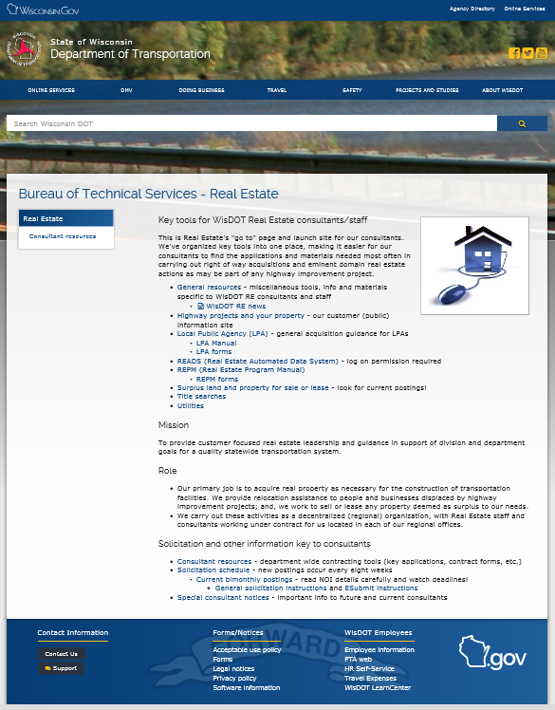
For current consultants! This is your launch page for everything WisDOT Real Estate related. We’ve made all of our most used/most needed tools, key resources, and ‘must have’ information directly available to you in one convenient spot on the internet (no log on required).
TIP: Consultants should bookmark this page; save it to your favorites; create a shortcut – do whatever works so you can reference this page again and again quick and easy. Internal staff can also access this page, but the tools offered here are still more limited than on our dotnet and therefore not your best all-inclusive starting point.
“Consultant RE launch site”
http://wisconsindot.gov/Pages/doing-bus/eng-consultants/cnslt-rsrces/re/default.aspx

Slide 27

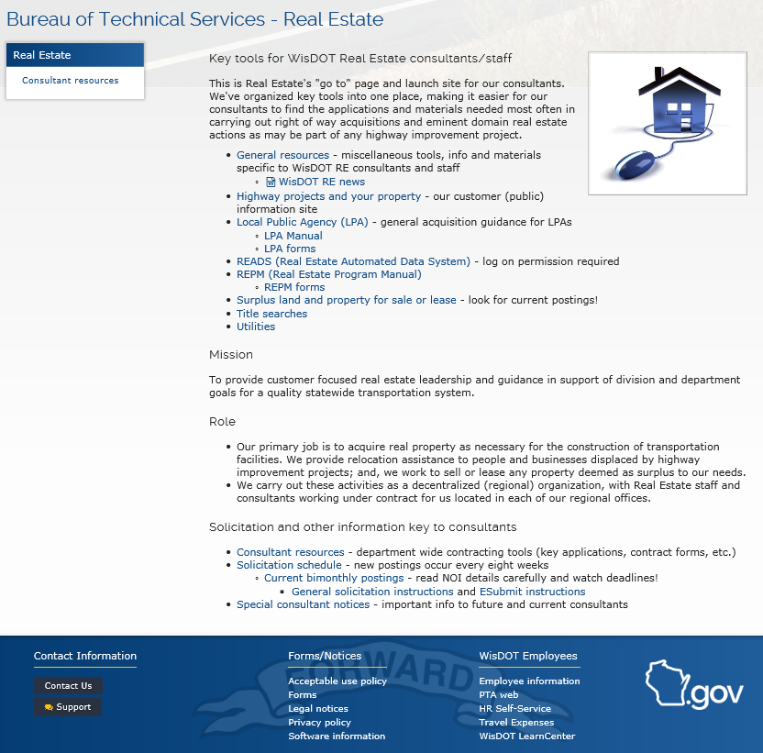
“Consultant RE launch site”
See lots more on ‘General resources’ page
Taking a closer look at our WisDOT RE consultant access point, be sure to check out the ‘General resources’ link. That link is especially important because it brings you to another page with a whole bunch more RE specific tools and resources (everything we didn’t have room for on your launch page).
http://wisconsindot.gov/Pages/doing-bus/eng-consultants/cnslt-rsrces/re/default.aspx

Slide 28

Now a look from inside our world of the WisDOT dotnet (the intranet)...
For internal staff only!
http://dotnet/

Slide 29
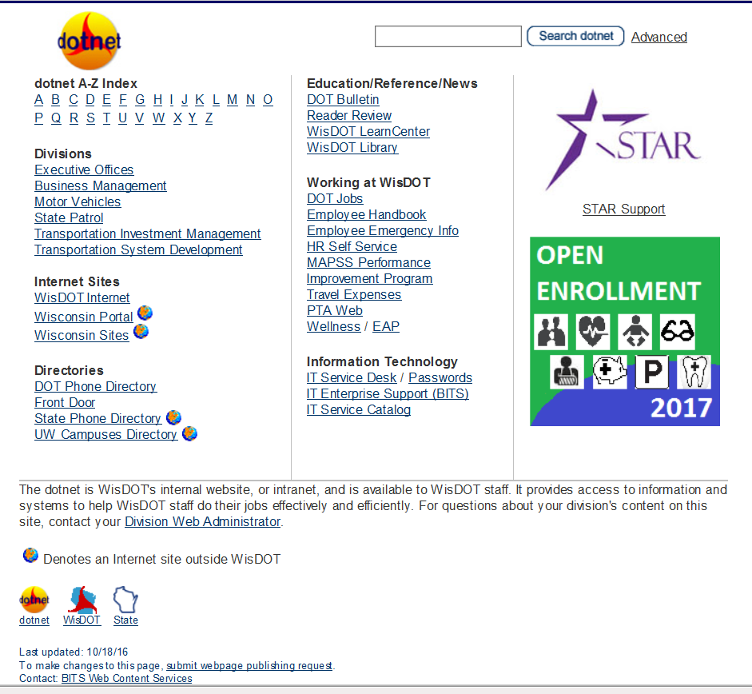

From our WisDOT intranet (the dotnet) home page, Real Estate is under Division of “Transportation System Development”
The wisdot dotnet is for internal staff only; this is the ‘go to’ site for anything specific to internal staff; everything here is closed to the public and closed consultants
http://dotnet/; then to: http://dotnet/dtsd/index.htm

Slide 30
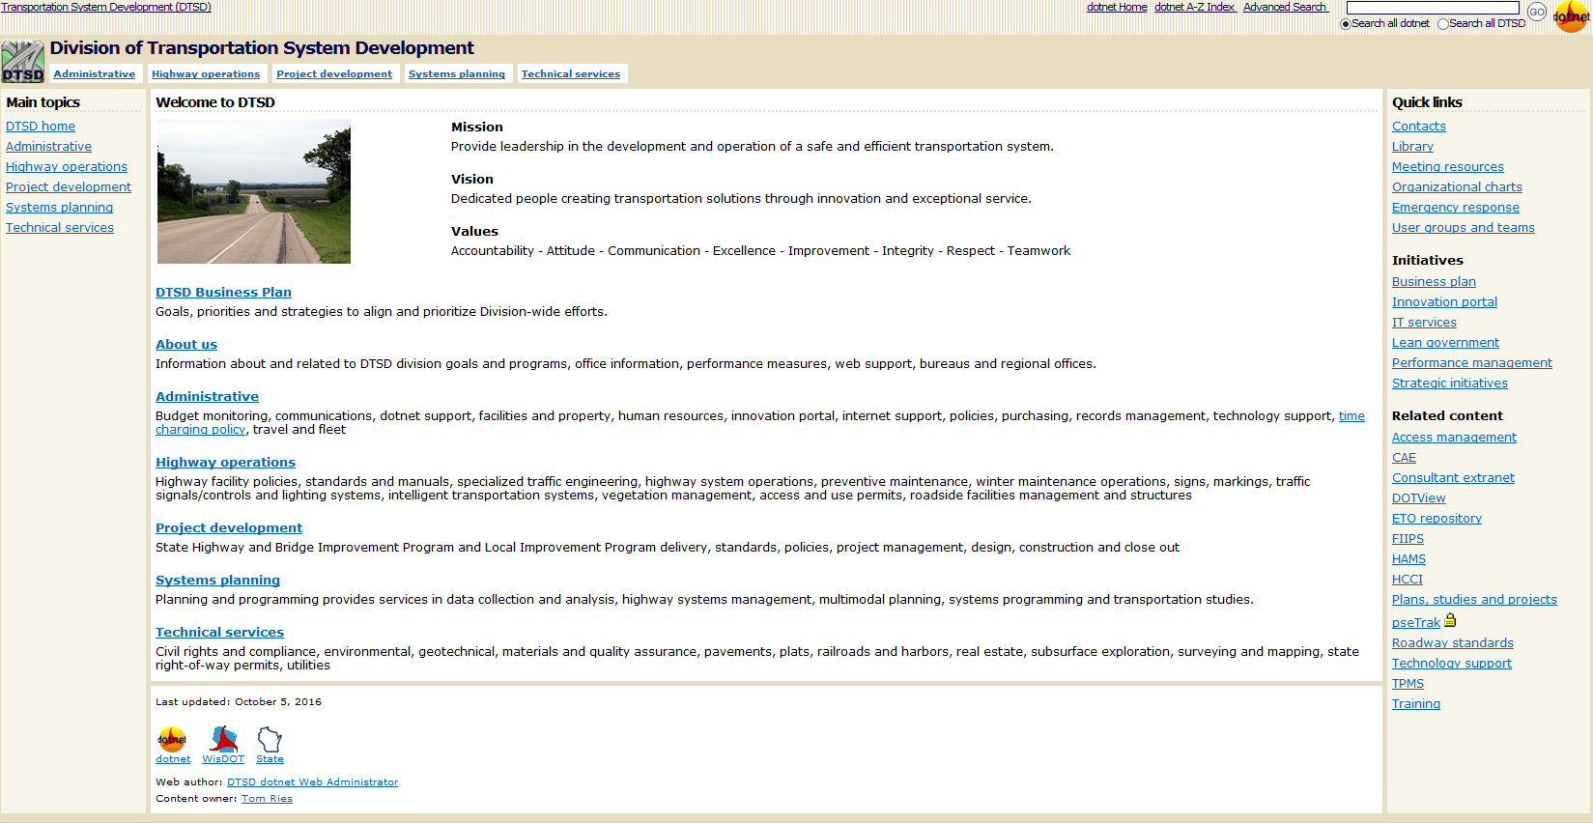
From Welcome to DTSD page, just one more click through “Technical Services”
RE (Real estate) is within
bts (bureau of technical services) under
dtsd (division of transportation system development) in
WisDOT (Wisconsin Department of Transportation)
WisDOT, dtsd/bts-re
http://dotnet/dtsd/index.htm; then to: http://dotnet/dtsd/technical/index.htm

Slide 31
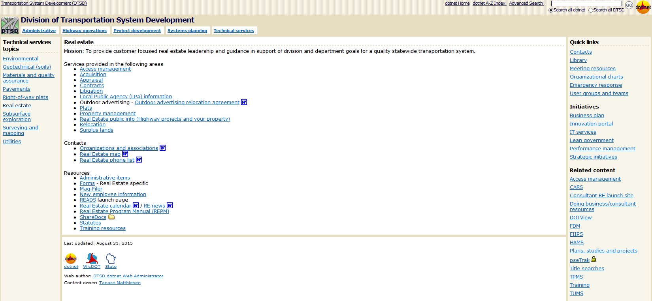
This is our Real Estate (RE) home page on dotnet
Welcome to DTSD/BTS-RE (real estate)!!! Our RE home (on dotnet for internal re staff only); this site is closed to public and to consultants. This site has Everything you NEED as an re employee; if something not already linked here, contact the content owner LISTED and ask them to add the topic(s) and more of the key resources you need.
http://dotnet/dtsd/index.htm; then to: http://dotnet/dtsd/technical/index.htm

Slide 32
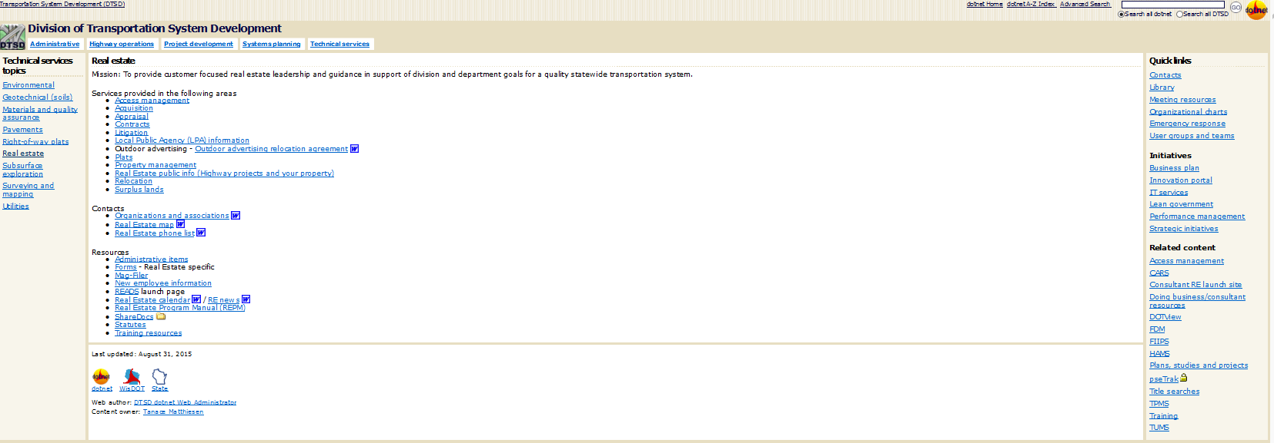
For WisDOT Staff (only!) – “dotnet” access to real estate
Remember! Consultants
do not have access to
info/docs exclusive to our dotnet Real Estate web, but
appropriate materials
can be forwarded.
http://dotnet/dtsd/technical/realestate/index.htm

Slide 33

In the next few slides, we will attempt to direct you to our most basic helpful tools and introduce some key and required resources. Also watch for key ‘TIPS’ along the way. The items and points of interest we highlight in this orientation are just a few of the most used, more common, and required RE tools and resources to which everything is available either via the intranet (for internal staff only; we call it our ‘dotnet’), plus we have made tons of stuff accessible directly to our consultant partners via the internet (no log on required). There are many more helpful tools and required resources that we won’t have time for in this orientation.
TIP: Its worth your time and effort to get familiar and comfortable in using web resources.
A closer look at WisDOT Real Estate tools and resources
For internal RE staff:
http://dotnet/dtsd/technical/realestate/index.htm
For RE consultants:
http://wisconsindot.gov/Pages/doing-bus/eng-consultants/cnslt-rsrces/re/default.aspx

Slide 34
State statutes, administrative code, and federal laws/regulations
State statutes
Table of contents
Chapter 32 - Eminent domain
Chapter 60 - Towns
Chapter 61 - Villages
Chapter 62 - Cities
Chapter 66 - General municipality law
Chapter 82 - Town highways
Chapter 83 - County highways
Chapter 84 - State trunk highways; federal aid
Chapter 86 - Miscellaneous highways
Chapter 91 - Farmland preservation
Chapter 244 - Uniform power of attorney for finances and property
Chapter 703 - Condominiums
Chapter 706 - Conveyances of real property; recording; titles
Chapter 846 - Real estate foreclosure
Chapter 893 - Limitations .... for claims against governmental units
Administrative code
Trans 201 - Control of outdoor advertising along and visible from highways on the interstate and federal-aid primary systems
Comm. 202 - Relocation assistance - has been renamed and renumbered to Department of Administration Administrative code: Chapter 92 - Relocation assistance
Federal laws/regulations
23 CFR - Highways
49 CFR Part 24 - Uniform relocation assistance and real property acquisition for federal and federally-assisted programs
Uniform relocation assistance and real property acquisition policies act of 1970, as amended
TIP: We put together this handy
Wis Stats - Quick reference list.
You can print and travel
with list to help guide you.

Slide 35
Remember that we have one launch site (starting point) for our Real Estate consultants that includes many basic helpful Real Estate specific tools as well as all of your required resources. And, we have a separate launch page (starting point) for internal staff that offers expanded tools and additional resources.
NOT MEANT FOR ACTUAL VIEWING/SAMPLE ONLY
NOT MEANT FOR ACTUAL VIEWING/SAMPLE ONLY
This is the launch site for current Real Estate consultants. This is an internet site; here, we’ve made all of our most used, most basic tools, key resources, and all your ‘must have’ information directly available to you in one convenient spot (no log on required).
This is the launch site for current Real Estate employees (internal staff only). This is an intranet site. This site contains all of the exact same materials available via the internet for our consultants, but internal staff see more (log on is required).

Slide 36
We all see exactly the same materials for any items made available to both external and internal staff. We also place multiple links, starting from various strategic and logical locations, so everyone can benefit from multiple access points; this is not meant to confuse, rather to make access more convenient no matter where you might be at any given time within our web system.
For internal staff, as you move about the web, you will be bouncing back and forth between the internet and the intranet (our dotnet). This is not a problem. Just remember that you see more than consultants, but you can download/share anything appropriate for them, if its not already been made available.

Slide 37
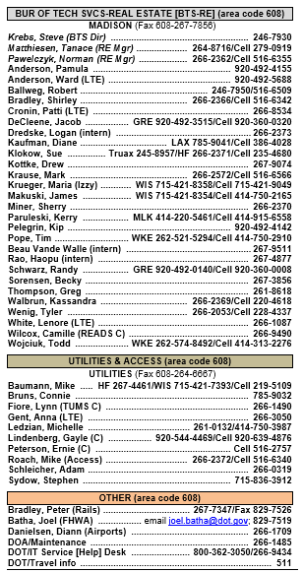
For statewide policy/procedure questions, these are the staff of WisDOT’s Real Estate central bureau office, including Utilities & Access....
TIP: For internal staff, our computers come set-up to default to the department dotnet home page, but you will need to visit the RE pages often to access basic online tools and key resources. So, as a minimum, we recommend you bookmark/save these pages as favorite bookmarks and/or shortcuts.
For internal RE staff only:
http://dotnet/dtsd/technical/realestate/index.htm
For RE consultants:
http://wisconsindot.gov/Pages/doing-bus/eng-consultants/cnslt-rsrces/re/default.aspx
For all WisDOT consultants:
http://wisconsindot.gov/Pages/doing-bus/eng-consultants/cnslt-rsrces/default.aspx
The public or internal staff can send general inquiries to: DOT DTSD BTS Statewide Real Estate

Slide 38
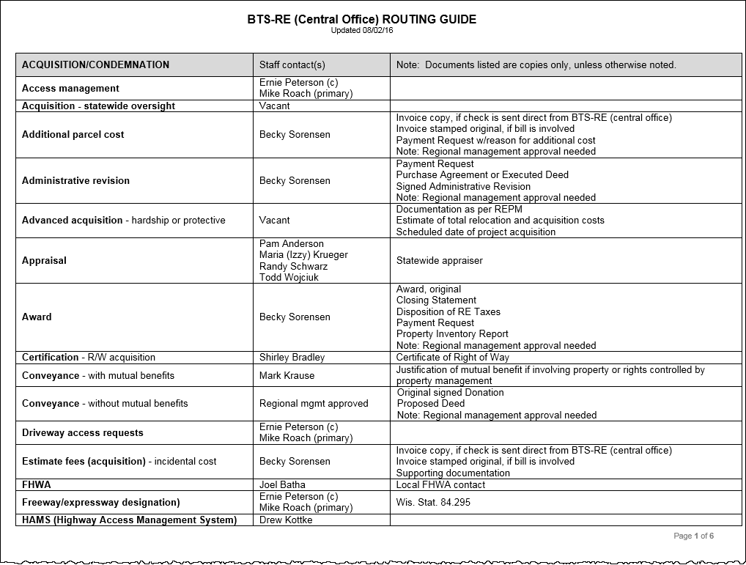
To help get you to the right person(s) quicker, WisDOT’s Real Estate central bureau office, including Utilities & Access, also maintains a simple and general routing guide with key point of contact info...
Bureau of Technical Services / Real Estate (BTS-RE)
Acquisition & Services Section
Appraisal / Relocation / Property Management Section
Utility & Access Unit
http://wisconsindot.gov/dtsdManuals/re/re-staffresources/routing.docx

Slide 39
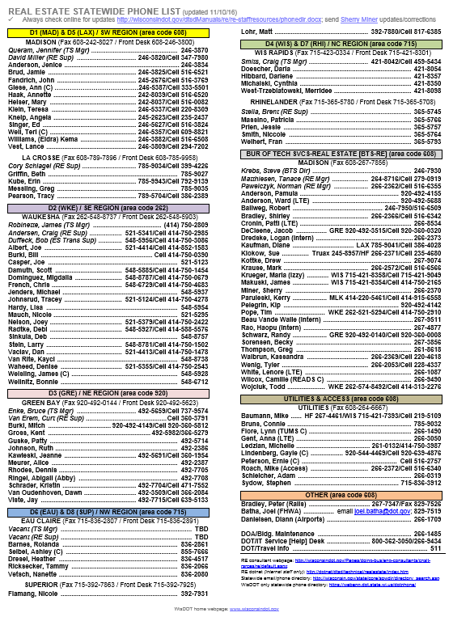

Other phone directories
DOT Phone Directory
State Phone Directory
To help everyone stay connected, we maintain our own statewide RE phone list
TIP: Although names & numbers will change and be updated with each new coming/going of staff, you may want to print and keep a copy of our statewide RE phone list handy for quick reference; remember to check for updates!
http://wisconsindot.gov/dtsdManuals/re/re-staffresources/phonedir.docx

Slide 40
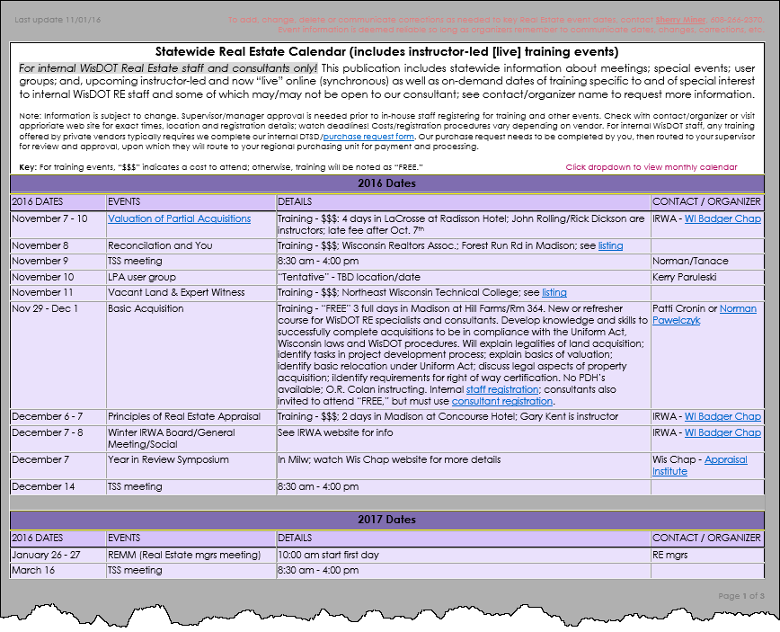

This is another statewide WisDOT Real Estate tool to be used for planning meetings, organizing events, and learning about training. We try to post information about key upcoming events to include instructor-led (live) Real Estate specific training (if known) onto our statewide RE calendar; please be aware that information comes and goes as we hear about it, so check back often and pass along news about events/training to be posted here.
Our statewide
Real Estate calendar
Includes statewide instructor-led training events
NOT MEANT FOR ACTUAL VIEWING/SAMPLE ONLY
Note: Costs for training will vary. Training information displayed by WisDOT RE is as a service only and is not necessarily an endorsement or a requirement. Each individual will need to make individual decisions, along with their supervisor, about appropriate training.
http://wisconsindot.gov/dtsdManuals/re/re-staffresources/calendar.docx

Slide 41

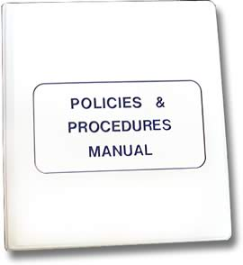
We’ve told you a little about our people, shared some basic tools, and introduced some key web pages. Now, we are going to talk about two of our most important required tools and resources. These two items are essential to everyone and everything we do. READS (the, Real Estate Automated Data System) is our official project management resource and critical data storage system; and, our REPM (the, Real Estate Program Manual), is our “tell-all” written guide to WisDOT Real Estate operating procedures.
READS: Access to the Real Estate Automated Data System (READS) is only available to WisDOT staff and to consultants currently under contract for WisDOT real estate acquisition projects. READS can only be accessed using an Internet Explorer and requires Microsoft Word and Adobe Reader.
REPM: The Real Estate Program Manual (REPM) was developed to benefit WisDOT Real Estate staff and our business partners in understanding and applying policies, guidelines, and practices of the WisDOT highway real estate acquisition program. It’s contents are reviewed and approved by the Federal Highway Administration (FHWA). The REPM includes publication of all current WisDOT/Real Estate approved forms and related documents. Materials in this manual require use of Acrobat® Reader™.

Slide 42
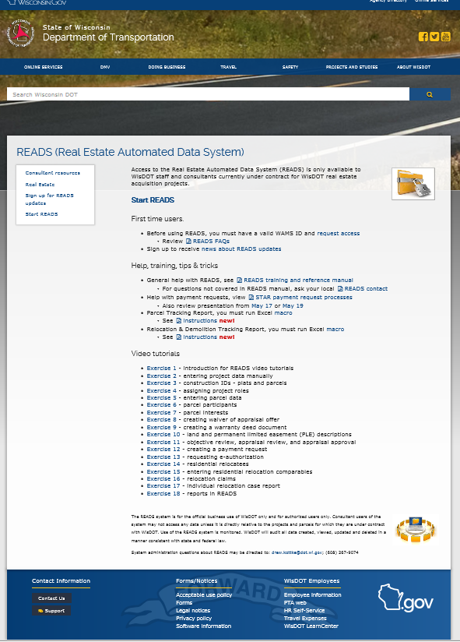
The READS system is for the official business use of WisDOT only and for authorized users only. Consultant users of the system may not access any data unless it is directly relative to the projects and parcels for which they are under contract with WisDOT. Use of the READS system is monitored. WisDOT will audit all data created, viewed, updated and deleted in a manner consistent with state and federal law.
This is our READS launch page; you can get help here and can go here to start READS
First time users - Before using READS, you must have a valid WAMS ID and request access
Review READS FAQs
Sign up to receive news about READS updates
http://wisconsindot.gov/Pages/doing-bus/eng-consultants/cnslt-rsrces/re/reads.aspx

Slide 43
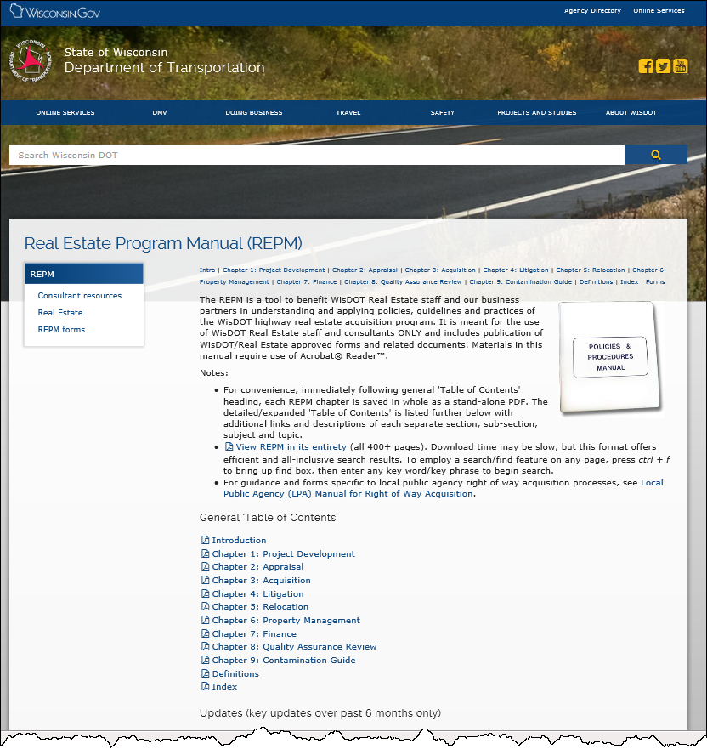
This is our REPM home
We recommend viewing the REPM in its entirety (all 400+ pages) for the most efficient and all-inclusive search results. TIP: After you have the document open, press ctrl + f to bring up your find box, then enter any key word or words into that box and begin a search.
For guidance and forms specific to local public agency right of way acquisition processes, see Local Public Agency (LPA) Manual for Right of Way Acquisition.
REPM: http://wisconsindot.gov/Pages/doing-bus/eng-consultants/cnslt-rsrces/re/repm.aspx

Slide 44

Okay then..., let’s pause to focus some important attention on a key productivity tool. This tool is universal, nothing specific or unique to Real Estate, but oh so important to us in our work here – using this simple tool will increase your personal efficiency and help us increase our overall effectiveness in learning and information sharing.
Hey! Want to impress your co-workers, your boss,
even yourself?

Slide 45


Ctrl+f is nothing more than a small window to a simple and straightforward electronic ‘find’ feature. It is without doubt, however, our best friend for productivity; it’s like trying to read by candlelight vs. daylight, but shockingly 90% of people, even those who consider themselves to be nicely “computer literate,” still don’t know how or when to effectively employ the Ctrl+f tool.
The tool is the simple keyboard shortcut of "Control-F."
Ctrl+f helps you get quickly to more finding, less searching.

Slide 46


Vs.
The Ctrl+f search tool is totally different than a “Google” search.
Stop tracing your finger through long documents!
Trying to rely upon just your eyes and a fingertip to search through long pieces of information, looking, looking, looking for just that one nugget of important information can be daunting and time-consuming and otherwise, just plain wasteful. Ctrl+f allows you to quickly search printed text in anything you have open, including Word docs, Excel spreadsheets, PDFs, web pages, and everything else you can think of. TIP: A Google search only finds web pages and once you get to the page, sometimes there's so much text, it can literally take hours to read everything just to find out if its got what you need. This is when you use Ctrl+f to quickly get to the specific piece(s) of information.

Slide 47
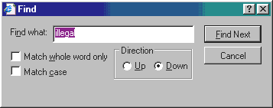
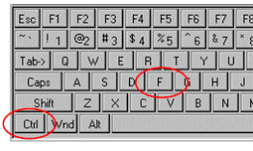
How do you use Control F?
Hit the "Ctrl" key (lower left area of your keyboard) AND the letter "F" key at the same time (simultaneously) - A little pop-up window will appear. Enter any word(s) you hope to find. Click on the "Find Next" button as needed to find all related hits; your computer will automatically locate and highlight the word(s) you are looking for.
‘control+f’ may be the most important computer skill you will ever have!

Slide 48


Back to the REPM
Access the Real Estate Program Manual and to the LPA Manual is via the internet
http://wisconsindot.gov/Pages/doing-bus/eng-consultants/cnslt-rsrces/re/default.aspx

Slide 49

For questions, comments or assistance using this manual, contact
WisDOT/Real Estate. Email: DOT DTSD BTS Statewide Real Estate; (608) 266-2370.
Real Estate Program Manual (REPM)
The REPM includes links to all current approved fill-ready/printable “RE…” forms and offers a view only version for each current in-use READS template form
The REPM only available online and is the only and "official" location to for all current approved WisDOT Real Estate (RE) specific forms, READS templates, and related documents. Fill-ready paper only forms can be downloaded directly from the REPM/Forms page; anything displayed as READS template must be created directly within READS as part of the current project activities. The REPM is a living document and may be changed at any time. Staff must reference the manual frequently and are encouraged to review the manual periodically and suggest changes to keep it current and to minimize differences between the manual and actual practices. The manual will be revised and updated to conform to changes in law, regulations, WisDOT organization, and policy, and to incorporate better practices identified through quality assurance activities. The department will certify to the Federal Highway Administration every five years that the manual conforms to existing practices and that procedures comply with state and federal laws and regulations.
Note: You must go to LPA Manual/Forms page if LPA right of way forms are needed.
http://wisconsindot.gov/Pages/doing-bus/eng-consultants/cnslt-rsrces/re/default.aspx

Slide 50
All the basics - Real Estate Program Manual (REPM)
Intro | Chapter 1: Project Development | Chapter 2: Appraisal | Chapter 3: Acquisition | Chapter 4: Litigation | Chapter 5: Relocation | Chapter 6: Property Management | Chapter 7: Finance | Chapter 8: Quality Assurance Review | Chapter 9: Contamination Guide | Definitions | Index | Forms
The REPM is a tool to benefit WisDOT Real Estate staff and our business
partners in understanding and applying policies, guidelines and practices of
the WisDOT highway real estate acquisition program. It is meant for the use
of WisDOT Real Estate staff and consultants ONLY and includes publication
of WisDOT/Real Estate approved forms and related documents.
Materials in this manual require use of Acrobat® Reader™.
Notes:
  For convenience, immediately following general 'Table of Contents' heading, each REPM chapter is saved in whole as a stand-alone PDF. The detailed/expanded 'Table of Contents' is listed further below with additional links and descriptions of each separate section, sub-section, subject and topic.
  Users can also view REPM in its entirety (all 400+ pages). Download time may be slow, but this format offers efficient and all-inclusive search results. To employ a search/find feature on any page, press ‘ctrl+f’ to bring up find box, then enter any key word/key phrase to begin search.
  For guidance and forms specific to local public agency right of way acquisition processes, see Local Public Agency (LPA) Manual for Right of Way Acquisition.
http://wisconsindot.gov/Pages/doing-bus/eng-consultants/cnslt-rsrces/re/default.aspx

Slide 51
Chapter 32 - Eminent domain; Chapter 60 - Towns; Chapter 61 - Villages; Chapter 62 - Cities; Chapter 66 - General municipality law; Chapter 82 - Town highways; Chapter 83 - County highways; Chapter 84 - State trunk highways; federal aid; Chapter 86 - Miscellaneous highways; Chapter 91 - Farmland preservation; Chapter 244 - Uniform power of attorney for finances and property; Chapter 703 - Condominiums; Chapter 706 - Conveyances of real property; recording; titles; Chapter 846 - Real estate foreclosure; Chapter 893 - Limitations for claims against governmental units.
Admin code: Trans 201 - Control of outdoor advertising along and visible from highways on the interstate and federal-aid primary systems; and, Comm. 202 - Relocation assistance - has been renamed and renumbered to Department of Administration Administrative code: Chapter 92 - Relocation assistance.
Federal laws/regulations (← see all at FHWA/Realty – Legislation & Regs): 23 CFR - Highways; 49 CFR Part 24 - Uniform relocation assistance and real property acquisition for federal and federally-assisted programs; and, Uniform relocation assistance and real property acquisition policies act of 1970, as amended.
------------------------------------------------------------------
  Table of Contents
  Introduction
  Chapter 1: Project Development
  Chapter 2: Appraisal
  Chapter 3: Acquisition
  Chapter 4: Litigation
  Chapter 5: Relocation
  Chapter 6: Property Management
  Chapter 7: Finance
  Chapter 8: Quality Assurance Review
  Chapter 9: Contamination Guide
  Chapter 10: Billboard Acquisitions & Relocations (coming)
  Definitions
  Forms
  Index
WisDOT’s Real Estate Program Manual (REPM)
For immediate reference and additional reading, the REPM provides convenience links to our most used state statutes, administrative code, federal laws and regulations
http://wisconsindot.gov/Pages/doing-bus/eng-consultants/cnslt-rsrces/re/default.aspx

Slide 52
REPM
Table of Contents
also see: REPM/Forms page)
TIP: It’s best to View REPM in its entirety (all 400+ pages); or, choose to look at each whole chapter separately.
http://wisconsindot.gov/Pages/doing-bus/eng-consultants/cnslt-rsrces/re/repm.aspx

Slide 53
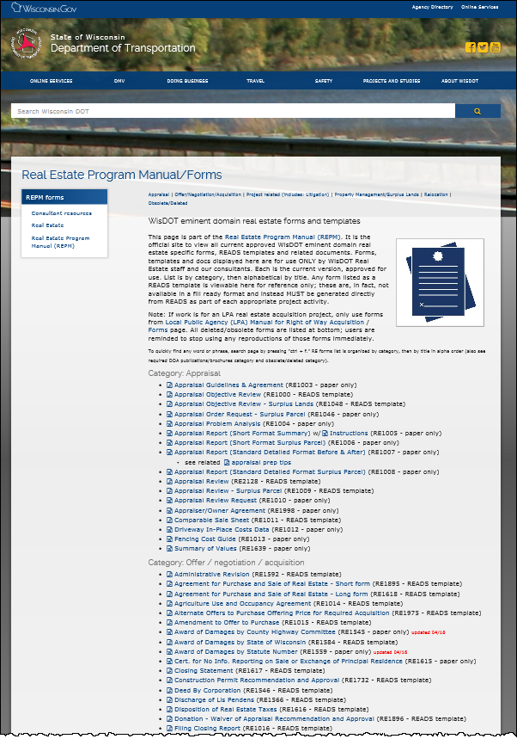
REPM/Forms page
RE forms are only available here or from READS
Our forms are grouped by category; then, in alpha order by form title.
CATEGORIES, SEE:
Appraisal; Offer/negotiation/acquisition; Project related; includes litigation; Property management/surplus lands; Relocation forms/templates; Relocation informational handouts; and, Wisconsin Required DOA publications/brochures). Also see: Obsolete/deleted information.
NOT MEANT FOR ACTUAL VIEWING/SAMPLE ONLY
http://wisconsindot.gov/Pages/doing-bus/eng-consultants/cnslt-rsrces/re/repm-forms.aspx

Slide 54
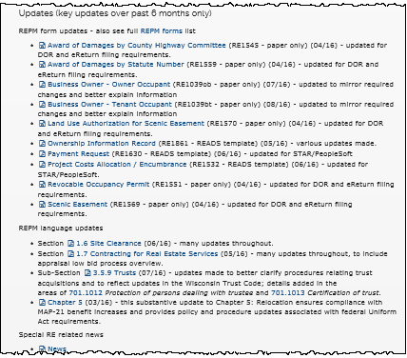
Check for updates!
Stay alert to
REPM form updates and language updates. Updated REPM & form news stays posted here for six months
NOT MEANT FOR ACTUAL VIEWING/SAMPLE ONLY
http://wisconsindot.gov/Pages/doing-bus/eng-consultants/cnslt-rsrces/re/repm.aspx

Slide 55
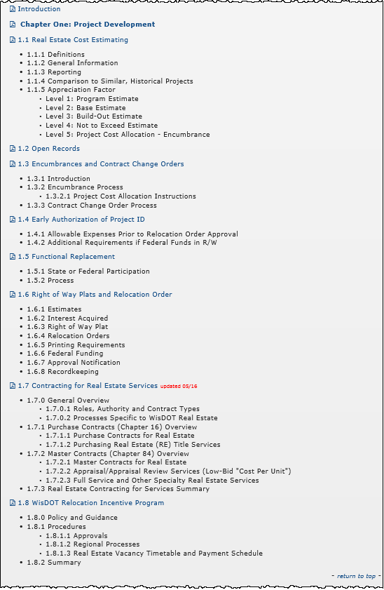


This chapter will be used by EVERYONE!
REPM/Chapter 1/Project Development
NOT MEANT FOR ACTUAL VIEWING/SAMPLE ONLY
http://wisconsindot.gov/dtsdManuals/re/repmchap1/chapter1.pdf

Slide 56
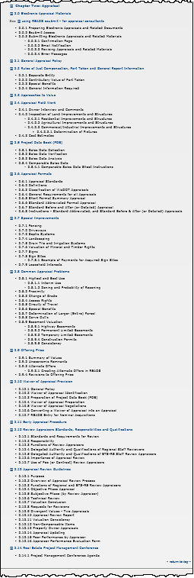
This chapter will be used mostly by appraisers
REPM/Chapter 2/Appraisal
NOT MEANT FOR ACTUAL VIEWING/SAMPLE ONLY
http://wisconsindot.gov/dtsdManuals/re/repmchap2/chapter2.pdf

Slide 57
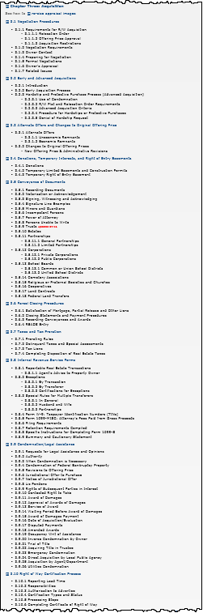
This chapter will be used mostly by acquisition (negotiation) agents
REPM/Chapter 3/Acquisition
NOT MEANT FOR ACTUAL VIEWING/SAMPLE ONLY
http://wisconsindot.gov/dtsdManuals/re/repmchap3/chapter3.pdf

Slide 58
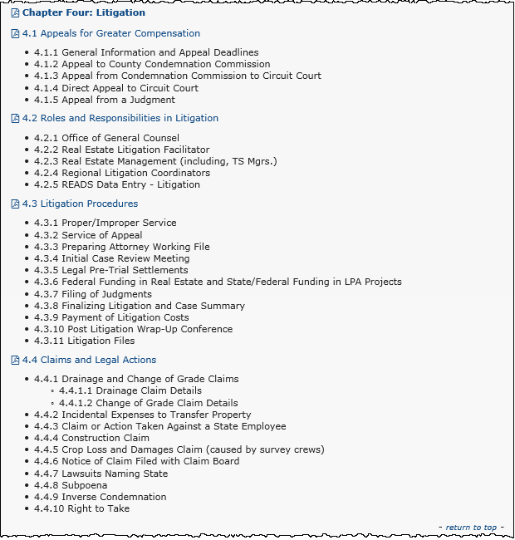
This chapter will be used mostly by litigation coordinators
REPM/Chapter 4/Litigation
NOT MEANT FOR ACTUAL VIEWING/SAMPLE ONLY
http://wisconsindot.gov/dtsdManuals/re/repmchap4/chapter4.pdf

Slide 59
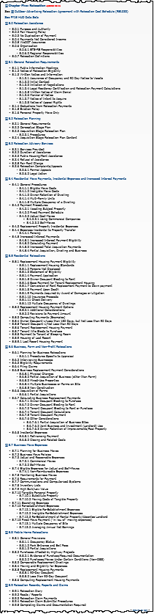
This chapter will be used mostly by relocation agents
REPM/Chapter 5/Relocation
NOT MEANT FOR ACTUAL VIEWING/SAMPLE ONLY
http://wisconsindot.gov/dtsdManuals/re/repmchap5/chapter5.pdf

Slide 60
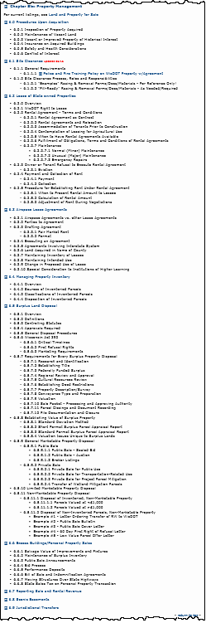
This chapter will be used mostly by property managers
REPM/Chapter 6/Property Management
NOT MEANT FOR ACTUAL VIEWING/SAMPLE ONLY
http://wisconsindot.gov/dtsdManuals/re/repmchap6/chapter6.pdf

Slide 61
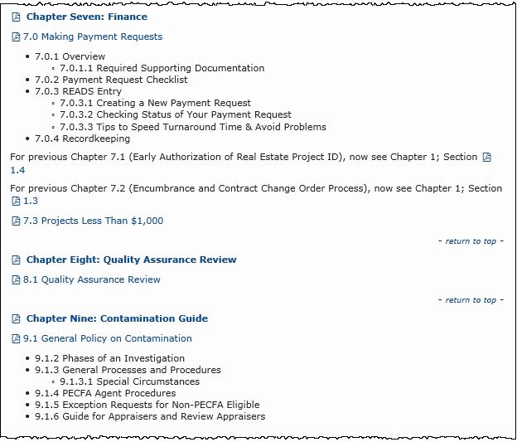
These chapters will be used by EVERYONE!
REPM/Chapters
7, 8 & 9
(Finance, QAR, Contamination Guide)
NOT MEANT FOR ACTUAL VIEWING/SAMPLE ONLY

Slide 62
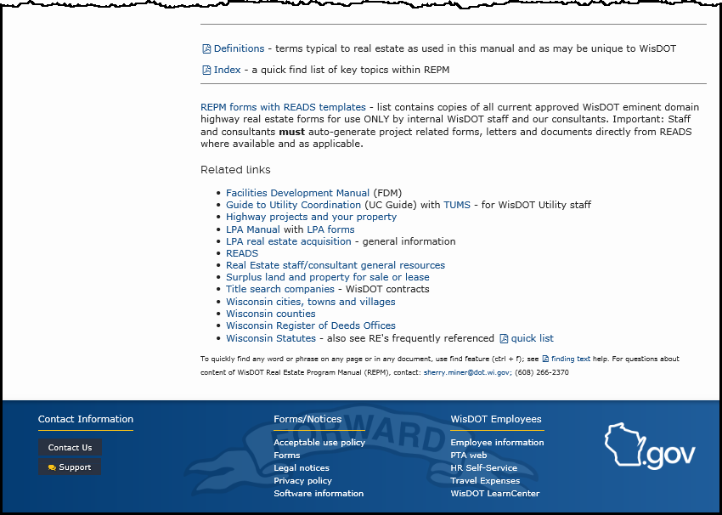
Two more key areas of the REPM: Definitions - terms typical to real estate as may be unique and Index - a quick find list of key topics within REPM.
Related links located at very bottom...
REPM/Misc. (bottom of REPM home page)
NOT MEANT FOR ACTUAL VIEWING/SAMPLE ONLY

Slide 63
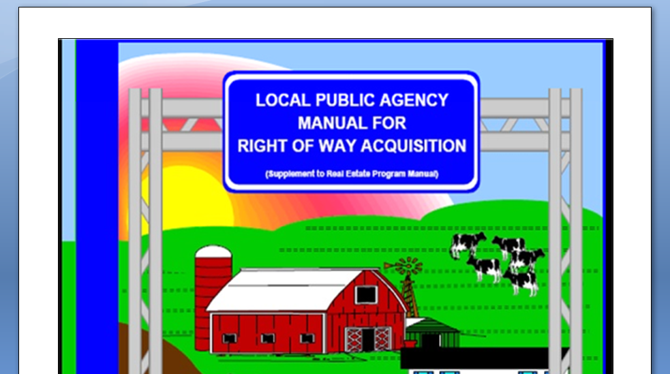

If you need it, this is our LPA Manual; you will use this only if/when and because you are working on a LPA sponsored project. This is our official ‘Local Public Agency (LPA) Manual for Right of Way Acquisition’
with link to LPA forms
http://wisconsindot.gov/Pages/doing-bus/eng-consultants/cnslt-rsrces/re/lpa-manual.aspx

Slide 64
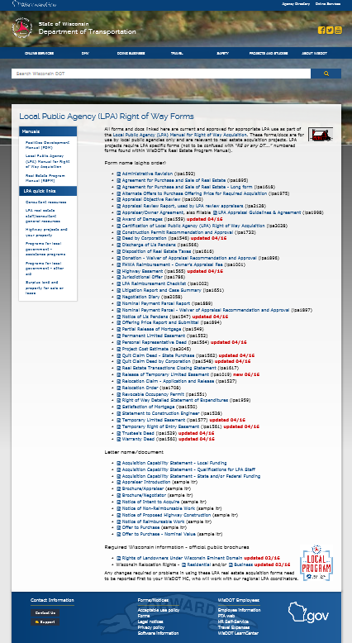

The LPA Manual is a sub-set of and references the REPM
LPA Manual/Forms (alpha order by title)
All LPA forms and docs linked here are current and approved for appropriate LPA use only as part of the Local Public Agency (LPA) Manual for Right of Way Acquisition. These forms/docs are for use by local public agencies only and are relevant to real estate acquisition projects. LPA projects require LPA specific forms (not to be confused with "RE or any DT..." numbered forms found within WisDOT's Real Estate Program Manual).
NOT MEANT FOR ACTUAL VIEWING/SAMPLE ONLY
http://wisconsindot.gov/Pages/doing-bus/eng-consultants/cnslt-rsrces/re/lpa-forms.aspx

Slide 65
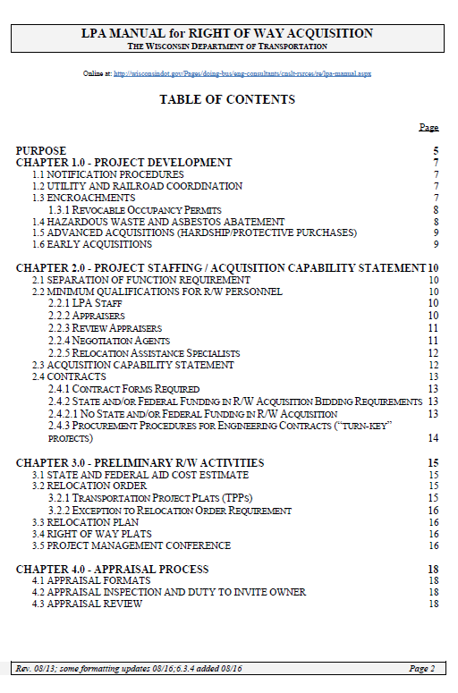
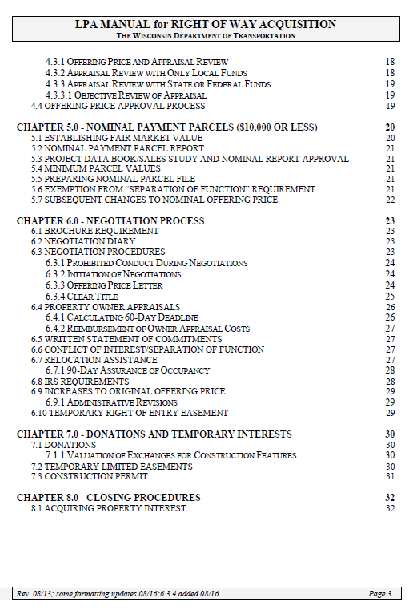
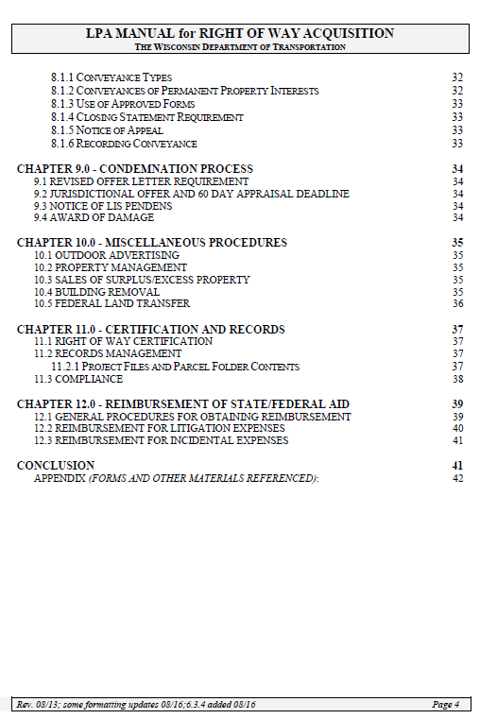

LPA Manual
Table of Contents

Slide 66
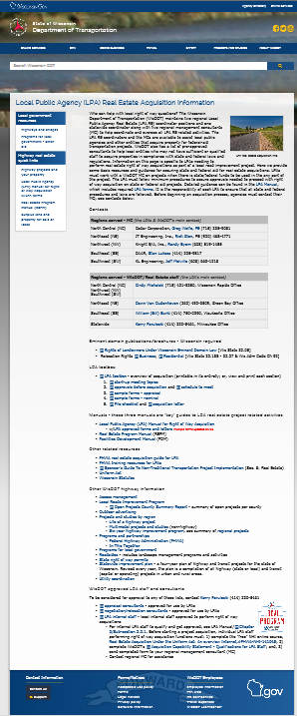
WisDOT Local Public Agency (LPA)
Real Estate Acquisition Information
Who can help with local right of way questions? The Wisconsin Department of Transportation (WisDOT) maintains two regional Local Public Agency Real Estate (LPA RE) coordinator positions and one statewide coordinator along with five regional management consultants (MC) to help coordinate and oversee all LPA RE related activities. The LPA RE coordinators and the MCs are available to assist local public agencies and other entities that acquire property for federal-aid transportation projects. WisDOT also has a list of pre-approved consultants to help local entities who may not have sufficient or qualified staff to acquire properties in compliance with state and federal laws and regulations. Information on this page is specific to LPAs needing to perform real estate right of way acquisitions as part of a local road improvement project. Here we provide some basic resources and guidance for securing state and federal aid for real estate acquisitions. LPAs must work with a WisDOT MC on projects when there is state/federal funds to be used in the any part of the project. The LPA must follow minimum procedures to secure approvals needed to proceed with right of way acquisition on state or federal aid projects. Detailed guidance can be found in the LPA Manual, which includes required LPA forms. It is the responsibility of each LPA to ensure that all state and federal procedures and laws are followed. Before beginning an acquisition process, agencies must contact their MC; see contacts below.
NOT MEANT FOR ACTUAL VIEWING/SAMPLE ONLY
http://wisconsindot.gov/Pages/doing-bus/local-gov/astnce-pgms/aid/lpa-re-info.aspx

Slide 67
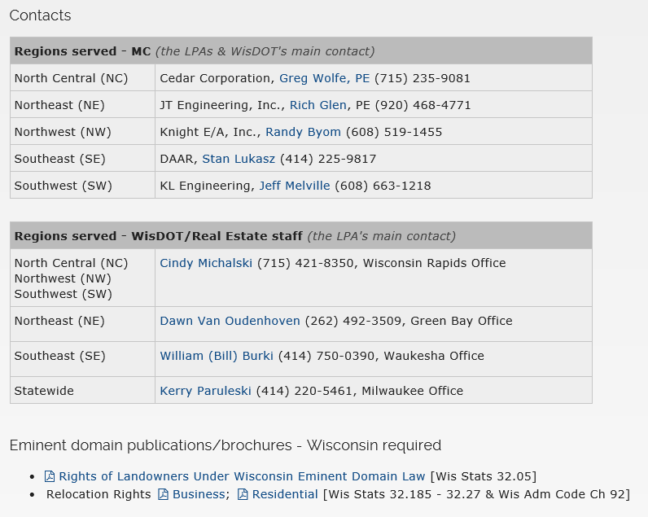
LPA / MC Contacts & Wisconsin Required Info
LPA Contacts

Slide 68

We also have some “home made” and dotnet only available online WisDOT Real Estate specific learning opportunities...
These are our currently available on BTS-RE web site; each can be forwarded to consultants upon request:
Appraisal Formats
Appraisal Inspection & Signatures
Access Valuation & Appraisal
Blitz Presentation, A simple "How to Prepare"
Compensable vs. Non-compensable
Controlling Access - Trans 233 & Beyond
Cost Estimating - See ShareDocs folders, click on 2009 folder, then to: CostEstimatingProcedures.
Data Sheets, 'Best Practices'
DOT acquisition process (an overview flowchart)
Intro to Real Estate Master Contracts - Work Order Processes
  Also see: Obtaining Consultant Services Under Chapter 84 – ‘A Quick Overview’
Life of a highway project
  Also see: long winding road doc
Local Public Agency Utility Coordination
New agent intro to FHWA
New employee help (just the basics)
Offering Price/Administrative Revision
Overview of Appraisal Process
TIP: All internal staff should visit our RE dotnet training page to get a refresher on some past training: http://dotnet/dtsd/technical/realestate/training/index.htm; and, brand new internal Real Estate employees, be sure to go here early on to get started: http://dotnet/dtsd/technical/realestate/training/new-employee.htm
Training
Check statewide RE calendar for info about instructor-led training (costs may vary).

Slide 69
WisDOT Real Estate Specific Learning Opportunities, continued
PC Tips & Tricks (a general and quick self-help guide)
  Adobe Acrobat 8 for Review Appraisers
  APEX software (self-help guide for appraisers using APEX sketching software)
  Appraisal Preparation Tips - for use with Appraisal Report (Standard Format Before and After)
  Consultant extranet access (log on instructions)
  Finding key words on web page
  Phone features (key to buttons on your phone)
  Real Estate web tour (new to WisDOT Real Estate? Take a quick tour of our web)
  Search ('How to search' for a file in Windows Explorer ; and, save to/view meeting notes, docs, etc. in 'ShareDocs' folders)
  Webcast (technology broadcasting live or pre-recorded presentations via Internet)
  Web conferencing (an application that allows a meeting in real time using Internet)
  Web running slow? (a quick an easy cleanup)
Planning & Project Development - Beginning
Project Development - Intermediate
Plats & Plans 1of 2; Plats & Plan 2 of 2
Plats & Plans: Negotiating Prep
Preparing to Negotiate
Present the Appraisal
Training
TIP: Remember to watch our statewide RE calendar for news about upcoming instructor-led training (costs may vary).

Slide 70
WisDOT Real Estate Specific Learning Opportunities, continued
Property Titles
Purpose of Project Data Book
READS Training & Reference Manual
Real Estate Awareness for non-Real Estate staff
Real Estate User Groups
Reasonable Access Determinations
Review Appraisal Purpose
Review Appraiser
Severance Damages
Scope of Work
Appraisal Scope of Work
Spiegelberg vs. WisDOT For additional background, see Spiegelberg guidance
Stats & Regs
Uniform Act overview
WisDOT University
WisDOT/DTSD (look at each grouping to see ALL current WisDOT sponsored training options)
WisDOT/BITS (e-learning information technology training - see "business" grouping)
WisDOT/BITS (instructor led info tech training - see DOT's IT month-at-glance postings)
WisDOT/DTSD (technical training) (to register, contact WisDOT Training Coordinator)
  WisDOT staff technical training registration form
  Non-WisDOT staff technical training registration form
Training
TIP: Remember to watch our statewide RE calendar for news about upcoming instructor-led training (costs may vary).

Slide 71
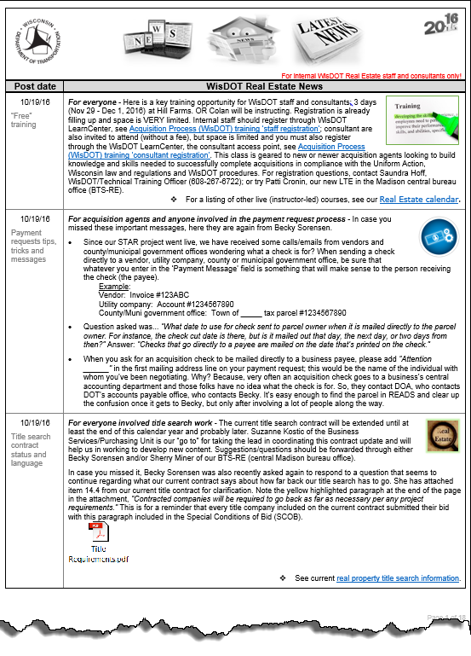
‘WisDOT RE News’
No presentation on WisDOT RE tools and resources would be complete without drawing attention to our internal newsletter intended to provide brief summary statements to key initiatives and changes affecting statewide WisDOT Real Estate programming and staff related activities. WisDOT Real Estate staff at all levels, consultant partners, and FHWA reps are encouraged to submit news and special items of interest to be posted in our statewide WisDOT RE News. Key updates are pushed out to all staff and current consultant contacts in periodic emails, while the tool is always available 24/7 online, see
RE news in its entirety.
NOT MEANT FOR ACTUAL VIEWING/SAMPLE ONLY
View now: http://wisconsindot.gov/dtsdManuals/re/re-staffresources/news.docx

Slide 72


One more important tool to mention is our department writing style guide...
The Wisconsin Department of Transportation style guide is for WisDOT employees and contractors who prepare department information for publication. This includes print materials, PowerPoint presentations and websites. In some cases, guidelines for web documents may differ from those of print documents. This resource is designed to give the department's public information products a consistent, uniform look and style. Our goal is to produce and provide clear and concise informational materials, which are easily understood by our customers.
See: http://wisconsindot.gov/Pages/doing-bus/eng-consultants/cnslt-rsrces/tools/style.aspx

Slide 73

In summary, these are the ‘key’ places on the web where you will need to go over and over to access WisDOT Real Estate tools and resources...
WisDOT home page (Internet)
http://www.wisconsindot.gov/
READS launch page (Internet) – special log on required!
http://wisconsindot.gov/Pages/doing-bus/eng-consultants/cnslt-rsrces/re/reads.aspx
REPM (includes all RE forms) (Internet)*
http://wisconsindot.gov/Pages/doing-bus/eng-consultants/cnslt-rsrces/re/repm.aspx
See also: LPA MANUAL (includes all LPA forms)
http://wisconsindot.gov/Pages/doing-bus/eng-consultants/cnslt-rsrces/re/lpa-manual.aspx
Launch site for WisDOT Real Estate consultants (Internet)*
http://wisconsindot.gov/Pages/doing-bus/eng-consultants/cnslt-rsrces/re/default.aspx
General site for all WisDOT consultants (Internet)
http://wisconsindot.gov/Pages/doing-bus/eng-consultants/cnslt-rsrces/default.aspx
- - - - - - - - - - - - - - - - - - - - - - - - -
WisDOT Real Estate internal staff (intranet; dotnet - for internal staff only!)*
http://dotnet/dtsd/technical/realestate/index.htm
*At minimum, save these pages as favorites/bookmarks.

Slide 74

More simply, these are our most common and most important...
WisDOT Real Estate tools & resources
Stay alert to
Updates!
Regional staff ☺
Statewide staff ☺
State statutes, administrative code, and federal laws/regulations
READS access
Real Estate Program Manual (REPM) w/RE forms
  Local Public Agency (LPA) Manual for Right of Way Acquisition w/LPA forms
Web resources – will have a launch site for everything you need!
Questions/comments, email DOT DTSD BTS Statewide Real Estate

Slide 75

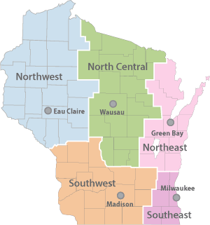




Processes may vary by region
Statewide program area Real Estate contacts
All the basics
“Highway projects and your property”
  Table of Contents
  Introduction
  Chapter 1: Project Development
  Chapter 2: Appraisal
  Chapter 3: Acquisition
  Chapter 4: Litigation
  Chapter 5: Relocation
  Chapter 6: Property Management
  Chapter 7: Finance
  Chapter 8: Quality Assurance Review
  Chapter 9: Contamination Guide
  Chapter 10: Billboard Acquisitions & Relocations (coming)
  Definitions
  Forms
  Index
TIP: We put together this handy
Wis Stats - Quick reference list.
You can print and travel
with list to help guide you.
Training
WisDOT, dtsd/bts-re
These chapters will be used by EVERYONE!
“Consultant RE launch site”
REPM/Forms page
RE forms are only available here or from READS
Check for updates!
From WisDOT internet home page, click “DOING BUSINESS”
Hey!
“How WisDOT sells surplus land”
200+ strong!
WisDOT/DTSD/BTS-RE
FAVORITE
Bookmark
Electronic systems help to create a statewide uniformity to processes, processing, and procedures.
Stay alert to
Updates!
Internet: www.wisconsindot.gov
Intranet: http://dotnet/...
Go to ‘New Real Estate employee’ dotnet page: http://dotnet/dtsd/technical/realestate/training/new-employee.htm
Welcome to DTSD/BTS-RE (real estate)!!!
- Tip: This symbol indicates WisDOT intranet
Tip: This symbol indicates WisDOT internet -
regional office locations
WisDOT Real Estate Tools & Resources

