Slide 1
Live Web Cast
Partial Release of Mortgage Part II
An Update on Policy
November 16, 2017
Attendance Sign-In Please Email:
Kerry.paruleski@dot.wi.gov
Wisconsin Department of Transportation
LPA Program – Real Estate
Notes:
Welcome
Thank you all for calling in. The webinar today will feature a review of the partial release of mortgage policy to benefit those of you who did not call into the webinar we had last fall regarding this. Then we will introduce you to the revised policy with the introduction of a risk assessment component for LPAs who are willing to take the risk of not obtaining absolute clear title on some ROW acquisitions.
The speakers today are myself, Kerry Paruleski the Statewide LPA RE Facilitator, Bill Burki the SE Region LPA RE Coordinator and Cindy Michalski the NC, NW, and SW LPA RE Coordinator. The presentation is being recorded and the link you used get to the webinar will be uploaded to our LPA website shortly.
I am interested in knowing which LPAs and consultants are online so if you could please send me an email confirming your attendance today I would appreciate it.Thanks.
Because we don’t have the ability to interact with you verbally during the presentation we have reserved a teleconference line that we will open up immediately after the web cast is over.
Now, onto today’s topic.

Slide 2
Two Part Presentation
First Part
  Review Summary of partial release of mortgage information
  Best practices on how to obtain partial release of mortgages
  Best practices on how to work with MERS
Second Part
  How and when a waiver of a partial release of mortgage can be used
Notes:
KP

Slide 3

Review & Summary
Partial Release of Mortgage
What When Why
Notes:
KP
We are having this webinar today because we feel it is important to talk about an important aspect to acquiring real estate that is needed for a federally or state funded project. It is important to understand that in exchange for federal aid, Federal highways is expecting the local municipalities to have obtained an adequate interest in the ROW. This means that the title to the ROW acquired should be clear of all liens and encumbrances.
You may be asking, why now, when everyone is trying to be fiscally responsible and most funding is tight or non-existent. Well, this isn’t a new policy or requirement. This has been in the WisDOT Real Estate Manual – which is the manual that the LPA manual refers to for more real estate detail – for decades. It is true that WisDOT itself went through a period of time in the 2000s when it felt that perhaps simple, low value, non complex acquistions didn’t need to have partial releases in order to obtain clear title because the risk appeared to be so low. When the market turned in the mid 2000s however, foreclosures sky rocketed and it became clear that not only was WisDOT putting its own projects at risk by not having clear title, but where doing a true disservice to the property holders who are under contract with banks for their properties.
Up to this point, we have pretty much allowed the local public agencies to make their own decisions regarding whether they wanted to take the risk and not obtain clear title. FHWA has become aware of this and has told WisDOT that it expects as part of our duty to oversee the spending of federal funds that property acquired for a state or Federal-aid project must be adequate for the construction, operation, and maintenance of the resulting facility and for the protection of both the facility and the traveling public. FHWA believes, and WisDOT agrees, that meeting the adequacy of interest test requires the LPA to acquire clear, marketable title to the real property or real property interests necessary to build the project. To not do this may jeopardize the project and thus the funding.
This will certainly be a rather new twist in the real estate part of a local program project. Today’s presentation is meant to give you an overview of what a partial release is and what it takes to obtain clear title. We will be working with you to make sure that schedules are maintained and give you ideas on how best to keep additional costs down.
As I said earlier, if you have questions regarding a specific project please contact your MC so we can set up a meeting to discuss your concerns. I will not be handing the mike over to Bill.

Slide 4
What is a Partial Release?
Review
It is a partial satisfaction of a mortgage. The lender acknowledges that the portion of the property being acquired has been fully paid and that the mortgage is no longer a lien on that portion of real property.
Notes:
KP

Slide 5

When do you need it?
Review
Any permanent acquisition that has a mortgage
  FEE
Subordination Agreement/Consent of Mortgage needed for
  PLE
  HE
Note:
A lender will likely not be willing to release their interests on a PLE or HE. For these cases a Subordination Agreement or Consent of Mortgage will be sufficient.
Notes:
KP
-The lender still has an interest in the property. They will not execute a partial release.
-Talk to your LPA RE Coordinator about Consent of Lien Holder language. We want to make sure the lender is subordinating to the LPA.

Slide 6
Why Partial Release Policy?
Review
Obtain Clear Title
Protect Property Owner
Protect LPA
Notes:
KP

Slide 7
To Obtain Clear Title
Review
LPA agrees to follow all state and federal requirements, 23 CFR 710.201(h).
Acquired property must be adequate for the construction, operation, and maintenance of the resulting facility and for the protection of both the facility and the traveling public, 23 CFR 710.201(e).
Notes:
KP
When the LPA accepts state or federal funds in any part of the project the LPA agrees to follow all state and federal requirement.
Which means it must meet the adequacy of interest test: Clear, marketable title to the real property or real property interests necessary to build the project.
Where the interest to be acquired is only a portion of the subject property (partial acquisition), WisDOT’s policy, with FHWA’s concurrence, requires the LPA to obtain either partial releases or subordination agreements for any prior recorded liens or title encumbrances. This requirement applies to recorded mortgages, no matter the complexity or dollar amount. The sole exception to this requirement is for temporary limited easements (TLE) where the risk of foreclosure prior to or during construction is low.

Slide 8
Protect the Property Owner
Review
Violation of Mortgage Agreement-
  Usually a violation to sell any property under the mortgage without the consent of the lender.
  The lender could:
  “declare immediately due and payable all sums secured by this Mortgage upon the sale or transfer, without Lender’s prior written consent, of all or ANY PART of the Real Property, or any interest in the Real Property.” (Taken from a JPMorgan Chase Bank Mortgage Agreement)
Notes:
KP
Property owners are putting a lot of trust in us. So we need to acquire the property correctly for them. In many cases, probably most. It is a violation of the mortgage agreement. The lender can call immediately due the entire mortgage.

Slide 9

Protect the LPA
Review
May have to pay twice:
  Foreclosure - LPA likely have to re-acquire property
Stall the project:
  If the mortgage company is uncooperative after foreclosing on the property, you may have to go through the condemnation process
Notes:
KP
If the property is foreclosed on there is the possibility the LPA will have to pay the lender to acquire the property again. The reason why is that the lender will not have received payment for the acquisition and therefore would not have released their rights to the property. The LPA will be subordinate to the lender.

Slide 10
Best Practices
Obtaining a Partial Release
Review
Notes:
Bill

Slide 11
Best Practices
Review
Preliminary Plat
  Identify all the parcels with FEE, PLE or HE.
Title Work
  Go through parcels with FEE, PLE or HE.
  Pick out parcels with mortgages.
  Now you have an idea of how many appraisals will be needed for partial releases.
Notes:
Bill

Slide 12

Best Practices
Review
Call the lenders.
Figure out the lender’s requirements.
  Maybe an appraisal is not needed.
Notes:
Bill

Slide 13
Best Practices
Review
Inform the Property Owner
Third Party Authorization Form
Send signed documents to lender
Notes:
Bill
Inform: Let them know that the lender may require a portion or all of the compensation to release the property being purchased. Also, let them know that it will be applied to the principle of their mortgage.
Third Party: Include the third party authorization form. This will give you the authorization to work with the property owner’s lender on their behalf. Some lenders will only accept their form. This is another reason to get in touch with the lenders beforehand so you don’t have to go back to the property owner to have another document signed.
If the lender does not have one use the standard authorization form in the LPA documents list.

Slide 14
Side Note
Review
Assignment of Leases and Rents
  Ask for Release
  Will usually reference Assignment of Leases and Rents document number in partial release document
Notes:
Bill

Slide 15
Mortgage Electronic Registration System (MERS)
Review
Notes:
Bill

Slide 16

What is MERS?
Review
MERS acts as mortgagee in the county land records for the lenders.
Allows lenders to buy and sell mortgages without recording assignments of mortgage.
Notes:
Bill

Slide 17
What does it look like?
Review
On Title
  Mortgage from John and Sue Smith to Mortgage Electronic Registration Systems, Inc. acting solely as nominee for Lender, “Lenders Name Here”, and its successors and assigns in the amount of $200,000 dated January 1, 2000 and recorded January 3, 2000.
Notes:
Bill

Slide 18
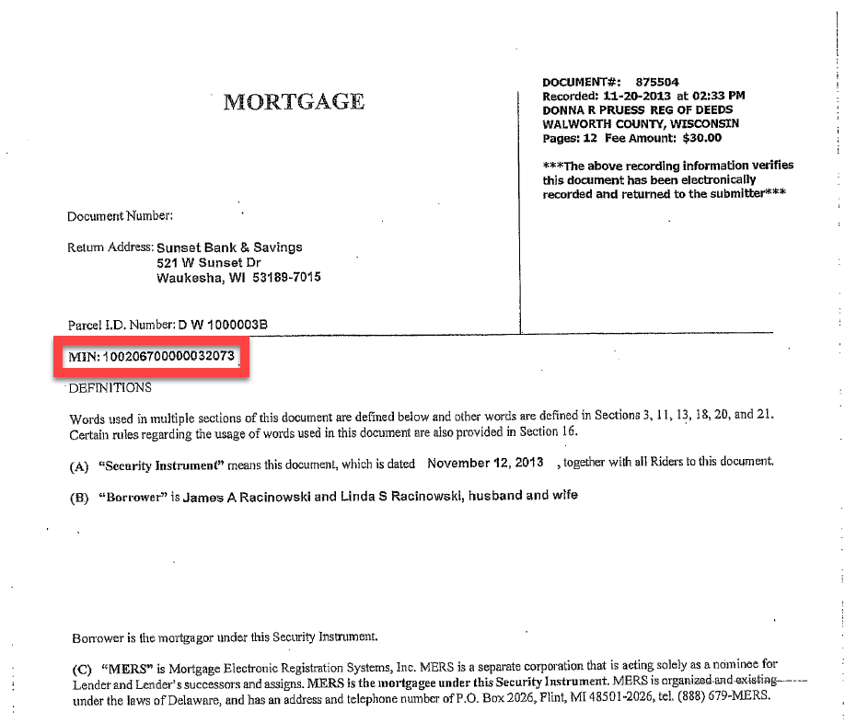
How to obtain a partial release?
Review
Notes:
Bill
On the mortgage document there will be a MIN #. You will then use this MIN # on the MERS website to identify the current lender.

Slide 19
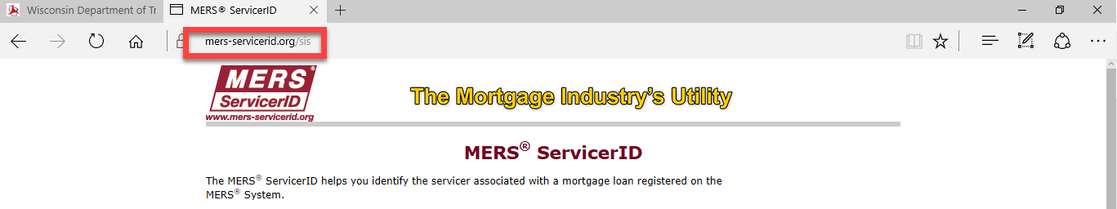
Review
Website Address: Mers-servicerid.org/sis
Notes:
Bill
This is a snapshot of what the website will look like. Below is the website address.

Slide 20
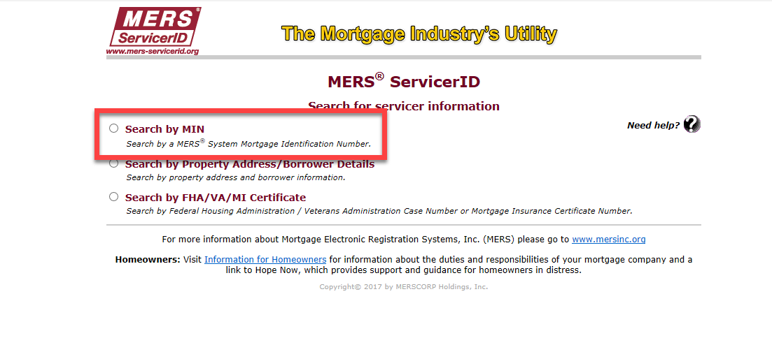
Review
Notes:
Bill
Click search by MIN. You can search other ways but I have had the most success using the MIN #.

Slide 21
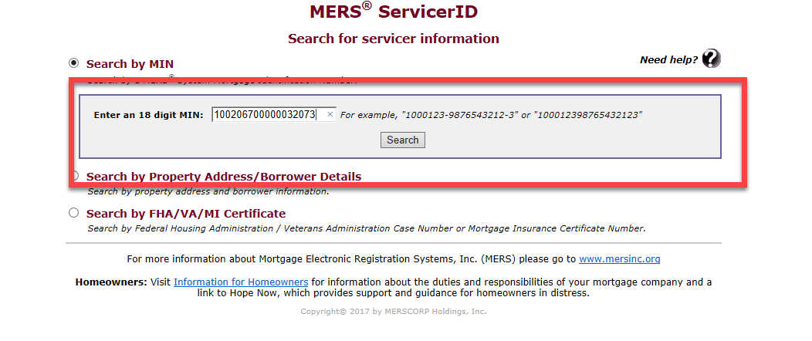
Review
Notes:
Bill
Punch in the MIN # and click search.

Slide 22
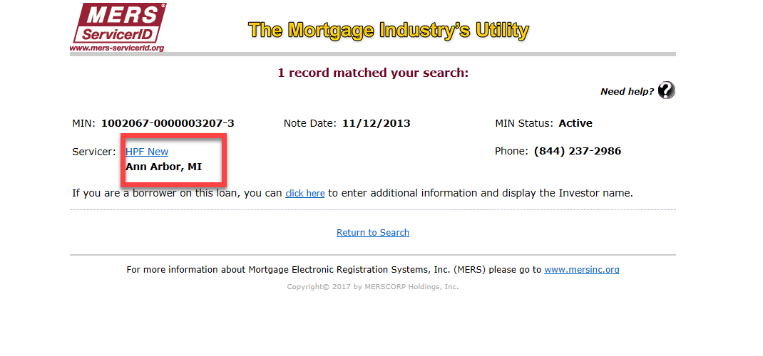
Review
Notes:
Bill
The current lender will pop up with some information. In the area in the red box area next to servicer you can typically click and it will bring you to the current lender’s website.
Go through this lender to obtain a partial release.

Slide 23
Scheduling
Review
Plan Ahead:
  Expect that an acquisition which needs a partial release to take longer to close.
Timelines from experience:
  Local banks and credit union- 1 week to 1 month
  National banks- 2 months or longer
Notes:
Cindy
Just as the slide states, you have to plan ahead. Look over title work, discuss with property owner early. You can’t wait until you find out if the owner is going to sign a conveyance to start discussing Mortgages.

Slide 24
If you cannot obtain a release in time?
Review
Notes:
Cindy

Slide 25
Jurisdictional Offer
Review
Obtain the property through a Jurisdictional Offer.
Figure out the date that a JO needs to be issued by:
  Make sure the process was followed and everything is in place for the JO to be executed. (Appraisal, Owner was given 60 days, etc.)
Issue the check with both the property owner and lender on it.
Notes:
Cindy
You need to have the discussion with the LPA about friendly condemnation when a partial release will not be feasible or attainable. Project dead lines are important.

Slide 26
Waiver of Partial Release Policy
NEW
(NOT obtaining clear title)
Notes:
KP
Give some background and why the change

Slide 27

Be Aware!
The waiver of the partial release policy only applies to projects where there are NO FEDERAL or STATE FUNDS in real estate acquisition.
Notes:
KP

Slide 28
Overview
The LPA may choose to acquire the property without all the encumbrances on the property being alleviated.
This is considered contrary to WisDOT policy
The LPA will risk the possibility of having to re-acquire
As well as risk delaying a project until all such matters are resolved
Notes:
KP

Slide 29
Criteria
For use on appropriate acquisition only
Risk Assessment must be completed
Property owner acknowledgement/consent is given
Notes:
KP
There are certain criteria that must be met in order for the waiver of partial release to be considered.

Slide 30
1. Acquisition Type
Requirements
Nominal Value (Under $10,000)
Minor (such as strip taking)
Non-Complex (such as land only, minimal landscape & damages)
Notes:
KP
First and foremost the parcel has to be the appropriate type.
The value of the acquisition has to be under $10,000
It has to be a minor taking such as a small strip along the road
And it has to be non complex – you don’t want to take the chance on parcels where there is the need for such things as access issues, costs to cure items, ect.

Slide 31

2. Risk Assessment
Requirements
Project Assessment
Parcel Assessment
Notes:
KP
Secondly a Risk assessment has to be done. It has two parts – a project assessment and a parcel assessment.

Slide 32
Project Assessment Documentation
Risk Assessment
Document in the Project File (such as):
  Why (program or construction needs or time constraints, etc.)
  Which (list the parcels)
Notes:
KP
Information should be put into the project file justifying bringing this element to the project. This is where you would talk about general terms such as program or construction needs, scheduling constraints, etc. A list of parcels where this will be done should also be included.
Essentially a statement as to why a partial release on all or some of the parcels will not be realized.

Slide 33
Parcel Assessment Documentation (for each parcel)
Risk Assessment
    a. Provide Parcel Details (such as):
      Land type fair market value
      Property acreage
      Total acquisition amount
      Type of acquisition
      Damages (copy of the Nominal Payment Parcel Report- Waiver of Appraisal Recommendation and Approval form)
Notes:
KP
An assessment for each parcel where there is a mortgage that will not be released will need to be done. Each parcel file should contain a document containing the details of the assessment.
You should include details such as…

Slide 34
Parcel Assessment Documentation continued (for each parcel)
Risk Assessment
    b. Provide Proof of Property Title Research
      Review to ensure that the property is in good standing and is at little to no risk of foreclosure.
      Document this
    c. Provide the Reason Why
      Document a statement explaining why a partial release of mortgage will not be obtained (difficulty in processing a lien release, time constraints, cost, etc.)
Notes:
KP
One of the most important aspects of the assessment is the scrutinization of the property title. It is highly recommended that the title you review is recent. Are encumbrances such as federal/state tax or child support liens complicate matters and might indicate risk. Also verifying that the property owner is in good standing with the lender and is not in foreclosure proceedings is a must. Your review should be documented verifying that you looked at the title and found no risk.
There should also be documentation stating why a partial release of mortgage will not be obtained. Tell us “why” -

Slide 35
3. Property Owner Acknowledgement
Risk Assessment
Property Owner Partial Release of Mortgage Acknowledgement, lpa1549
  http://wisconsindot.gov/Pages/doing-bus/local-gov/astnce-pgms/aid/lpa-re-info.aspx\
Notes:
Bill
The LPA/negotiator is required to provide to every property owner (in which a partial release will not be obtained)

Slide 36
WARNING
Risk Assessment
Wisdot reserves the right to not sign a Cert 1 if this documentation is not provided in the project and parcel files.
All projects are subject to document review upon request
Notes:
KP

Slide 37
Conclusion
It is WisDOT’s policy to always get clear title to ROW on all projects how ever in some cases LPAs may choose to conduct a Risk Assessment in lieu of a partial release of mortgage on simple and non-complex parcels
Waiver of Partial Release only applies to Locally Funded Real Estate Projects (i.e. no Federal or State Funds in RE)
Provide the completed documentation in each parcel file where a partial release of mortgage will not be obtained
  Risk Assessment
  Property Owner Acknowledgement
Notes:
KP

Slide 38
Tools
Review
WisDOT Local Program RE website
  http://wisconsindot.gov/Pages/doing-bus/local-gov/astnce-pgms/aid/lpa-re-info.aspx\
  Contact Information
  LPA Training Library
  RE Manuals (LPA RE manual, REPM, FDM)
  Resources (FHWA links, MERS, etc.)
  Approved LPA Staff & Consultant Lists
Notes:
KP
Talk about the excel sheet beging created for lender contacts – show where in website it will go?

Slide 39
Contact Information
Kerry Paruleski, LPA RE Central Office
  P: 414-220-5461
  Kerry.Paruleski@dot.wi.gov
Bill Burki, LPA RE Coordinator SE Region
  P: 414-750-0390
  William.burki@dot.wi.gov
Cindy Michalski, LPA RE Coordinator SW, NW and NC Regions
  P: 715-421-8350
  Cynthia.Michalski@dot.wi.gov
Notes:
KP

