Slide 1

    Local Program Real Estate
    2019 Webinar Series
    Relocation in the Local Program Part 1
    Relocation Updates
    Wednesday October 9, 2019
    Trouble Shoot Issues Contact
    Call (414) 239-4156
    Kassandra Walbrun, Statewide Relocation Facilitator
    Sarah Lamp, WisDOT Relocation Consultant
    Kerry Paruleski, Statewide LPREM
Notes:
KP
Welcome
Thank you all for calling in. The webinar today will feature XXXX
The speakers today are myself, Kerry Paruleski the Statewide LPA RE Facilitator, Kassandra Walbrun, Statewide Relocation Facilitator, Sara Lamp, WisDOT Relocation Consultant, and Cindy Michalski, LPREPM.

Slide 2

Housekeeping
    Trouble Shoot Issues Contact
    Call (414) 239-4156
    Two Part Webinar
    Online Presentation
      https://livestream.com/accounts/14475780/events/6310029
    Teleconference Q & A
      (888) 557-8511
      Access Code 2483508
    Attendance – EMAIL
      Kerry.Paruleski@dot.wi.gov
        Local Program Real Estate (LPRE) Website
        https://wisconsindot.gov/Pages/doing-bus/local-gov/astnce-pgms/aid/lpa-re-info.aspx
Notes:
KP
The presentation is being recorded and the link you used get to the webinar will be uploaded to our LPA website shortly.
I am interested in knowing which LPAs and consultants are online so if you could please send me an email confirming your attendance today I would appreciate it.Thanks.
Because we don’t have the ability to interact with you verbally during the presentation we have reserved a teleconference line that we will open up immediately after the web cast is over.
Now, onto today’s topic.

Slide 3

Manual Updates
Real Estate Program Manual (REPM)
&
Local Program Real Estate Manual (LP RE manual)
Notes:
KP
LPA RE manual and REPM

Slide 4
Use of Manuals in the Local Program
Code of Federal Regulations
Title 23: Highways
SUBCHAPTER H—RIGHT-OF-WAY AND ENVIRONMENT
PART 710—RIGHT-OF-WAY AND REAL ESTATE
§710.105 State responsibilities.
(c) Right-of-way (ROW) operations manual. Each STD which receives funding from the highway trust fund shall maintain a manual describing its right of- way organization, policies, and procedures. The manual shall describe functions and procedures for all phases of the real estate program, including appraisal and appraisal review, negotiation and eminent domain, property management, and relocation assistance. The manual …
Notes:
KP
Reminder on manuals – it’s a federal regulation

Slide 5
Relocation in the Local Program
NOTE:
LPRE Manual provides guidance on specific Local Program requirements and oversight.
REPM is to be used for relocation policy, practices, and procedures.
Notes:
KP
Introduction to the difference between the two manuals
REPM is to be used for further guidance that the LPA manual does not include – General WisDOT practices are to be followed

Slide 6
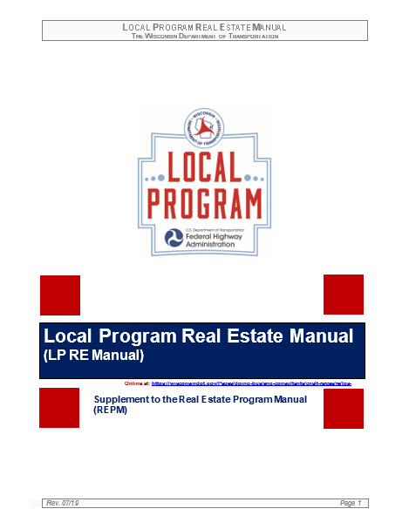
Relocation Program Updates in the
Local Program Real Estate (LPRE) Manual …
Link:
https://wisconsindot.gov/Pages/doing-bus/eng-consultants/cnslt-rsrces/re/lpa-manual.aspx
Notes:
KP
SHOW THE WEBSITE – WHERE TO FIND THE MANUAL
– Key updates that have been done and Sarah will go into more detail about these updates

Slide 7
What’s new? EVERYTHING!!!!
Section 6.7 Relocation Oversight Policy
6.7.1 Written Notice and Informational Requirements
6.7.2 Relocation Diary
6.7.3 Relocation Procedures
6.7.4 Acquisition Stage Relocation Plan
6.7.5 Documentation Requirements
6.7.6 Personal Property Move Only
6.7.7 Claim Denial and Appeal
Notes:
SL
will go into detail of the new sections of the Relo of the LPRE manual
(TOGGLE TO THE LP RE MANUAL TO GO OVER IN DETAIL EACH SECTION LISTED HERE)
Stress – The entire section of our manual has changed. This is new so don’t rely completely on knowledge of how past projects worked
LPA process is found generally in the LP RE Manual but the details and policy and procedures are found in the REPM
The department is happy to assist the LPAs, DOT is here to support and guidance
Give an overview of each section
LPA Manual used to direct the relocation specialist to the LPREPM for guidance, maybe for a total of one page and only outlined the importance of the 90 day notice. The entire section on relocation has been revamped to give general guidance to the relocation specialist for Local Program projects with WisDOT oversight to incorporate READS and improving the process for efficiency. The biggest difference is that WisDOT has to approve the plan, computations and claims. This is done to protect the interest of the local program

Slide 8
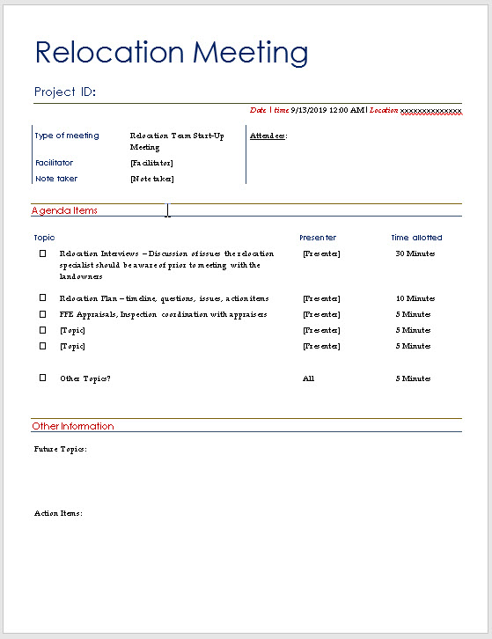
Start-up Meeting Agenda
Notes:
SL
(TOGGLE TO WORD doc)
Start up meeting agenda – There will be a relocation start up meeting with any project with more than 3 relocations separate from the project start up meeting.

Slide 9
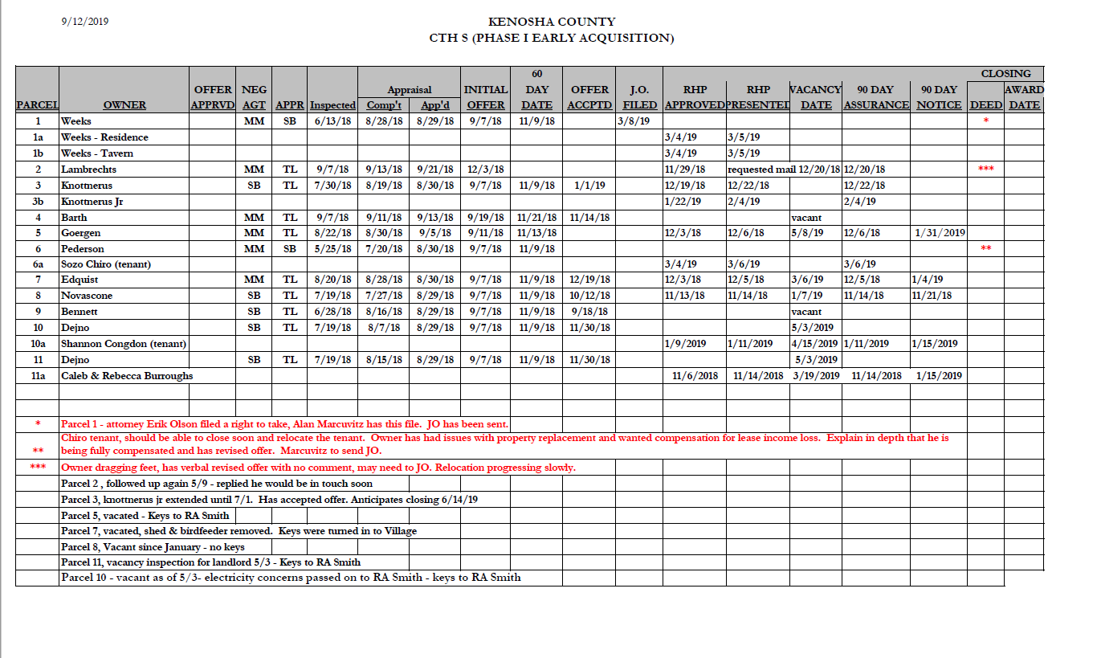
Monthly Relocation Spreadsheet
Notes:
SL
TOGGLE to THE SPREADSHEET
Monthly relocation meeting spreadsheet – each month to be completed by the specialist and submitted prior to the meeting – this meeting is meant to discuss any issues and spearhead any potential issues that need to be discussed

Slide 10
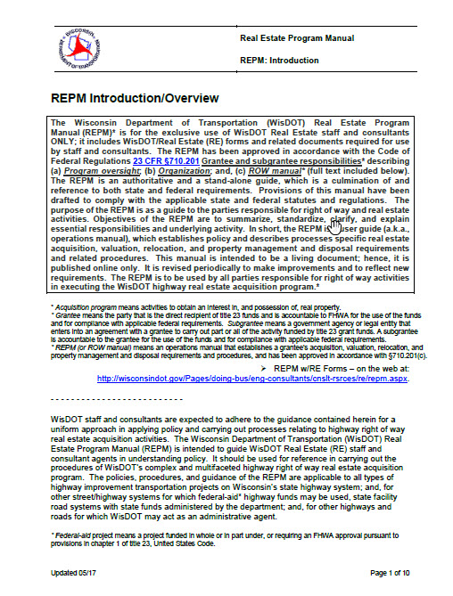
Relocation Program Updates in the
Real Estate Program Manual (REPM)
Link:
https://wisconsindot.gov/Pages/doing-bus/eng-consultants/cnslt-rsrces/re/repm.aspx
Notes:
KW – Introduction
SL – Key updates that have been done
Updates on both manuals

Slide 11
REPM Updates
Chapter 5 full revision published 12/18
Federal updates for MAP-21 changes to the Uniform ACT
State updates for ACT 243-2018
REPM forms updates
Updated Procedures
Updated Calculation Examples
Relocation Records, Reports and Claims – 5.10
Notes:
SL
Updates for the REPM

Slide 12

ACT 243 Changes
Notes:
KW

Slide 13
1. Removed capped BRP payments for County and State projects and increased the maximum payments for local programs to $80,000 for tenants and $100,000 for owners
2. Added language that created a new category of eligibilities for businesses for “Reasonable Project Costs
What did ACT 243 Change for the Relocation Program?
Notes:
KW
Recent Changes to the relocation program – ACT 243
Changes in capped amounts
Reasonable project costs

Slide 14
ACT 243 Changes
Reasonable Project Costs
Capital Costs, including actual costs of the construction of improvements, new buildings
Demolition, alteration, or reconstruction of existing buildings, structures and fixtures
Removal, containment or restoration of soil or groundwater affected by environmental pollution
Clearing and grading of land
Financing costs
Notes:
KW
Recent Changes to the relocation program – ACT 243
Changes in capped amounts
Reasonable project costs

Slide 15
ACT 243 Changes
Reasonable Project Costs(cont’d)
Professional service costs
Imputed administrative costs including reasonable charges for the time spent by the owner or tenant in connection with the project
Costs related to the construction or alteration of public utilities
Notes:
KW

Slide 16

Consultant Policy Changes
Notes:
KP
Explain why changes to the approval process

Slide 17
Relocation Assistance Specialist
LPRE Manual Updates
Section 2.2.5 Relocation Assistance Specialists
Relocation Specialist must be on the approved list. A new Relocation Specialist Application form will be used to evaluate consultants/LPA staff.
NOTE: LPA staff wishing to do relocation work must be up-to-date on processes, procedures, and requirements and regularly conduct relocation services that follow both State and Federal laws and statutes
Notes:
KP
2.2.5 Relocation Assistance Specialists
The LPA may choose to conduct relocation assistance on its own project or may choose to use a relocation specialist on the approved relocation specialist list. If the chosen relocation agent or LPA staff member is not currently on the approved list, then they should submit a Relocation Specialist Application which can be found on the WisDOT Local Program RE website and submit to the LPREM (contact information found on the Local Program Real Estate website). The link to the website is: http://wisconsindot.gov/Pages/doing-bus/local-gov/astnce-pgms/aid/lpa-re-info.aspx.
Note: LPA staff who will be performing their own relocation assistance, must be up-to-date on all processes, procedures and requirements found in this manual as well as the REPM. It is important to remember that when Federal/State funds are used ANYWHERE in a project, additional relocation related requirements are triggered. The LPREPM is available for any general questions and will provide guidance upon request, however it is expected that the LPA staff is experienced enough to conduct the relocation assistance independently. Best practice is to hire an experienced relocation specialist from the approved list.
Individuals seeking admittance to the approved relocation specialist list are expected to be experts in eminent domain acquisition, relocation practices and procedures and are expected to provide the LPA with guidance and accurate documentation. For more detailed explanation on skills and knowledge required please see the Relocation Agent Application (found on the link listed above).
SHOW MANUAL AND APPLICATION

Slide 18
Relocation Assistance Specialist
LPRE Manual Updates
Section 2.2.6 Continuing Education/Expertise
Always RSVP (yes or no) to a training invitation
Webinar offerings will always be recorded and posted online for those unable to attend the live event
Notes:
KP
2.2.6 Continuing Education/Expertise
The LPA Sponsor chooses its consultants from WisDOT’s Statewide List of Approved LPA Fee Appraisal Consultants and the Statewide List of Approved Fee Negotiation and/or Relocation Consultants lists. All consultants on this list are expected to be the experts in their chosen field. This includes being up-to-date on all the process, procedures, and requirements listed in both this manual and in the REPM. LPA staff who are approved and conduct ROW activities are also expected to participate in continuing education and to maintain expertise.
Periodically, WisDOT will offer real estate or appraisal related seminars, webinars, and trainings free of charge. It is expected that Local Program approved real estate consultants and LPA staff should always RSVP to invitations to these events. Attendance is taken at all events and attendees are cross referenced with the approved real estate consultant lists. (If a consultant or LPA staff person cannot make an offered event they must still RSVP with the reason for not attending.) All seminars and trainings offered will be posted on the Local Program RE website which will allow the consultant and LPA staff person to fulfill the training requirement. The LPREM should be notified upon completion (contact information found on the LPA RE website). Contact information and lists are found at https://wisconsindot.gov/Pages/doing-bus/local-gov/astnce-pgms/aid/lpa-re-info.aspx.

Slide 19
Relocation Assistance Specialist
LPRE Manual Updates
Section 2.2.7 LPA Staff/Consultant Performance
Up-to-date on all procedures and practices
NOTE: Official forms and documents are found in READS (in some cases Local Program specific forms or letters will only be found on the LP RE website).
Notes:
KP
2.2.7 LPA Staff / Consultant Performance
Approved LPA staff and consultants are expected to be up-to-date on all procedures and practices. The negotiator, whether LPA staff or a consultant, is expected to provide expert guidance to the LPA Sponsor and to know all the federal and state regulations and laws. The negotiator will be familiar with both this manual and the REPM. Proper documentation is paramount in the local program, and the negotiator should know what type of documentation is required and where to find the most up-to-date version of any required forms. The LPREPMs are available to discuss any concerns and answer questions, however they should not be relied upon for quality control.
Note: The official forms and documents are found in READS (in some cases Local Program specific forms or letters will only be found on the LPA real estate website, https://wisconsindot.gov/Pages/doing-bus/local-gov/astnce-pgms/aid/lpa-re-info.aspx). The forms are subject to change without notice and, therefore, should always be downloaded from READS or in some cases from the LPA RE website.

Slide 20
Relocation Assistance Specialist
LPRE Manual Updates
Section 2.2.8 LPA Staff/Consultant Evaluation
LPREPM will conduct a short review on all LP project
Evaluations will be shared with LPA Sponsor and consultant
Notes:
KP
2.2.8 LPA Staff / Consultant Evaluation
All consultants and LPA staff who perform ROW activities on a project will be evaluated by the regional LPREPM upon completion of Certification 1 status. All evaluations will be shared with the LPA Sponsor and consultant (if applicable). The evaluation forms are found on the LPA real estate website (https://wisconsindot.gov/Pages/doing-bus/local-gov/astnce-pgms/aid/lpa-re-info.aspx).
The evaluation will be used as a tool in verifying that the consultants/LPA staff are adequately performing by:
Meeting deadlines, especially PS&E deadline
Guiding LPA Sponsors throughout the project
Knowing the process, procedures, and requirements as listed in all the manuals (REPM, FDM, LP RE Manual, etc.)
Submitting correct documentation in a timely manner

Slide 21
Relocation Assistance Specialist
LPRE Manual Updates
Section 2.2.9 Unsatisfactory Performance by a LPA Staff / Consultant
Suggestions for improvement
Removal from approved lists
Notes:
KP
2.2.9 Unsatisfactory Performance by a LPA Staff / Consultant
The LPREPM will contact the consultant/LPA staff for inadequate performance and will make suggestions for ways to improve. Continued inadequate/poor performance will result in the removal of the consultant’s or LPA staff person’s name from the approval list until corrective measures (to be determined) are made.

Slide 22
Expectations
READS
    Use as official file during acquisition
    Provide LPA with official documentation at end of project (either hard copy or electronic)
    All relocation plans and claims will be filed through READS
Be the Expert
    Oversight does not mean we are correcting mistakes
    Being an approved relocation specialist means knowing policy, procedures, and how to do documentation correctly
    Review claim documentation prior to submittal to ensure it will be approved the first time
    Claim receipt organization complete
Notes:
KP
Expectations for Relocation Agents
Generating all documents from READS
Utilizing READS as the official file for LPA projects AND providing a hard copy to the LPA
List of relocation projects and references completed in the past 3 years including references
on the statewide approved fee negotiation/relocation list
Resume includes relocation course work through IRWA or NHI

Slide 23
What if…
“What if there are no federal or state funds in the real estate only in construction…”
“What do you mean we have to follow the Uniform Act?”
“What if we did’nt get WisDOT approval…”
What happens if approvals are missed?
What happens if it’s not documented?
“Can we let the tenant finish out a lease term so that we don’t have to provide relocation benefits?”
Notes:
KW
Oversight
Updates to the LPA RE Manual with a standardized approval process
Expectations for Relocation Agents
Generating all documents from READS
Utilizing READS as the official file for LPA projects AND providing a hard copy to the LPA
List of relocation projects and references completed in the past 3 years including references
on the statewide approved fee negotiation/relocation list
Resume includes relocation course work through IRWA or NHI

Slide 24

Upcoming Training
Notes:
kp

Slide 25

Contact Information
Kassandra Walbrun
Statewide Relocation Faciltator
Kassandra.Walbrun@dot.wi.gov
(608) 266-2369
Kerry Paruleski
Local Program Real Estate Manager
Kerry.Paruleski@dot.wi.gov
(414) 239-4156
Notes:
Go to website and show

Slide 26

THANK
YOU!

Slide 27
Q & A
    Teleconference Q & A
      (888) 557-8511
      Access Code 2483508
Notes:
Go to website and show

