Slide 1



“A previously recorded live web cast”
Partial Release of Mortgage as presented September 22, 2016
LPAs and consultants can get credit for viewing presentation, if requested, by emailing:
Kerry.Paruleski@dot.wi.gov or Cynthia.Michalski@dot.wi.gov
Wisconsin Department of Transportation (WisDOT)
LPA Program – Real Estate

Slide 2


In exchange for federal aid, the Federal Highway Administration (FHWA) expects local municipalities to obtain an adequate interest in the right of way (R/W). This means that title to any R/W acquired should be clear of all liens and encumbrances. We put together this presentation to talk directly about acquiring clear title to real estate that is needed for state or federal funded local road projects. You may be asking, “why now?” Obtaining and insuring clear title to real estate for highway projects is nothing new. This has been the policy and requirement for decades. In fact, the WisDOT Real Estate Program Manual (REPM), the larger part of our Local Public Agency (LPA) Manual for Right of Way Acquisition, details the processes and procedures for clearing right of way, including obtaining clear title to any property needed for projects.
This is a WisDOT presentation on clearing title for real estate during the acquisition process for a local road project with guidance as to
why, when, and how to obtain partial mortgage releases.

Slide 3

This presentation is intended to provide an overview of what it takes to obtain a clear real estate or real property title and provide information about what a partial mortgage release is, why you need it, when, and how to get it. WisDOT will work with you, the LPA, to make sure that project schedules are maintained and we can give you ideas for keeping costs down. If you have questions regarding a specific project, please contact your regional WisDOT LPA management consultant (MC) – individual contact info is listed at end. Your regional MC will work with you to discuss questions/concerns.

Slide 4


Up to this point, WisDOT (in our role as an oversight agency) had pretty much allowed local public agencies (LPAs) to weigh their own risks and make their own decisions on securing clear title for certain low value property acquisitions. FHWA recently become aware of this practice and reminded WisDOT that part of our duty to oversee federal funds and spending is they expect that for all property acquired as part of a state or federal-aid project, those properties must be adequate for the construction, operation, and maintenance of the resulting facility and for the protection of both the facility and the traveling public. FHWA believes, and WisDOT agrees, that meeting the ‘adequacy of interest test’ requires the LPA to acquire clear, marketable title to all real property or real property interests necessary for the project. To not do this, may jeopardize the project, and thus the funding.
This is a key clarifying point to WisDOT’s oversight role, the LPA’s responsibility, and FHWA’s expectations for acquisitions on LPA projects...
‘adequacy of interest test’

Slide 5


Obtaining and insuring clear title on property acquired for highway projects is not new policy. WisDOT did, however, go through a brief period in the early 2000s when we felt that perhaps for simple, low value, non-complex acquisitions, because the risk appeared low, maybe we wouldn’t really need to go through the extra steps and sometimes long process of having to obtain partial mortgage releases. But, when the real estate market turned downward in the mid-2000s and foreclosures skyrocketed, it became very clear that we were putting our own projects at risk by not going after and insuring absolute clear title for all property acquired, and we were also doing a disservice to any property owners who were under a legally binding mortgage contract with their financial institution.
Things have changed, but not really!

Slide 6



So, let us begin this presentation on securing clear title to real estate; and specifically, why, when and how to obtain a partial mortgage release on property acquisitions for LPA road projects.

Slide 7

Partial Release of Mortgages

Slide 8


What is a Partial Mortgage Release?
It is a partial satisfaction of a mortgage. The lender acknowledges that the portion of the property being acquired has been fully paid and that the mortgage is no longer a lien on that portion of real property.

Slide 9

Why do we need a
Partial Mortgage Release?

Slide 10

Clear Title
The LPA, when accepting state or federal funds to be used for any aspect of their transportation project (real estate, design, or construction), agrees to follow all state and federal requirements.
See: 23 CFR 710.201(h).

Slide 11

Clear Title
Under federal law, property acquired for a state or federal-aid project must be adequate for the construction, operation, and maintenance of the resulting facility and for the protection of both the facility and the traveling public. See, 23 CFR 710.201(e). Meeting the adequacy of interest test requires the LPA to acquire clear, marketable title to the real property or real property interests necessary to build the project.

Slide 12

Clear Title
Where the interest to be acquired is only a portion of the subject property (partial acquisition), WisDOT’s policy, with FHWA’s concurrence, requires the LPA to obtain either partial releases or subordination agreements for any prior recorded liens or title encumbrances. This requirement applies to recorded mortgages, no matter the complexity or dollar amount. The sole exception to this requirement is for temporary limited easements (TLE) where the risk of foreclosure prior to or during construction is low.

Slide 13

Protect the Property Owner
Mortgage agreement provisions -
  In most mortgage agreements, it is a violation to sell off any property under the mortgage without the consent of the lender, which is why we need to obtain a mortgage release or partial mortgage release.
  Mortgages are legally binding agreements and the lender has the ability to:
    “...declare immediately due and payable all sums secured by this Mortgage upon the sale or transfer, without Lender’s prior written consent, of all or ANY PART of the Real Property, or any interest in the Real Property.”
    (Taken from a JPMorgan Chase Bank mortgage agreement.)

Slide 14

Protect the Property Owner
Property owners are putting a lot of trust in us. So, we need to acquire the property correctly for them. In many cases, probably most, if there is a violation of the mortgage agreement, the lender can immediately call the entire mortgage due.

Slide 15


Protect the LPA
You may have to pay twice:
  In the case of a property being foreclosed on, the LPA will likely have to pay the lender to acquire the property again.
  Why? The lender will not have received payment from the initial acquisition and would not have released their rights to the property. The LPA would be subordinate to the lender in the chain of title.

Slide 16


Protect the LPA
Issues could hold up project...
  If the mortgage company is uncooperative after foreclosing on the property, you may have to go through the condemnation process.

Slide 17


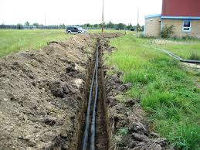

When do you need it?
Simple rule: You need to obtain a partial mortgage release on any permanent acquisition that has a mortgage, including...
  FEE
  PLE
  HE

Slide 18


Side Note...
A lender will likely not be willing to release their interests on a PLE or HE because the lender still has an interest in the property.
Talk to your MC about ‘Consent of Lien Holder’ language. We want to make sure the lender is subordinating to the LPA.
For these cases a ‘Subordination Agreement’ or ‘Consent of Lien Holder’ will be sufficient
  See LPA manual/forms

Slide 19


Obtaining a
Partial Mortgage Release
Notes:
.

Slide 20

Scheduling
Plan ahead:
  Expect that acquisitions needing a partial mortgage release can take longer to close.
Timelines from experience:
  Local banks and credit unions – typically take from one week to one month!
  National banks – typically take two months or longer!!!

Slide 21
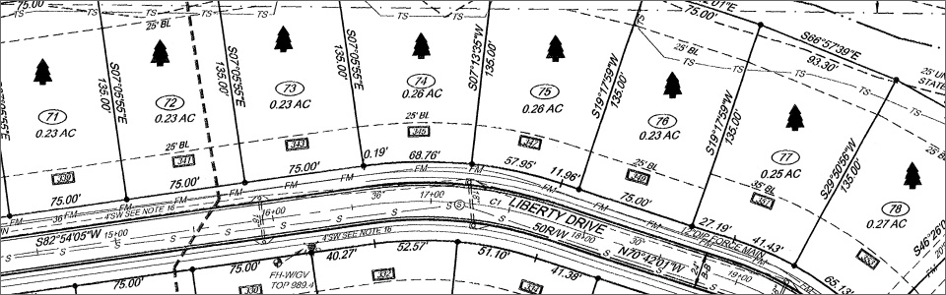

Use the ‘Preliminary’ Plat
Once you have a preliminary plat, we suggest getting started right away to find all the parcels that will require permanent acquisition in FEE, PLE or HE.

Slide 22

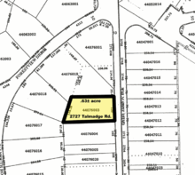
~ Go Through Title Work ~
Once you know which parcels will require a permanent interest, go through the title work for those parcels, looking for those with mortgages. This will give you an idea of how many possible appraisals will be needed for partial releases.
Make sure you have
updated title work!

Slide 23

Call the Lenders...
Research lender’s requirements
  (maybe an appraisal is not needed)
Get a point of contact
Keep information for future releases

Slide 24

Call the Lenders/Ask Questions
Possible lender requirements:
  Appraisal
  TPP and legal
  Check processing fees
  Authorization form
  Purchase Agreement
  Closing Statement
  Payoff amount
  Partial release document*
  * Not all lenders will draft the partial release; they may require you to do so.

Slide 25

Meet with Property Owner
Inform the property owner that their lender may require for a portion, or even all of the compensation to release the property being purchased; it should be applied to the principle of the property owner’s mortgage.
Provide a third-party authorization form. This will give you the authorization to work with the property owner’s lender on their behalf.
  Note: Some lenders will only accept their own forms. This is another reason to connect with the lenders before meeting with the property owner so you don’t have to go back to the owner to have another document signed. If the lender does not have one, use the standard authorization form in LPA Manual/forms list.

Slide 26

Send Documents to Lender 
Send third-party authorization to lender
  A third-party authorization form may take some time to process; so, get it to the lender ASAP
Once signed, send remaining documents and checks for processing

Slide 27

Side Note...
Assignment of leases and rents:
  Ask for release
  Will usually reference ‘Assignment of Leases and Rents’ document number in partial release document

Slide 28

The Mortgage Electronic Registration System (MERS)

Slide 29


What is MERS?
MERS acts as mortgagee in the county land records for the lender and servicers. Future assignments of any loan -- where MERS is the mortgagee -- registered on the MERS® System are not necessary because MERS remains the mortgagee no matter
how many times
servicing is traded.
MERS and the MERS® System were created by the mortgage banking industry to streamline the mortgage process by using electronic commerce. It allows lenders to buy and sell mortgages without recording new assignments of mortgage.
From MERS “about us:” “Today’s financial services industry depends on technological innovations to provide its customers with access to information, increased efficiency and reduced processing costs. MERSCORP Holdings, Inc. owns and operates the MERS® System, a national electronic registry system that tracks the changes in servicing rights and beneficial ownership interests in mortgage loans that are registered on the System.”

Slide 30
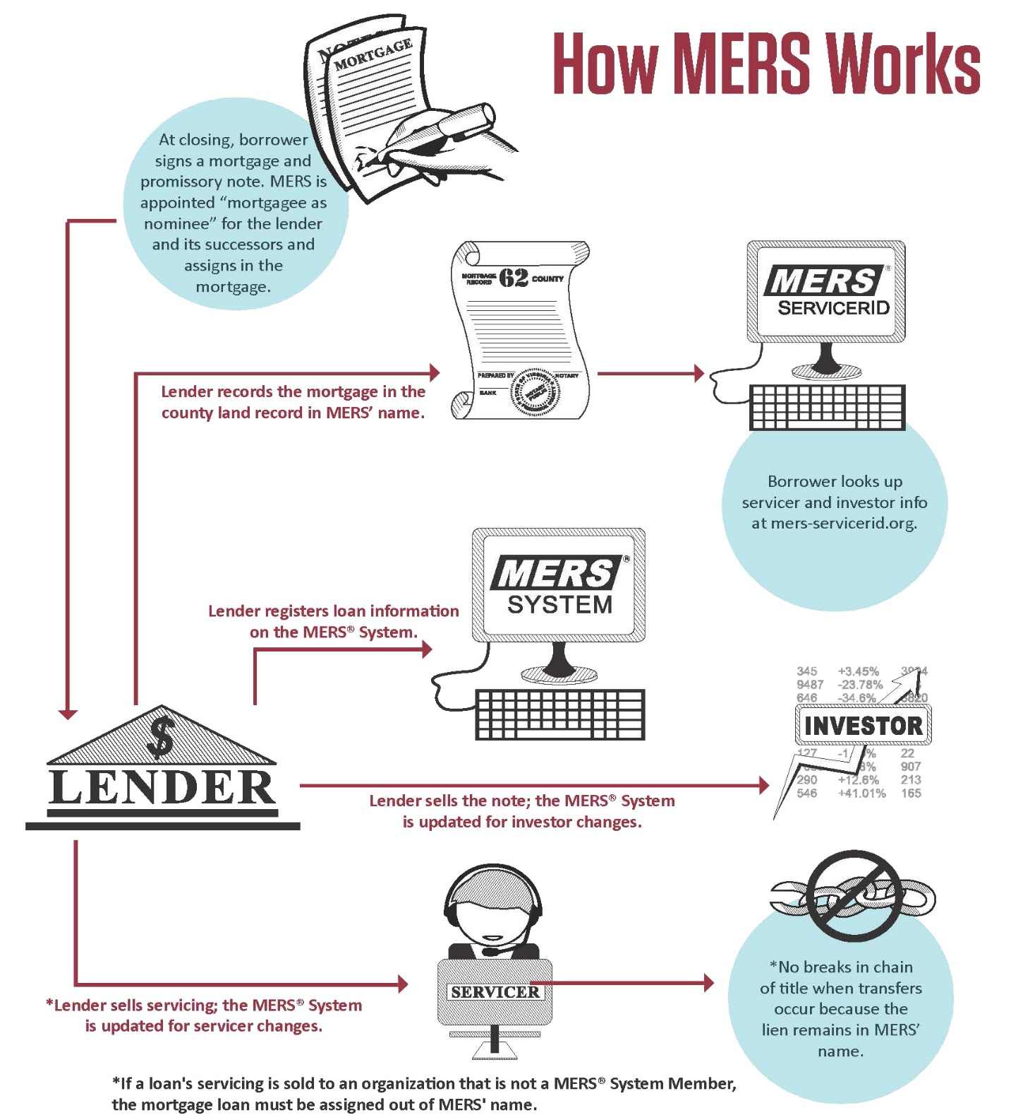
See MERS FAQs at: https://www.mersinc.org/about-us/faq#whatismers

Slide 31

using MERS...
After working first with the current lender and property owner to gather all pertinent information:
  Go into MERS at https://www.mers-servicerid.org/sis/
  Enter 18 digit Mortgage Identification Number (MIN), which can be found on the original mortgage document.
  Proceed to obtain a partial release as described previously with the current lender.

Slide 32

What will MERS information look like?
‘Sample’ MERS reference on title:
  “Mortgage from John and Sue Smith to Mortgage Electronic Registration Systems, Inc. acting solely as nominee for Lender, “Lenders Name Here,” and its successors and assigns in the amount of $200,000 dated January 1, 2000 and recorded January 3, 2000.”

Slide 33

What if you cannot obtain a release in time?

Slide 34

Jurisdictional Offer (JO)
If you cannot obtain a release in time, you may obtain the property through condemnation via a Jurisdictional Offer.
Figure out date that JO needs to be issued by:
  Make sure process was followed and everything is in place for JO to be executed (appraisal done, owner given 60 days, etc.)
  See LPA Manual/Chapter 9.0 Condemnation Process
Issue check with both property owner and lender on it.
  See Real Estate Program Manual (REPM), Chapter 3/3.9.6 Jurisdictional Offer (JO) to Purchase; 3.9.7 Notice Jurisdictional Offer; and, look for other key references throughout the REPM specific to the Jurisdictional Offer (JO) process and processing.

Slide 35


Who can help with local right of way questions?
The Wisconsin Department of Transportation (WisDOT) has several regional Local Public Agency Real Estate (LPA RE) coordinator positions and one statewide coordinator along with five regional management consultants (MC) to help coordinate and oversee all LPA RE related activities.
See: http://wisconsindot.gov/Pages/doing-bus/local-gov/astnce-pgms/aid/lpa-re-info.aspx. Information on that page is specific to LPAs needing to perform real estate right of way acquisitions as part of a local road improvement project. There, we provide some basic resources and guidance for securing state and federal aid for real estate acquisitions.

Slide 36
Local Public Agency (LPA) Real Estate Acquisition Information
See: http://wisconsindot.gov/Pages/doing-bus/local-gov/astnce-pgms/aid/lpa-re-info.aspx
The LPA RE coordinators and the MCs are available to assist local public agencies and other entities that acquire property for federal-aid transportation projects. WisDOT also has a list of pre-approved consultants to help local entities who may not have sufficient or qualified staff to acquire properties in compliance with state and federal laws and regulations. LPAs must work with a WisDOT MC on projects when there is state/federal funds to be used in the any part of the project. The LPA must follow minimum procedures to secure approvals needed to proceed with right of way acquisition on state or federal aid projects. Detailed guidance can be found in the LPA Manual, which includes required LPA forms. It is the responsibility of each LPA to ensure that all state and federal procedures and laws are followed. Before beginning an acquisition process, agencies must contact their MC; see contacts on later slide...

Slide 37

WisDOT’s Local Public Agency (LPA) Manual for Right of Way Acquisition
See: http://wisconsindot.gov/Pages/doing-bus/eng-consultants/cnslt-rsrces/re/lpa-manual.aspx#table
Using the LPA Manual...
The Local Public Agency (LPA) Manual for Right of Way Acquisition w/LPA forms is intended to assist local public agencies (LPAs) in the state of Wisconsin to secure funding for local road projects
and is to be used as a guide to local government staff for right of way acquisitions.
LPA Manual – can be viewed in its entirety as a PDF or in Microsoft Word.

Slide 38

Local Public Agency (LPA) Manual for Right of Way Acquisition
See: http://wisconsindot.gov/Pages/doing-bus/eng-consultants/cnslt-rsrces/re/lpa-manual.aspx#table
The Local Public Agency (LPA) Manual for Right of Way Acquisition is intended to assist Local Public Agencies (LPAs) in the state of Wisconsin to secure funding for local road projects and is to be used as a guide to right of way acquisition. This manual briefly describes the processes, documents and approvals necessary to obtain Wisconsin Department of Transportation (WisDOT) and/or Federal Highway Administration (FHWA) funds. This is a compilation of information from many sources and is intended as a reference for administrative and field personnel in local governmental agencies. It is not intended to be a comprehensive document. The official version of this manual is the online/electronic publication. Access is available via the WisDOT website. It is intended to be a living document; hence, it will be revised periodically to reflect new requirements. It will also be changed as needed to make it more useful to its readers. Users should use the current online/electronic publication for reference. Local Public Agencies (LPAs) must follow the minimum procedures outlined in this manual to secure the approvals needed to proceed with right of way acquisition on state or federal aid projects. The request for use of federal funds in right of way is to be coordinated with the regional Real Estate (RE) Coordinator for WisDOT assigned to the area in which the local project is located. It is the responsibility of the LPA to ensure that all state and federal procedures and laws are followed. Transportation construction projects using federal funds under a local project agreement, except sidewalks, are likely general improvements that primarily benefit the public at large and for which special assessments cannot be levied under s. 66.0703, Wis. Stats. Municipalities desiring to obtain the required local project funding through special assessments levied against particular parcels should seek advice of legal counsel. See Hildebrand v. Menasha, 2011 WI App 83.
Key documents, forms and letters as referenced throughout this manual are listed in the Appendix, and fill-ready forms can be downloaded directly from the LPA Manual/Forms page. Also be aware that this manual is a sub-section of the larger Real Estate Program Manual (REPM), also accessible via WisDOT’s website. To obtain additional detailed information, direction and guidance relating to the policies and procedures as outlined and discussed throughout this manual, you should make frequent reference to and use of the REPM in its entirety.
Caution! Do not start the acquisition process until the following approvals have been obtained and documented in the project files: Design Study Report; Right of Way Plat or Construction Plan; Relocation Plan (if required)
Relocation Order; Acquisition Capability Statement/Real Estate Contracts; Real Estate Funding Approval (when state and/or federal aid is in right of way); Exception: For advanced acquisitions, see Section 1.5 Advanced Acquisitions.
Legal references: Uniform Relocation Assistance and Real Property Acquisition Policies Act of 1970, as amended (Uniform Act); 49 CFR; and, 23 CFR; Chapter 32/Eminent Domain, Wisconsin Statutes; Dept. of Administration/Admin Code: Chapter 92 - Relocation Assistance.

Slide 39
WisDOT
LPA Management Consultants (MC)
Contact Information
Regions served - MC (these are the LPAs & WisDOT's main contact)
North Central (NC) | Cedar Corporation, Greg Wolfe, PE (715) 235-9081
Northeast (NE) | JT Engineering, Inc., Rich Glen, PE (920) 468-4771
Northwest (NW) | Knight E/A, Inc., Randy Byom (608) 519-1455
Southeast (SE) | DAAR, Stan Lukasz (414) 225-9817
Southwest (SW) | KL Engineering, Jeff Melville (608) 663-1218
http://wisconsindot.gov/Pages/doing-bus/local-gov/astnce-pgms/aid/lpa-re-info.aspx

Slide 40
WisDOT LPA Real Estate
Contact Information
Kerry Paruleski, LPA RE Central Office
  414-220-5461
  Kerry.Paruleski@dot.wi.gov
Bill Burki, LPA RE Coordinator SE Region
  414-382-7037
  William.burki@dot.wi.gov
Cindy Michalski, LPA RE Coordinator SW, NW and NC Regions
  715-421-8350
  Cynthia.Michalski@dot.wi.gov
Dawn Van Oudenhoven, LPA RE Coordinator NE Region
  920-366-2084
  Dawn.vanoudenhoven@dot.wi.gov
http://wisconsindot.gov/Pages/doing-bus/local-gov/astnce-pgms/aid/lpa-re-info.aspx

