Slide 1
Understanding and Complying with New Storm Water Mitigation Requirements from the EPA
WHRP Project 0092-13-03
Qian Liao, Hani Titi, and Jin Li
University of Wisconsin-Milwaukee

Slide 2
Background
U.S. EPA published the new Effluent Limitations Guideline (ELGs) in December 2009
  All construction sites disturbing 20 or more acres of land must sample to stormwater discharge
  The daily average of turbidity must not exceed 280 NTU
  The limitation applies for storms less than a 2-year 24-hour event
The numeric limitation was removed in EPA’s final rule in 2014 as a part of a settlement of industrial law suit. However, EPA may consider additional effluent limitations and monitoring requirement in future regulations.
Little information has been documented for actual turbidity levels in stormwater runoff from Wisconsin construction sites

Slide 3
Research Activities
Conduct literature review: turbidity, EPA’s ELGs
Take grab samples of stormwater from identified WisDOT construction sites to measure the turbidity, TSS, pH and conductivity
Deploy automated turbidity sampling devices to measure the turbidity time series of the effluent from construction sites.
Explore the correlation between the turbidity runoff and the precipitation
Conduct laboratory experiments to examine the TSS-turbidity correlation

Slide 4
1. Literature Review

Slide 5
Understanding Turbidity
Turbidity is a measure of water clarity, i.e., how much the material suspended in water decreases the passage of light through the water.
Suspended materials mainly include soil particles, algae, microbes and other substances.
Turbidity is an important parameter in assessing the environmental health of water bodies.
Practically, turbidity can be measured by a Nephelometer which detects particle light scattering from the side of the light beam(s) The units of a calibrated nephelometer are called the Nephelometric Turbidity Units (NTU)

Slide 6
TSS-Turbidity Relation
Total Suspended Solids (TSS): total mass of small solid particles in water which does not settle out by gravity.
TSS is usually measured by filtration, e.g., EPA Standard Method 160.2
Many studies demonstrated good correlations between TSS and turbidity, although correlation coefficients varied significantly, largely due to different properties of solid particles
Better correlations were found for construction site runoff samples, possibly due to the lack of organic matters in soil.
Many studies suggested a linear TSS-Turbidity relation, i.e.,
TSS (mg L⁻¹) = α Turbidity (NTU),
where α = 0.6~3.4 (mg L⁻¹ NTU⁻¹)

Slide 7
Factors Affect Turbidity Measurements
Factors related samples:
  Particle size, shape, and color
  Water color, dissolved organic matters
Factors related to devices:
  Light sources (e.g., tungsten lamps, LEDs, lasers)
  Type of photodetectors
  Angles of detections
Calibration standards (Formazin or SDVB particles)

Slide 8
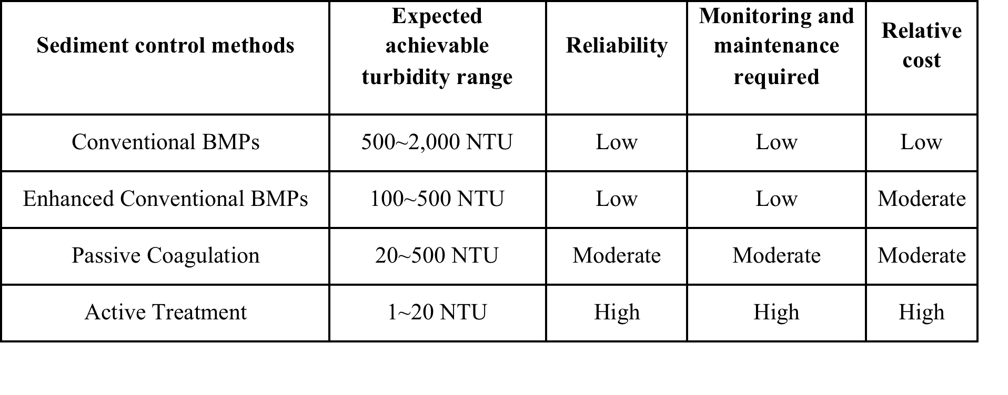
Turbidity of Construction Site Runoff
NCHRP project report (2012)*
* NCHRP (2012) Turbidity reduction and monitoring strategies for highway construction projects. NCHRP Project 25-25(74) Final Report.
Notes:
Note: NCHRP: National Cooperative Highway Research Program, (2012)

Slide 9
2. Methodology

Slide 10
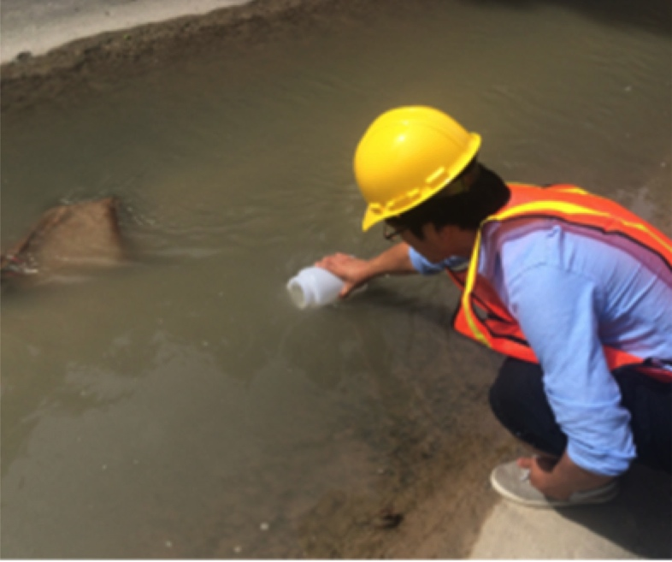
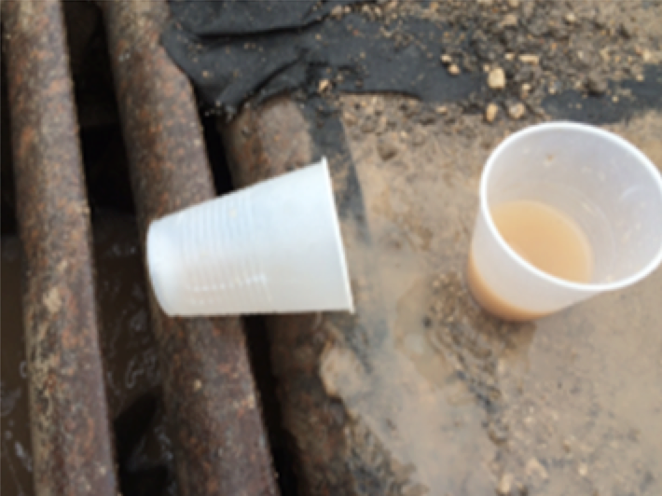
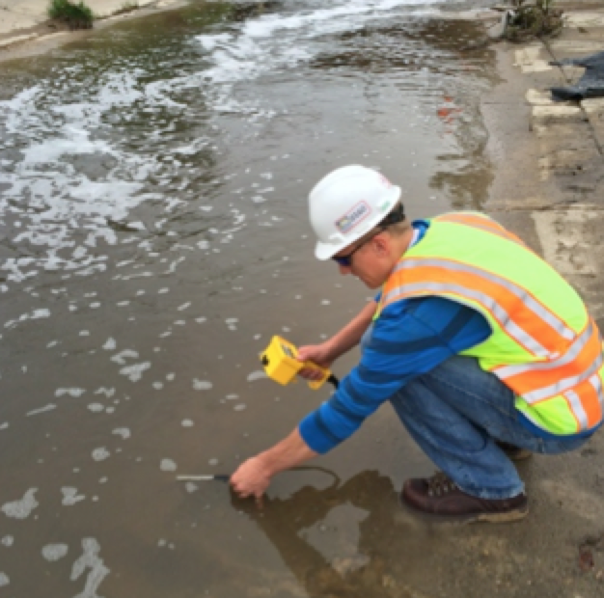
Field Grab Sample Collection and Measurement

Slide 11
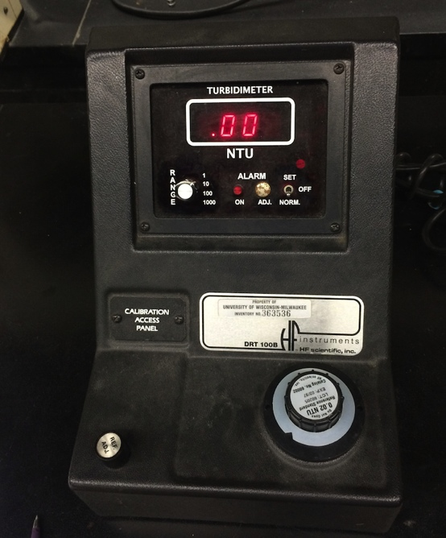
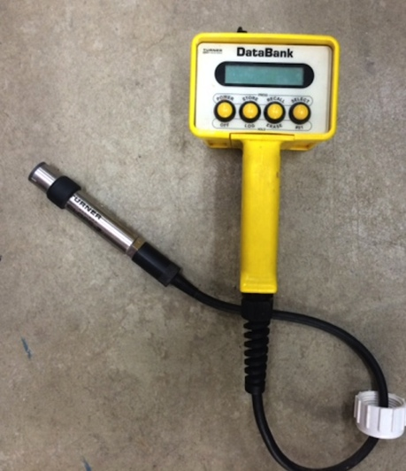
Turbidimeters
Lab bench-top nephelometer: HS Scientific DRT-100B turbidimeter
Handheld probe: Turner Designs Cyclops-7 submersible turbidity sensor

Slide 12
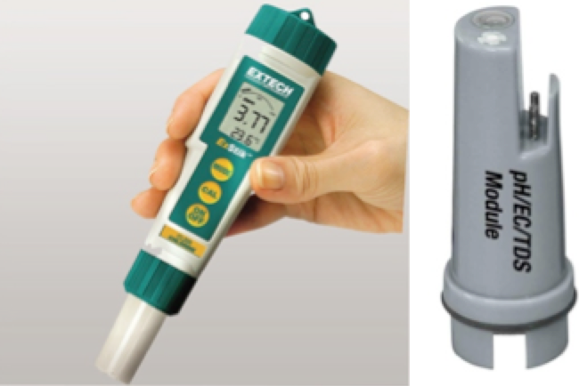
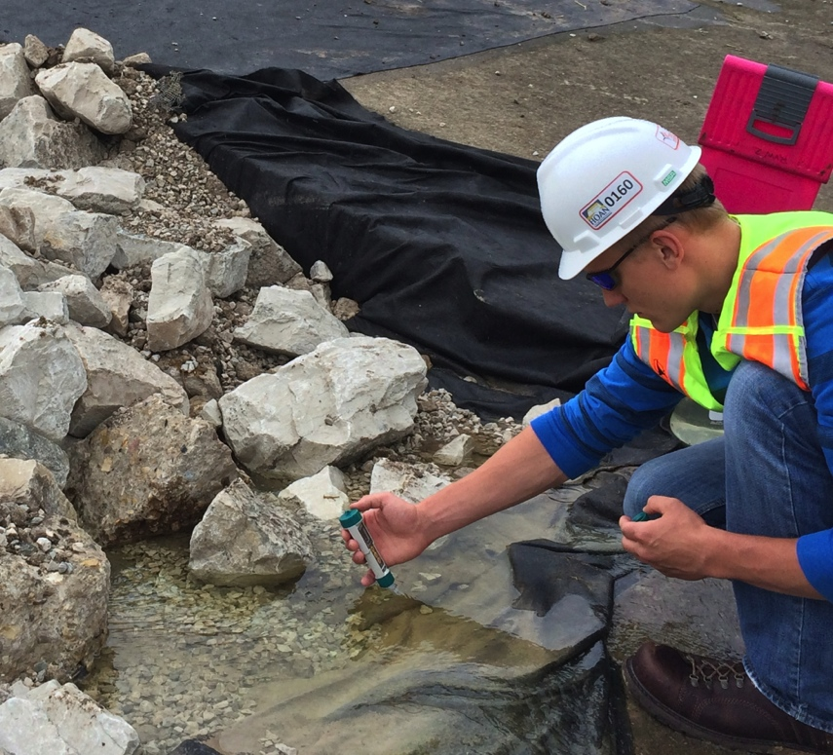
pH and Conductivity
ExTech ExStik EC500 pH/Conductivity handheld sensor

Slide 13
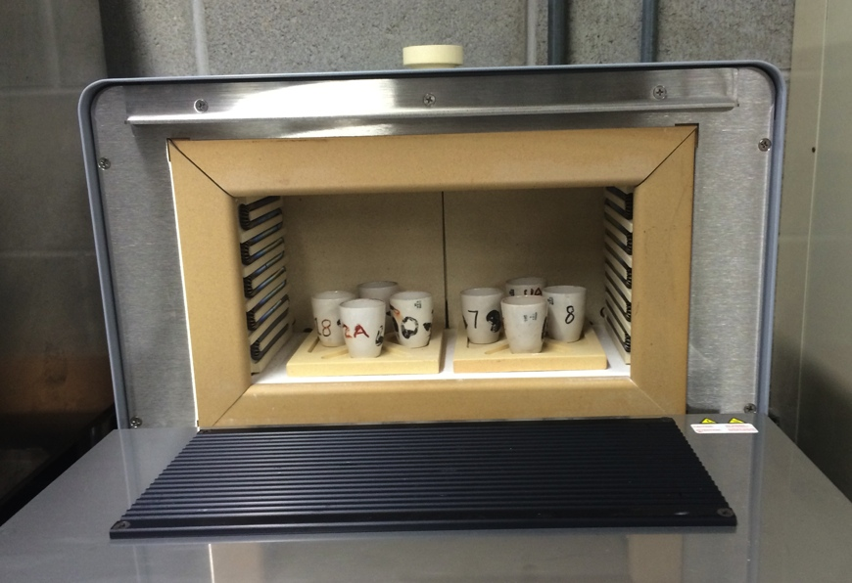
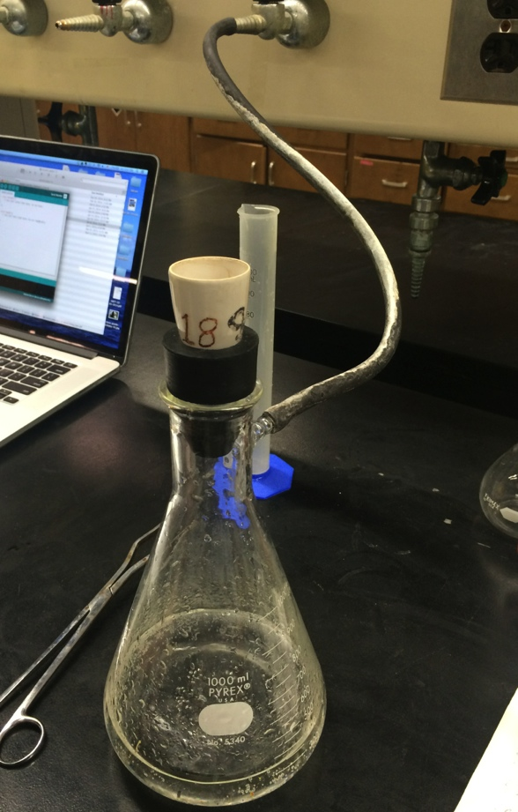
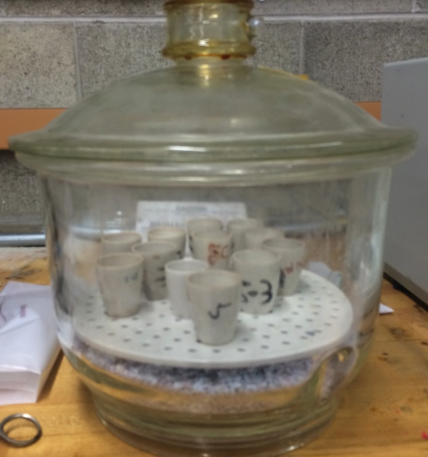
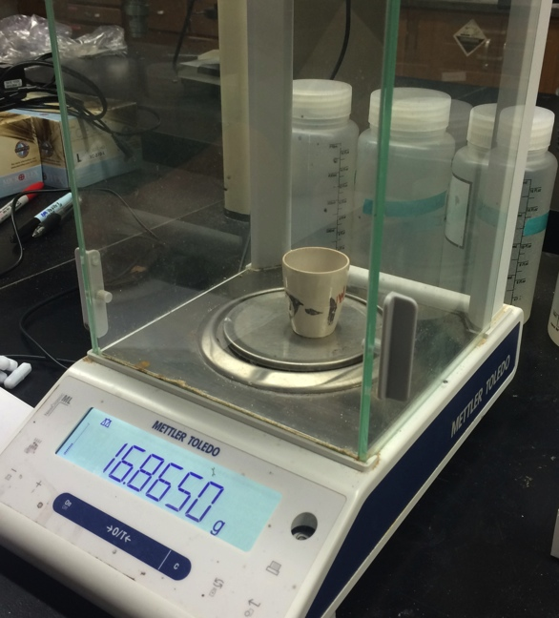
Total Suspended Solids Measurement
2
1
3
4
Notes:
1. Filter through a Gooch cubicle, 2. Dried in the oven (105 ºC) for 1 hour, 3, further dried in the desiccator for 20 min, 4, residuals are weighed.

Slide 14
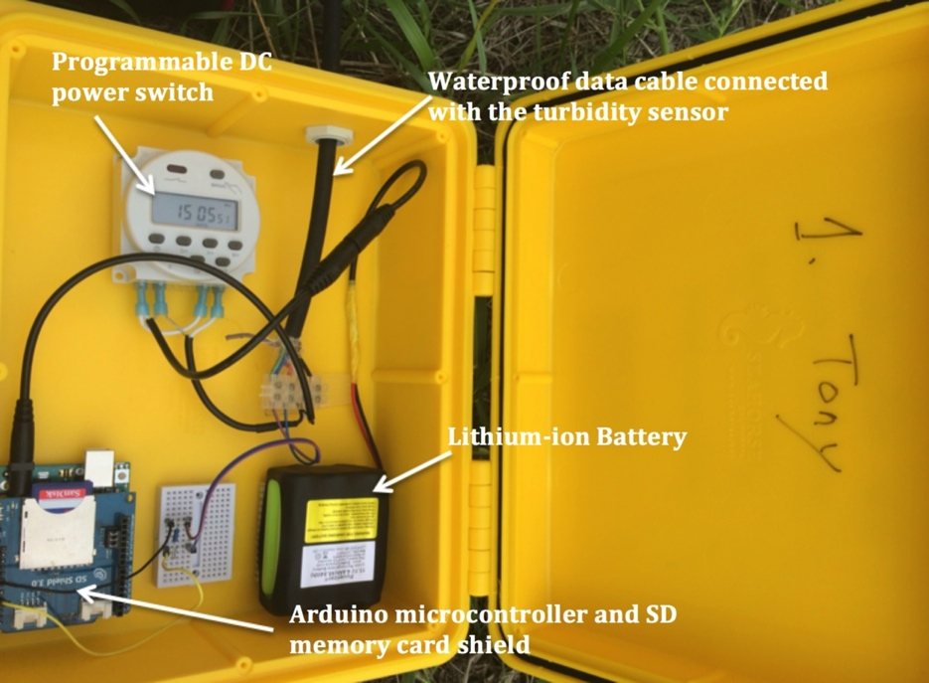
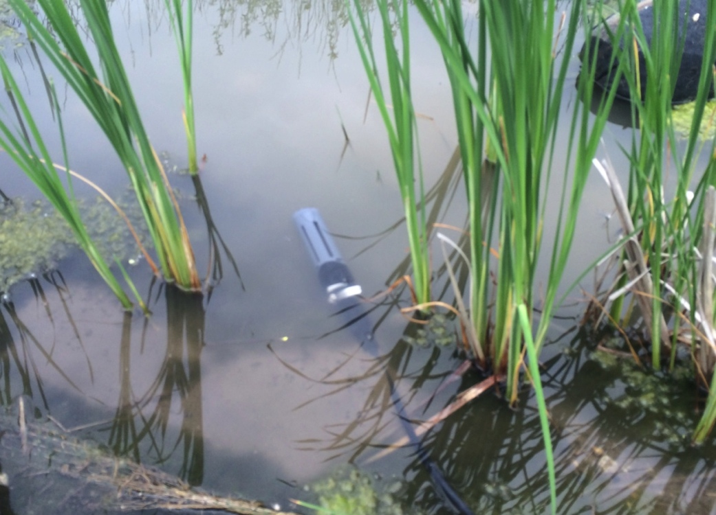
Automated Turbidity Sampling Device
Developed based on Turner Designs Cyclops submersible turbidity probes
Measures time series turbidity at major outfalls (streams, storm drains or rivers) of construction sites
Sampling frequency: 17 times a day

Slide 15
3. Field Grab Samples

Slide 16
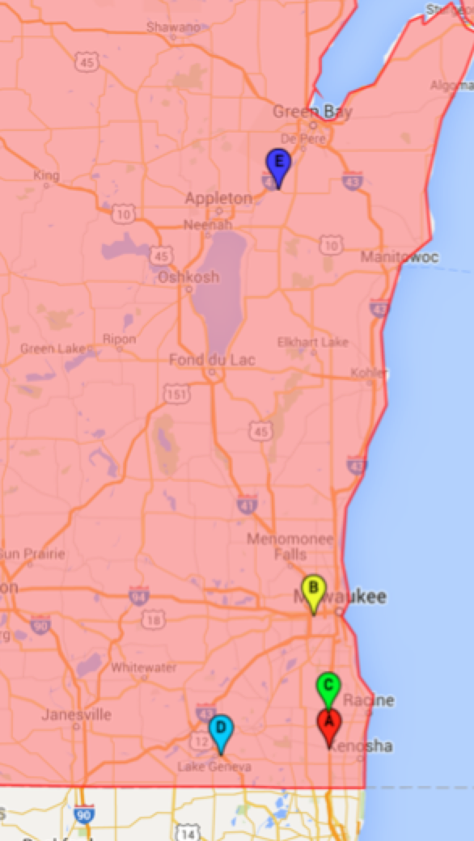
Identified Sites
Site Name | Location | Grab samples | Automated Samples
A. Kenosha | STH-50 & I-94 | Yes | no
B. Wauwatosa | STH-181 & I-94 | Yes | Yes
C. Racine | SHT-20 & I-94 | Yes | Yes
D. Lake Geneva | STH-50 & US-12 | Yes | Yes
E. Wrightstown | STH-96 & Fox River | No | Yes

Slide 17
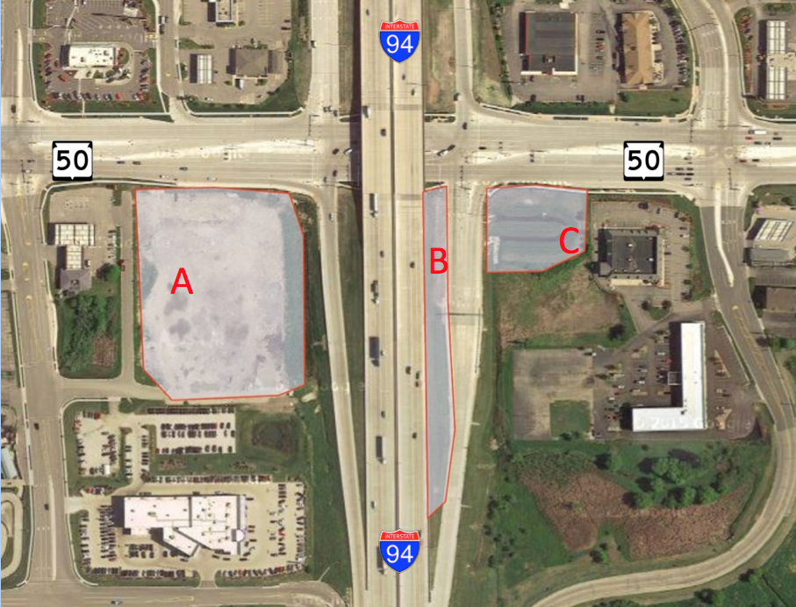
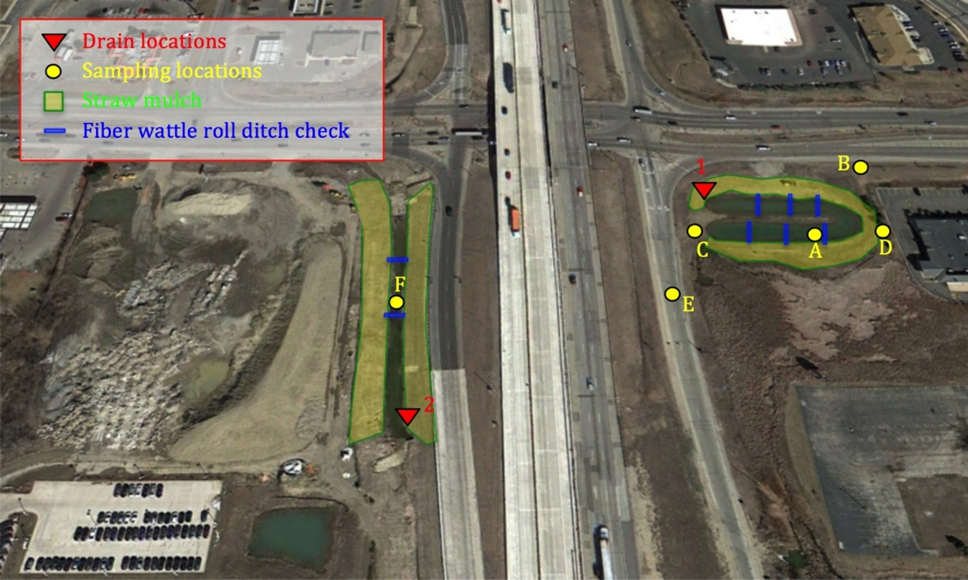
Kenosha Site
Total disturbed land area: 7.7 acres
BMPs: straw mulch, retention pond, ditch checks.
Sampling locations:
  Retention pond
  Inlet of the retention pond
  Paved surface
  Stormwater ditch

Slide 18
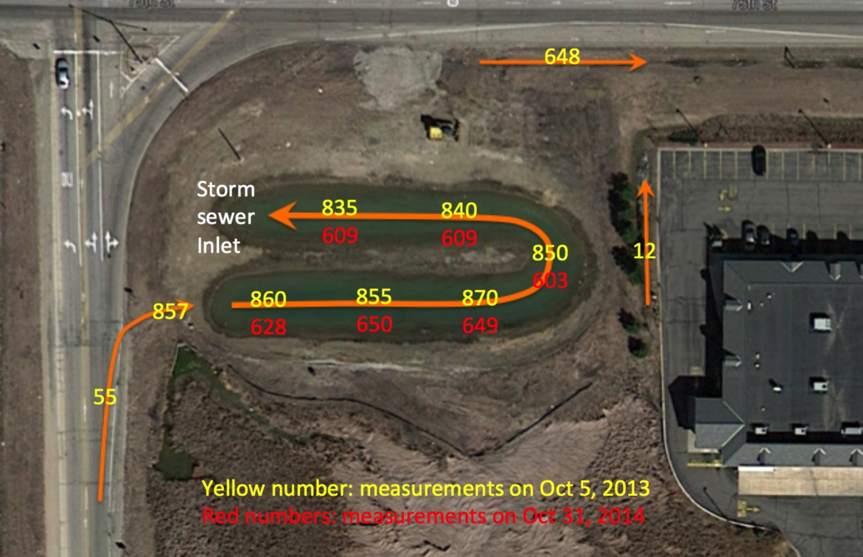
Kenosha Site: Grab Sample Turbidity
Yellow: Oct 5, 2013
Red: Oct 31, 2013

Slide 19
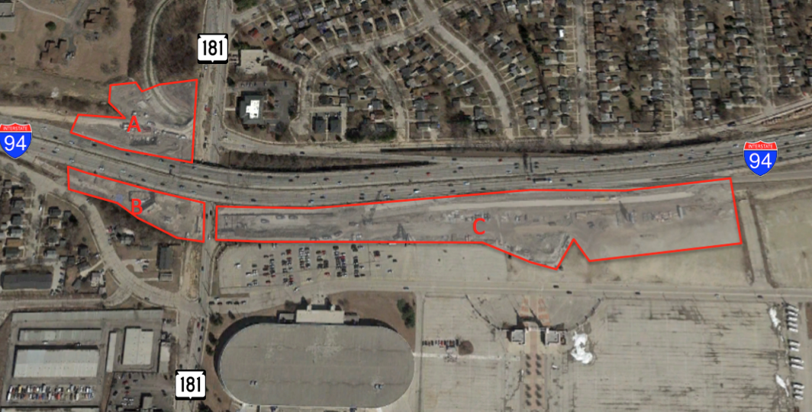
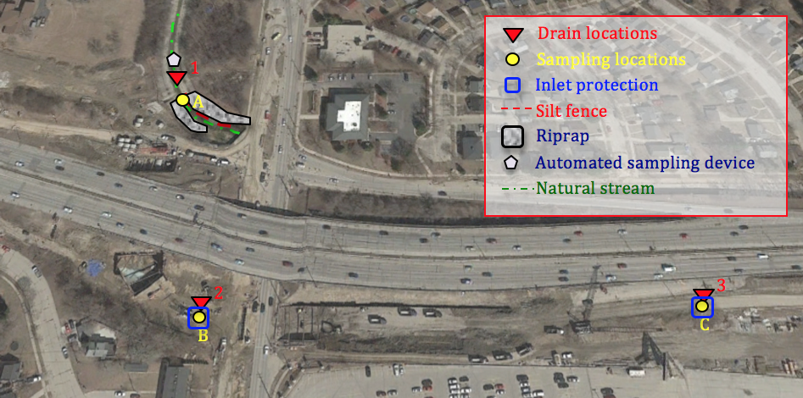
Wauwatosa Site
Total disturbed land area: 10.9 acres
BMPs: Inlet protections, ripraps, silt fences
Sampling locations:
  Stormwater inlet
  Honey creek

Slide 20
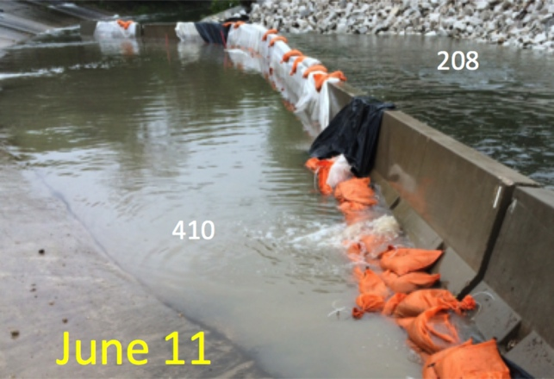
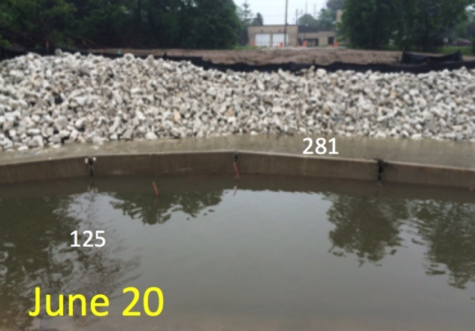
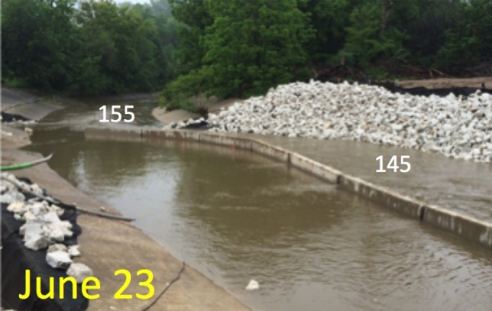
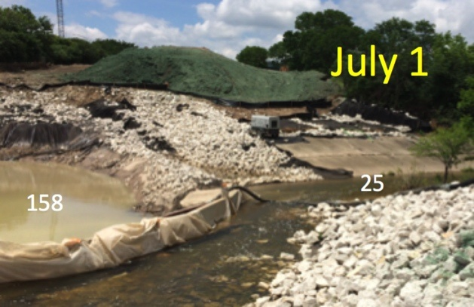
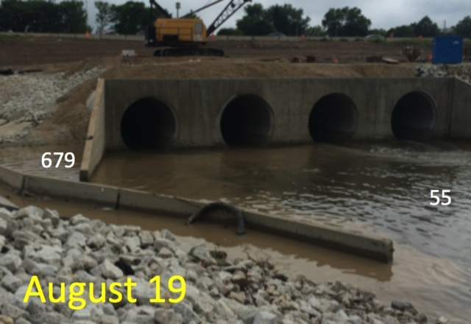
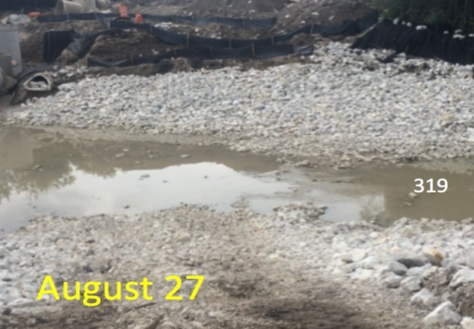
Wauwatosa Site: Grab Sample Turbidity

Slide 21
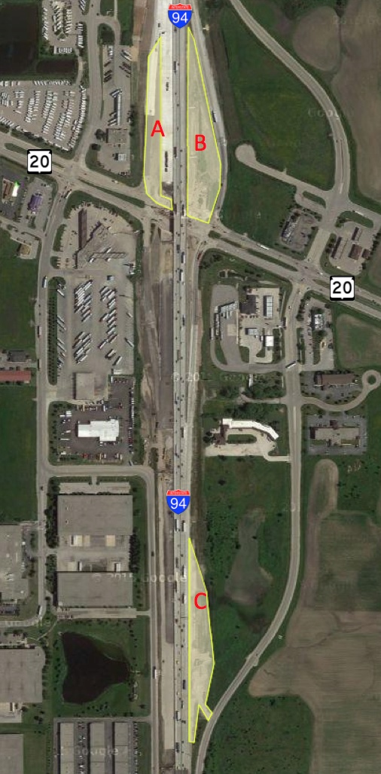
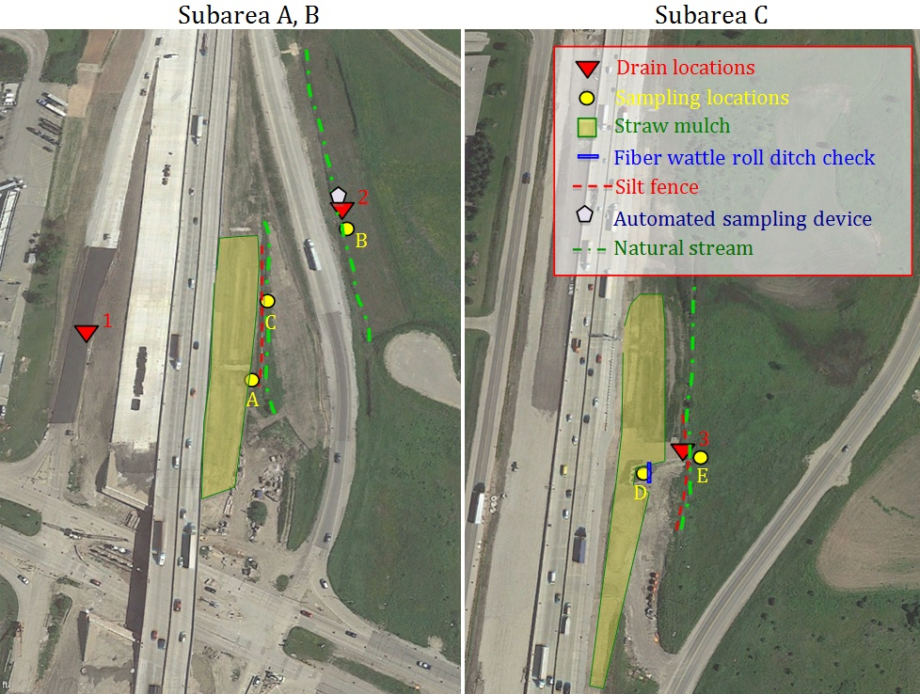
Racine Site
Total disturbed land area: 7.92 acres
BMPs: straw mulch, silt fence, ditch checks
Sampling locations:
  Natural stream along disturbed soil
  Natural stream (outfall)
  Stormwater ditch

Slide 22
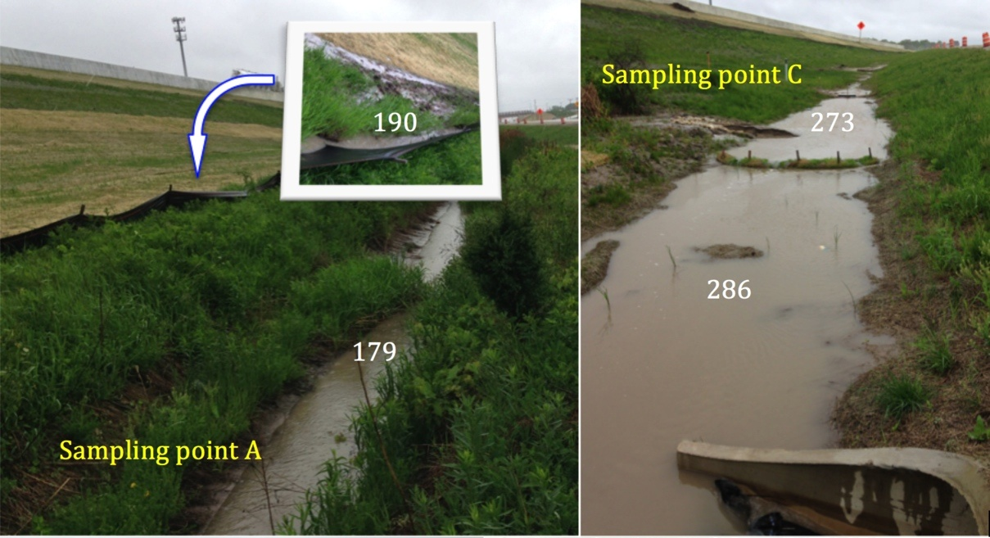
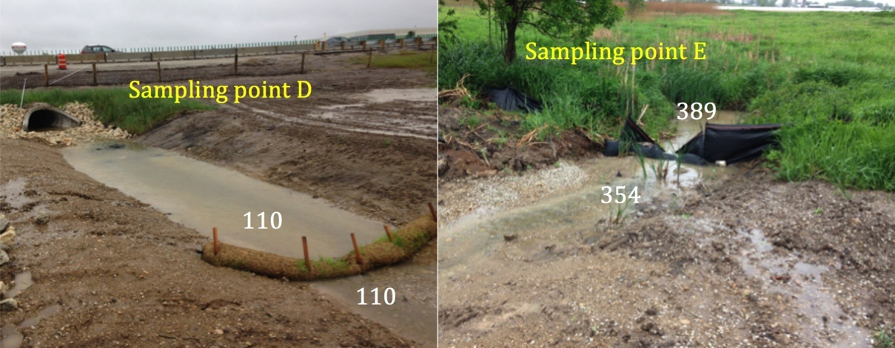
Racine Site: Grab Sample Turbidity
Sampling date: May 30, 2015

Slide 23
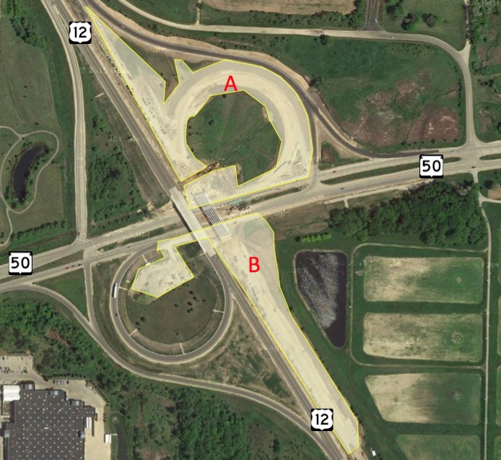
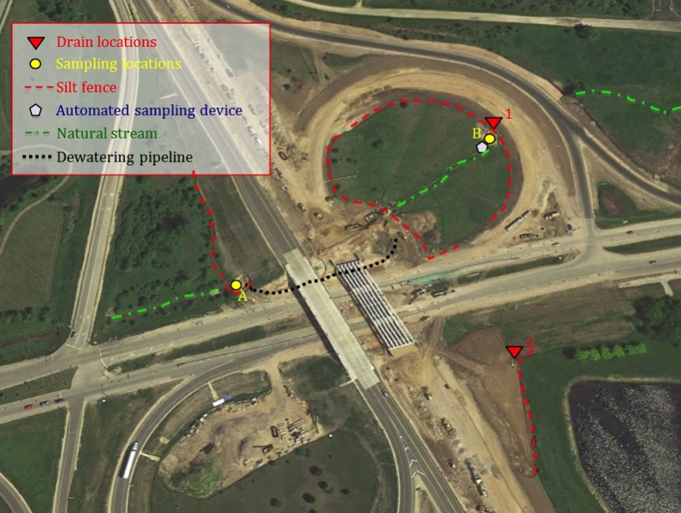
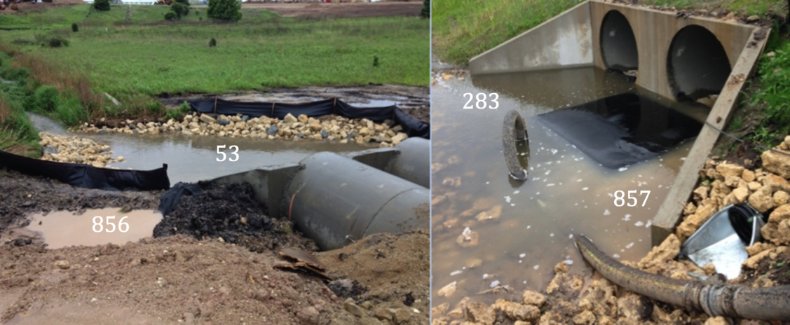
Lake Geneva Site
Total disturbed land area: 11.75 acres
BMPs: silt fence, dewatering pipe and filter bags
Sampling locations:
  Culvert inlets (outfall)
Sampling results: May 30, 2015

Slide 24
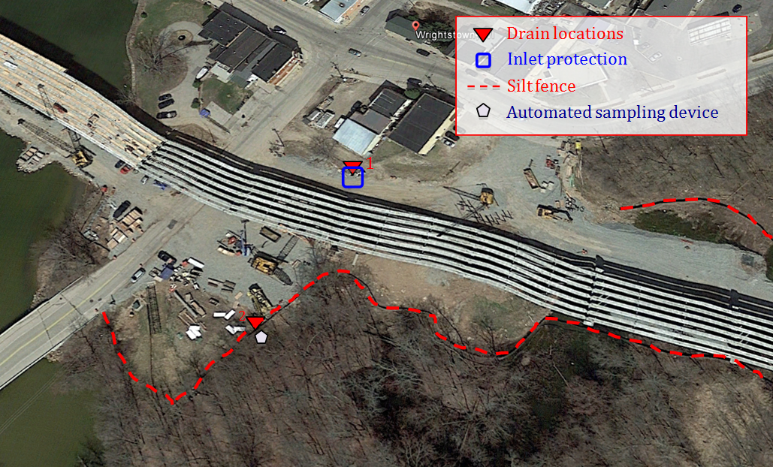
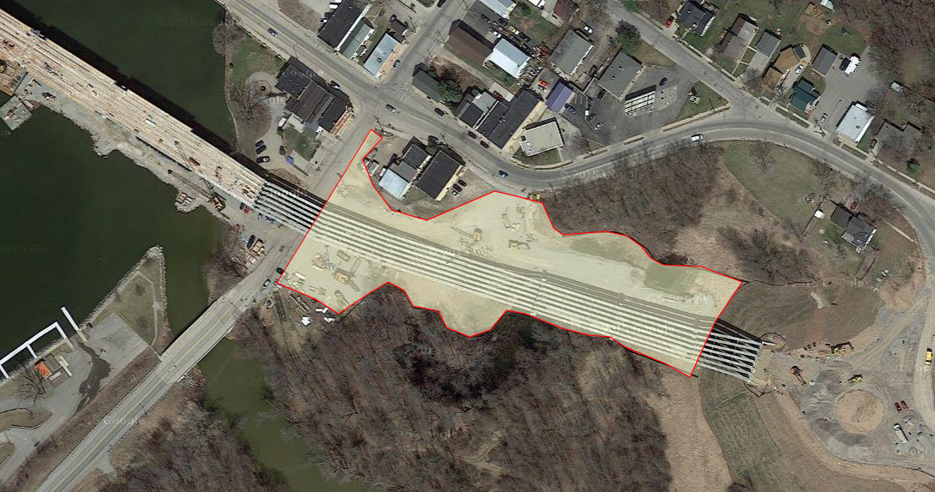
Wrightstown Site
Total disturbed land area: 2.77 acres
BMPs: silt fence, ripraps
No grab samples

Slide 25
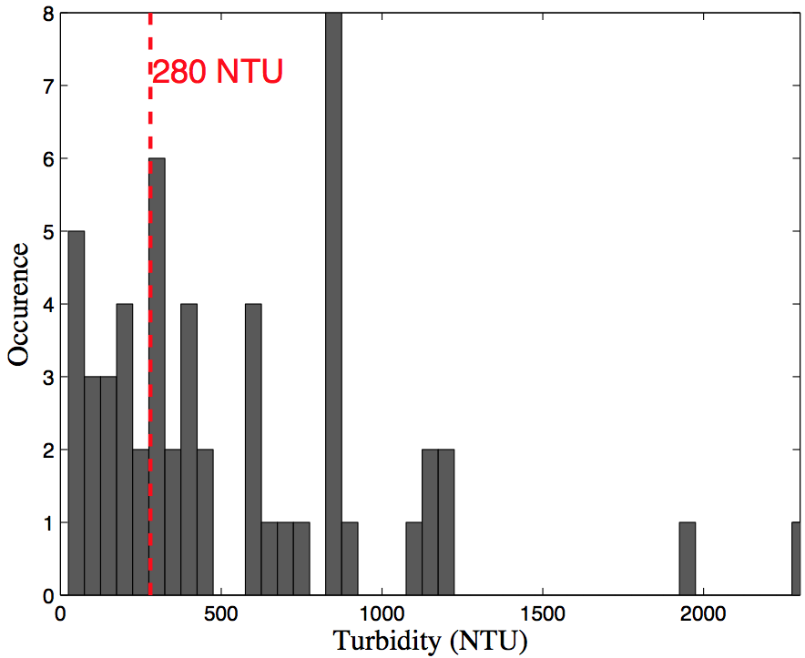
Turbidity Histogram
Turbidity ranged from 20 to 2300 NTU based on 57 Grab samples

Slide 26
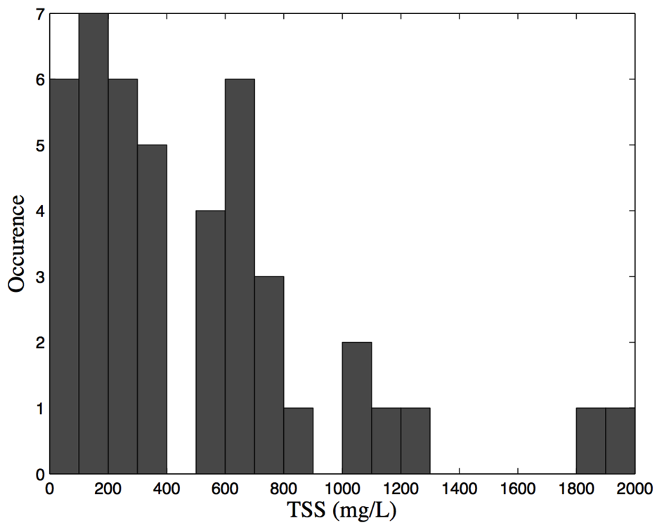
TSS Histogram
44 Samples

Slide 27
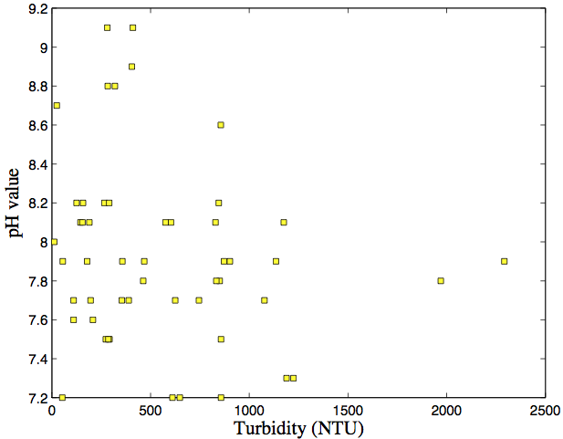
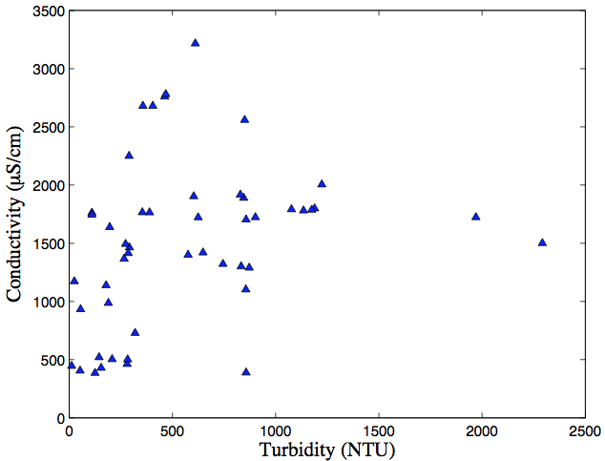
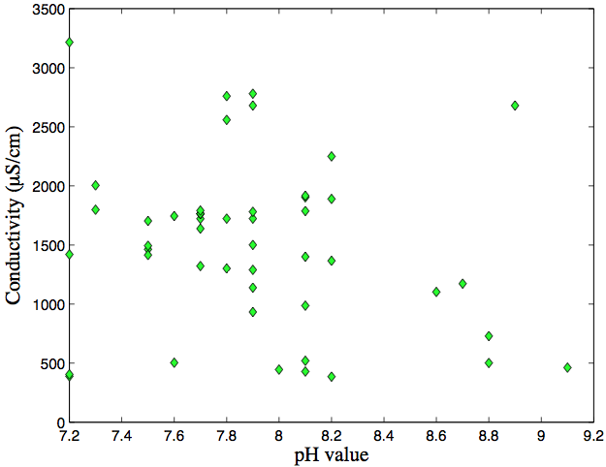
No Correlations among Turbidity, pH and Conductivity

Slide 28
4. TSS-Turbidity Relation

Slide 29
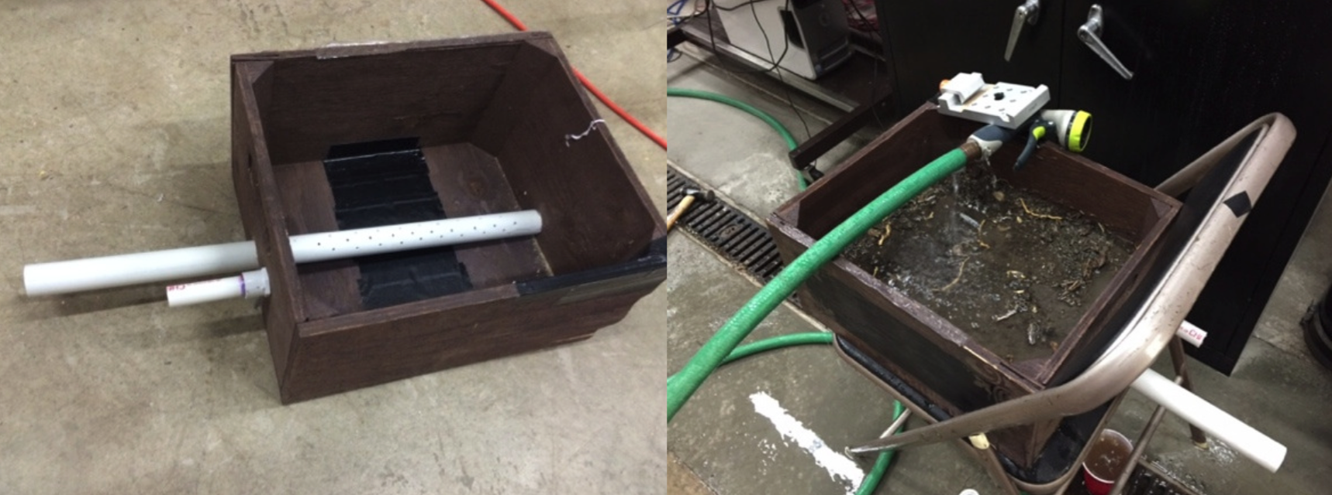
Turbidity of Lab-Simulated Runoff
Laboratory test with soil samples from selected sites to examine
  Characteristics of effluent turbidity time series
  A practical procedure to determine a site specific TSS-turbidity correlation

Slide 30
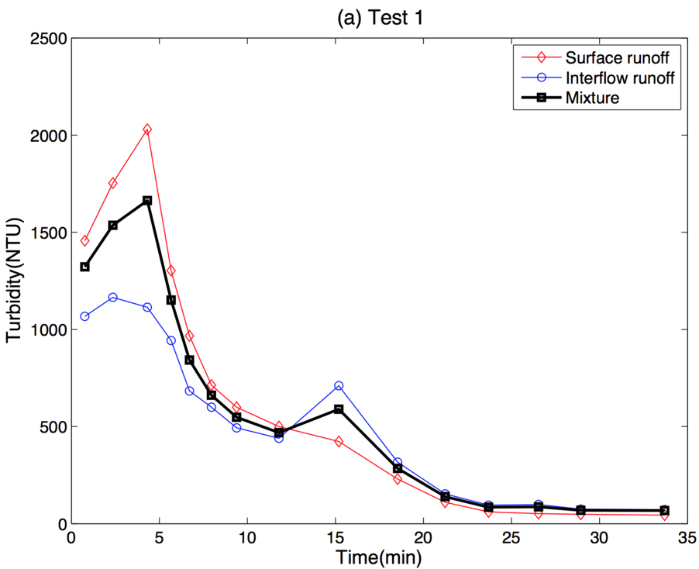
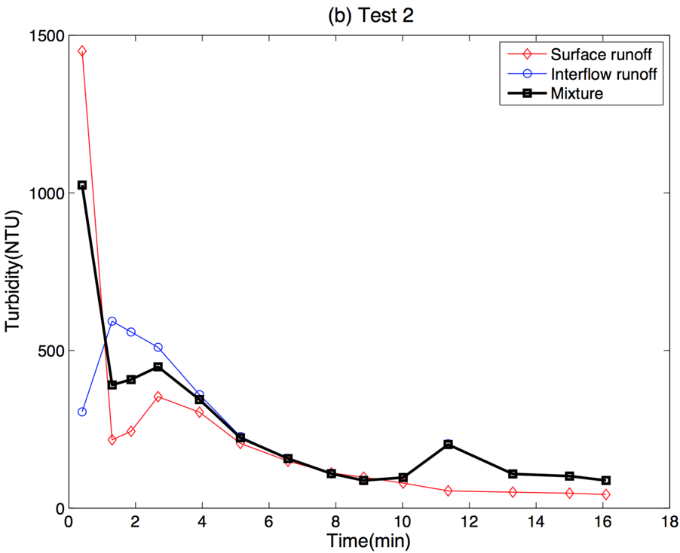
Simulated Rainfall-Runoff Turbidity Process
Test 1: Dry soil
Test 2: Wet soil (16 hours after test 1)
A secondary turbidity peak (due to subsurface interflow) can be observed in both tests

Slide 31
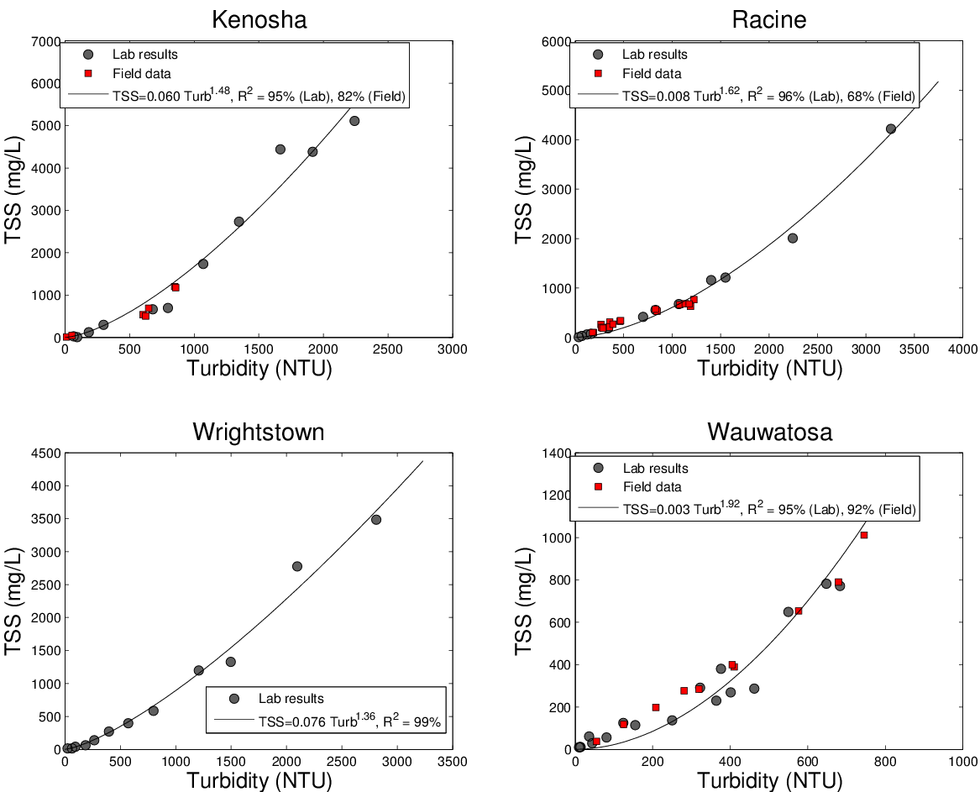
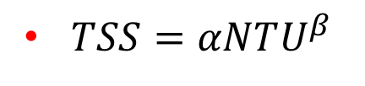
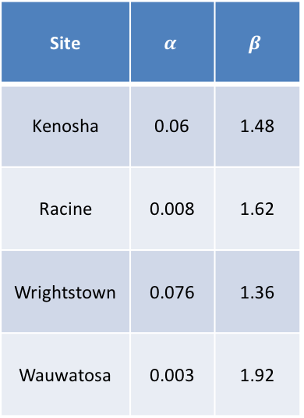
TSS vs. Turbidity: Power Law Relation
$TSS=αNTU^{β}$
Site | $$α$$ | $$β$$
Kenosha | 0.06 | 1.48
Racine | 0.008 | 1.62
Wrightstown | 0.076 | 1.36
Wauwatosa | 0.003 | 1.92

Slide 32
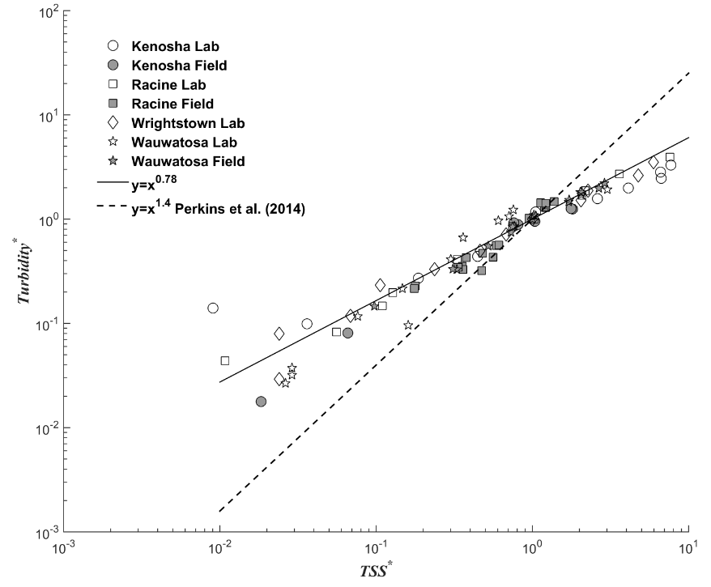
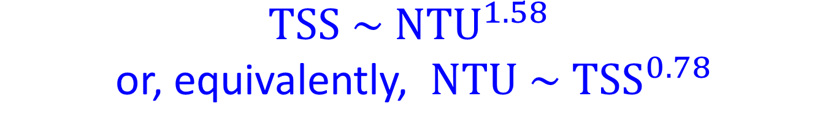
$TSS \sim NTU^{1.58}$ or, equivalently, $NTU \sim TSS^{0.78}$

Slide 33
5. Correlation between Turbidity Runoff and Precipitation

Slide 34
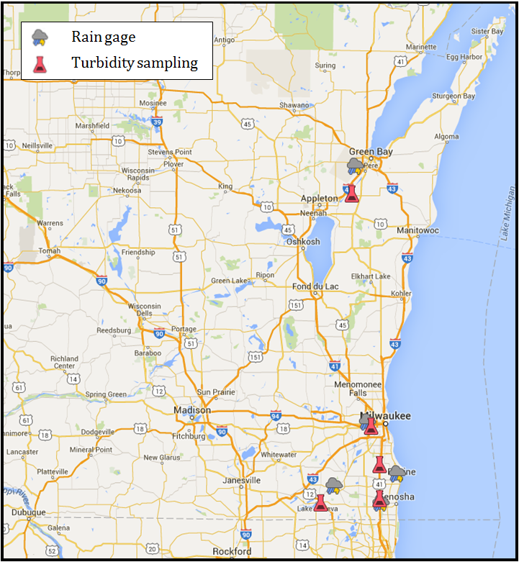
Automated Turbidity Sampling: Sites and Weather Stations
Automated turbidity sampling devices were deployed at four sites:
  Racine (11 events)
  Lake Geneva (8 events)
  Wrightstown (3 events)
  Wauwatosa (8 events)

Slide 35
Rainfall-Turbidity Runoff Time Series
Example: data series from Lake Geneva Site

Slide 36
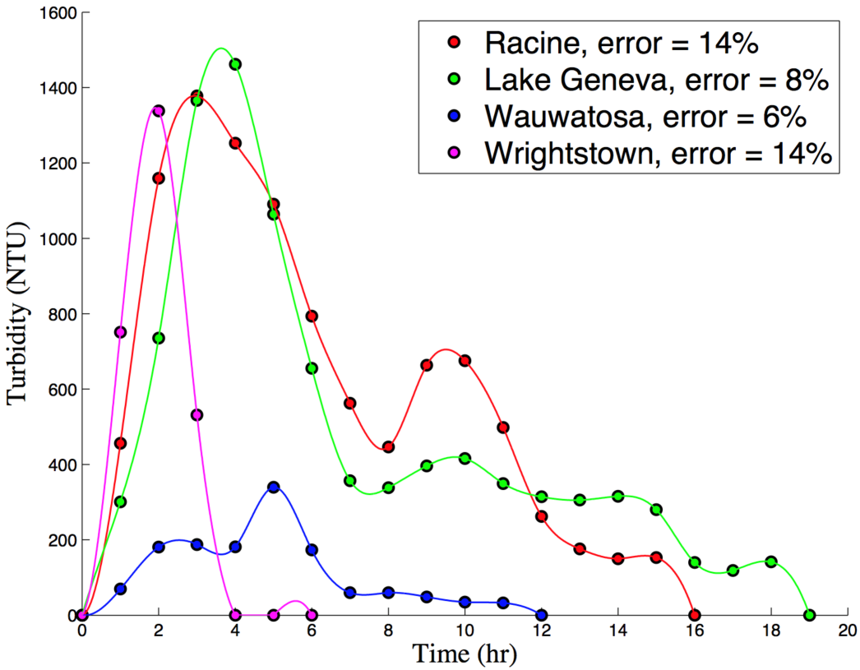
Unit Turbidity Runoff Response Function
Analogous to the unit hydrograph approach, a unit turbidity runoff response function can be reconstructed from recorded turbidity&precipitation time series.
Note: Errors are defined as the ratio of root mean square errors to the peak turbidity level.

Slide 37
Statistics From Data Series
Total rainfall depth
Average rainfall intensity
Peak rainfall intensity
Event averaged turbidity
Peak turbidity
24-hour averaged turbidity (EPA limitation: <280 NTU)
Turbidity runoff duration
Rainfall centroid time
Turbidity runoff centroid time

Slide 38

Rainfall-Turbidity Correlation
We claim that statistics of rainfall and turbidity are correlated if
  Linear regression $R^{2}>50\%$
  And the hypothesis testing rejects the null hypothesis with $P<0.05$
 | Racine | Lake Geneva | Wrightstown | Wauwatosa
Mean turbidity (T_{a}) vs. mean rain intensity (I_{a}) | × | × | × | ×
Peak turbidity (T_{p}) vs. mean rain intensity (I_{a}) | × | × | × | ×
Mean turbidity (T_{a}) vs. peak rain intensity (I_{p}) | × | × | × | √
Peak turbidity (T_{p}) vs. peak rain intensity (I_{p}) | × | × | √ | ×
Mean turbidity (T_{a}) vs. total rain depth (P) | × | × | × | √
Peak turbidity (T_{p}) vs. total rain depth (P) | √ | √ | √ | √
Peak daily average turbidity (T₂₄) vs. total rain depth (P) | √ | x | √ | √
Note: √ : correlated, × : uncorrelated

Slide 39

Peak Turbidity ~ Precipitation Depth
Good linear relation was found between the peak turbidity and the total precipitation depth for all four sites: $T_{P}=aP$, where $a=1831, 1921, 1178 and 349$ (NTU/in) for Racine, Lake Geneva, Wrightstown and Wauwatosa sites, respectively

Slide 40

24-hour average Turbidity vs. Precipitation Depth
Good linear correlation was found between the maximum 24-hour average turbidity and the total precipitation depth at all but one site

Slide 41

Conclusions
Turbidity of grab samples during or after storms ranged from 20 to 2,300 NTU, agreed well with the 500~2,000 NTU range reported in NCHRP (2012).
Conventional BMP controls are not able to significantly reduce the turbidity. However, they are effective at reducing soil erosion, runoff volume and speed, thus reducing the total sediment load into receiving waters.
Relation between the TSS and turbidity of grab samples can be described by a power-law relation, i.e., $TSS=αNTU^{β}$, where the exponent $β$ ranged from 1.36 to 1.92, and the coefficient varied significantly from 0.003 to 0.076.
A unit runoff turbidity function, which represents the response of turbidity runoff process to a unit precipitation depth, can be reconstructed from measured data. The reconstructed unit response function was able to reasonably describe all recorded turbidity runoff events.
Both the peak turbidity and the maximum daily average turbidity were found to be linearly correlated with the total precipitation depth for all sampling sites

Slide 42
Backup Slides

Slide 43

Turbidity Measurements: Other Methods and Units
Formazin Nephelometric Units (FNU): Since Formazin (a polymer) solution is widely used for calibrating a nephelometer.
Jackson Turbidity Unit (JTU): used for the Jackson Candle method which measures light attenuation as it travels through the column of the sample.
This is no standard method to convert between various turbidity units (e.g., NTU vs. FNU). Note: Turbidity units are NOT physical units
Jackson Candle Method

Slide 44
EPA Standard Method: 180.1
Based on a comparison of the intensity of light scattered by the sample with that by a standard (Formazin)
Measurement units: NTU
Detecting angle within ±30º of the center
Detector within 10 cm from the light beam
Measurement range: 0~40 NTU. For turbidities exceeding 40 NTU, dilute the sample to <40NTU.

Slide 45


Turbidimeters
Benchtop meters
  Tungsten lamp
  Superior accuracy and sensitivity
  Complies with EPA standard (EPA Method 180.1)
Handheld meters (field applications)
  Near infrared light source
  Can measure high turbidity (ideal for construction site monitoring)
  Datalogger for automated sampling

Slide 46
Related Research (Texas DOT)
Performance Testing of Coagulants to Reduce Stormwater Runoff Turbidity (project number: 0-6638)
Objective: to test the polyacrylamide (PAM) as a coagulant for erosion and sediment controls
Findings:
  PAM application on tested clay soils with 1:3 slopes was not effective in reducing runoff turbidity or soil loss
  PAM added in sedimentation devices increased sediment removal rate by 8 to 18 percent, compared with sedimentation without PAM treatment

Slide 47

Turbidity of Construction Site Runoff
McFalls et al. (2014): Texas DOT project report

Slide 48
Related Research (Minnesota DOT)
Development and Evaluation of Effective Turbidity Monitoring Methods for Construction Projects (MN/RC 2014-24)
Objective: to investigate turbidity relationships for conditions of Minnesota and to develop protocols for the design and installation of cost-effective monitoring systems.
Findings:
  Relation between turbidity and TSS can be described by a power law with an exponent of 7/5 based on fourteen different soil samples in Minnesota.
  Field monitoring of runoff from construction sites found that turbidity often exceeded 1,000 NTU and sometimes surpassed 3,000 NTU.

Slide 49

Perkins et al. (2014)
Turbidity-TSS relation for Minnesota soils

Slide 50

Turbidity Readings: Field Meter vs. Bench-top Turbidimeter
Total field grab samples: 54
For 24 grab samples, turbidity was measured by both the handheld meter onsite and the lab bench-top meter

Slide 51

pH Histogram
51 Samples

Slide 52

Conductivity Histogram
49 Samples

Slide 53


TSS vs. Turbidity: Linear Regression
$TSS=bNTU$
Site | Coefficient b
Kenosha | 2.16
Racine | 1.04
Wrightstown | 1.15
Wauwatosa | 1.11

Slide 54

Total Sediment Load
Assume a linear correlation between TSS and turbidity, the total sediment load of an storm event is proportional to $F_{T}=\int_{0}^{T_{D}}{Q\left(t\right)T\left(t\right)dt}$, where $Q\left(t\right)$ is the runoff hydrograph.
Assuming that the discharge $Q\left(t\right)$ rises and falls following the same trend as turbidity $T(t)$, the total sediment flux can be estimated to be proportional to
$F_{T}\sim F_{TS}≡\int_{0}^{T_{D}}{T^{2}\left(t\right)dt}$

Slide 55




Total Sediment Load ~ Precipitation Depth
A power law relation is found between $F_{T}$ and $P$
$$F_{T}=λP^{θ}$$
Site | $$λ$$ | $$θ$$
Racine | $$9.6×{10}^{6}$$ | 3.27
Lake Geneva | $$6.8×{10}^{6}$$ | 1.25
Wrightstown | $$2.0×{10}^{6}$$ | 1.59
Wauwatosa | $$1.5×{10}^{6}$$ | 1.39

Slide 56
Racine Site Statistics
Event ID | P (in) | I_{a} (in/hr) | I_{p} (in/hr) | T_{a} (NTU) | T_{p} (NTU) | T₂₄ (NTU) | D_{p} (hr) | D_{t} (hr) | C_{p} (hr) | C_{t} (hr)
1 | 0.67 | 0.061 | 0.18 | 436 | 1,502 | 662 | 16 | 38 | 10.4 | 16.0
2 | 1.02 | 0.049 | 0.28 | 395 | 2,434 | 727 | 47 | 104 | 17.5 | 40.2
3 | 0.42 | 0.105 | 0.16 | 325 | 936 | 379 | 4 | 10 | 2.9 | 5.5
4 | 0.68 | 0.227 | 0.29 | 227 | 811 | 335 | 4 | 11 | 2.8 | 4.3
5 | 0.80 | 0.400 | 0.77 | 622 | 1,637 | 761 | 2 | 11 | 1.0 | 4.2
6 | 0.90 | 0.450 | 0.86 | 1,077 | 1,767 | 1,077 | 2 | 16 | 1.0 | 7.2
7 | 0.61 | 0/153 | 0.42 | 166 | 511 | 235 | 5 | 16 | 1.6 | 6.8
8 | 0.25 | 0.125 | 0.14 | 142 | 362 | 246 | 2 | 14 | 1.6 | 6.1
9 | 0.37 | 0.123 | 0.32 | 122 | 238 | 152 | 3 | 21 | 2.0 | 10.4
10 | 0.36 | 0.120 | 0.26 | 67 | 185 | 98 | 4 | 21 | 1.9 | 9.6
11 | 0.34 | 0.068 | 0.12 | 91 | 462 | 225 | 5 | 24 | 3.0 | 8.6

Slide 57
Lake Geneva Site Statistics
Event ID | P (in) | I_{a} (in/hr) | I_{p} (in/hr) | T_{a} (NTU) | T_{p} (NTU) | T₂₄ (NTU) | D_{p} (hr) | D_{t} (hr) | C_{p} (hr) | C_{t} (hr)
1 | 1.13 | 0.094 | 0.36 | 433 | 1.747 | 594 | 23 | 38 | 10.8 | 13.4
2 | 0.35 | 0.088 | 0.27 | 198 | 1,130 | 541 | 15 | 21 | 3.1 | 7.0
3 | 1.03 | 0.515 | 0.61 | 671 | 2,390 | 1,108 | 2 | 27 | 1.4 | 9.3
4 | 0.26 | 0.065 | 0.09 | 236 | 728 | 316 | 16 | 32 | 9.1 | 18.0
5 | 0.51 | 0.510 | 0.51 | 227 | 1,215 | 382 | 2 | 27 | 1.0 | 10.5
6 | 1.15 | 0.383 | 0.99 | 623 | 2,468 | 1,034 | 3 | 24 | 1.9 | 10.3
7 | 1.30 | 0.650 | 1.17 | 534 | 1,978 | 884 | 2 | 17 | 1.9 | 8.0
8 | 0.83 | 0.415 | 0.51 | 1,138 | 1,636 | 1,065 | 2 | 14 | 1.4 | 4.4

Slide 58
Wrightstown Site Statistics
Event ID | P (in) | I_{a} (in/hr) | I_{p} (in/hr) | T_{a} (NTU) | T_{p} (NTU) | T₂₄ (NTU) | D_{p} (hr) | D_{t} (hr) | C_{p} (hr) | C_{t} (hr)
1 | 1.41 | 0.282 | 0.64 | 767 | 1,343 | 880 | 5 | 12 | 2.6 | 4.1
2 | 2.50 | 0.417 | 0.96 | 1,975 | 2,500 | 1,975 | 6 | 7 | 2.2 | 3.3
3 | 0.75 | 0.150 | 0.44 | 736 | 1,009 | 736 | 5 | 7 | 3.2 | 3.3
Wauwatosa Site Statistics
Event ID | P (in) | I_{a} (in/hr) | I_{p} (in/hr) | T_{a} (NTU) | T_{p} (NTU) | T₂₄ (NTU) | D_{p} (hr) | D_{t} (hr) | C_{p} (hr) | C_{t} (hr)
1 | 0.41 | 0.137 | 0.29 | 41 | 133 | 58 | 3 | 16 | 1.4 | 7.4
2 | 0.90 | 0.225 | 0.58 | 125 | 463 | 171 | 4 | 13 | 1.5 | 5.7
3 | 0.17 | 0.057 | 0.08 | 21 | 64 | 36 | 3 | 14 | 1.9 | 5.8
4 | 0.15 | 0.050 | 0.06 | 32 | 103 | 43 | 3 | 13 | 2.2 | 6.5
5 | 0.55 | 0.275 | 0.50 | 86 | 180 | 79 | 2 | 10 | 1.1 | 3.9
6 | 0.30 | 0.150 | 0.22 | 44 | 113 | 49 | 2 | 13 | 1.7 | 6.8
7 | 0.27 | 0.054 | 0.09 | 42 | 153 | 48 | 5 | 13 | 3.4 | 6.2
8 | 0.15 | 0.025 | 0.04 | 35 | 112 | 39 | 7 | 18 | 3.3 | 8.3

