Slide 1
High Value Research
Sweet 16 – RAC Region 3
Diane Gurtner
WisDOT Research & Library Services
National RAC and TRB State Representatives meeting
Wichita, Kansas
July 24, 2018

Slide 2
The Wisconsin Highway Research Program (WHRP)
Established in collaboration with UW – Madison in 1998
FFY 2017 budget of $1.23 million
Primary research areas
  Flexible Pavements
  Rigid Pavements
  Structures
  Geotechnics
http://wisconsindot.gov/Pages/about-wisdot/research/whrp.aspx

Slide 3
Critical Factors Affecting Asphalt Concrete Durability
WHRP 0092-14-06
Objective: Investigate factors affecting asphalt concrete durability, and evaluate WisDOT’s current mixture criteria relative to best practices.

Slide 4
Scope
Determine relationships among four compositional factors through semi-circular bend and oven aging tests on laboratory-prepared mixtures
Verify cracking-resistance estimates on plant-produced mixtures

Slide 5
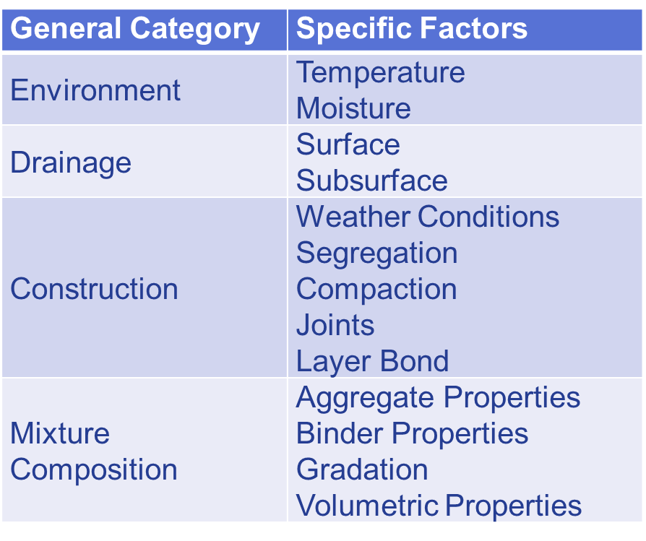
Examined Factors

Slide 6
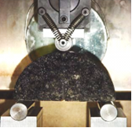
Tests
Semi-circular bend at intermediate temperatures to measure cracking resistance
Oven aging to measure age hardening

Slide 7
How to Improve Durability
Increase
  Volume of effective binder
  Polymer modification
  Tack coat application rate
  Density targets
  Asphalt content
Decrease
  Virgin binder low temperature grade
  Recycled binder content

Slide 8
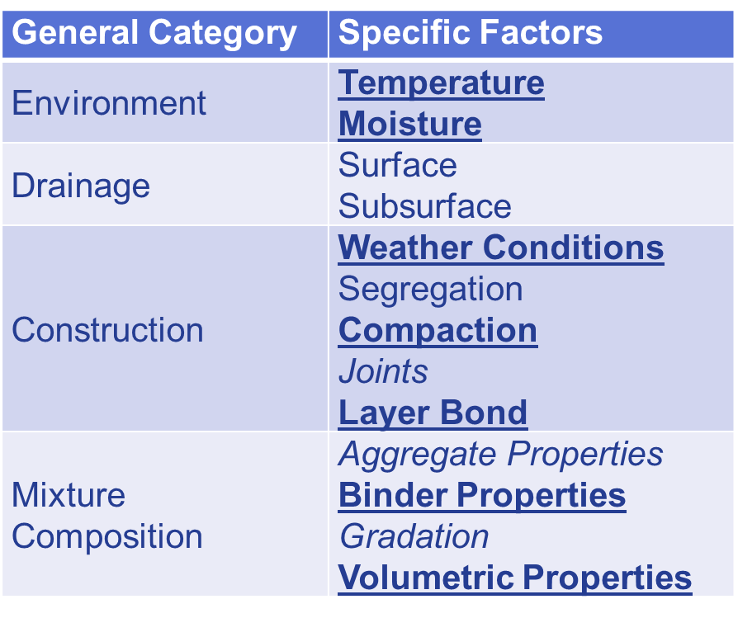
Factors Targeted for Improvement
Notes:
Bolded factors have been addressed in specification changes
Specification changes for italicized factors are being developed.

Slide 9
Changes to WisDOT Specs
Increased:
  Density targets
  Asphalt content
  Voids in mixed aggregates from 12.5mm to 14.5mm in low-traffic and medium-traffic mixes
  Tensile strength ratios from 75% to 80% for anti-strip mixes and 70% to 75% for non anti-strip mixes
  Application of tack coat from 0.025 to 0.05-0.07gal/sy
Mandated warm mix asphalt additive for cold-weather paving below 40F
Aiming to increase use 9.5mm overlays on high-traffic roads

Slide 10
Benefits
Increases average asphalt pavement life by two years or more
Reduces annual costs by $25 million
Reduces pressure on WisDOT’s letting program
Notes:
Increasing pavement lifespan decreases the frequency at which replacement or repair is needed and alleviates pressure on the letting program.

Slide 11
Contacts and Resources
WisDOT Research & Library Homepage
Final Report | Research Brief
Principal Investigator
Ramon Bonaquist, Advanced Asphalt Technologies
aatt@erols.com
Project Manager
Carl Johnson, Stark Asphalt
carlj@starkasphalt.com
WisDOT Project Contact
Barry Paye, Bureau of Technical Services
barry.paye@dot.wi.gov
WisDOT Research & Library Services
research@dot.wi.gov

