Slide 1
Estimate Initiative Update
Fred Schunke
Estimating Engineer
Traffic Improvement Conference
Online
March 9, 2021
Notes:
Thank you for joining me for an update to the estimate initiative. My name is Fred Schunke, and again I am the statewide estimating engineer, and I work in Proposal Management Section in the Bureau of Project Development.

Slide 2
Estimate Initiative
About the initiative
Estimate Documentation Updates
Updating FDM 19-5
Training videos
Future plans
Notes:
In this presentation, I will provide information about the estimate initiative. From this initiative, updates were made to the Estimate Documentation Template, some upcoming FDM 19-5 updates, new training videos, and future plans for developing estimates.
The FDM 19-5 updates make up a significant portion of today’s presentation.

Slide 3
Estimate Initiative
About the Initiative
Estimating is a focus from inception to award
Estimates are not meeting goals.
  60% of proposals within 10%
  75% of proposals within 15%
Develop a consistent estimating process to be used DSTD
wide from LC 12 to LC 40
Notes:
Project costs and estimating are a department focus from project inception to award.
Estimates unfortunately are not meeting current estimate accuracy goals. These goals include 60% of proposals are estimated within 10% of the low bid, and 75% of proposals are estimated within 15% of the low bid.
The goals of this initiative is to increase estimate accuracy by developing a consistent estimating process to be used statewide from LC 12 when final delivery is started to LC 40 when proposals are awarded.
Next, I will share some updates to the Estimate Documentation from the Estimate Initiative.

Slide 4
Estimate Initiative
Estimate Documentation
FDM 19-5-6 and Estimate Document Template were updated
Created a guidance document
Significant Items Definition Updated
  Significant items make up 80% of the project costs; or the top 20% of items whichever comes first.
Fewer locations for comments
Notes:
Reviewing and updating the estimate documentation template and guidance were the first priorities of the estimate initiative.
FDM 19-5-6 and the estimate documentation template have already been updated with links to the new template and guidance document.
A guidance document was created to go along with the estimate documentation template. It includes guidance and examples.
Significant items definition has been updated as follows. Significant items make up 80% of the project costs; or the top 20% of items whichever comes first.
If there are 100 items in a project, and you reach 80% of project costs with only the top 15 items, then those 15 items are the significant items.
If there are 100 items in a project, and you only reach 75% of project costs with the top 20 or 20% of items, then the top 20 items are the significant items, and you do not need to consider any more items as significant.
The estimate documentation template now has fewer locations for comments. For instance, there is only one comments field for project characteristics instead of having comment fields for each category of characteristics.
The goal is for designers to consistently document their estimate and focus on the bid items that are significant to the project.
Next, I will share some of the upcoming changes to FDM 19-5. Some changes were added because of the Estimate Initiative, but some updates were already being completed but was prioritized to be completed sooner.

Slide 5
Estimate Initiative
Updating FDM 19-5
Updates are preliminary
Additional Estimating Webpage content copied to FDM 19-5
  Estimates are Confidential
    Link to Confidentiality Memo
  Estimating user Group
Notes:
First, I want to explain that the FDM updates I am sharing today are preliminary and are subject to change in the final version. These updates plan on being published in May of this year.
Any additional content that is found on the estimating webpages will be copied to FDM 19-5-5. This includes the confidentiality memo and information about the estimating user group.
The confidentiality memo explains that a construction estimate is always confidential, the contractor's bid tab information is confidential until after the proposal is awarded, and it explains why.
The objective of estimating user group is to review, develop and recommend WisDOT procedures and best practices on cost estimating for projects. Under the leadership of the Proposal Management Section in the Bureau of Project Development, this includes construction estimate training, maintaining the Estimating Webpages and maintaining most of FDM 19-5.

Slide 6
Estimate Initiative
Updating FDM 19-5
Renumbered for more links at single decimal level
  FDM 19-5-6 example
    Current headings – Construction Estimate Documentation
      Estimate Documentation Report
    Updated headings – Construction Estimate Documentation Report
      Estimate Documentation Information
      Estimate documentation report headings listed
Notes:
We have reorganized FDM 19-5 so that there are more relevant headings at the single decimal level. The FDM table of contents goes down to the single decimal level. With more relevant headings, we all should have an easier time finding the information we need. Even I sometimes struggle finding what I am looking for in this section, and I helped write a lot of it.
For instance, FDM 19-5-6 contains guidance to the Estimate Documentation Report and is titled Construction Estimate Documentation.
Currently, there is only one subheading in the table of contents, FDM 19-5-6.1 Estimate Documentation Report. The updated headings already exist at the next, lower level under Estimate Documentation Report.
In this update, we have renamed FDM 19-5-6 as Construction Estimate Documentation Report. At the single decimal level, we will have Estimate Documentation Information and all the Estimate Documentation Report Headings listed. These include:
Executive Summary
Estimating Tool parameters
Similar Projects or Proposals
Project characteristics
Item Level Documentation
Attachments
We have worked to add relevant headings at a higher level throughout FDM 19-5.

Slide 7
Estimate Initiative
Updating FDM 19-5-5
Better flow and new content for new designers
  Decrease additional guidance for new designers
Estimate Types and Components
  Cost-based estimating
  Allowance items (known unknowns)
  Contingency items (unknown unknowns)
Notes:
FDM 19-5-5 Construction Estimates is being completely overhauled. This FDM section is going to look a lot different than the previous version. Our overall guidance will remain the same. However, 19-5-5 will have a much better flow for new designers. It should decrease the need for additional guidance when a new designer is asked to create an estimate for the first time, or you need a refresher.
The next new section of the FDM after the confidentiality memo and the estimating user group, is the Estimate Types and Components Section.
This section explains that the Department uses bid-based estimating which uses historical bid data to develop estimates. Cost-based estimating is another estimate type that the department uses which creates an estimate like a contractor. Cost-based estimates are usually done with items with little or no bid history, and there are no similar items. The Cost-based estimate guidance has been expanded using AASHTO’s Practical Guide to Cost Estimating and experience from construction staff. Cost-based estimating elements include labor, equipment, materials, overhead and profit. Each element contains basic guidance and where to find more information.
Estimate components include the various types of bid items such as standard, STSP and SPV items. Links to the relevant FDM sections and webpages are provided.
Allowance and Contingency items are defined from AASHTO’s Practical Guide to Cost Estimating.
An allowance item is a known part of the construction estimate, but standard items have not been quantified. Or a known, unknown.
A contingency item is an estimated cost associated with identified uncertainties. These are usually from a risk assessment. Or an unknown, unknown.

Slide 8
Estimate Initiative
Updating FDM 19-5-5
Estimating Tools
  Descriptions updated
    Who created and update the tools
    Type of application
    Credentials to use tools
    Link to tool guidance
Notes:
After estimate and item types are defined, estimating tools and resources are listed.
Descriptions for each tool have been updated. Before, you could read some descriptions and still would not know basic information about each tool without going to another source. Each tool’s description now explains who created and updates the tool, what type of application or what application is needed for each tool, credentials to use each tool, and links to additional guidance or where the guidance is located.

Slide 9
Estimate Initiative
Updating FDM 19-5-5
Estimating Tools
  Primary tools
    Table showing what tools are recommended for each item type
  Other tools and resources
    Major and Backbone Projects Tools
    Plans and proposals
    Find Bid Data
    Price Items
Notes:
The estimating tools section is now divided into two main sections, primary tools, and other tools and resources.
Primary tools list the main tools used by the department for developing construction estimates. Table 5.1 has been added, and it shows what estimating tools are used for each item type defined in the previous section. I will share this table in the next slide.
Other tools and resources are additional resources that can be helpful in estimate development. Some new resources and tools include the Major and Backbone Projects Tools for pre-30% estimates, a link to plans and proposals on the HCCI Webpage, and some new guidance for Find Bid Data and Pricing Items in Preconstruction.

Slide 10
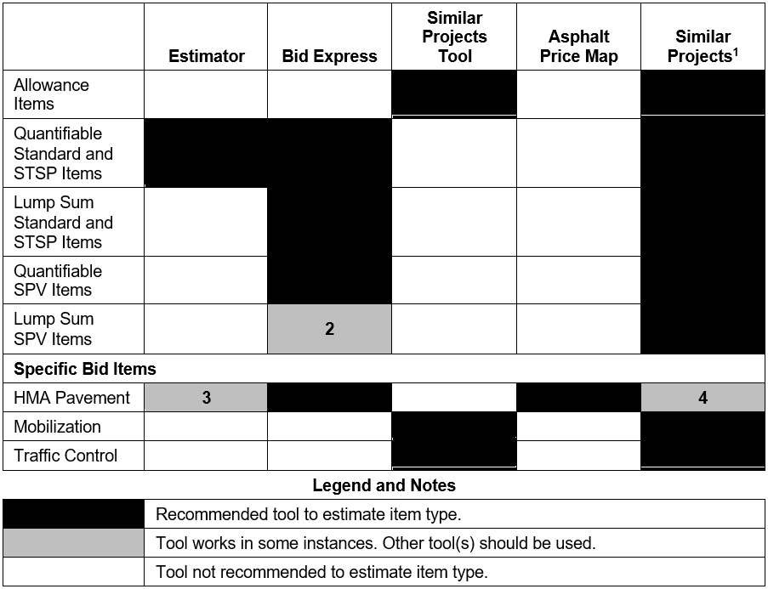
Tools to Estimate Each Item Type
Not an estimating tool.
Not similarly scoped. Find similar projects.
Only in NW and SE Regions
May not be in a similarly priced, geographic area.
Notes:
Here is the new table for FDM 19-5-5 that shows what primary tool should be used for each type of bid item.
The various items are listed on the left, including allowance items, quantifiable items, lump sum items, and specific bid items.
The primary tools with similar projects are listed across the top.
The matrix below shows what estimating tools should be used with each item type.
Black squares are recommended tools for each item type.
Gray squares are tools that work in some instances which are defined on the right.
These numbered notes are in the FDM.
Number one explains that similar projects are not an estimating tool but are used in estimate development.
Two says Bid Express results may not be similarly scoped if there are similar SPV item descriptions. Similar projects likely are needed to find similarly scoped items.
Three says Estimator should only be used in the NW and SE Regions, where bid prices are consistent throughout the region. Prices vary throughout the other regions.
And Four says similar projects may not be in a similarly priced, geographic area with HMA pavement items.

Slide 11
Estimate Initiative
Updating FDM 19-5-5
Estimate Development reorganized to match Estimate Documentation
  Similar projects guidance
  Project characteristics greatly expanded
    Subheadings matching Estimate Documentation
    Content from past presentations
  Bid Item Estimating Guidance
  Unit Price Guidance
Notes:
After Tools and Resources, the Construction Estimate Development Section has been reorganized to better match the Estimate Documentation Report. The subsections within the Construction Estimate Development Section include similar projects guidance, project characteristics, bid item estimating guidance, and unit price guidance.
Project characteristics has been greatly expanded with subheadings to match the Estimate Documentation Report and contains relevant content from past presentations. This includes a table that shows recommended letting months by Improvement Strategy that I will share in the next 2 slides.
Bid item estimating guidance includes additional guidance for specific bid items such as Mobilization and asphalt pavement items.
Unit price guidance includes rounding unit prices, regression price guidance, calculating percentage items such as allowance and mobilization items, blending unit prices, and adjusting unit prices using the Wisconsin DOT Chained Fisher Construction Cost Index.

Slide 12
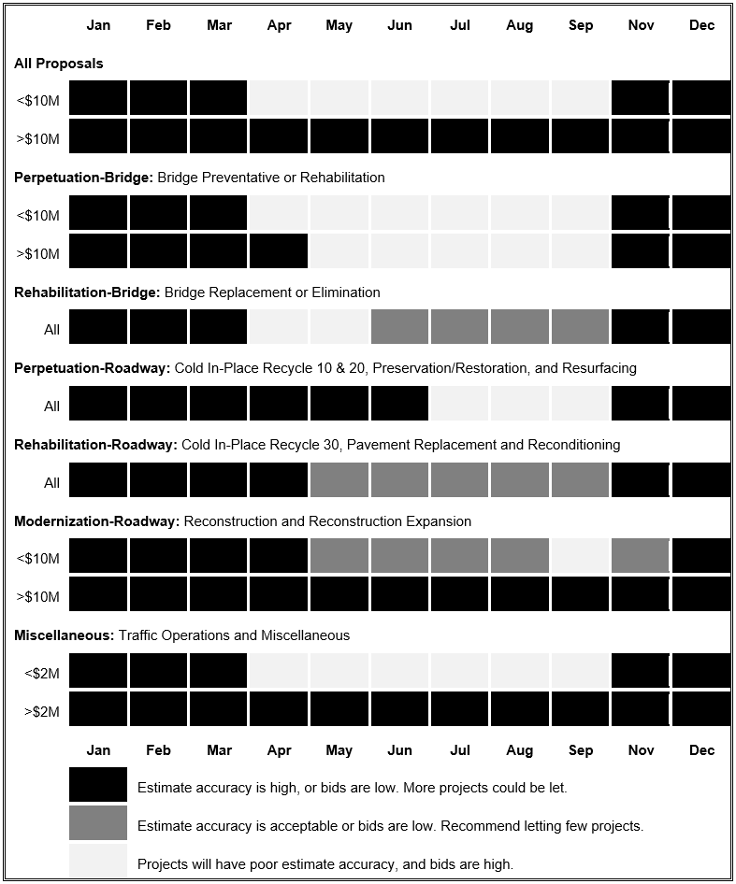
Recommended Letting Months by Improvement Strategy
Notes:
This is only a portion of the table but shows recommended letting months by Improvement Strategy for all proposals and bridge related contracts. If the letting date can be moved and the letting still has capacity, I would recommend to move the project’s letting into a more favorable letting. Estimate prices will need to be increased if a project is let in a less favorable month. Estimator already adjusts regression prices by season and do not need to be increased.
The letting date does influence bid prices. Bids are typically higher in the spring and summer months. Contracts let closer to when work is scheduled to begin will see higher bid prices, and contractors are focused on their on-hand work. Also, competition decreases in April and May as contractors fill up with work before a construction season, which leads to higher prices.
For contracts less than $10 million, November through March letting months have higher estimate accuracy or the bids are low. Contractors are concentrating on bidding for work in the next construction season and bid aggressively.
A contract more than $10 million usually can be in any letting month. Larger contractors who bid on larger contracts likely have dedicated staff for developing bids.

Slide 13
Recommended Letting Months by Improvement Strategy
Notes:
For your reference, I have included the second half this table.
I was surprised to see good bids for roadway perpetuation contracts through June, and that you can still have a few roadway rehabilitation contracts per letting through the summer.

Slide 14
Estimate Initiative
Updating FDM 19-5-7
Updating estimates after PS&E
  Review major items when central office plan review comments are received
  Estimate changes >10% or >$100,000, contact Region FIIPS Coordinator
Reaching out to contractors after a letting
  Work with Bureau of Project Development, Jill Fehrman
Explaining why quantities need to be checked
  Link to Unbalanced Bid Analysis in CMM 210.2.1
Notes:
In FDM 19-5-7, Construction Estimate Review, we added guidance for updating construction estimate after PS&E.
We ask that designers review major bid items to recent lettings when central office plan review comments are received. A link to the recent estimating trends document is provided. This will be the last time that prices can be adjusted, unless an addendum for other design needs is completed.
If the project’s estimate changes after PS&E by 10% or $100,000 contact Regional FIIPS Coordinator to work with Programing Finance staff to update FIIPS. Once the project is sent to FHWA, six to eight weeks prior to the letting date, the estimate and project funding is locked in FIIPS.
After bid results have been received, design teams can reach out to industry, through Bureau of Project Development (BPD), for biddability and constructability information. This includes contacting eligible bidders that did not turn in a bid to determine reasons for lack of interest in a proposal. Contact Jill Fehrman, the BPD Proposal Management Section Chief, if there is a need to outreach to industry to help with a justification response. This now is consistent with FDM 11-5-1.2, industry collaboration during design.
Information is provided explaining why quantities need to be checked. The department is required to award projects to the true low bidder. When a quantity error is found, an Unbalanced Bid Analysis is completed. The Construction and Materials Manual (CMM 210.2.1) contains the steps followed when Bureau of Project Development completes an Unbalanced Bid Analysis.

Slide 15
Estimate Initiative
Training Videos
Completed or nearly completed videos
  Estimate Documentation
  Quantities 2 Plans
  Estimating Webpages
Plans to add to Learning Center for PDHs
Future videos for creating an estimate and each
estimating tool
Notes:
We created an estimate training webpage for training videos as they become available. The training videos are based upon FDM 19-5 along with tools and resources linked in this FDM section. The Estimate Training Webpage is linked in the next FDM update.
For Estimate Documentation Training, the script and presentation is almost done, and the video will be completed soon afterwards.
Quantities 2 Plans and Estimating Webpages Videos are completed and will be posted soon. Hopefully, both will be posted at the time of this presentation.
For DOT staff, we would like to add these training videos to the DOT Learning Center with questions for PDHs and for everyone including consultants, we would like to have virtual events with a session to answer questions for PDHs. I think it’s good to provide incentive with this helpful information.
Eventually, we also plan on creating additional training videos for creating a construction estimates and a training video for each estimating tool.

Slide 16
Estimate Initiative
Future Plans: Minor Tool Updates
In Estimator, update Project Work Types
  Match Improvement Strategies of FDM 11-1 Att. 10.1
Update Bid Express User Guide
Add Links to Plans and Proposals
  Bid Express, Similar Projects Tool and Asphalt Price Map
Notes:
Here are some minor updates we would like to complete in the future from the Estimate Initiative.
In Estimator, we would like to change the Project Work Type Categories to match Improvement Strategies listed in FDM 11-1 Attachment 10.1. If there is enough data, Estimator will adjust the regression prices based upon the Project Work Type. Bridge and roadway rehabilitation projects would have separate, higher regression prices compared to bridge replacement and reconstruction projects for concrete masonry, earthwork and other items.
Very little guidance would have to change. The Estimate Project Field Information would have to be updated on the AASHTOWare Preconstruction Knowledgebase Site.
We also would like to update the Bid Express User Guide to include tips and tricks from myself and designers.
As we update the various tools, we are looking to add links to plan and proposals, making them easier to find.

Slide 17
Estimate Initiative
Future Plans: Major Tool Updates
Most primary estimating tools in one location
  Bid Express Find Bid Data
  Estimator Estimation
  Same location as AASHTOWare Preconstruction
Notes:
A long-term goal from the Estimate Initiative is to combine multiple tools into one or have them at one location. This will be a multi-year effort.
Estimator and Bid Express are the two primary tools used in estimate development, which make up the first two columns of the new Estimating Tools and Item Type Table I shared earlier. Find Bid Data, once it has been updated, would be like Bid Express for finding bid history. I already am coordinating with Infotech, the software developer, to make Find Bid Data easier to use.
Estimation is a web application that replaces Estimator for estimate creation and regression prices.
Find Bid Data and Estimation would be on the AASHTOWare Preconstruction Webpage where we already submit PS&E Estimates.
Estimates would be at one, online location, and transitioning from preliminary to final estimates would be easier.
And these tools have already been developed by Infotech and are used in other states.

Slide 18

Contact Information
Fred Schunke
Estimating Engineer, DTSD-BPD
fred.schunke@dot.wi.gov
(608) 266-9626
Notes:
These are all the updates I wanted to share today for updated guidance That is everything we currently have on the Estimating Webpages. If you have any questions or comments, feel free to email or call me using the contact information provided on the screen.
Thank you.

