Slide 1


Presented by
Rosalind Roberson
DBE Support Services Coordinator
November 2023
DBE SUPPORT SERVICES
IN HIGHWAY CONSTRUCTION
Notes:
Welcome to the Wisconsin Department of Transportation DBE Support Services presentation. I am Rosalind Roberson, the DBE Support Services Coordinator. In this presentation you will learn about services available to DBE firms currently doing business with WisDOT and certified DBEs new to highway contracting.

Slide 2
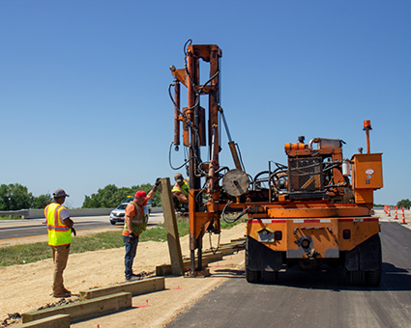
WisDOT DBE Support Services
  DBE Support Services (DBESS) operates as a resource for the DBE program.
  The primary purpose of providing support to disadvantaged, minority and women-owned enterprises is to facilitate the firms' development into viable, self-sufficient businesses capable of competing for, and performing on federally assisted highway projects thereby increasing their participation in highway contracting.
Notes:
The primary purpose of providing support to disadvantaged, minority and women-owned enterprises is to facilitate the firms' development into viable, self-sufficient Businesses capable of competing for, and performing on DOT projects thereby increasing their participation in highway contracting.

Slide 3
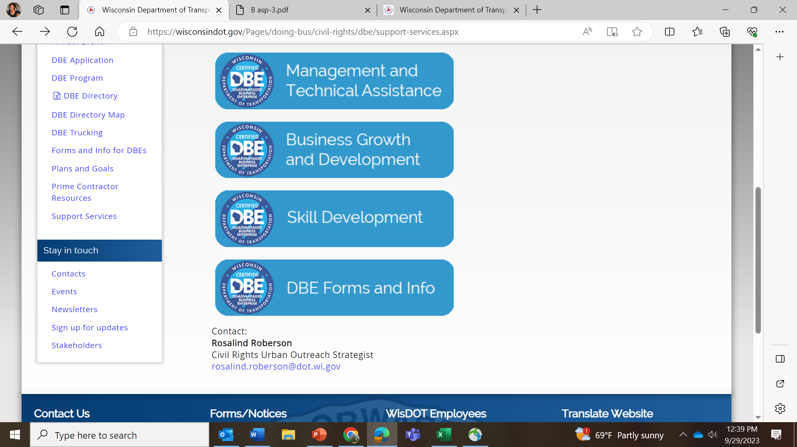
DBE SUPPORT SERVICES (DBESS)
Agenda
Disadvantaged Business Enterprise (DBE) Support Services Programs
  DBE Dedicated Programs and Resources
  Management and Technical Assistance
  Business Growth and Development
  Skill Development
  DBE Forms and Information
  Support Services webpage
Notes:
I will provide a brief overview of the DBE Dedicated Programs and resources established by WisDOT for DBE success on DOT projects. You will also receive information on the various DBE programs and services to include, management and technical assistance, business growth and development, skill development and common DBE Forms. Go to the Support Services webpage to download this presentation to access the links reference in each slide.

Slide 4
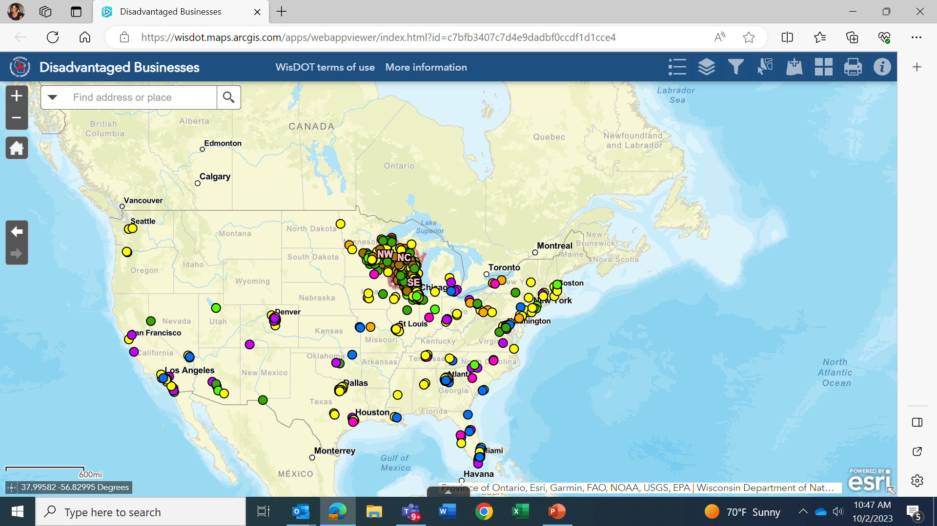
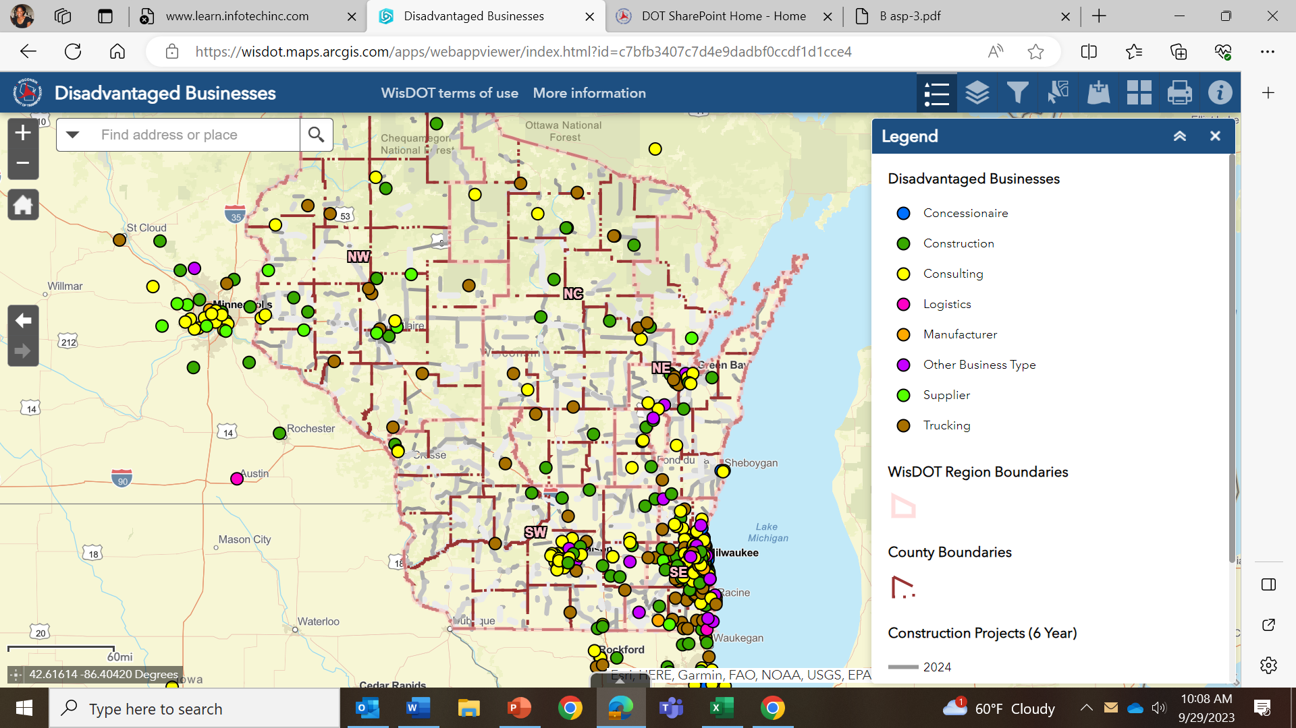
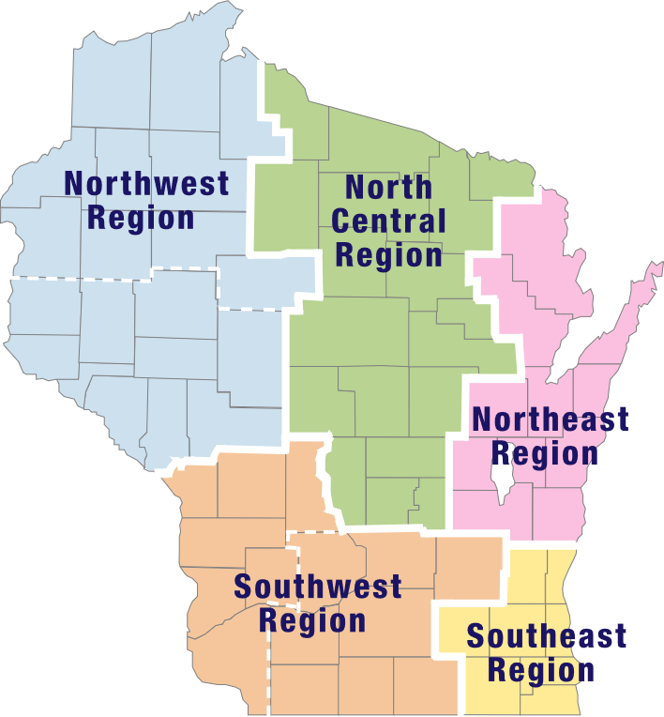
DBE SUPPORT SERVICES (DBESS)
Resource Center 6150 W. Fond Du Lac Ave, Milwaukee, WI
DBE DIRECTORY MAP LEGEND
    DBE Directory Map
    Conference room
    Plans and proposals
    One-on-one consultation
    Printing and scanning services
    Computer and internet access
Notes:
The UCP Directory contains over 1000 DBE firms from various industries throughout Wisconsin and the United States. To see the geographic locations of Wisconsin certified DBEs and WisDOT projects click the link positioned in this slide. Over 50% of the UCP DBEs are located in the SE region of Wisconsin. Based on the geographic location of these firms the DBE Resource Center is located in Milwaukee at 6150 W. Fond du Lac Ave. The Resource center is open from 8 am to 4 pm for DBE firms who request one-on one consultation. A large conference room for business meetings, computers with internet access, printing and scanning services are available at no cost to the DBE.

Slide 5
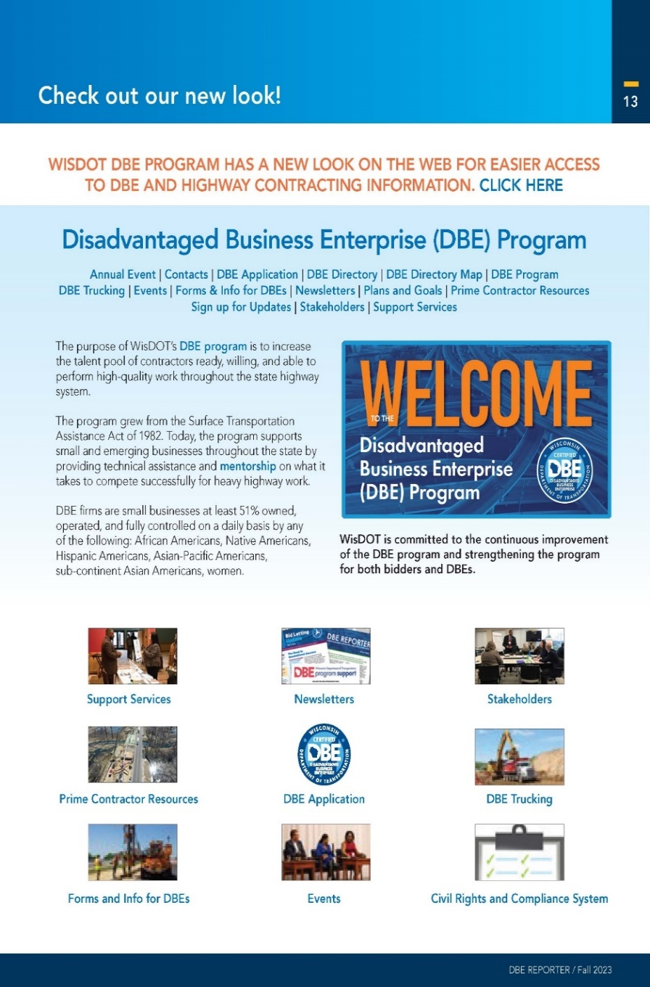
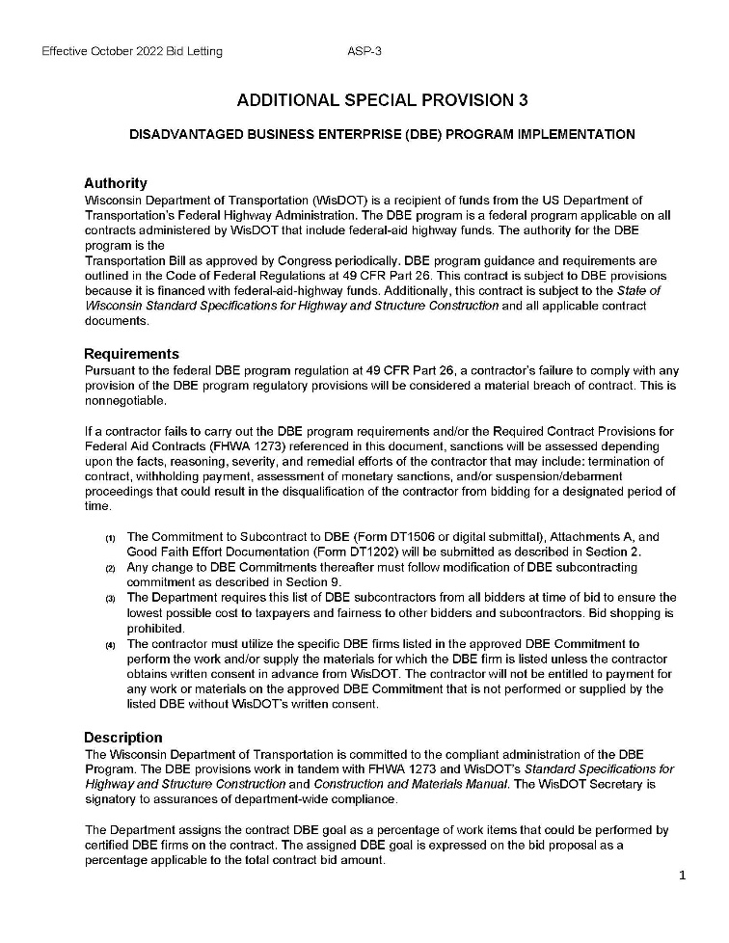
DBE SUPPORT SERVICES
Dedicated Programs for Sustainability and Success
  DBE Program Implementation ASP 3
  Prompt Payment- ASP 7
  Contractor Payments – CMM 236
  Performance Monitoring
  DBE Program Webpages
Notes:
DBE Dedicated Programs for sustainability and Success: To ensure the success of a DBE’s performance on DOT projects WisDOT includes special provisions in a prime’s contract. Failure to comply with any provision of the DBE regulations will be considered a material breach of contract. DBEs with highway subcontracts are encourage read ASP3 on the implementation of the DBE program. It is imperative that all contractors understand the rules of engagement when subcontracting with a DBE firm to include Good Faith Effort, use of Joint Checks, DBE credit, DBE utilization, and DBE replacement. Click on the links in this slide to learn more about DBE participation on DOT contracts to include prompt payments and contractor payments. It is also recommended that DBEs and primes be familiar with the DBE program webpages to better understand the DBE Program and other services offered to DBEs and primes for success on highway construction projects.

Slide 6
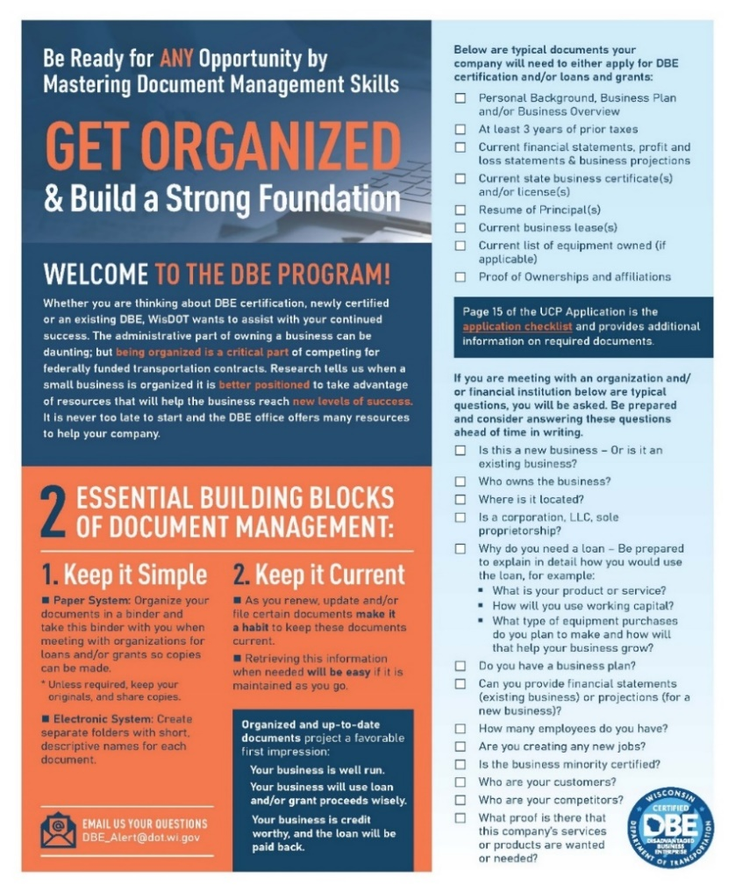
DBE SUPPORT SERVICES
Management and Technical Assistance
Assessment
QuickBooks
Certified Payroll
SBN Account
Workshops
Certification
Estimating and Quotes
Contract Reviews
Capability Statements
Trucking
Notes:
Management and Technical Assistance: Professional consultants and industry leaders offer an array of services to assist DBEs. Businesses new to highway contracting can meet one-on-one with Support Service consultants to get their business documents organized, evaluate accounting systems, review subcontracts, and enter certified payroll. Any DBE new to highway construction and seeking support must complete the capacity building assessment to determine your business needs. During your initial consultation, services and workshops are recommended to get you started in the right direction for highway contracting. You can contact the DBE Support Service office for more information on Business Management and Technical Assistance.

Slide 7
DBE SUPPORT SERVICES
DBE Forms and Information
​Monthly DBE Directory Updates
Access the Unified​ Certification​ Program (UCP) Directory​
No Change Affidavit (NCA) form
Work Area Expansion Request
​​
Notice of Annual Affidavit Process Change
Annual No Change Affidavit Form​
​DBE Change to Business form
​DBE Request for Tax​ Filing Extension​​
Notes:
For easy access to DBE forms and Information the DBE Program has a webpage dedicated to DBE forms you can download and resubmit. Go to this webpage to if you have changes to your company status, to request a work area expansion, file your no change affidavit and much more. Click on any of the links in this slide for more information.

Slide 8
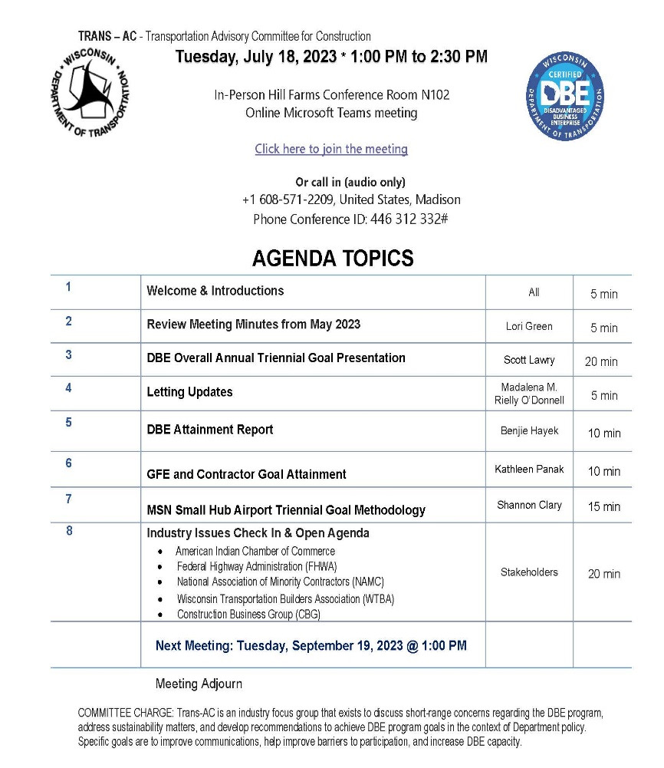
DBE SUPPORT SERVICES
Business Growth and Development
      Stakeholder Engagements
      Networking Events
      Newsletters and DBE Alerts
      Mentor Protégé Program
      Mobilization Loan Guaranty
Notes:
WisDOT is committed to the growth and development of a diverse contracting environment. The Office of Business Opportunity and Equity Compliance has organized programs, networking events and stakeholder meetings to ensure DBEs have the opportunity to meet DOT staff, prime contractors and consultants. For instance the DBE Stakeholder Advisory Committee meets every quarter to work with WisDOT on approaches to achieve greater DBE participation and strategies to monitor progress and discuss upcoming transportation projects. Click on stakeholder engagement link for more information and dates on upcoming DBE stakeholder meetings.

Slide 9
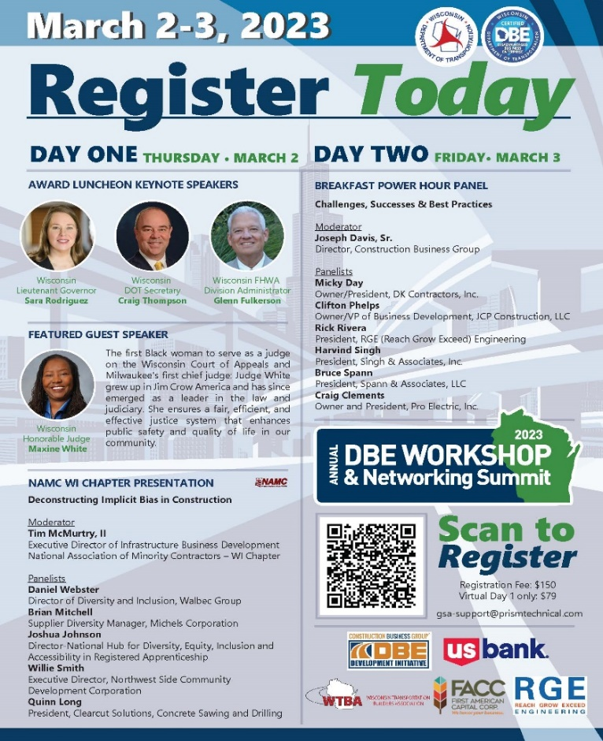
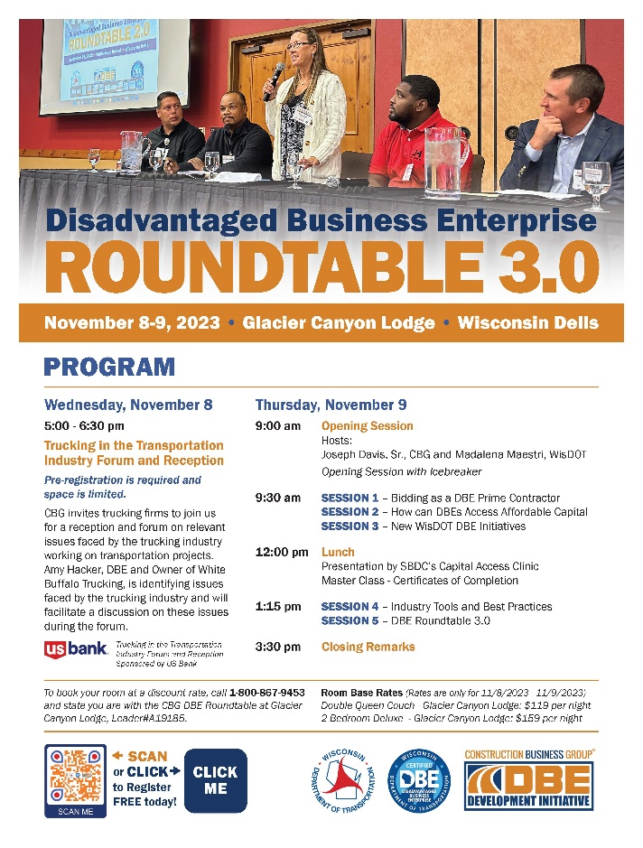
DBE SUPPORT SERVICES
Business Growth and Development
      Stakeholder Engagements
      Networking Events
      Newsletters and DBE Alerts
      Mentor Protégé Program
      Mobilization Loan Guaranty
Notes:
WisDOT host the Annual DBE Workshop and Networking Summit to bring industry stakeholders together for educational and networking purposes. DBE firms have the opportunity to meet with DOT staff, primes and other industry stakeholders to discuss opportunities, share experiences, and learn industry trends. In collaboration with the Construction Business Group WisDOT co-host the DBE Roundtable to discuss issues surrounding DBE participation on DOT projects. Click on networking flyers in this slide for more information on these strategic DBE events.

Slide 10
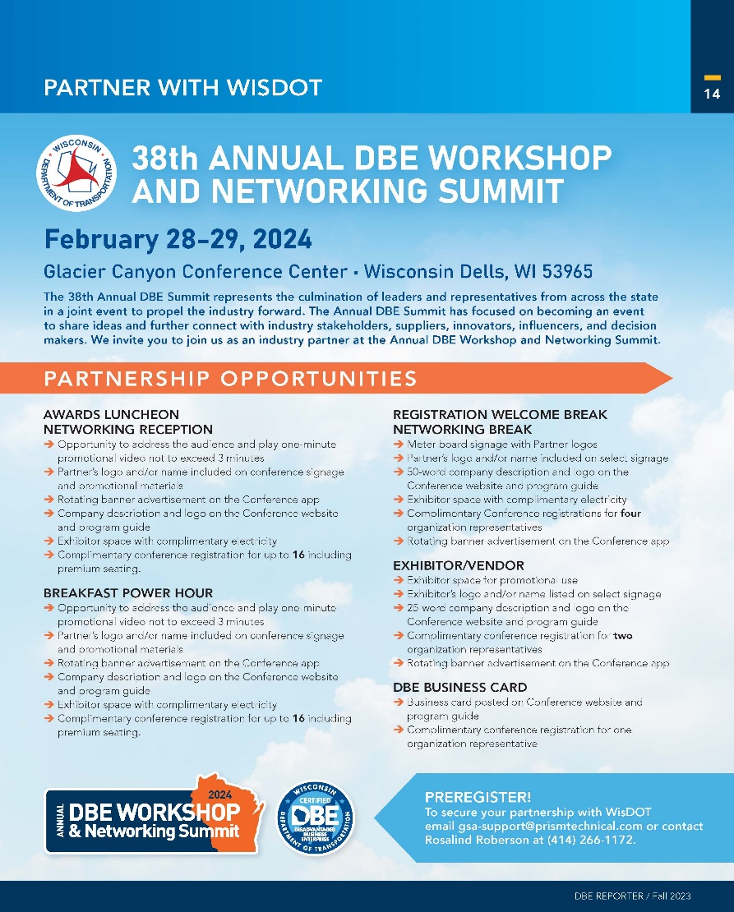
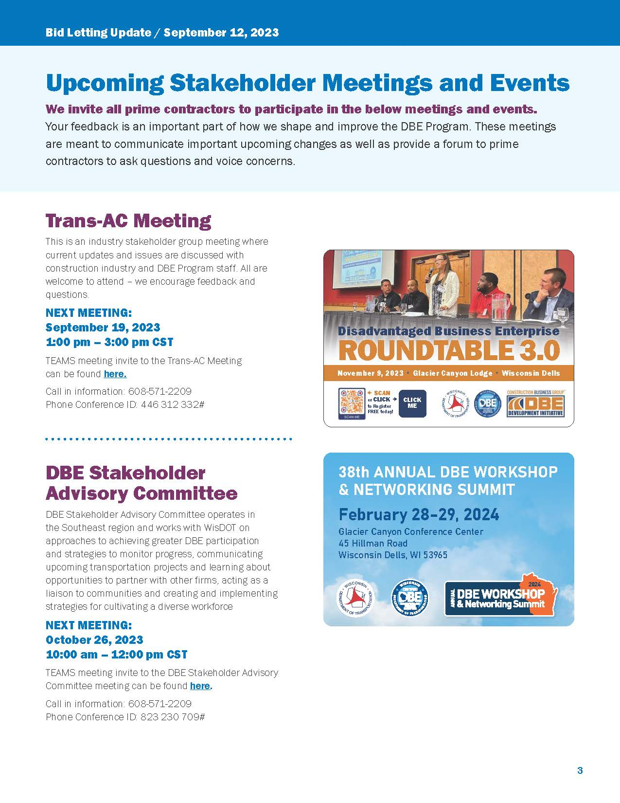
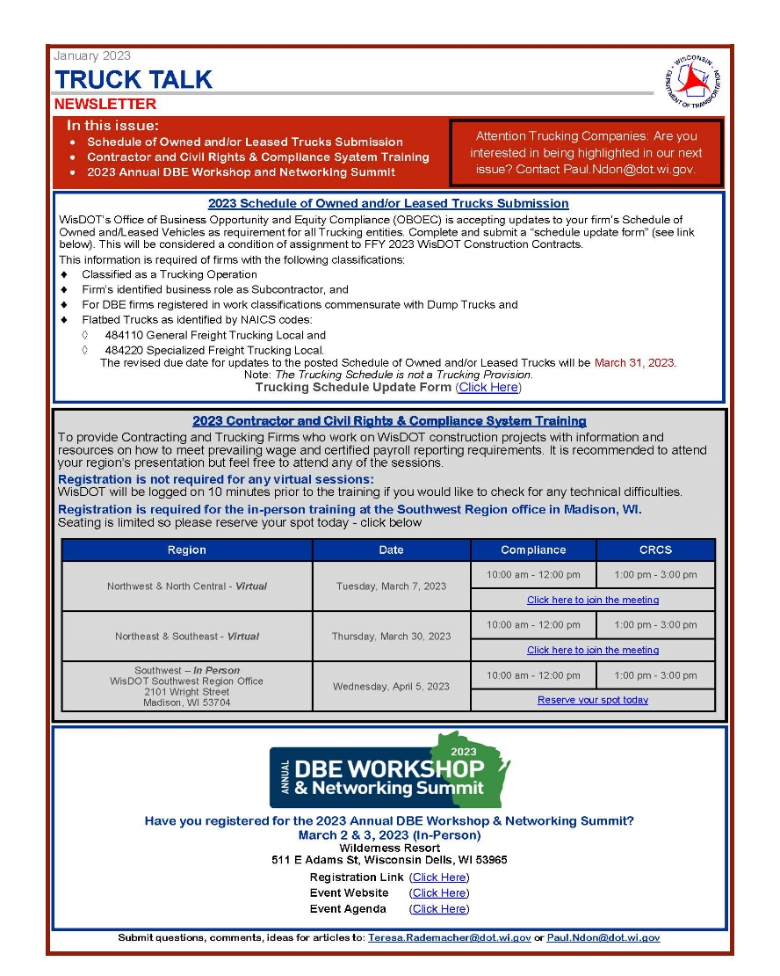
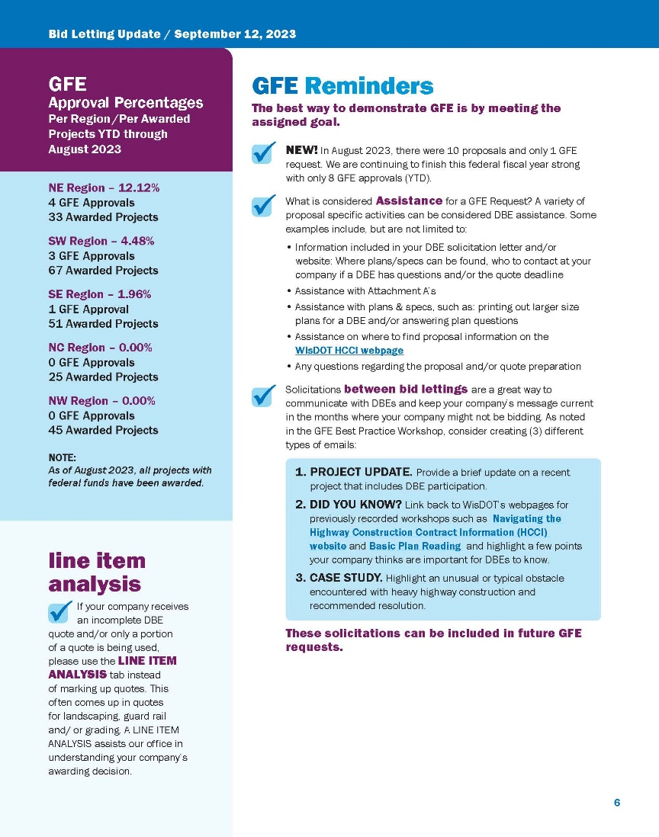


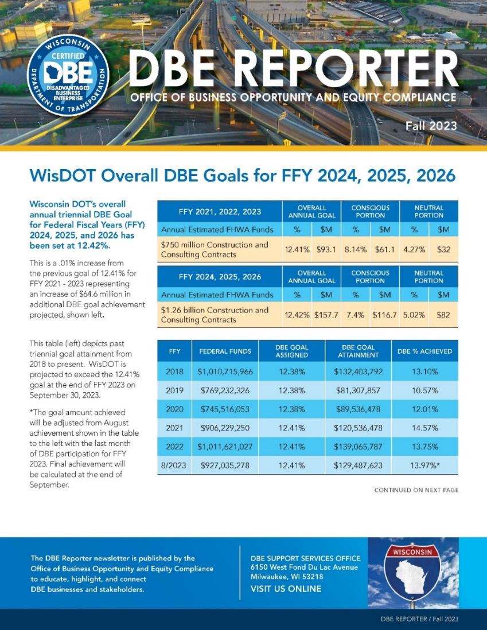
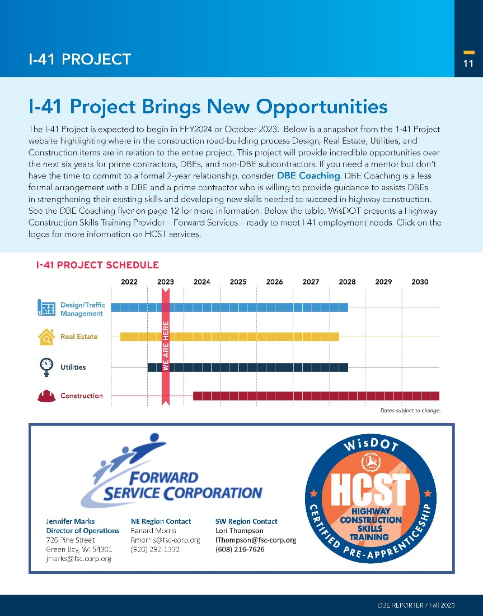
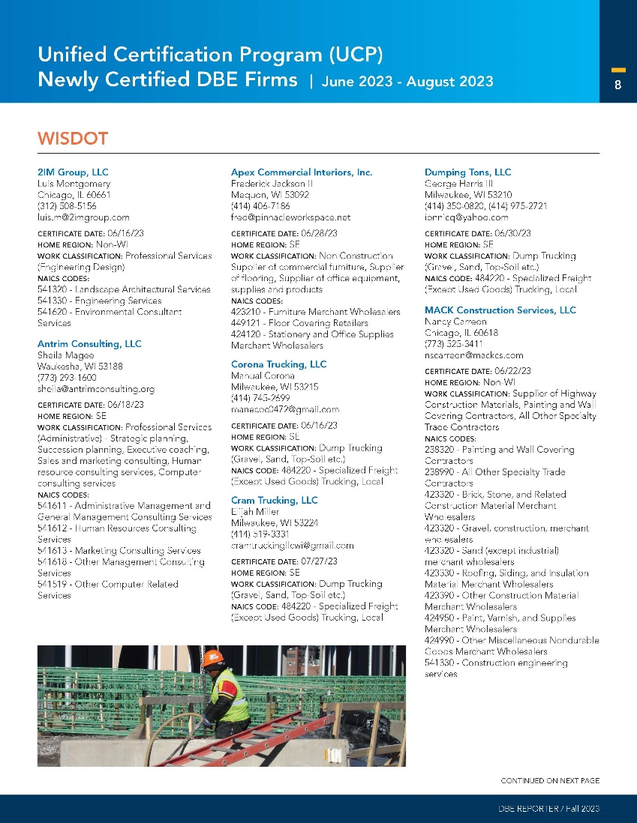
DBE SUPPORT SERVICES
Newsletters and DBE Alerts
DBE Reporter
  A quarterly newsletter for DBE firms that showcase the information on the newly certified DBE firms, DBE Goal Summary Report, upcoming events and DBE spotlight for opportunities.
Bid Letting Updates
  A monthly newsletter for DBE and prime contractors highlighting bid reminders, Good Faith Effort reminders and spotlights on projects and primes who support the DBE Program.
TRUCK TALK
  Truck Talk provides information regarding trucking on WisDOT highway construction projects. WisDOT will share updates on the ​Trucking Industry, it’s facilitation, and any applicable information on new data, reports, and studies.
DBE Alerts
  Weekly emails are sent to DBE firms regarding specific project let opportunities, trainings or events sponsored by industry professionals.
Notes:
OBOEC publishes several newsletters to keep DBEs, primes, trucking and the highway construction community informed on activities in the DBE Program and the Department. For instance, The DBE Reporter is published quarterly with information on the most recent DBE goal attainment numbers, newly certified DBE firms, DBE Profiles and upcoming events. The Bid Letting Update is a monthly newsletter that highlights bid reminders, Good Faith Effort and prime and project spotlights. We also have a newsletter for Trucking companies called Truck Talk. Go to the newsletter webpage for all information reported during the year. You will also see the DBE Alert emails announcing information specific on project lets for subcontracting opportunities, trainings and networking events sponsored by industry professionals.

Slide 11
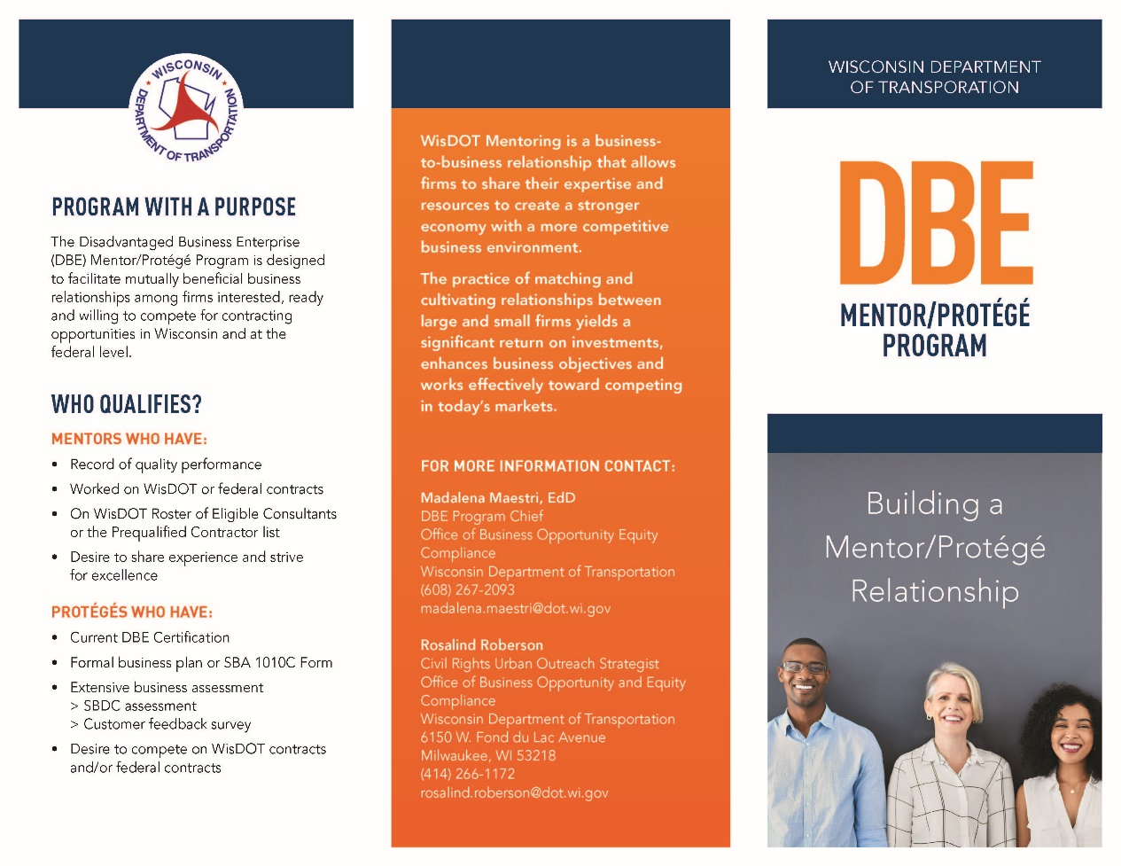
DBE SUPPORT SERVICES
Business Growth and Development
    Stakeholder Engagements
    Networking Events
    Newsletters and DBE Alerts
    Mentor Protégé Program
    Mobilization Loan Guaranty
Designed to facilitate mutually beneficial business relationships among firms interested, ready and willing to compete for contracting opportunities in Wisconsin.
Encourages proactive teaming efforts with DBE firms on State and Federally funded projects​.
Increases opportunities for DBE firms to prime projects.​
Creates a support structure for DBE firms to pursue, select, win contracts.
Notes:
WisDOT’s most beneficial program for growth and development of its DBEs is the Mentor Protégé Program. WisDOT Mentor Protégé Program is designed to facilitate mutually beneficial business relationships among firms interested, ready and willing to compete for contracting opportunities in Wisconsin. It encourages proactive teaming efforts with DBE firms on state and federally funded projects​, It increases opportunities for DBE firms to prime projects​ and creates a support structure for DBE firms to pursue, select, win contracts.

Slide 12
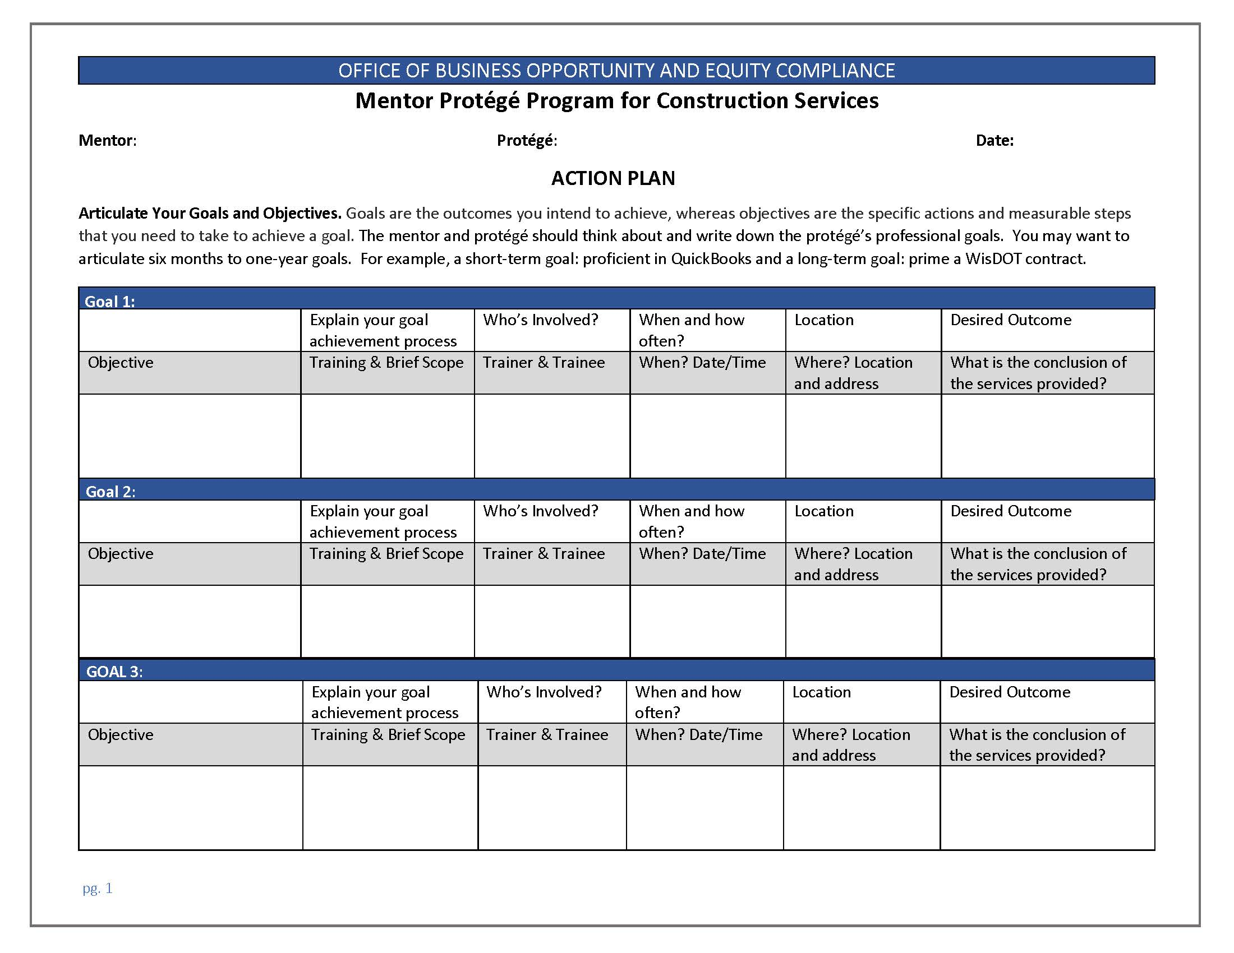
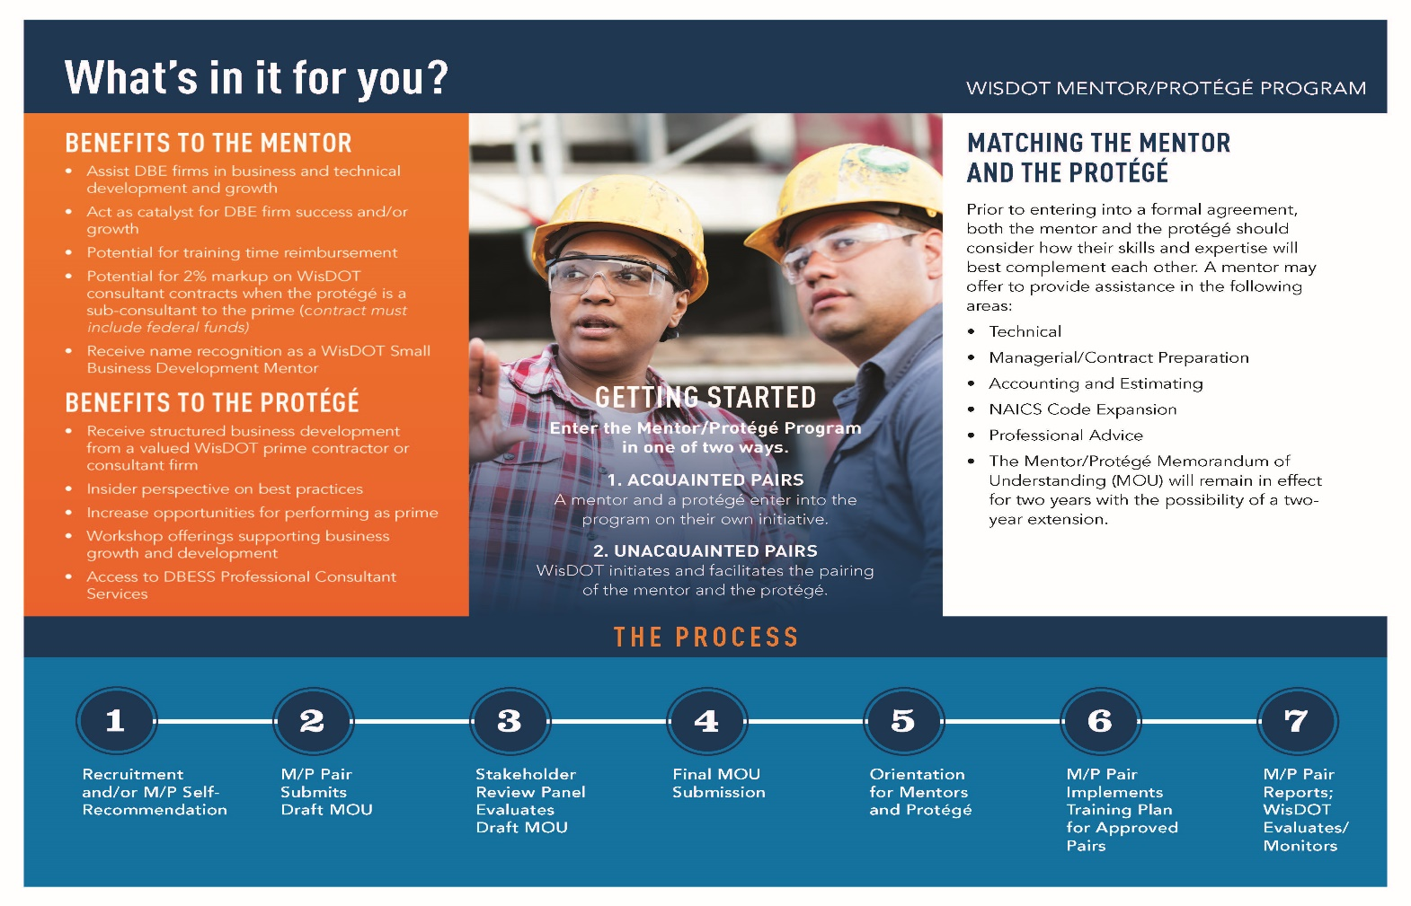
DBE SUPPORT SERVICES
Mentor Protégé Program purpose and benefits
RECRUITMENT & PAIRING
STAKEHOLDER REVIEW PANEL
IMPLEMENT ACTION PLAN
MONITORING
ORIENTATION
DRAFT MOU FOR APPROVAL
FINAL MOU APPROVAL
WisDOT MENTOR/PROTÉGÉ PROGRAM BROCHURE
ACTION PLAN
The Process
Notes:
Primes participating in the WisDOT Mentor Protégé program allows them to share their expertise and resources to create a stronger economy with a more competitive business environment. Other benefits for primes include the potential for reimbursement for training and name recognition as a WisDOT Small Business Development Mentor. The protégé receives structured business development from a valued WisDOT prime contractor or consultant firm to include an insider’s perspective on best practices. After a match is made, the process starts with an orientation which introduces the prime and DBE to the parameters of the program. If the pair agrees to work together, a memorandum of understanding is signed by the mentor, protégé, DBE Program staff. When the final MOU is approved, the pair completes and submits an action plan that includes training goals and objectives agreed upon by the pair during the development of their MOU. The Mentor/Protégé MOU will remain in effect for two years with an option to extend the relationship for another two years. For more information on how you can participate in the WisDOT Mentor Protégé Program click on the brochure to review how this program can benefit you as a prime/mentor or as a DBE/protégé.

Slide 13
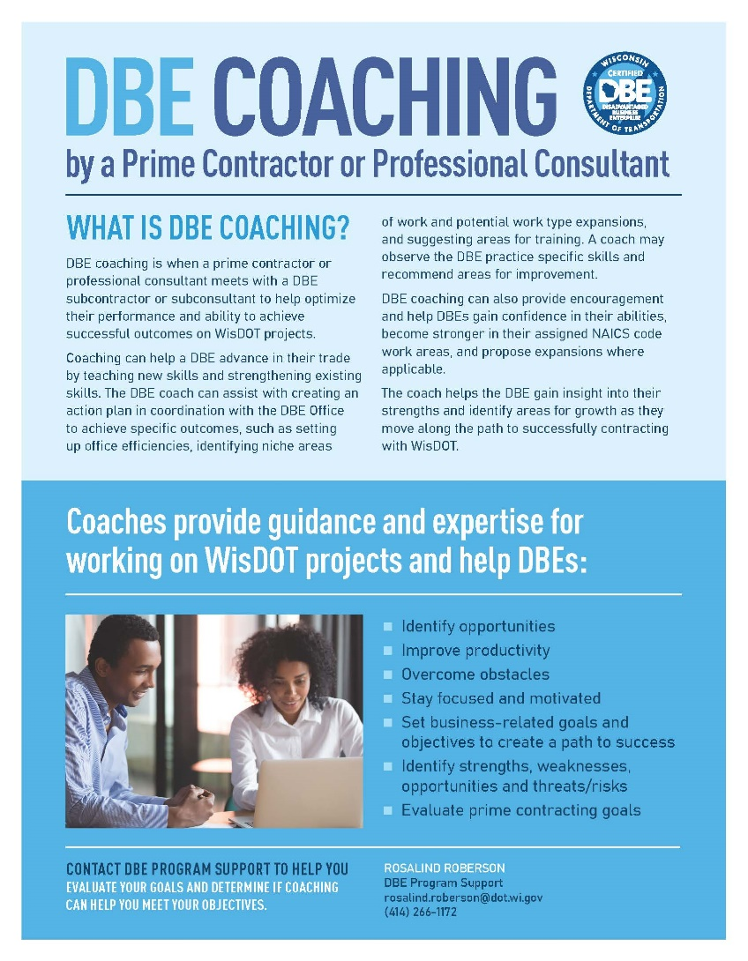
DBE SUPPORT SERVICES
DBE Coaching
An informal and short-term relationship.
A formal MOU is not a requirement to start a coaching relationship.
DBE is assigned a DBESS consultant or DOT prime.
DBE will complete an action plan with a DBESS consultant or prime to determine and assist with business needs.
Notes:
DBE Coaching is another option for a prime to assist a DBE without a formal MOU agreement. DBE Coaching is an informal and short-term relationship between the DBE and prime. Upon request a DBE is assigned a support services consultant or DOT prime contractor to help the DBE advance in their trade by teaching new skills and strengthening existing skills. An action plan is developed to track the DBE’s skill develop and performance to achieve successful outcomes on WisDOT projects. Click on the DBE Coaching flyer to learn more.

Slide 14
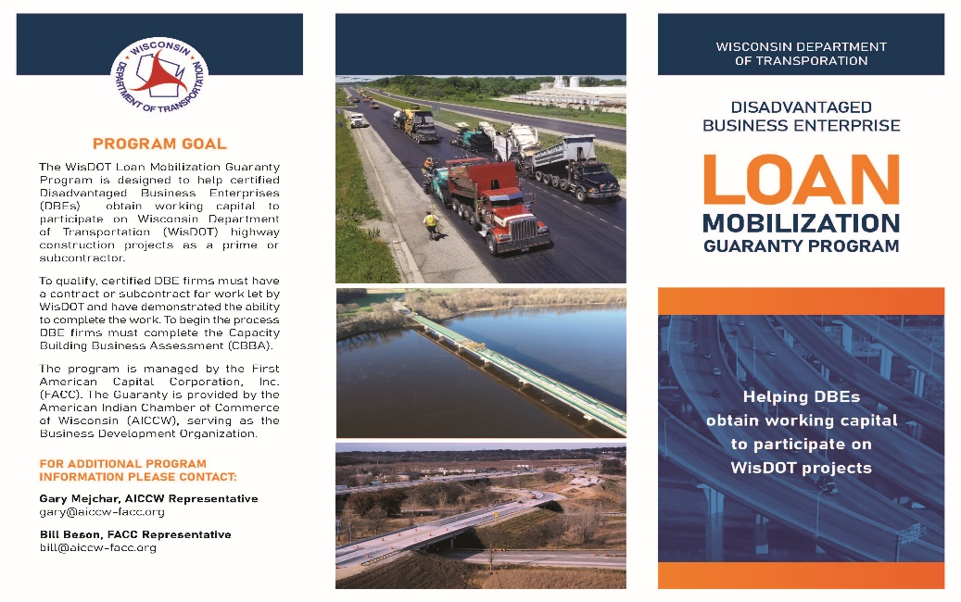
DBE SUPPORT SERVICES
Loan Mobilization Guaranty Program
Designed to assist DBE firms obtain working capital to mobilize their contract or subcontract on DOT construction projects
A DOT contract is required to begin the process.
DBE qualified for 50% of the contract dollar amount and the bank of choice is given a 90% Guaranty on the loan.
Joint paychecks are issued to lender and DBE until loan is paid in full. Term of the loan is for six months and can be extended upon request another six months.
Any Wisconsin bank, CDFI, saving and loan, or credit union is eligible to get this guaranty under the program.
DBE Small Business Resource Guide
Notes:
The WisDOT Loan mobilization guaranty program is designed to assist DBE firms with working capital to mobilize their subcontracts with primes on DOT projects. A DOT contract is a requirement to begin the process. The DBE qualifies for 50% of the contract dollar amount. Once approved by a bank of choice, a 90% guaranty on the loan is offered to bank on behalf of the DBE. Joint paychecks are prepared and issued to lender and the DBE is paid a % of the payment until the loan is paid in full. Any Wisconsin bank, credit union, or CDFI is eligible to get this guaranty under the program. Click on the brochure to learn more about the WisDOT Loan Mobilization Guaranty Program and Click on the link to the DBE Small Business Resource Guide to see the list of organizations and CDFIs who support small business development in the State of Wisconsin.

Slide 15
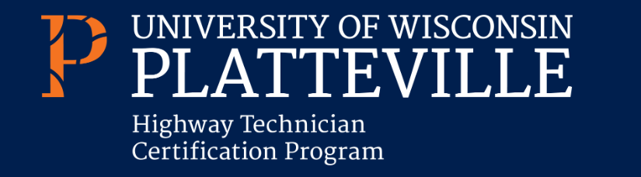
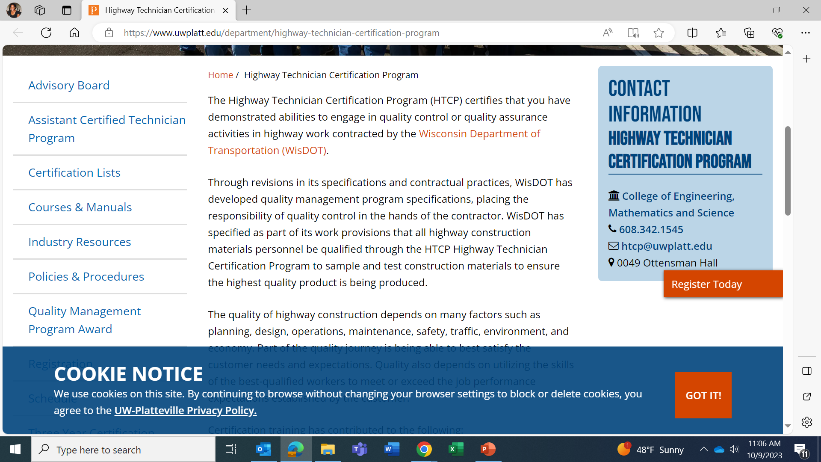
DBE SUPPORT SERVICES
Highway Technician Certification Program
Through revisions in its specifications and contractual practices, WisDOT has developed quality management program specifications, placing the responsibility of quality control in the hands of the contractor. WisDOT has specified as part of its work provisions that all highway construction materials personnel be qualified through the Highway Technician Certification Program (HCTP) to sample and test construction materials to ensure the highest quality product is being produced.
The Highway Technician Certification Program certifies that you have demonstrated abilities to engage in quality control activities in highway work contracted by the Wisconsin Department of Transportation.
Visit the DBESS webpage​ to learn more about the HTCP.
Notes:
Through revisions in its specifications and contractual practices, WisDOT has developed quality management program specifications, placing the responsibility of quality control in the hands of the contractor. WisDOT has specified as part of its work provisions that all highway construction materials personnel be qualified through the HTCP Highway Technician Certification Program to sample and test construction materials to ensure the highest quality product is being produced. The Highway Technician Certification Program certifies that you have demonstrated abilities to engage in quality control activities in highway work contracted by the Wisconsin Department of Transportation. Visit the DBESS webpage​ to learn more about the Highway Technician Program and click on the UW Platteville flyer to learn more about the highway technician courses and the registration process.

Slide 16

DBE SUPPORT SERVICES
Highway Construction Skills Training (HCST)
Created to supply a diverse workforce for the highway construction community.
HCST is a six-week intensive training program that requires the following construction trainings and certificates to pass the course:
  Complete the flagger certificate training
  Complete the OSHA 10 safety training
  Pass CDL written exam
  Pass a construction trade apprenticeship test
Graduates earn a pre-apprenticeship certificate for Journey level training.
Contractors that utilize the trained workers in WisDOT work zones become eligible for reimbursements under Additional Special Provision (ASP) 1​.
Contact a HCST Provider for more information
Notes:
The Highway Construction Skills Training is WisDOT’s Labor Development Program created to supply a diverse workforce on road construction projects. The labor development program is six-weeks of intensive training that prepares workers for careers in road construction. After completing the training program the graduates earn a pre-apprenticeship certificate that qualifies them for journey level construction training. Contractors that hired HCST workers for on-the-job training in DOT work zones become eligible for reimbursements. See Additional Special Provision (ASP) 1​. document For more information. Click on the logo to go to the HCST DOT webpage.

Slide 17
DBE SUPPORT SERVICES
Construction Business Group DBE Master Class
Designed and delivered by industry subject matter experts, this Master Class curriculum provides strategic resources for DBEs who are eager to enter the road-paving industry and build capacity to compete for and perform on DOT highway construction projects. For more information click on the link to view the DBE Master Class Video.
WisDOT Certification Process
Establishing a Strategic Vision
Employment & Labor Law/Labor Management Agreements
Aligning Strategy with Business Development
Performance Awareness Workshop
Cash Flow Strategies & Income Statements/Balance Sheets
Practical Problem Solving & the Art of Communication
Business Law & Contracts for Contractors
Organizational Effectiveness
Project Planning and Scheduling
Change Order Management & Supply Chain Management
Risk Management and Crisis Control
Bidding & Quoting the Accurate Project for Your Company
Notes:
Designed and delivered by industry subject matter experts, the DBE Master Class provides strategic resources for DBEs who are eager to enter the road-paving industry or build capacity to compete for and perform on DOT highway construction projects. The DBE Master Class curriculum include 13 modules that provide industry perspectives, advice, and practical application of the topics shared by industry professionals. For more information on how to get involve with the construction business group DBE Development Initiative click on the DBE Master Class Video. Link

Slide 18

DBE SUPPORT SERVICES
WisDOT LearnCenter
WisDOT offers training courses to consultants and contractors at no cost to you.
To register and review available trainings click on the realize your potential link below.
Realize Your Potential
Notes:
WisDOT Learn Center offers training courses to consultants and contractors to keep the industry informed on trends in heavy highway contracting. To register and review available trainings click on the realize your potential link to create your account.

Slide 19
In Conclusion
WisDOT DBE Support Services is committed to help you . . .
Grow your business
Enhance your skills
Develop your relationships and
Build your workforce
  . . . to become successful in the highway construction industry.
Notes:
In conclusion WisDOT DBE Support Services is committed to help you . . Grow your business, Enhance your skills Develop your relationships and Build your workforce to become successful in the highway construction industry

Slide 20

Questions on DBE Support Services
Contact:
Rosalind Roberson, DBE Support Services Coordinator
Rosalind.roberson@dot.wi.gov
(414) 266-1172

